Slide 1
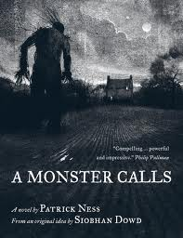
A Monster Calls Written By Patrick Ness
Presentation By Mr. Sidel

Slide 2
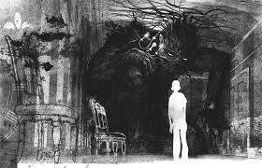
Exposition
Setting
Present day England
Protagonist
Connor
Antagonist
The Monster
His mother’s
cancer

Slide 3
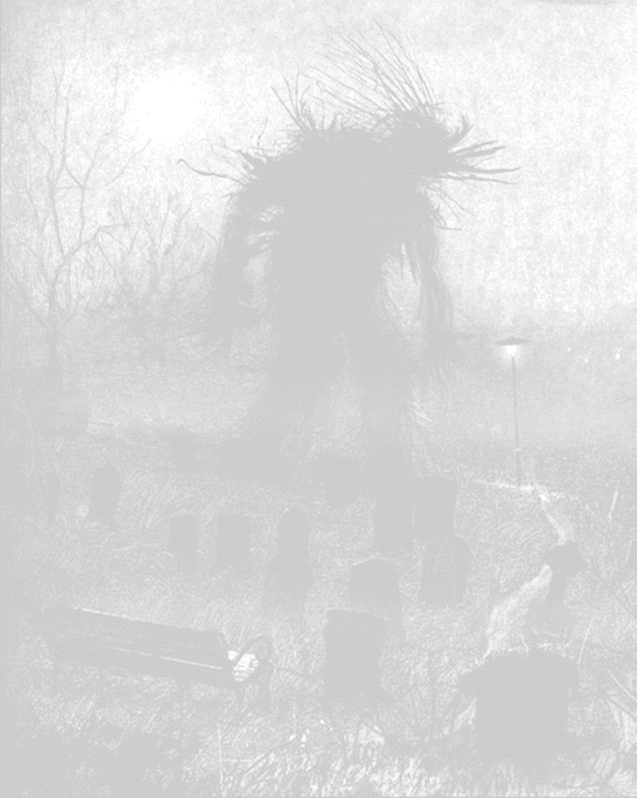
Rising Action and Climax
Conflict
A monster visits Connor every night at 12:07.
Complications
Connor is blamed for vandalism and assault while under the monster’s influence
Climax
Connor must face the monster to understand the purpose of these visits

Slide 4
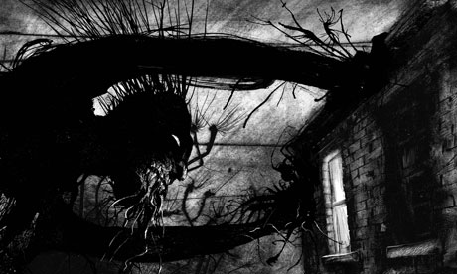
Falling Action and Resolution
Falling Action
Connor begins to understand the reason for the monster’s visits
Resolution
Connor faces comes to peace with his mother’s battle with cancer
Theme
While losing a loved one is hard, we must accept the loss and move on.

Slide 5
Conclusion
How did characters, conflict, and the setting related to the theme?
Thank you for your attention.

