Slide 1
United States History
America: From Isolation to War
Dr. King-Owen
Timeline Activity

Slide 2
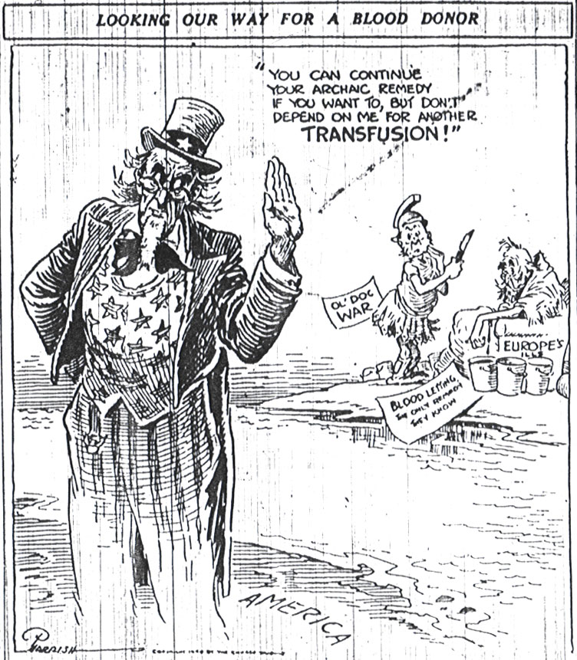
Isolationist Cartoons:
America rejects giving its “blood” (troops) to fight in Europe’s conflicts.

Slide 3
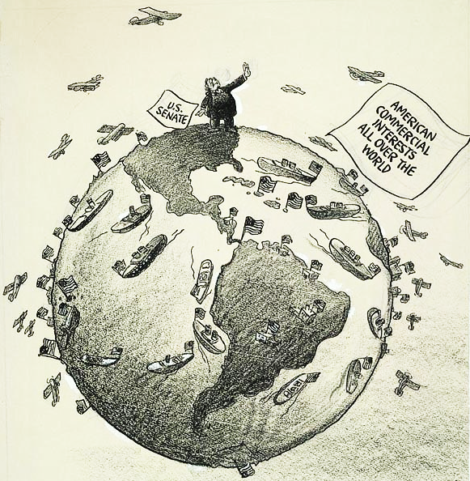
“No Foreign Entanglements”
(1935)
America rejects political involvement BUT our economic involvement is global. Can the U.S. have such isolation?

Slide 4
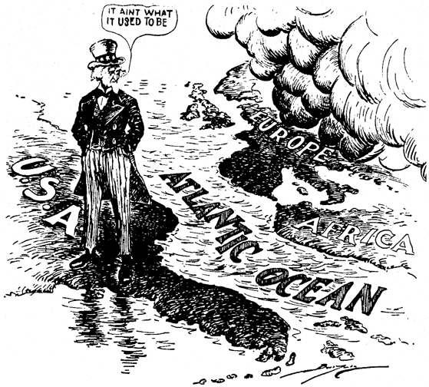

Slide 5
Quarantine Speech (1937)
President Franklin D. Roosevelt began to argue against isolationism by 1937
FDR says that neutrality is foolish if there is a disease that is spreading
The U.S. cannot isolate itself from the effects of an epidemic of war – even though America seeks peace

Slide 6
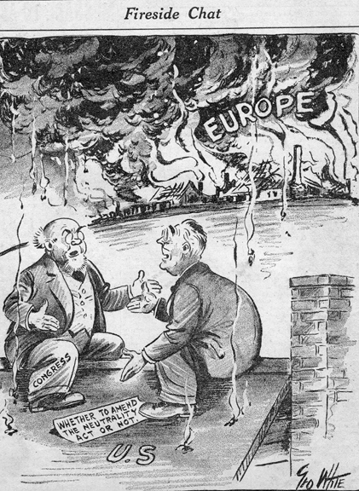
This cartoon suggests the “Quarantine Speech” of 1937, in which Roosevelt argued that war abroad eventually would hurt the United States.

Slide 7
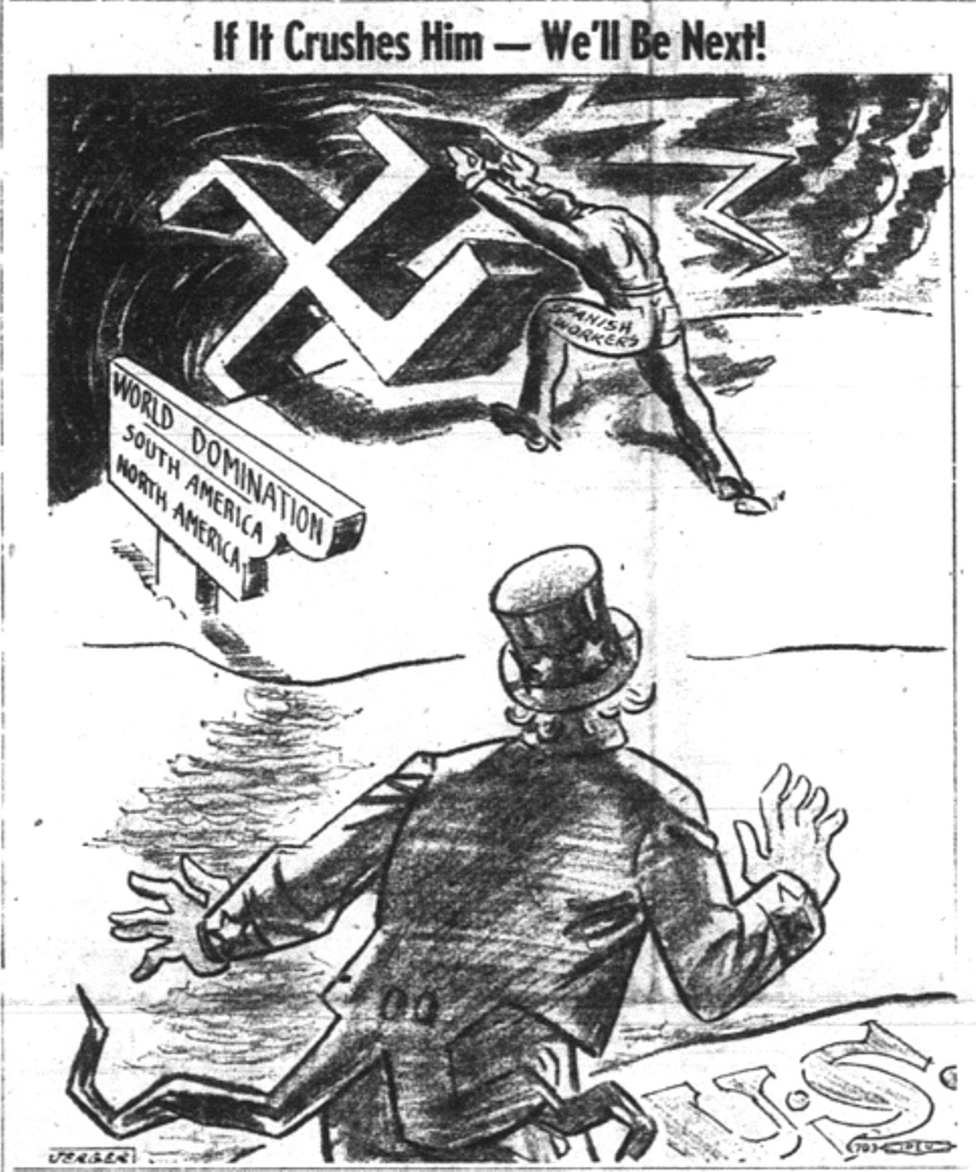
Anti-Isolationist Cartoon:
If other countries fall to Hitler, then the U.S. will be in greater danger.

Slide 8
The War in Europe
September 1, 1939 – Hitler invaded Poland with a “lightning” fast combination of speed and firepower (blitzkrieg in German)
The invasion of Poland is the start of World War II.
It took Hitler 35 days to conquer France, leaving Britain next. In Operation Sea Lion, (1940) Hitler began to destroy Britain’s air force through attacks by the German Luftwaffe (air force). Hitler bombed Britain for 267 days.

Slide 9
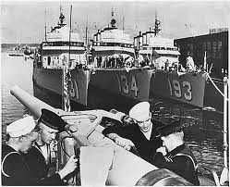
"Arsenal of Democracy" - 1940
Roosevelt concluded a Destroyers-for-Bases treaty with the British
The best way to avoid war was to help the Allies win it
U.S. sold ships to British in exchange for naval bases on British soil

Slide 10
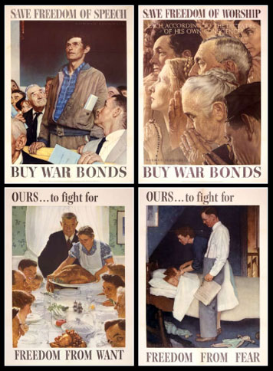
The Four Freedoms, 1941
In 1941, FDR told Congress that the United States worked to protect 4 basic freedoms of the people:
Freedom from fear
Freedom of speech
Freedom of worship
Freedom from want
He argued that the Nazis and Japan threatened all of these freedoms.

Slide 11
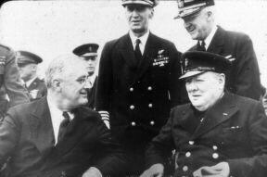
The Atlantic Charter - 1941
In July 1941, Roosevelt and the British Prime Minister, Winston Churchill, met discuss the goals of fighting the Axis Powers.
The Atlantic Charter basically re-stated President Woodrow Wilson’s 14 Points (1918) – nations should determine their own government

Slide 12
The Lend-Lease, 1941
Congress agreed to give the Allies supplies for the war
The material was a “loan” with a long-repayment
$50.1 billion in supplies given to Britain, France, Soviets, China
Kept the Allies going at a critical time when Nazis were very successful

Slide 13
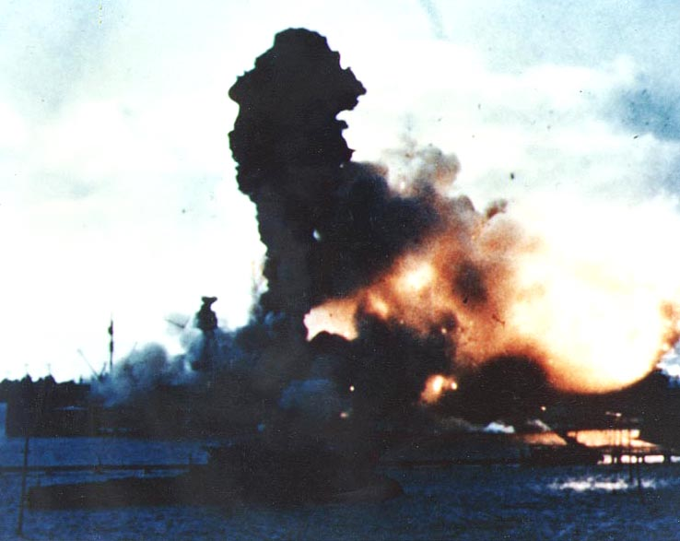
Pearl Harbor: December 7, 1941
In 1940, FDR put the US Navy at Pearl Harbor in anticipation of Japanese aggression
U.S. had stopped sales of oil, steel, and scrap metal to Japan, reducing their ability to wage war in Asia
Japanese attacked the U.S. fleet at Pearl Harbor, killing 2400 Americans
US entered World War II as a result of Pearl Habor.

Slide 15
