Slide 1
United States History
Globalization and its Discontents
Dr. King-Owen
[14.01]

Slide 2
Globalization: Complaints
Multi-national corporations :
Seek profit over workers’ health
Violate local democracy
Spur conformity (McDonaldism, Coca-colaization)
Are not regulated the same everywhere
Destroy the environment
Undermine union power

Slide 3
World Trade Organization
WTO formed in 1995:
Helps negotiate trade policies with the goal of increasing world trade
1999 – WTO protests in Seattle
40,000 people criticized the WTO for increasing poverty and destroying the environment

Slide 4
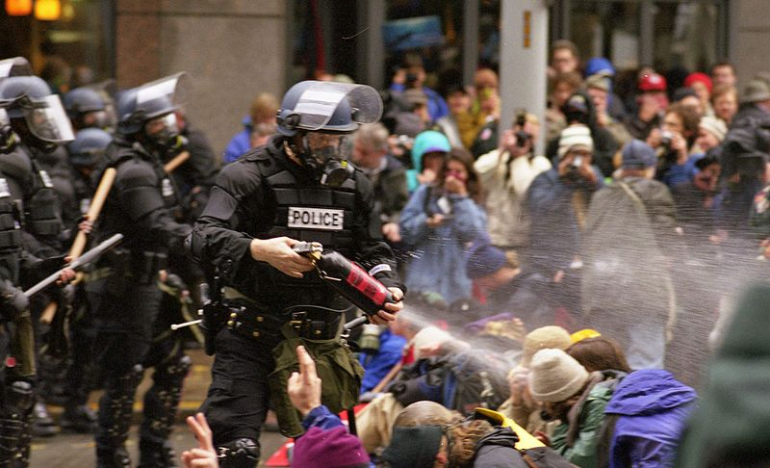

Slide 5
NAFTA (1994)
North American Free Trade Agreement
Eliminates most tariffs on trade between U.S., Mexico, and Canada
Consequences
Manufacturing jobs go to Mexico where labor is cheaper
U.S. companies downsize (fire workers) or outsource (send jobs abroad)
Increase in pollution

Slide 6
