Slide 1
UNITED STATES HISTORY
The Environment [14.01] * Dr. King-Owen

Slide 2
Global Warming?
Climate Science Battles
Liberal view: human activities (carbon emissions) do affect global temperatures
Conservative view: evidence for human effect on climate change is weak/fabricated
School districts are calling “global warming” controversial and an “unproven theory”

Slide 3
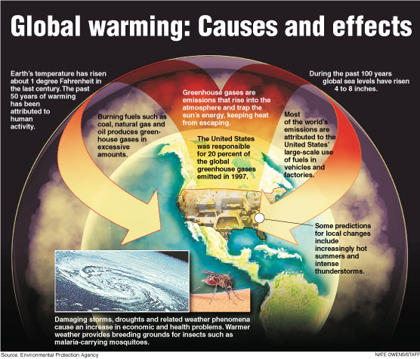

Slide 4
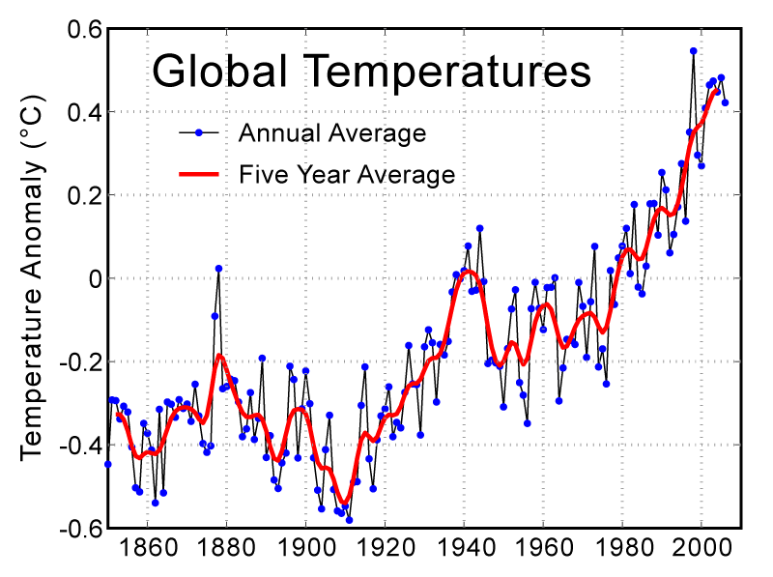

Slide 5
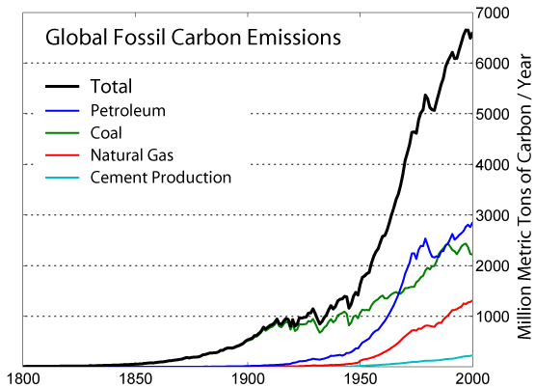

Slide 6
Pollution
Saving the Environment vs. Business Growth
Regulating pollution is expensive
Saving certain species cuts jobs
Protecting certain areas limits use of resources
Alaska National Wildlife Refuge, 2005-2008
Drilling for oil vs. saving wildlife
1989 – Exxon Valdez oil spill – 11 to 32 million gallons of oil spilled on coast
Compare: 205.8 million gallons spilled in the 2010 BP Oil Spill

Slide 7
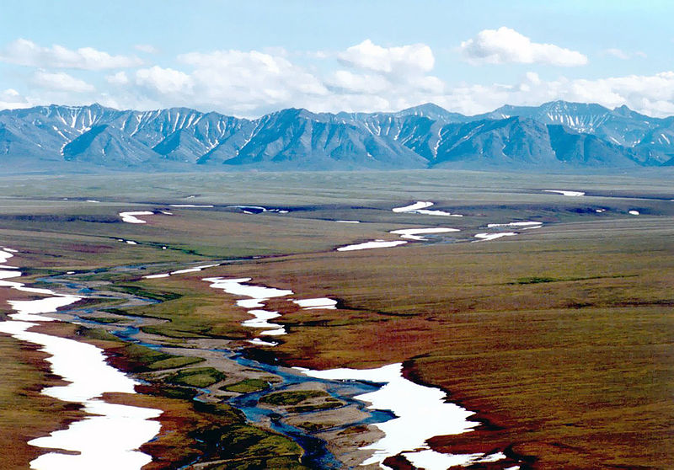

Slide 8
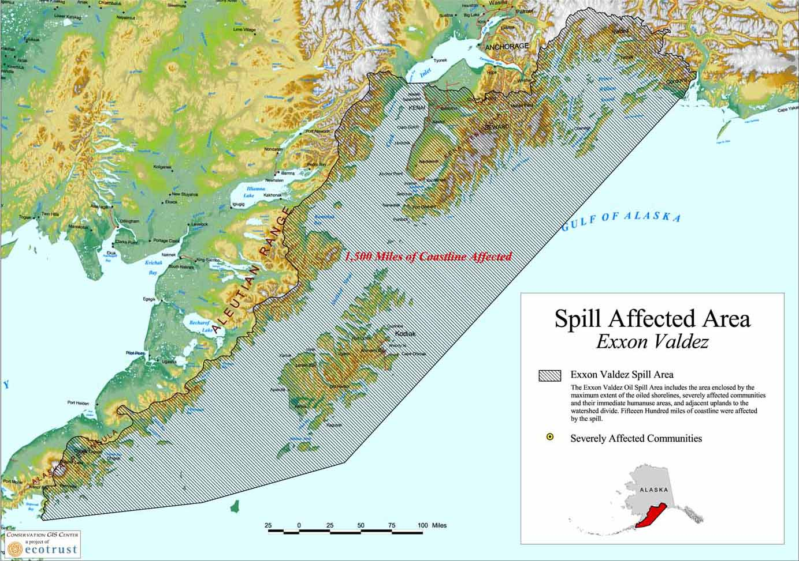

Slide 9
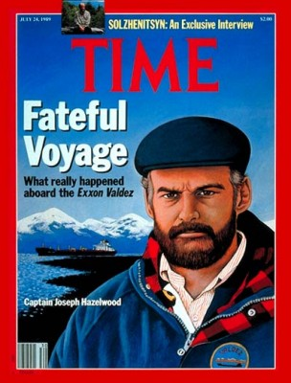
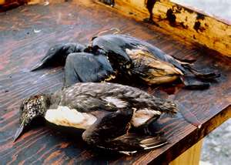
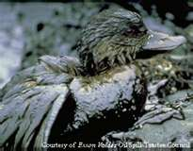

Slide 10
Regulation
1997, Kyoto Protocol
191 states have signed (by 2011)
Nations agree to reduce greenhouse gases
The United States has not signed
Rejected by President George W. Bush because it provided exemptions for other countries
Market-Based Pollution Control Proposed
“cap-and-trade” approach – companies could trade permits for pollution up to a certain “capped” level

Slide 11
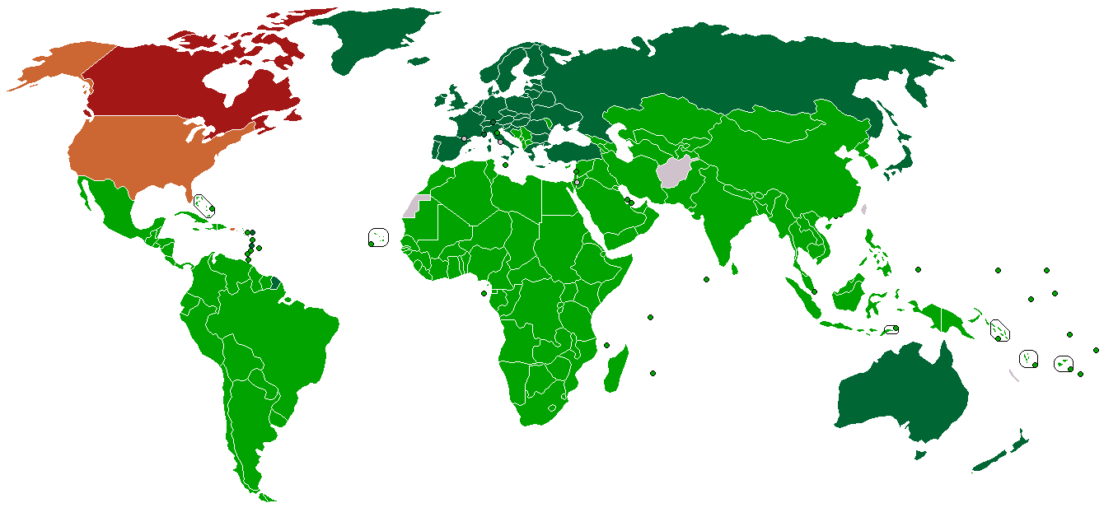

Slide 12
