Slide 1
United states history
Boom…Bust…Boom…Bust…Boom…Bust
Dr. King-Owen
[14.02]

Slide 2
Savings and Loan Crisis, 1989
Deregulation of banking under Reagan:
Allowed banks to make risky investments
Led to collapse of 400 savings and loan banks
Savings and Loan Bailout, 1989
Congress offered a bailout of $159 billion to keep S&Ls afloat
Corporate welfare – why is giving $$$ to companies when they are bankrupt acceptable when giving money to the poor is not?

Slide 3
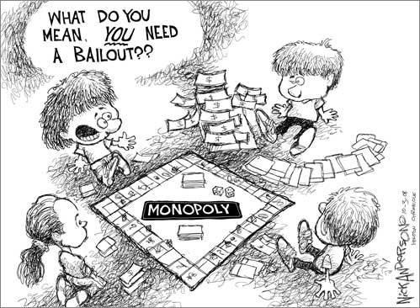
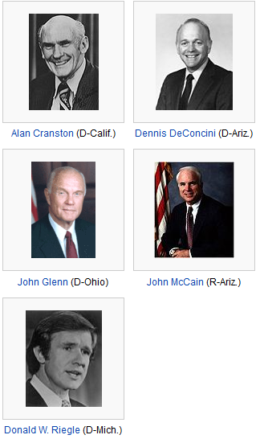
The “Keating Five” (S&L Crisis)
Senators accused of corruption in 1989.
Charles Keating, of Lincoln Savings and Loan,
contributed political funds to each Senator.
Cranston, DeConcini, and Riegle were found
Guilty of helping Keating avoid investigation.
Glenn and McCain acted in “poor judgment.”

Slide 4
DotCom Bubble, 2000
Growth in internet technology led to people invest wildly in start-up tech companies
Federal Reserve increased interest rates to slow investment
Companies went bankrupt
Scandals in accounting were uncovered at Enron and Worldcom (2001)
Sarbanes-Oxley Act (2002) – companies are forced to follow ethical accounting laws

Slide 5
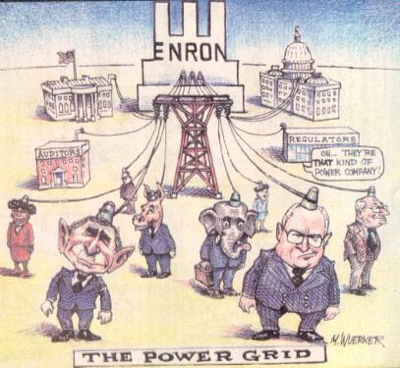
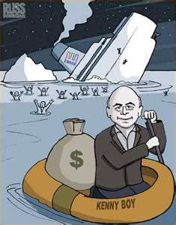

Slide 6
Housing Bubble, 2008
Poorly regulated loans to risky home-buyers (“sub-prime mortgages”)
Americans were getting rich from rising home prices by selling the American Dream of home ownership to those could not afford it
When mortgages failed, all those who extended credit lost money and the economy spiraled into a recession (lasting until July 2009)

Slide 7
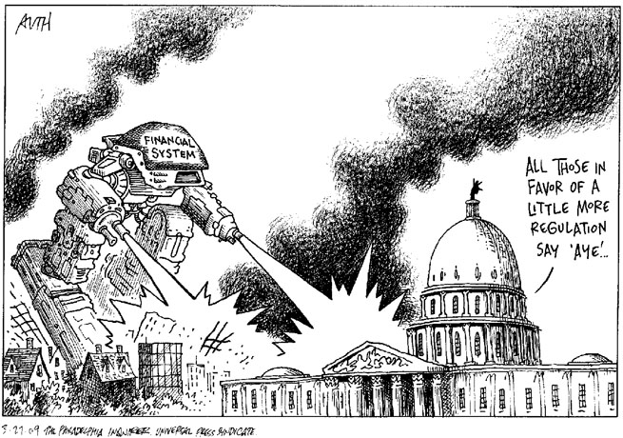

Slide 8
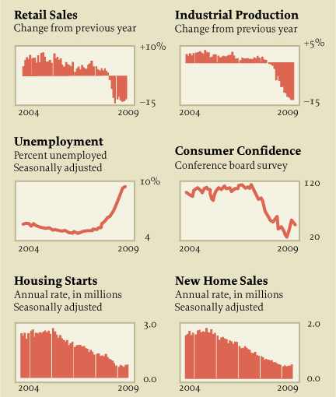

Slide 9
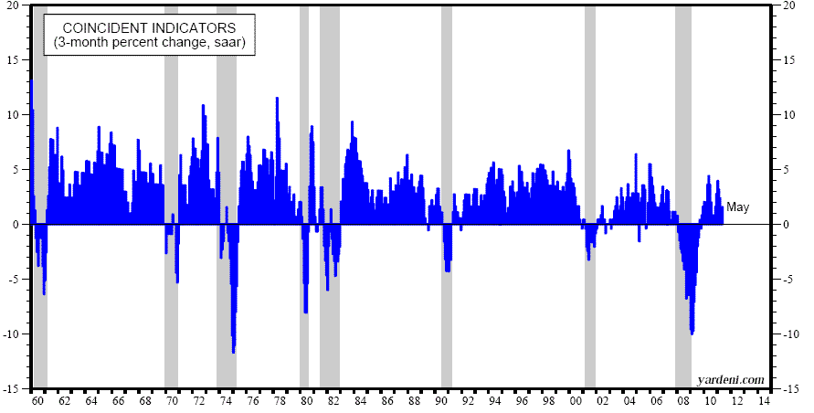
Business Cycle
1979 Oil Crisis
2000 Dot-Com Bubble
1973 OPEC Oil Crisis + stagflation
1989 Savings and Loan Crisis
2008 Housing Bubble

Slide 10
Solutions
What can be done to prevent cycles of boom and bust?

Slide 11
Cures for Bubbles
Bailouts
1989 – Bailout of S&Ls ($159 billion)
2008 – TARP Bailout ($431 billion)
Regulation
Sarbanes-Oxley Act (2002)
Stimulus
2009 – deficit spending (like in the New Deal)
What are the costs of using bailouts?
What are downsides to regulation?
What are problems with a stimulus?

Slide 12
Cultures of Poverty and Wealth
 | POVERTY | MIDDLE CLASS | WEALTHY
Money | Spend it | Manage it | Invest it
Food | Quantity | Quality | Beauty
Clothing | Personal expression | Quality and conforms to norms | Artistic value and designer
Time | Present | Future | Past
Destiny | Fate (choice is an illusion) | Choice (individuals can change future) | Fixed (wealthy always on top)
Values | Survival | Achievement | Connections

