Slide 1
United States history
The Culture Wars
Dr. King-Owen
[14.03]

Slide 2
Culture Wars
In the 1990s, growing multiculturalism began to cause debates over the future of America
Pluralism = diversity
Religious (Christianity vs. Secular [Non-Religious] Values)
Ethnic (Black, White, Hispanic, Asian…..)
Gender and Sex (identity, orientation)
Tensions increased because of migration
Sunbelt – population of the South grows b/c of immigrants from North AND Latin America
Sunbelt tends to vote Republican

Slide 5
REligion
Bible-Belt conservatives called for federal and state laws to:
end abortion
end federal money for stem cell research
limit marriage to one woman and one man
stop the teaching of evolution

Slide 6
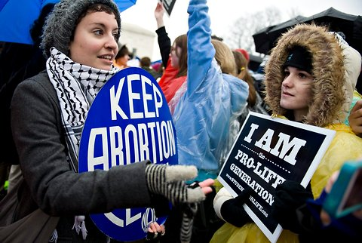

Slide 7
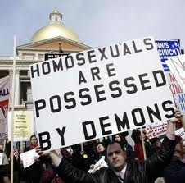

Slide 8
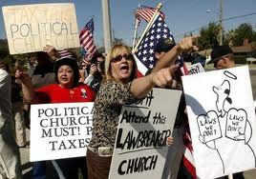
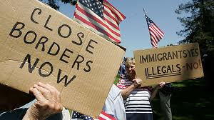
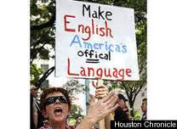
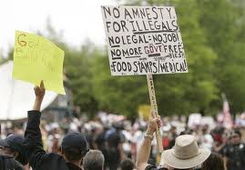

Slide 9
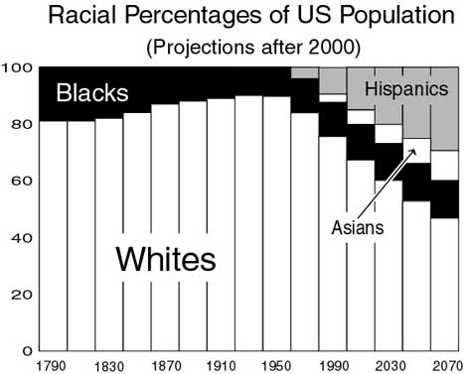

Slide 10
Same-Sex Marriage
Defense of Marriage Act (1996) – Congress rejected same-sex marriage (now before the Supreme Court)
2013- US v. Windsor overturned part of DOMA
Prop 8 (California, 2008) – same-sex marriage made unconstitutional (Now being reviewed by the Supreme Court)
2015 – Supreme Court rules that same-sex marriage is legal in the US (Obergefell v. Hodges)

Slide 11
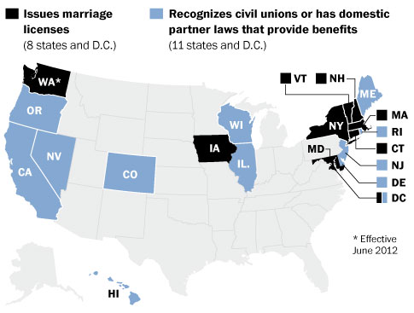

Slide 12
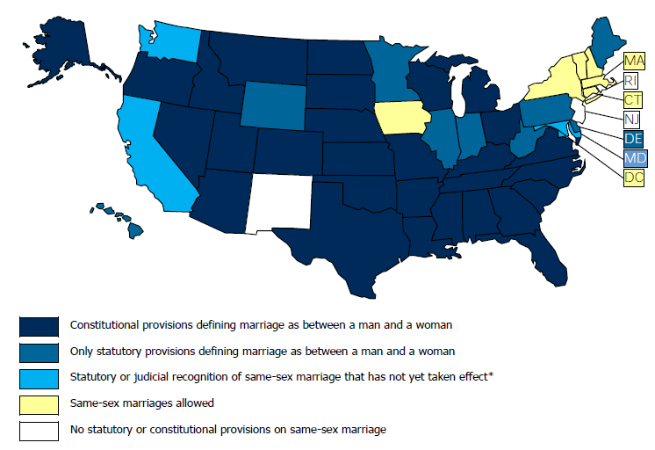

Slide 13
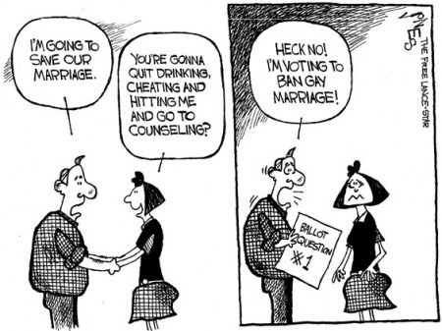

Slide 14
Education
Multicultural education – more emphasis on diversity of views (not “dead white men”)
Globalization– U.S. competes with the world
Accountability – showing achievement in reading and math
No Child Left Behind Act, 2001 – state testing to prove students are achieving

Slide 15
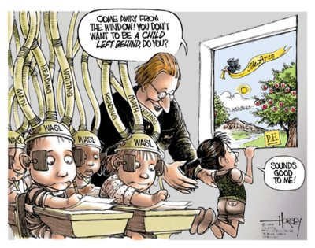

Slide 16
