Slide 3
United States History
Why 9/11 ?
Dr. King-Owen
[14.04]

Slide 4
9/11: 8:46 a.m.
Hijackers: 19 young men
Members of al-Qaeda, a militant Islamic terrorist organization
Took control of 4 planes
2 flew into the World Trade Center
1 into the Pentagon
1 into a field in PA
2,996 deaths from the attacks
Cost: $178 billion in damage

Slide 5
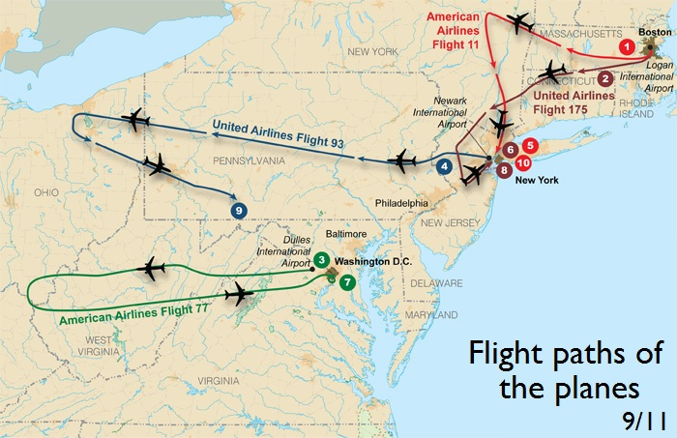

Slide 6
Why?
al-Qaeda claimed that the attacks were a response to:
U.S. support for Israel
U.S. troops in Saudi Arabia (leftover from the Gulf War)
Economic sanctions against Iraq (1990-2003)
Why the World Trade Center?
Symbolic of U.S. economic power in the world
Symbolic of American greed to radicals

Slide 7
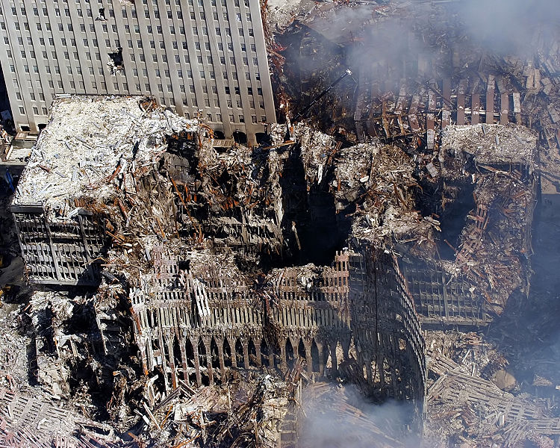

Slide 8
Results
Declaration of a “War on Terror”
U.S. will hunt down the terrorists
U.S. will invade Afghanistan (2001) for harboring al-Qaeda
USA Patriot Act (2001)
Makes it easier to track and prosecute terrorists
Creation of Department of Homeland Security (2002)
To coordinate intelligence on terrorism to protect America

Slide 9
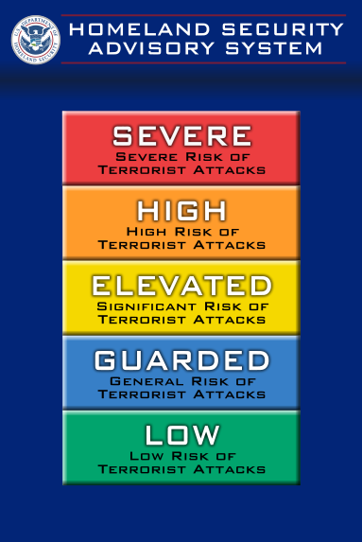

Slide 10
Results
Economic decline
NY economy devastated
Increase in national debt (defense spending)
Defense spending increased 86%
9/11 Commission (2002-2004)
Revealed that the U.S. was not ready for an attack
Multiple failures of defense, especially in the lack of coordination between agencies

Slide 11
