Slide 1
United States History
The Bush Doctrine
Dr. King-Owen
[14.04]

Slide 2
9/11: 8:46 a.m.
19 young men, members of al-Qaeda, a militant Islamic terrorist organization, hijack 4 planes:
2 flew into the World Trade Center (symbol of U.S. economic power)
1 into the Pentagon
1 into a field in PA
2,996 deaths from the attacks
Cost: $178 billion in damage

Slide 3
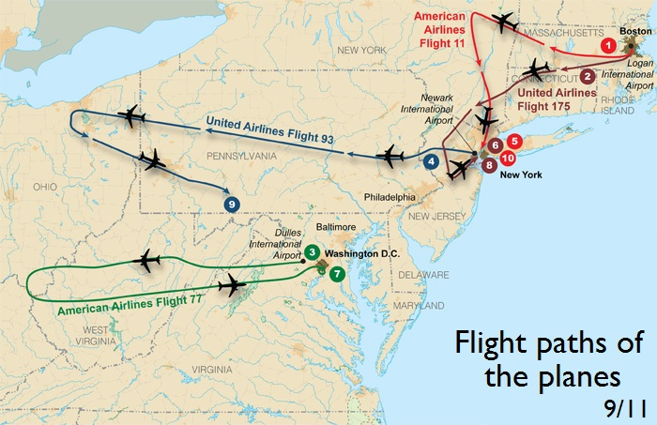

Slide 4
al-Qaeda claimed that the attacks were a response to:
U.S. support for Israel
U.S. troops in Saudi Arabia (leftover from the Gulf War)
Economic sanctions against Iraq (1990-2003)
Why the World Trade Center?
Symbolic of U.S. economic power in the world
Symbolic of American greed to radicals

Slide 5
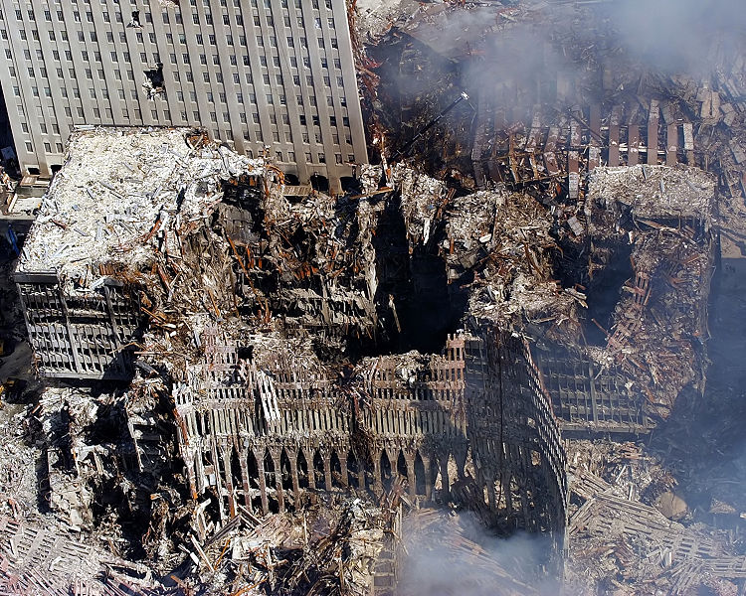

Slide 6
Results
Declaration of a “War on Terror”
U.S. will hunt down the terrorists:
USA Patriot Act (2001)
Makes it easier to track and prosecute terrorists
Creation of Department of Homeland Security (2002)
To coordinate intelligence on terrorism to protect America
The U.S. invaded Afghanistan in 2001:
Taliban, radical Muslims, had harbored al-Qaeda there

Slide 7
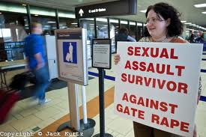
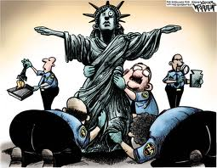

Slide 8
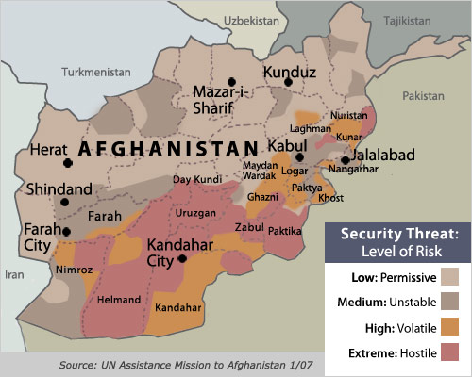

Slide 9
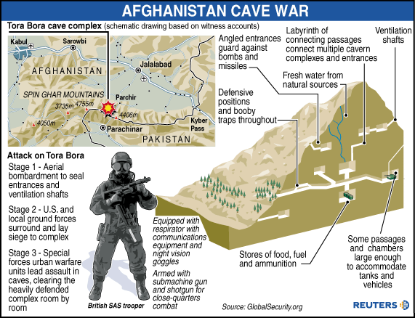

Slide 10
Bush Doctrine
Bush Doctrine (2002)
Axis of Evil – identify governments that encourage terrorism (Iraq, North Korea, Iran)
Unilateralism – U.S. is willing to use military force anywhere without support or permission from any other country
Democracy – it is in America’s best interest to promote democracy in other countries
Pre-emptive War – U.S. can go to war before another country attacks America

Slide 11
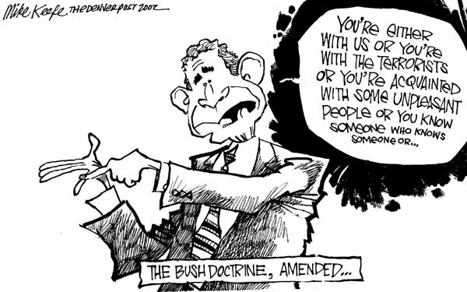

Slide 12
Operation Iraqi Freedom, 2003
U.S. + Great Britain invaded Iraq in 2003
Goal: to remove “weapons of mass destruction” held by Saddam Hussein
Both U.S. and G.B. favored “regime change” to free the Iraqi people from Hussein
Hussein was captured in 2003, tried, and executed in 2006
No weapons of mass destruction have been found
Torture – U.S. tortured “enemy combatants” to gain information

Slide 13
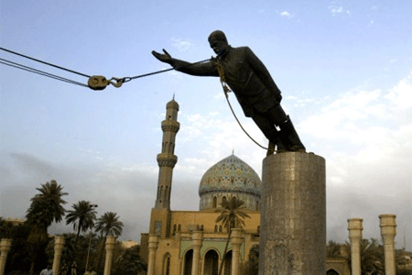

Slide 14
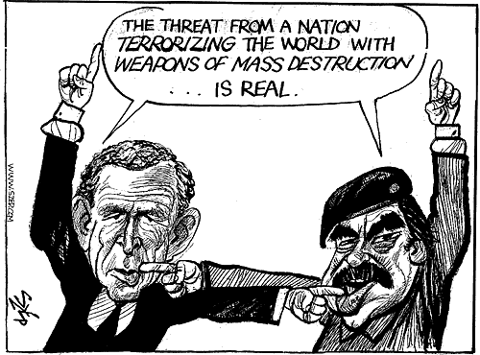

Slide 15
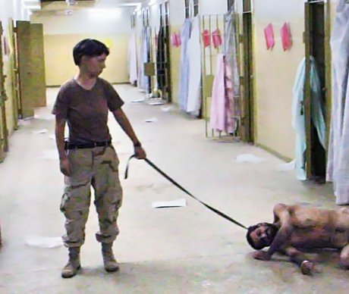
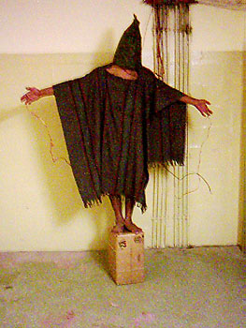
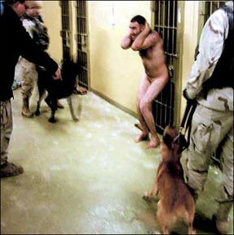

Slide 16
