Slide 1
UNITED STATES HISTORY
Progressive Presidents
Dr. King-Owen
[8.02]

Slide 2
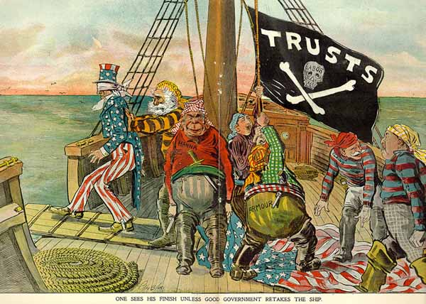

Slide 3
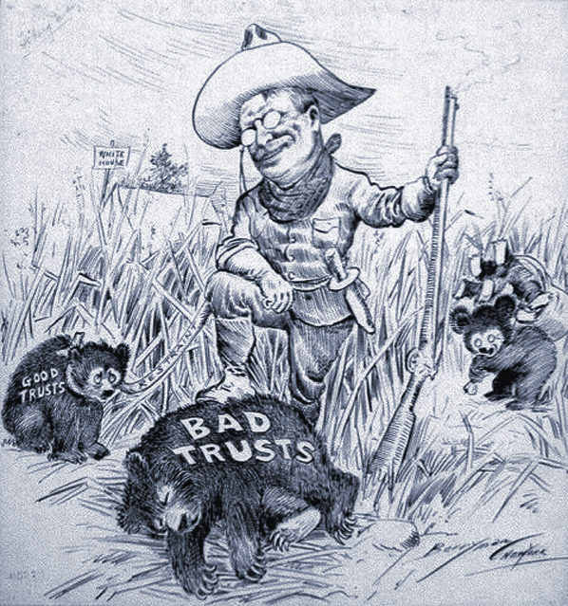
President Roosevelt shoots “bad trusts” and ties up “good trusts”

Slide 4
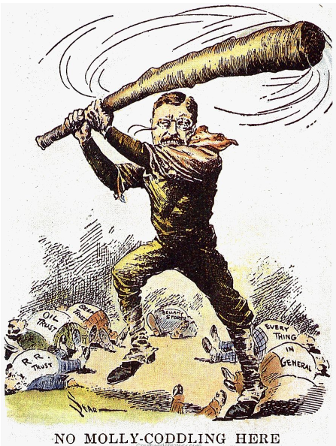
Teddy Roosevelt takes his “big stick” against the trusts.
“Walk softly and carry a big stick….” T. Roosevelt

Slide 5
Trust Buster: Teddy Roosevelt
Government should regulate business to protect the public
1902 Anthracite Coal Strike – TR forced the owners to negotiate with workers
1906 – applied the Sherman Antitrust Act (1890) against Standard Oil and broke up the monopoly
1906 – Meat Inspection Act – meat plants will be inspected for health reasons
1906 – Hepburn Act – federal government could set railroad rates

Slide 6
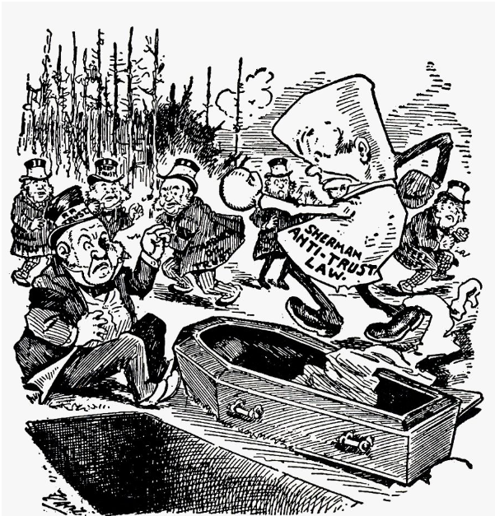
Sherman Antitrust Law
Attacks the trusts – laws work if they are enforced

Slide 7
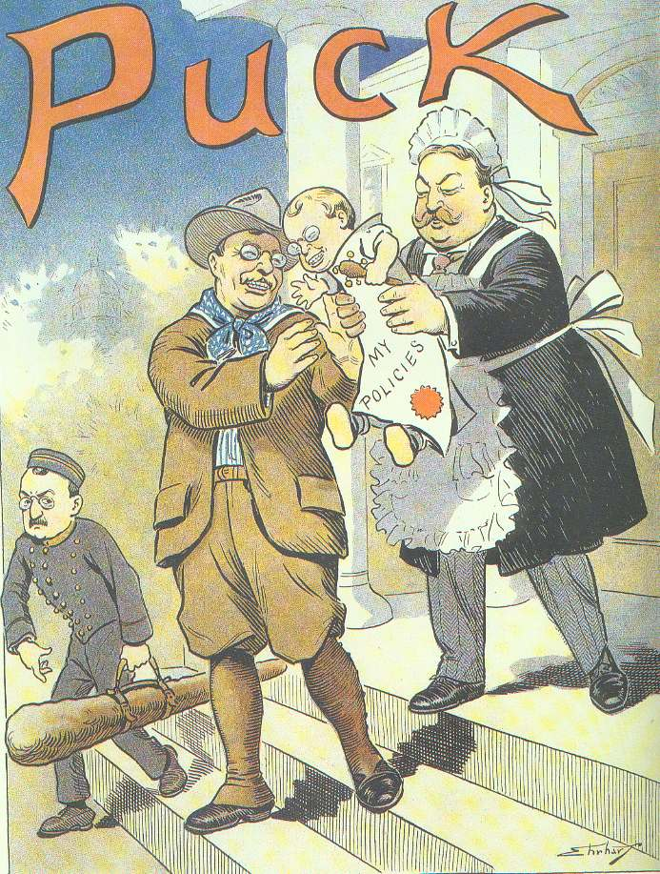
Gut Buster: William H. Taft
Taft busted more trusts than T. Roosevelt
Taft lacked T Roosevelt’s charm
Critics made fun of his size and love of golf
His political party (Republicans) split over reform
1912 T. Roosevelt ran against Taft in a third party (Bull Moose)

Slide 8
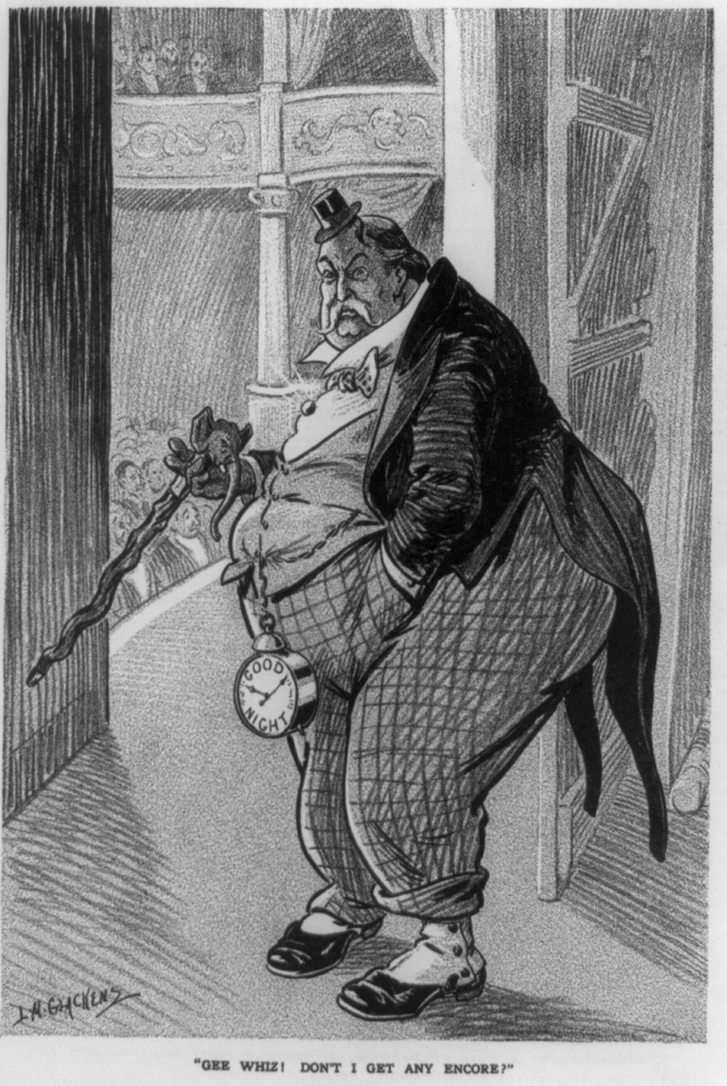
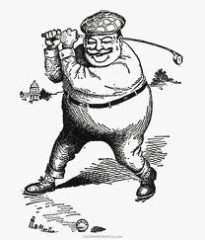

Slide 9
Brain Buster: Woodrow Wilson
W. Wilson: from Princeton Professor to President
17th Amendment (1913) – U.S. Senators elected by the people
Federal Reserve Act (1913)
12 federal banks created, led by the “Fed”
Controlled the nation’s money supply
Clayton Antitrust Act (1914)
Prevented the formation of monopolies
Federal Trade Commission – monitors companies to prevent illegal actions
Keating-Owen Act (1916)
Child labor outlawed
Ruled unconstitutional in 1918

Slide 10
