Slide 1
United states history
America’s Home Front during World War I
[8.03]
Dr. King-Owen

Slide 2
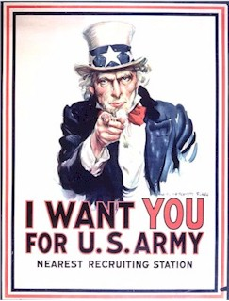
Creating a War State
May 1917 – Selective Service Act
Required young men to register for military service (24 million did; 3 million went off to fight)
More than 400,000 African-Americans fought for the U.S.

Slide 3
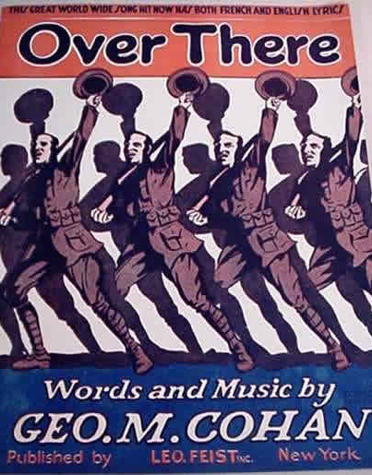
“Over There”
Over there, over there Send the word, send the word over there That the Yanks are coming, the Yanks are coming, The drums rum-tumming everywhere So prepare, say a prayer Send the word, send the word to beware We'll be over, we're coming over, And we won't come back till it's over, over there!

Slide 4
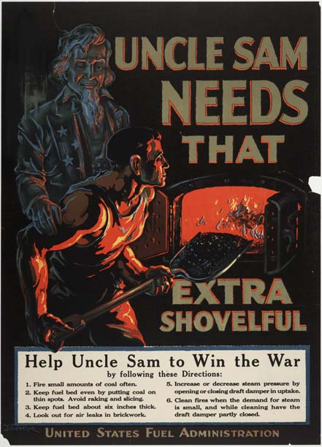
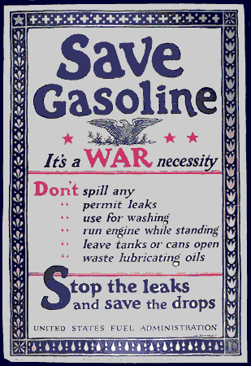

Slide 5
War State Economy
United States government regulated the American economy to make it more effective for war production
War Industries Board – set prices, quotas for production, distributed raw materials
Government controlled coal and oil
Food Conservation: people encouraged to save food, plant “Victory Gardens”

Slide 7
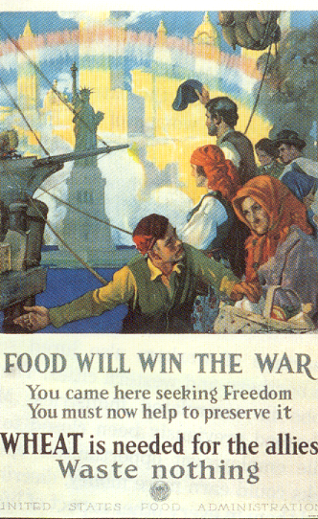
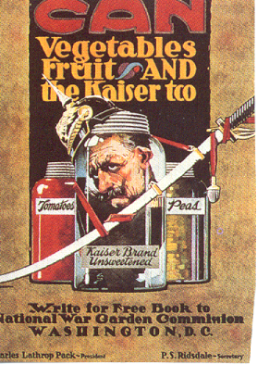

Slide 8
Workers and Industries
Hourly wages for workers rose 20% during the war, but food and housing prices also rose; so workers joined unions in record numbers
Industries made record profits during the war – some increased 1600%
National War Labor Board – created to prevent strikes and help unions get higher wages, 8-hour day

Slide 9
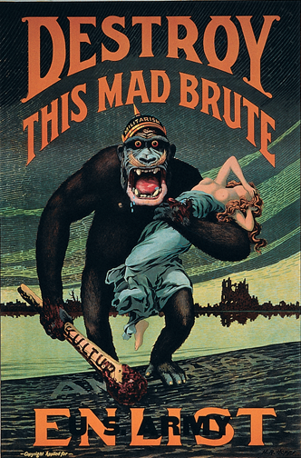
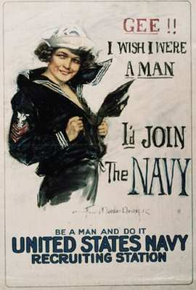

Slide 10
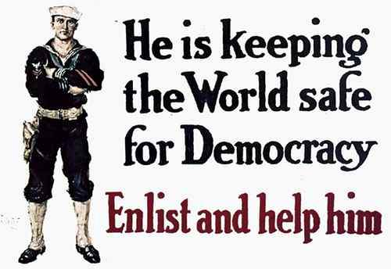

Slide 11
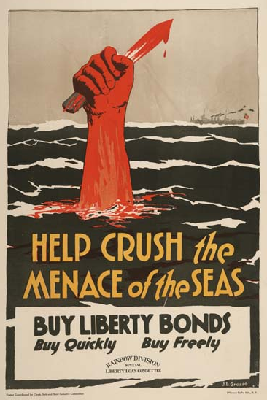
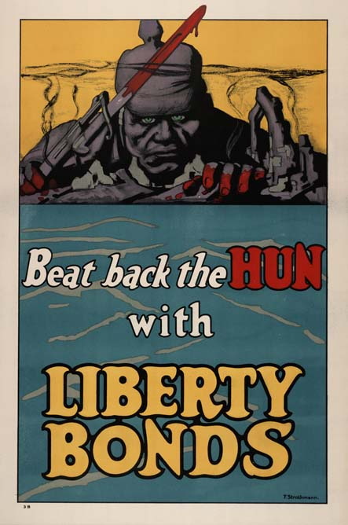

Slide 12
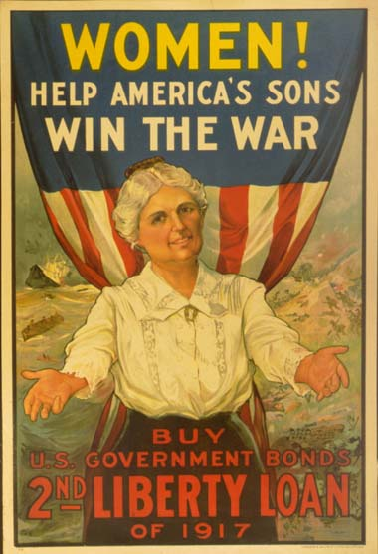
Selling the War
Government spent $35.5 million on the war; raised 1/3 of money in taxes and the rest through bonds (loans)
Committee on Public Information – spread pro-war propaganda in public media to encourage patriotism and Anti-German feeling

Slide 13
Dark Side of Dissent
1917 – Congress passed the Espionage and Sedition Acts to punish traitors
$10,000 fine, 20 years in jail for criticizing the government or the war effort
2000 people prosecuted for anti-war activities
Many were Socialists and Union leaders
Hundreds were deported (sent from the U.S.)

Slide 14
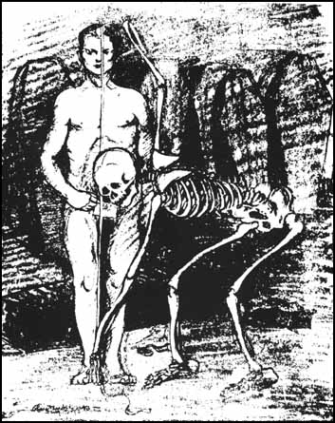
This cartoon, “Conscription” (1917), was declared a violation of the Espionage Act.
The cartoon suggests that boys who sign up for the draft are going off to their deaths.

Slide 15
Schenck v. United States (1919)
Charles Schenck handed out leaflets against the draft for the war and was prosecuted under the Sedition Act
The Supreme Court heard Schenck’s case – did Schenck have a right under the First Amendment to “free speech”?
Court ruled that in times of war, speech that creates a “clear and present danger” is NOT protected by the Constitution

Slide 16
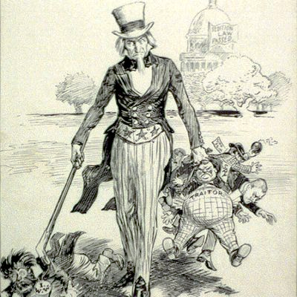
Uncle Sam Knows How to Deal with Traitors

