Slide 1
United States History
American Entry into World War I?
Dr. King-Owen
[8.03]

Slide 2
Should America go to War?
YES
NO
We are related by blood to Europeans
We have economic ties to the Allies
The struggle does not concern us
America should be an example of peace

Slide 3
If the United States allows companies to sell guns and ammunition to other countries, is the U.S. truly neutral?

Slide 4
The Path to war 1
The German U-Boats
By 1915, Germany would sink any ship sailing near Britain with its submarines
Should the U.S. go to war to prevent Germany from attacking our neutral ships?

Slide 5
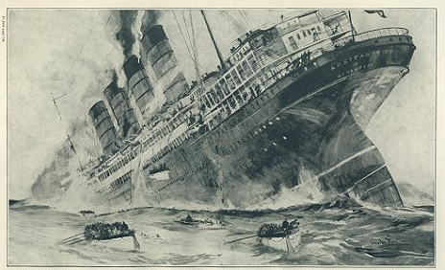
The path to war ii
1915 – A German u-boat sinks the Lusitania, killing 128 Americans (and 1070 others)
Should the U.S. go to war as revenge for the Lusitania? [Remember the Maine!]

Slide 6
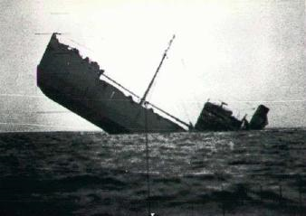
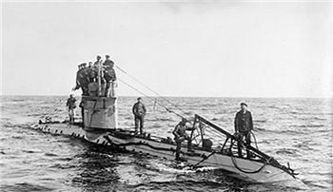
The Path to War III
1916 – Germany sank the Sussex after promising it would not sink any more passenger ships; 80 people die
Should the U.S. go to war because Germany broke its promise?

Slide 7
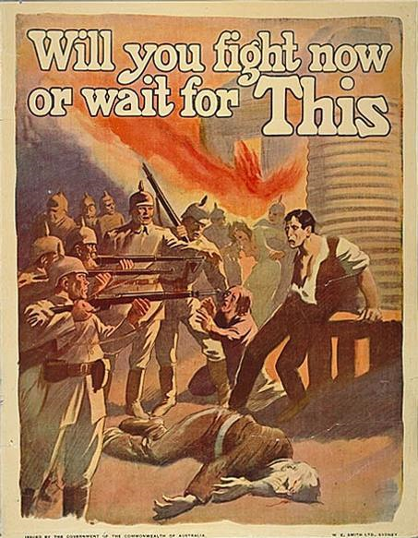
The path to War IV
1917 – Germany announces it will sink all ships—enemy or neutral—in British waters
Should the US go to war because Germany has pledged to sink all ships?

Slide 8
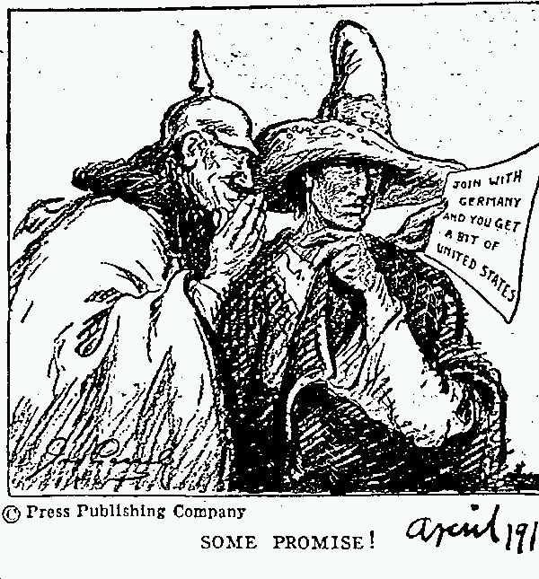
The path to War V
This telegram was called the Zimmerman Note
1917 – German agent sends a telegram to Mexican officials: “Join us and we’ll help you get back all the lands the U.S. took from you.”
Should the US go to war now that Mexico might team up with Germany?

Slide 9
The United States Finally Enters the War
Two factors led to U.S. involvement:
The Zimmerman Note – suggested that Germany was planning to invade the U.S. with Mexican help
Unrestricted Submarine Warfare – in 1917 Germany sank four unarmed American ships, killing 36

Slide 10
A short War
The United States declared war April 1917
To make the world “safe for democracy”
To fight for “ultimate peace”
November, 1918, the war ends – at a cost of:
22 million dead
$338 billion cost

