Slide 1
United States History
Progressivism
Dr. King-Owen
[8.01]

Slide 2
What was Progressivism?
Reform movement
(1890-1920)
led by educated Experts
to Improve public health, democracy, and labor
Progressivism
was a
who formed Organizations
and used the Government

Slide 3
Some Progressive Organizations
Organization | What it Did
YMCA (Young Men’s Christian Association) | Provided religious instruction, exercise, and education for young men
WCTU (Women’s Christian Temperance Union) | Wanted to ban the drinking of alcohol
ASL (Anti-Saloon League) | Wanted to close saloons
NAWSA* (National American Women Suffrage Association) | Fight for women’s right to vote
NAACP* (National Association for the Advancement of Colored People) | Fight to end Jim Crow laws

Slide 4
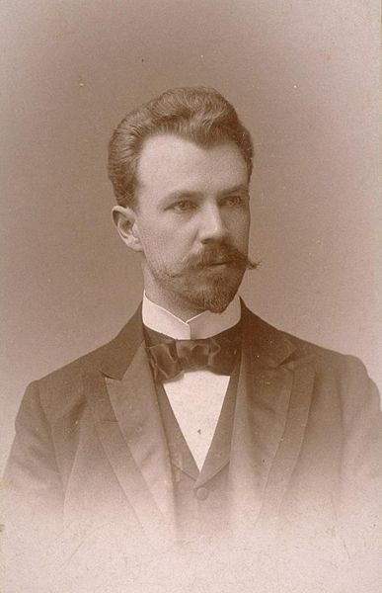
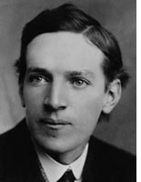
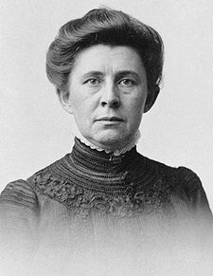
Muckrakers
Muckraker: investigative journalist who exposes corrupt, illegal, and dangerous business practices
Ida Tarbell
v.
Standard Oil
Exposed Rockefeller’s oil business practices
Lincoln Steffens
v.
City Bosses
Exposed city bosses’ corruption
Upton Sinclair
v.
Meat Monopolies
Exposed terrible working conditions in meat factories
Notes:
Mary had a little lamb
And when she saw it sicken,
She shipped it off to Packingtown,
And now it’s labeled chicken.

Slide 5
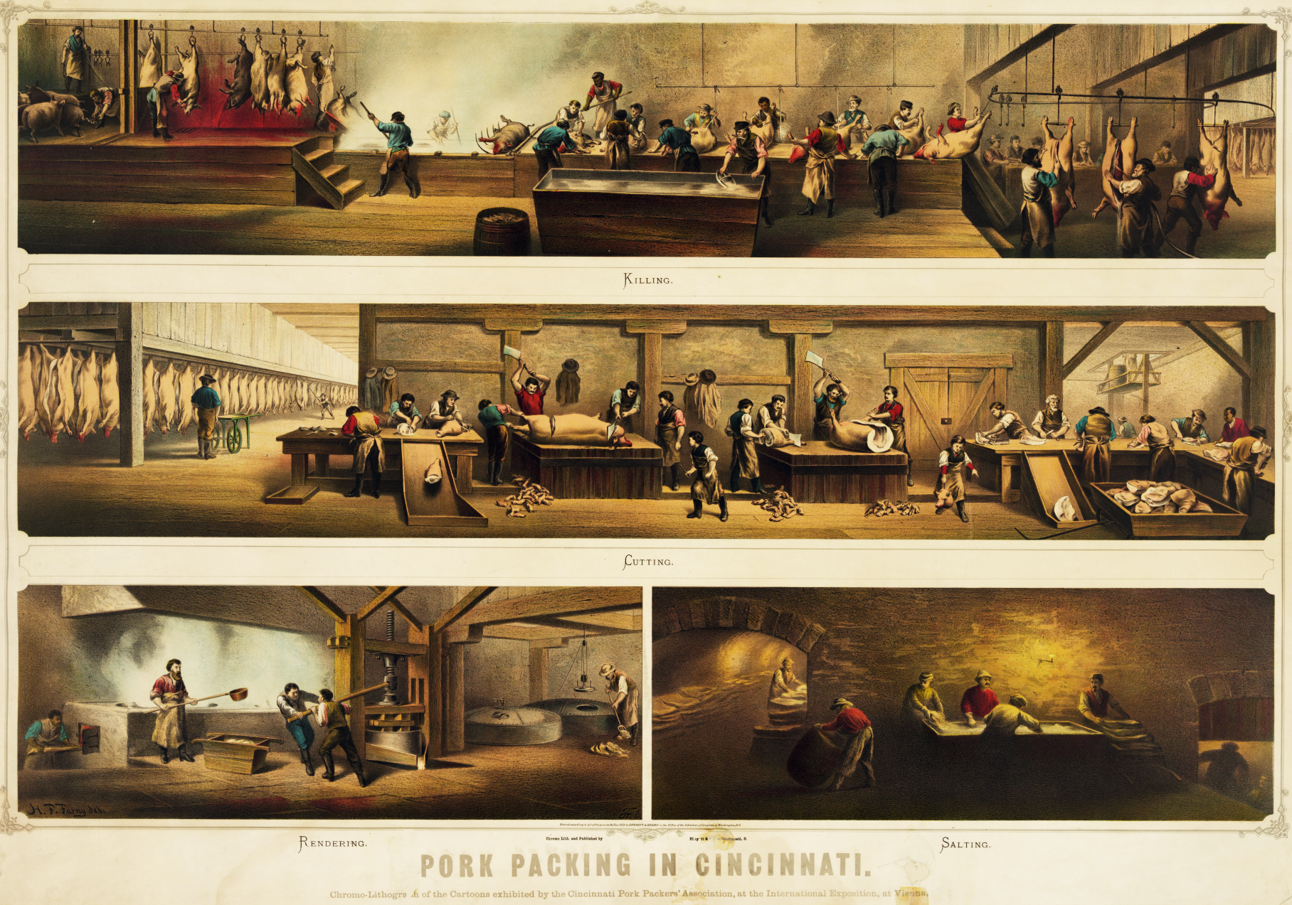
Notes:
Picture from 1873

Slide 6
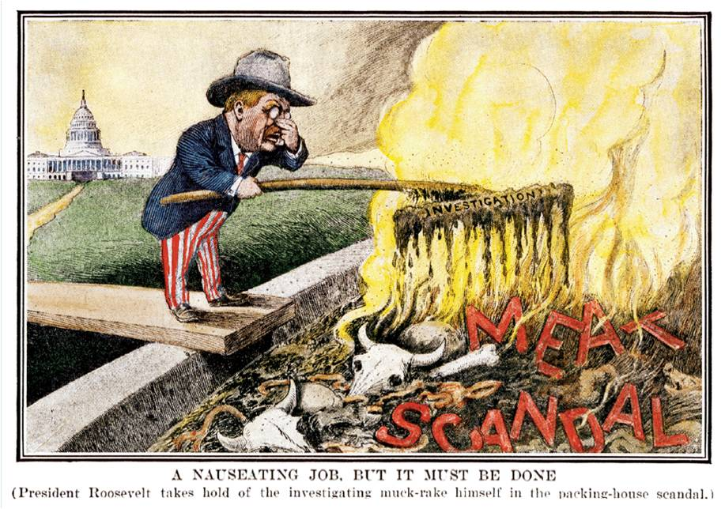

Slide 7
The Jungle and the Meat Industry
Teddy was reading Upton Sinclair’s novel, toying with a light breakfast an’ idly turnin’ over th’ pages iv the new book with both hands. Suddenly, he rose from the table, an’ cryin’: I’m pizened,’ begun throwin sausages out iv th’ window. Th’ ninth wan struck Sinitor Biv’ridge on the head an’ made him a blond. It bounced off, exploded, an’ blew the leg off a secret-service agent, an’ th’ scattered fragmints destroyed a handsome row iv ol’ oak-trees. Sinitor Biv’ridge rushed in, thinkin’ that the president was bein’ asassynated by his devoted followers in the Sinit, and discovered Teddy engaged in hand-to-hand combat with a potter ham. Th’ Sinitor fr’m Injyanny, with a few well-directed wurruds, put out th’fuse an’rendered the’missile harmless. Since thin, th’ President, like the rest iv us, has become a viggytaryan.

Slide 8
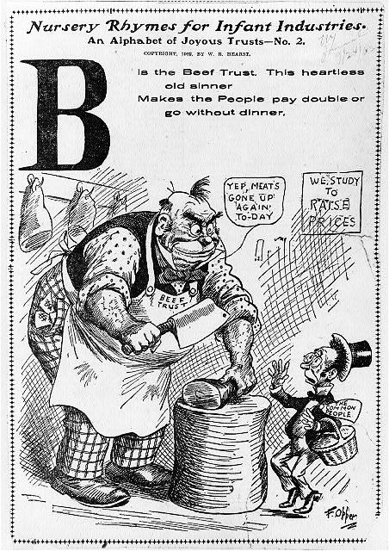
Cartoon against the “Beef Trust”
Mary had a little lamb
And when she saw it sicken,
She shipped it off to Packingtown,
And now it’s labeled chicken.
“… as for the other men, who worked in tank rooms in which there were open vats near the the floor, their peculiar trouble was that they fell into the vats; and when they were fished out, there was never enough of them left to be worth exhibiting—sometimes they would be overlooked for days, till all but the bones of them had gone out to the world as Durham's Pure Leaf Lard!” [Upton Sinclair]

Slide 9
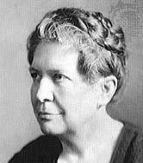
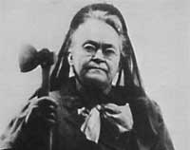
Women as Reformers
Women’s Virtue and Goodness
Many women were reformers, working to help poor children or stop alcohol abuse
As wives and mothers, they needed to “clean up” the world – because men couldn’t do it!
Florence Kelley
-end child labor
Carry Nation
-prohibition of alcohol
Susan B. Anthony
-right to vote for women

Slide 10
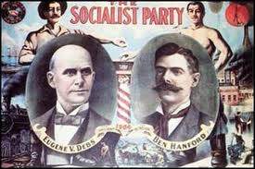
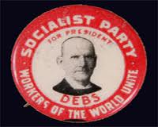
Socialism
Some labor leaders, like Eugene V. Debs, did not think that reforming the American economy was enough
Debs believed in socialism
All factories and businesses would be owned by the people
Socialism would end the conflict between labor and industry
People would be equal

Slide 11
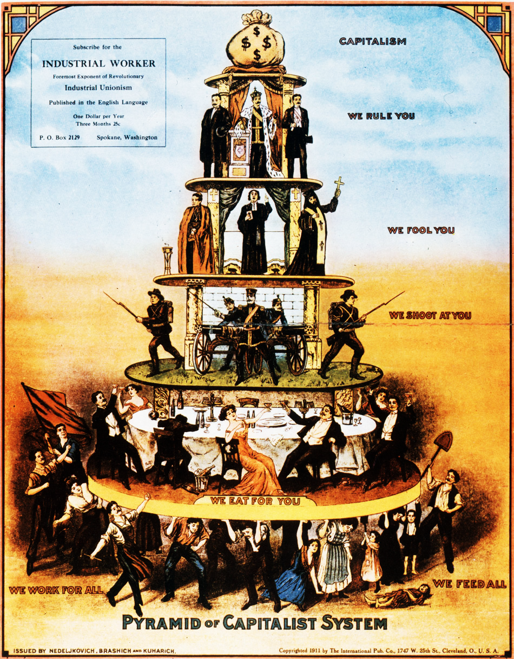
This cartoon shows the socialist criticism of a capitalist society—where those who work have to hold up the rest of society.

Slide 12
Unions
Union workers fought for many reforms:
End child labor
Reduce working hours for women
Muller v. Oregon, 1908 – women could be restricted to a 10 hour work day
Payment of worker’s compensation, insurance

Slide 13
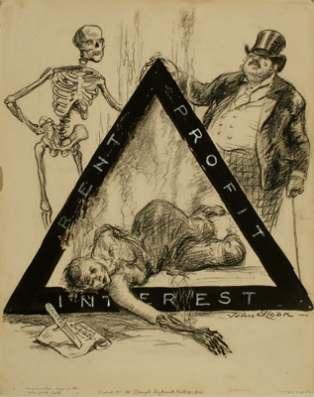
1911 – Triangle Shirtwaist Fire
-after fire broke out, 146 people died (mostly women) who couldn’t get out of the factory because the owner locked the doors
Notes:
Youngest victim was just 15. Most of the girls were in their 20s.

Slide 14
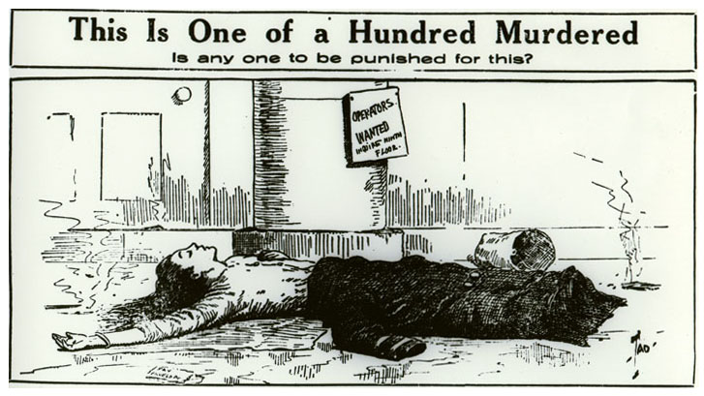
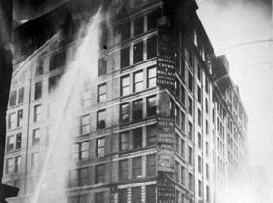
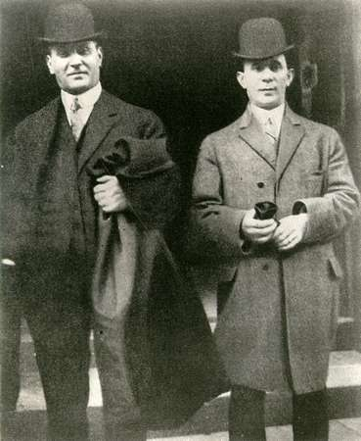
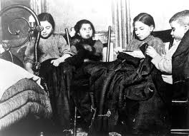
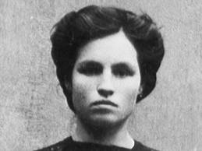

Slide 15
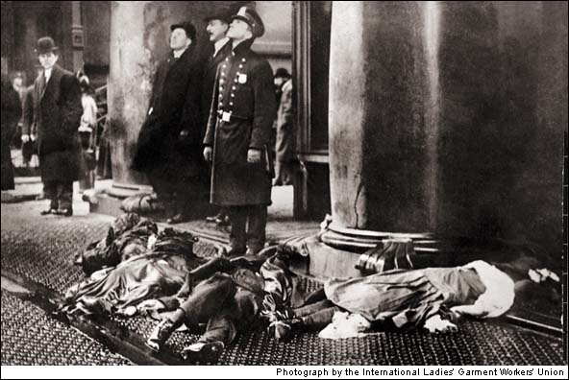

Slide 16
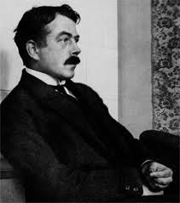
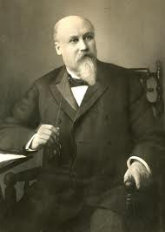
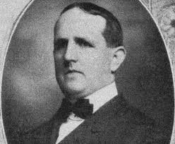
Corrupt City Governments
Cities adopted new forms of management to limit the corruption of political bosses
City departments would be run by ‘experts’ in government
Reform mayors took over public utilities (gas, water, electricity, and public transport)
Notes:
Mayors: Golden Rule Jones (Toledo), Hazen Pingree (Detroit), Tom L. Jones (Cleveland)

Slide 17
Political Reform
Electoral Reform
States adopted new rules to allow citizens to have more power in government:
Initiative – people propose a law
Referendum – people vote on new laws
Recall – people can remove corrupt leaders
Direct Election of Senators
17th Amendment (1913) gave the people of America the right to elect their Senators to Congress (instead of being chosen by states)

