Slide 1
United states history
World War I: Legacies
Dr. King-Owen
[8.04]

Slide 2
Treaty of Versailles
What President Wilson wanted:
An end to all wars
Open diplomacy to prevent future war
League of Nations to protect the peace
What European leaders wanted:
To PUNISH Germany for the war by:
Getting $$$ for costs
Disarming Germany
Taking Germany’s colonies away

Slide 3
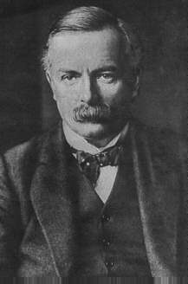
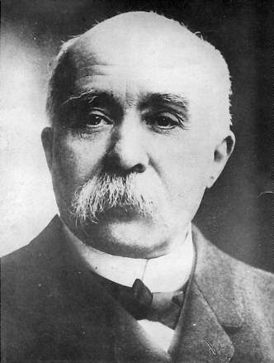
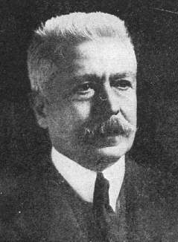
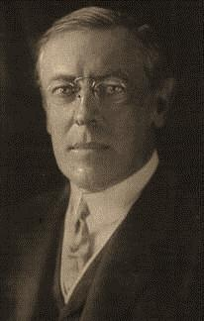
T
H
E
B
I
G
F
O
U
R
L
l
o
y
d
G
e
o
r
g
e
C
l
e
m
e
n
c
e
a
u
O
r
l
a
n
d
o
W
i
l
s
o
n

Slide 4
Wilson’s 14 Points
What Wilson wanted:
No secret treaties
Freedom of seas
Free trade
Reducing weapons
Colonies move toward self-control
Association of nations to protect peace
Did he get it?
NO
NO
NO
Germany disarmed
Germany loses its colonies
League of Nations created

Slide 5
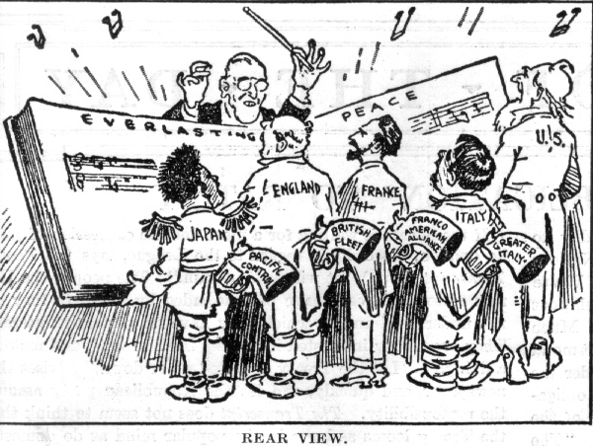

Slide 6
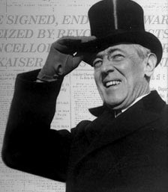
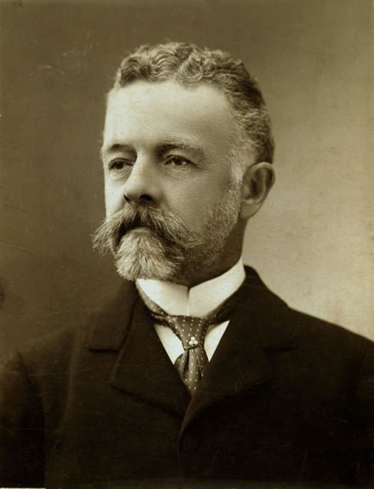
The Treaty and the U.S. Senate
The U.S. Senate ratifies all treaties made by the President but
Senate fought Wilson’s treaty
Worried that the League of Nations would take away Congress’ power to declare war
Treaty would commit the U.S. to European wars in the future
Treaty would violate the U.S. policy of having no “foreign alliances”
vs

Slide 7
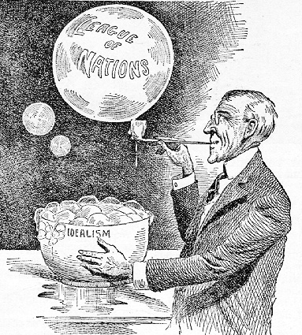
Wilson’s Defeat
Wilson refused to compromise with the Senate on the Treaty, so:
The Senate rejected the League of Nations
The League of Nations became a failure without the U.S.

Slide 8
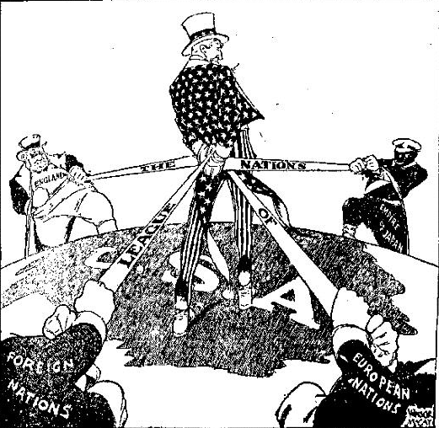

Slide 9
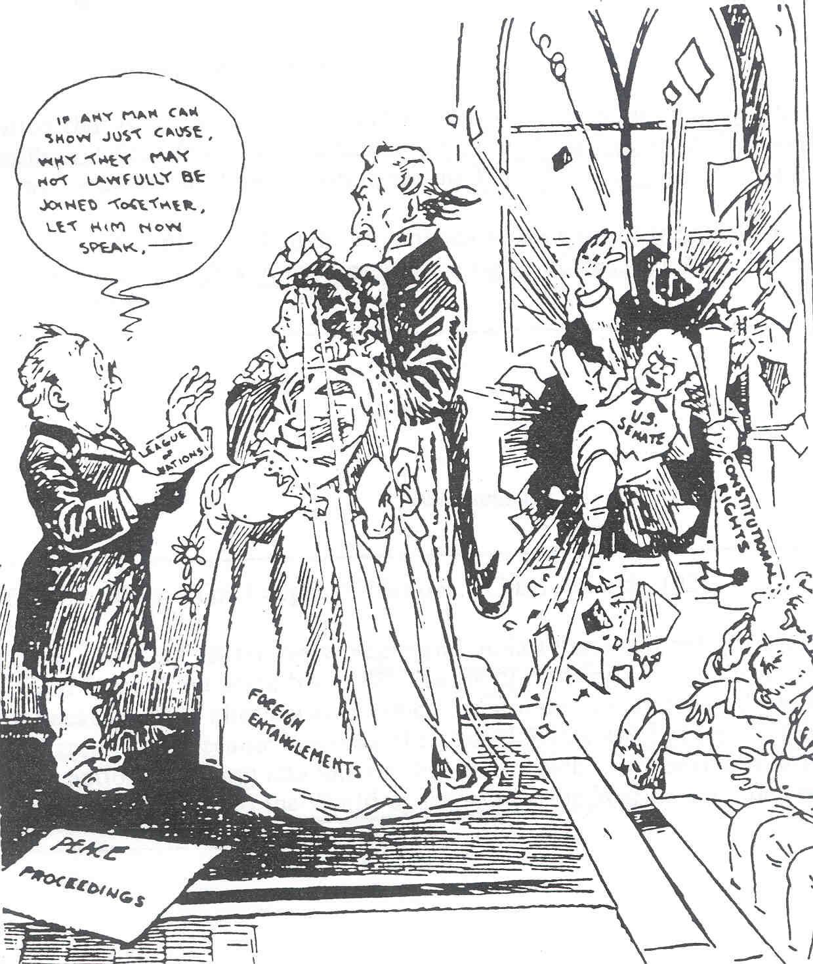

Slide 10
Long-Term Consequences
World War I set the stage for World War II by:
Making Germans angry over the “war guilt clause” that made them responsible for WWI
Forcing Germans to pay REPARATIONS ($53 billion), causing economic hardship
Taking land away from Germany
Failing to control militarism and imperialism through a League of Nations

