Slide 1
Quick Quiz: WWI
True or False:
An immediate cause of World War I was the British bombing of Serbia.
European countries were building bigger armies in the late 19th century.
Nationalism is the expansion of a country to new lands.
America’s foreign policy until 1917 was largely interventionist in nature.
F
T
F
F

Slide 2
United States history
Origins of the Great War (WWI)
Dr. King-Owen
[8.03]

Slide 3
Unstable Europe
1914 – World War I breaks out
Long-Term Causes
Immediate Causes
MILITARISM – growing military power
ALLIANCES – system of alliances that committed nations to each other’s defense
IMPERIALISM – control over colonies
NATIONALISM – growing pride in national identity
Serbian nationalists resented Austria’s control over Bosnia
Archduke Franz Ferdinand, heir to the Austrian throne, visited Bosnia in 1914
Ferdinand was killed by a Serbian nationalist
One-by-one, the countries declared war

Slide 4
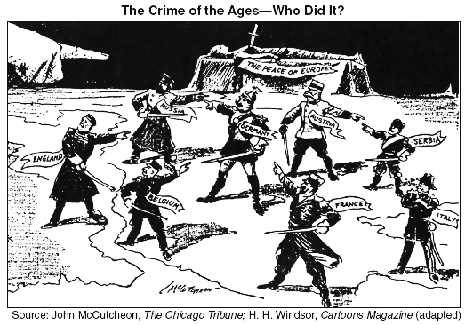

Slide 5
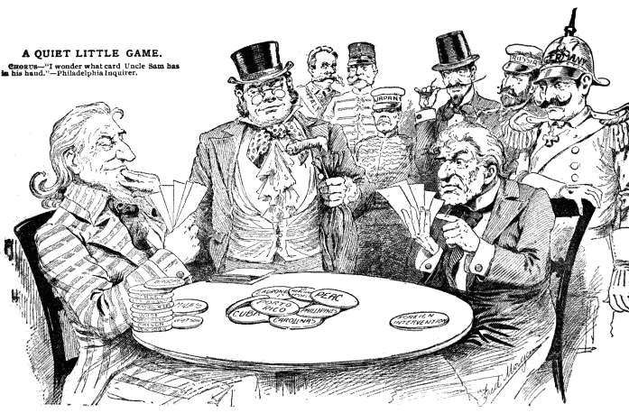

Slide 6
Alliance System
Allied Powers
Central Powers
France, Britain, and Russia were allied
Germany, Austria-Hungary, and the Ottoman Empire were allied

Slide 7
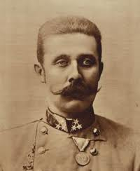
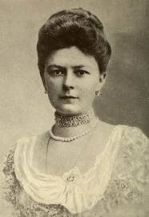
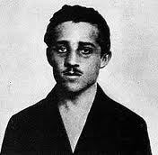
Short Term Causes
Archduke Franz Ferdinand was visiting Bosnia in 1914 with his pregnant wife Sophie
A Serbian Nationalist, Gavrilo Princip, shot Ferdinand and Sophie because he resented Austria-Hungary’s dominance of Bosnia
Austria-Hungary declared war against Serbia for the murders

Slide 8
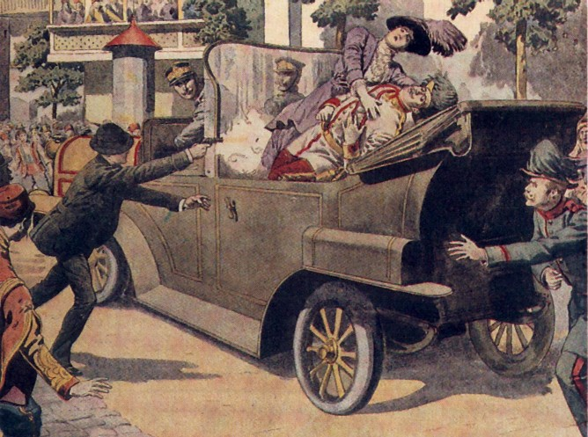

Slide 9
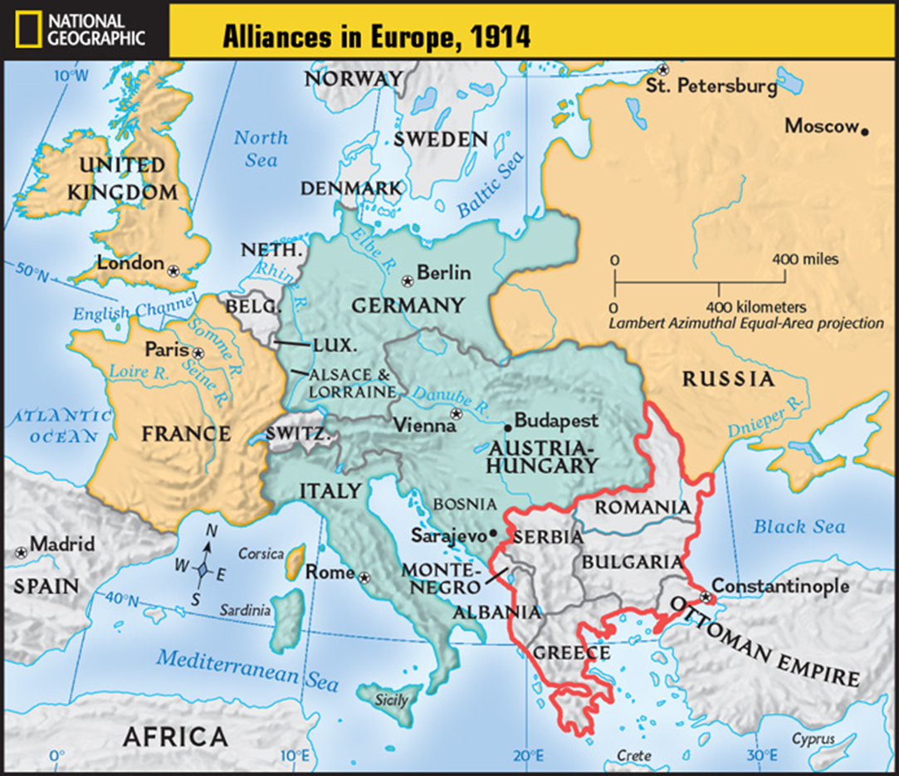

Slide 10
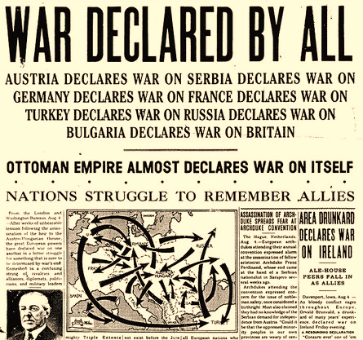
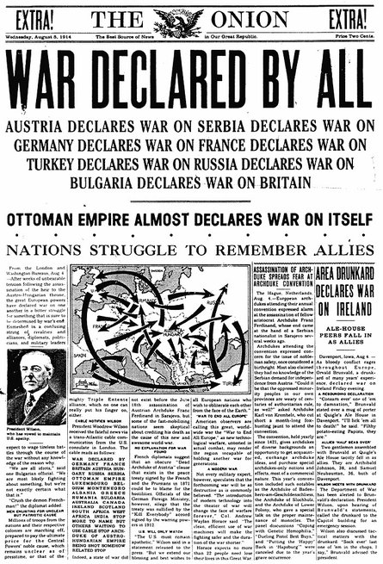

Slide 11
America: Neutral
America remains neutral to the war in 1914
Though most Americans favored the Allies, the official policy of the U.S. tended toward isolationism
Alliances with Europe are seen as threats to U.S. stability (“foreign entanglements”)
However, Americans have economic ties to Europe
Attacks on ships carrying goods to Europe made it difficult to be neutral

Slide 12
True or False?
According to the Roosevelt Corollary, Americans will intervene in the affairs of Latin American countries if they are unstable.
American foreign policy has tended to be isolationist until 1917.
The Spanish-American war made the United States a world power.
The Open Door Notes concerned the Philippines.
T
T
T
F

Slide 13
True or False?
F
One of the reasons Americans expanded overseas was because they believed they were culturally inferior to other people.
The United States acquired most of its new territories in the late 1890s by war.
The assassination of Archduke Franz Ferdinand was an immediate cause of World War I.
Some Americans wanted to take the Philippines because it would give the U.S. access to Chinese markets.
T
T
T

Slide 14
True or False?
American imperialism is very similar to the idea of manifest destiny.
According to Dollar Diplomacy, Americans would intervene in other countries’ affairs to protect U.S. business interests.
Americans blamed the Spanish for blowing up the ship the McKinley in the Havana harbor.
Yellow journalism discouraged Americans from seeking war with Spain.
T
T
F
F

