Slide 1
United States History
Women’s Suffrage
Dr. King-Owen
[8.02]

Slide 2
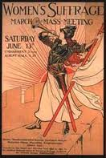
NAWSA
Leaders of the Seneca Falls convention (1848) formed the National American Woman Suffrage Association
Industrialists feared women would vote against the use of child labor or against liquor
NAWSA went to court to get women’s rights to vote

Slide 3
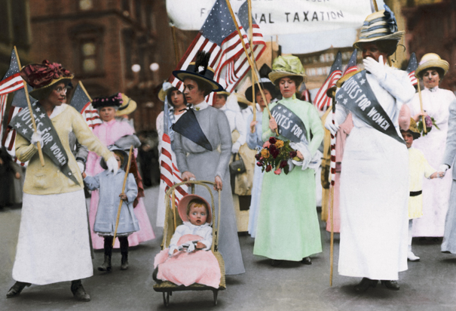

Slide 4
Western Voters
Women won the right to vote in western states first
1869 Wyoming
1890s – Colorado, Idaho, Utah
Why the West?
Populists wanted women to vote for their reform party
Women worked hard to get voting rights in the West

Slide 5
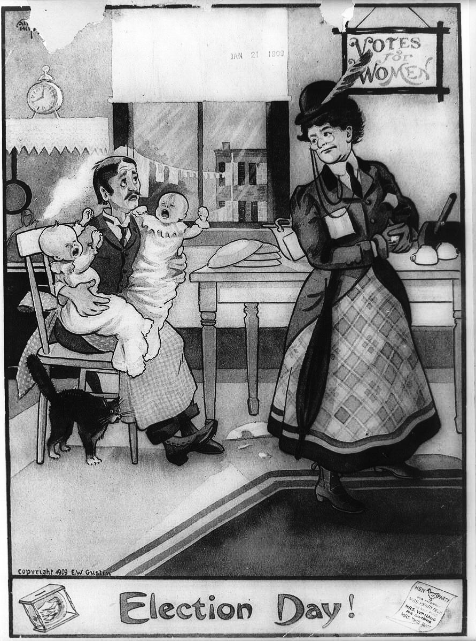

Slide 6
Women Go Radical
Radical Suffragettes decided that NAWSA’s strategy of legal fights was not enough –
1917 they established a 24-hour picket line at the White House
President Wilson agreed to suffrage in 1918 –
he wanted women’s support for America’s involvement in World War I
19th amendment was passed 1920 – granting women the right to vote

Slide 7
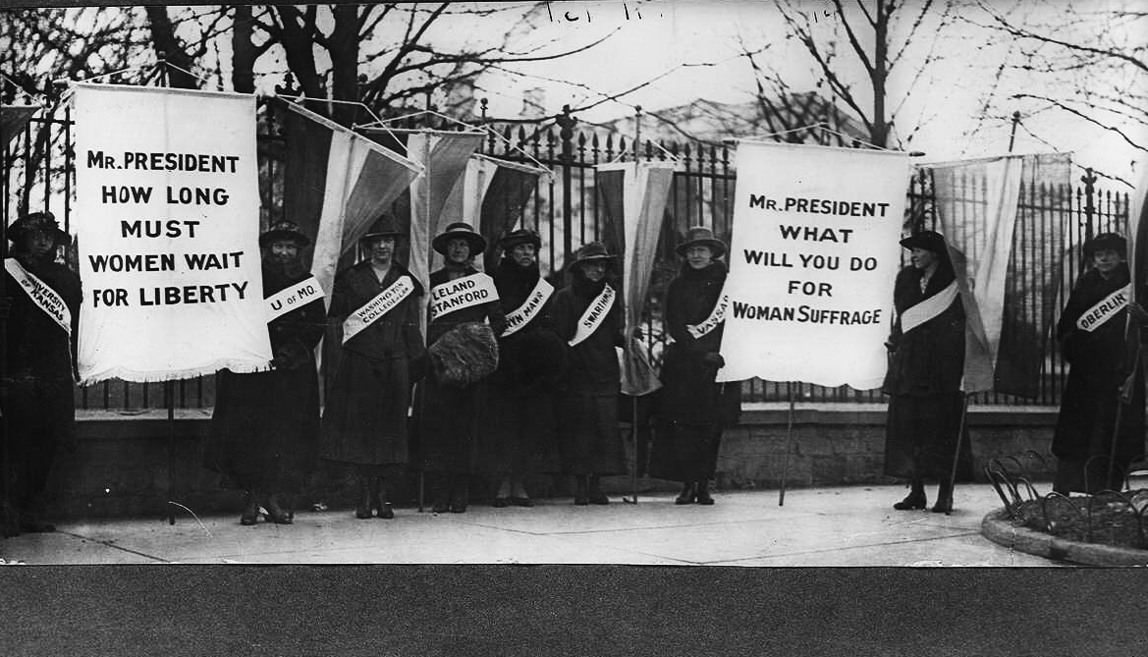
Women Picketing Outside the White House, 1917 by members of the National Women’s Party
Notes:
To punish the women who picketed outside the White House, 1917 – guards beat and tortured the suffragettes, feed them worm-infested slop, forced-fed Alice Paul until she vomited because she went on a hunger strike. Tried to have Paul declared insane. They were arrested for “obstructing traffic.” Wilson announced in 1918 that suffrage was needed as a war measure and urged Congress to pass the legislation.

Slide 8
