Slide 1
United states History
Economic inequality in the 1920s
Dr. King-Owen

Slide 2
1920s: Living Large
Standard of Living improved
Average income rose from $522 to $705 a year
Wealth was unequally distributed
Farmers especially suffered
Rich got very much richer
Decline of unions meant workers had little power to improve their condition
Notes:
During the 1920s -- $2500 – minimum income for decent family life
71% of American families made less than $2500 a year in 1929
80% of Americans had NO savings
Declining Farm Production (dropped by 47% from 1919 to 1929)
Farmers growing poorer: held 16% of national income in 1919 but only 9% by 1929
Increasing foreclosures: By 1929, 435,000 farmers were forced off their land

Slide 3
Income Gap
In 1928, 1,152 people in the U.S. made 892 times more money than the bottom 90%

Slide 4
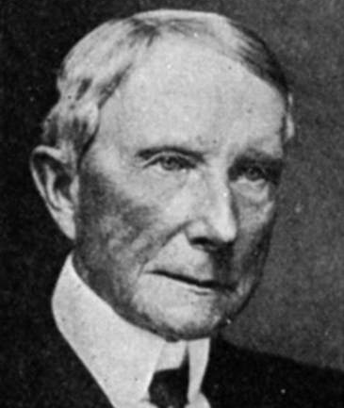
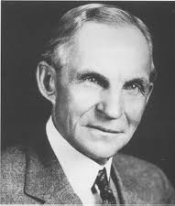
Top Three Richest Men in 1925
John D. Rockefeller
Est. at $374 billion
Henry Ford
Est. at $188.1 billion
Andrew Mellon
Est. at $19 million

Slide 5
Stock market Investments
The wealthy and those who hoped to be wealthy invested in the Stock Market.

Slide 6
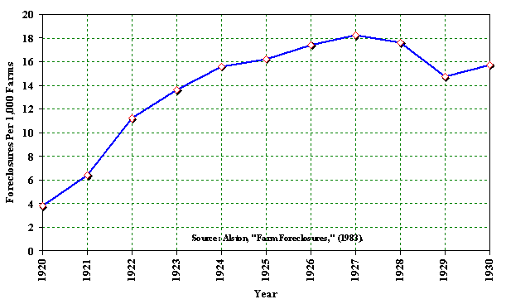
Farm Foreclosure Rate

Slide 7
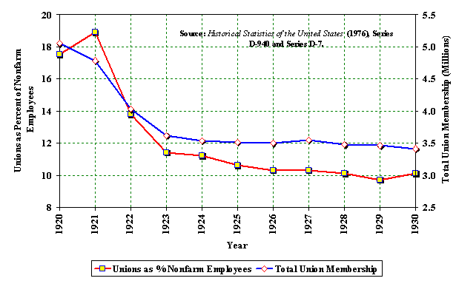
Declining Union membership

Slide 8
Spend, Spend, Spend
Installment Buying Plans encourage a “buy-now-pay-later” attitude
Reckless purchasing of consumer goods on credit
Scientific advertising increases buying
Popular products: radios and cars
Notes:
By 1928 more than 2/3 of all furniture, phonographs, and washing machines were bought on credit; ½ of all sewing machines, pianos, and vacuum cleaners

Slide 9
Consumer Spending
Spending increased in the 1920s.
People did not save money.

Slide 10
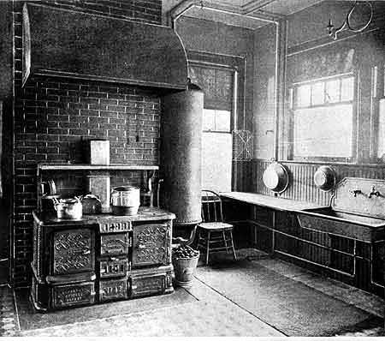

Slide 11
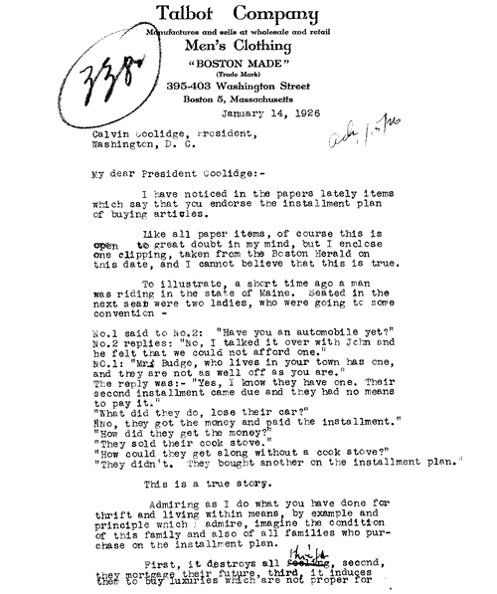

Slide 12
Serious questions
America currently has the same income equality as it was in 1928. Many protesters complain that the richer are getting richer and the poorer are getting poorer. Do you think that income inequality is a problem that needs to be solved? Write a paragraph about income inequality and give 2 reasons for your stand on the issue.

