Slide 1
United States History
The New Deal: REFORM
[9.04]
Dr. King-Owen

Slide 2
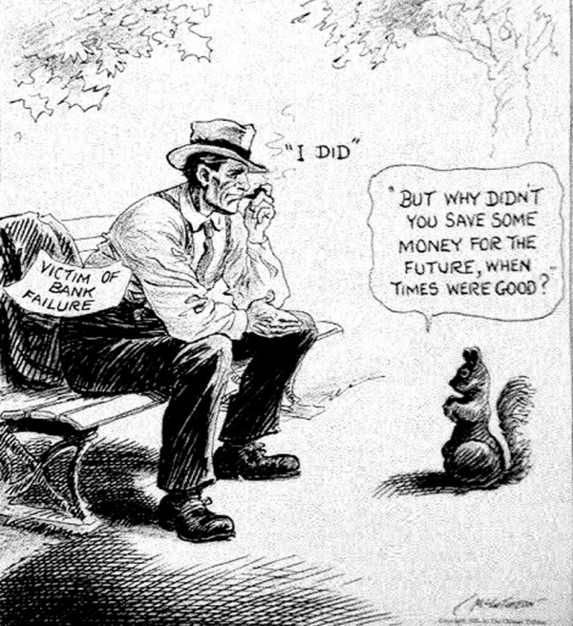
Reform
Reform acts of the New Deal tried to fix the economy to prevent future problems

Slide 3
Glass-Steagall Banking Act, 1933
1933 – FDR declared a “bank holiday” to stop people from taking their money out of banks
GS Act created the Federal Deposit Insurance Corporation—which insured bank deposits against loss

Slide 4
Securities and Exchange Act, 1933-1934
Regulates buying and selling of stock
Prevents fraud in sale of stock

Slide 5
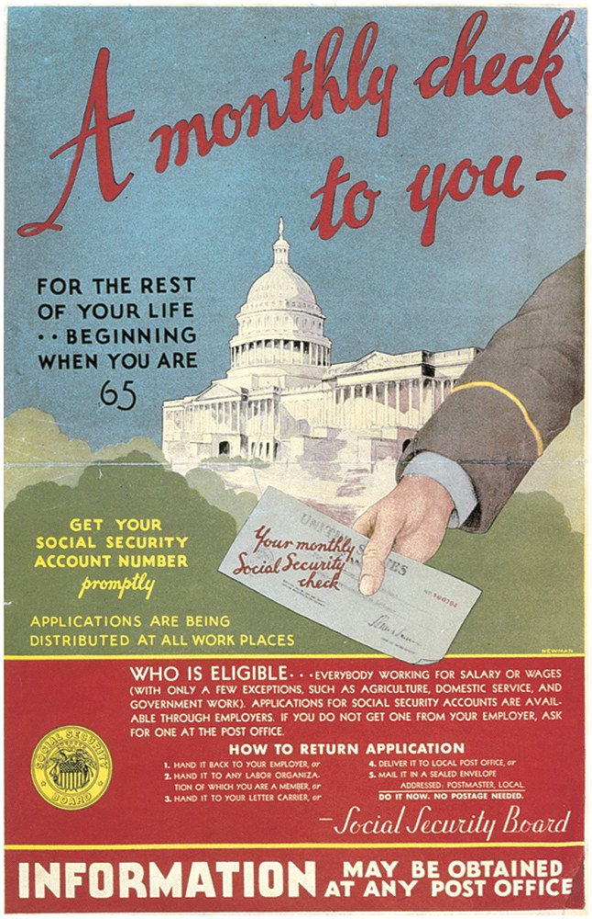
Social Security Act, 1935
Set up pensions for the elderly and disabled workers
Workers would pay taxes to provide them with savings in the future

Slide 6
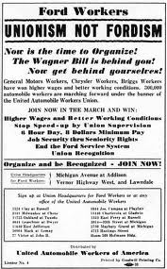
Wagner Act, 1935
Protected unions by forbidding employers to:
Discriminate against union members
Refuse to collectively bargain
Force workers to not join unions
Created the National Labor Relations Board to resolve employer-worker disputes

Slide 7
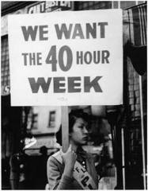
Fair Labor Standards Act, 1938
FLSA created a minimum wage and maximum hours (40 hours/week and 40 cents an hour by 1945)
Banned some forms of child labor

Slide 8
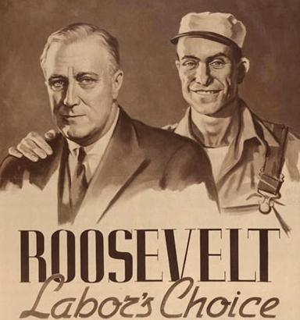
Democrats + Labor Unions
Reforms that helped labor unions created a strong link between Democrats and labor unions

