Slide 1
United States history
The New Deal: RECOVERY
Dr. King-Owen [9.04]

Slide 2
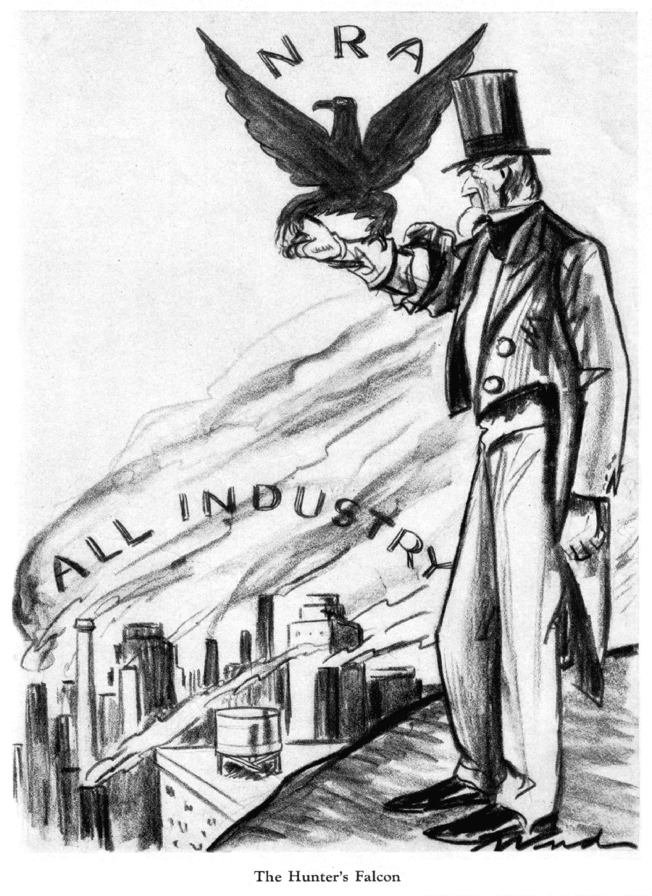
recovery
New Deal programs that encouraged RECOVERY aimed to:
Get the economy moving
Encourage businesses to hire and produce
Bring economic development to rural areas
Help agriculture

Slide 3
National Industrial Recovery Act, 1933
President had the authority to:
Set prices
Establish business practices
Set hours of labor and minimum pay
Businesses thought that the 10,000 pages of “codes” were a burden
Supreme Court declared the act unconstitutional in 1935

Slide 4
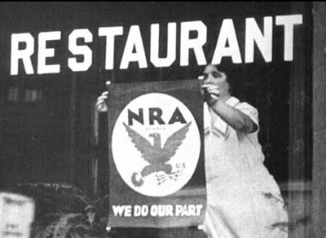

Slide 5
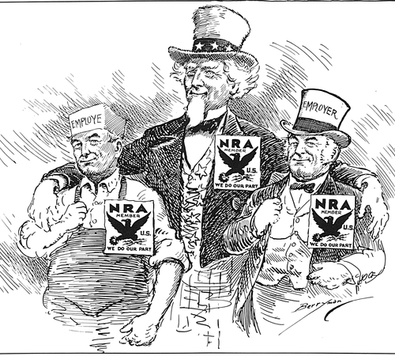

Slide 6
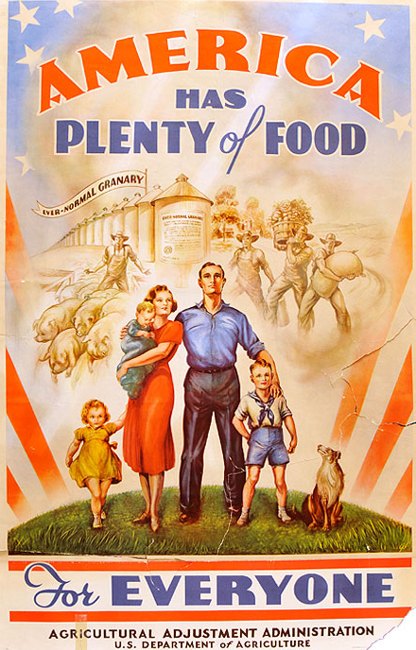
Agricultural adjustment act, 1933
Gave farmers subsidies—a payment to encourage them NOT to plant crops
By creating scarcity, produce prices would go up
Tax on processors of produce would be used to fund the subsidies
Supreme Court declared the act unconstitutional in 1936

Slide 7
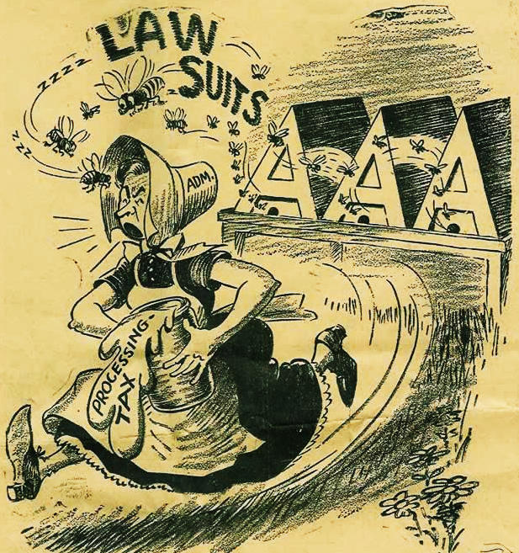
The “Sick Chicken” case of 1936 resulted in the Supreme Court declaring that the federal government could not use a processing tax on one group to pay another group.

Slide 8
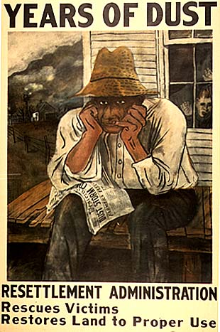
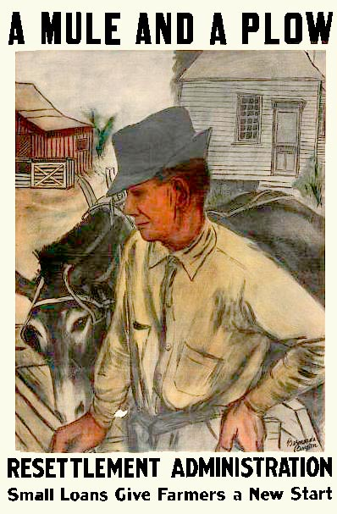

Slide 9
Tennessee valley authority, 1933
Was a federally-owned corporation that sold electricity to the TN valley
Built hydroelectric power plants, created lakes
15,000 families were moved by dam construction
Hated by private power companies

Slide 10
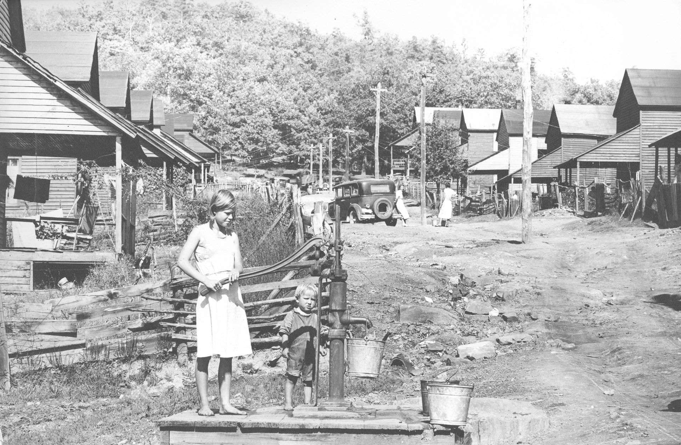

Slide 11
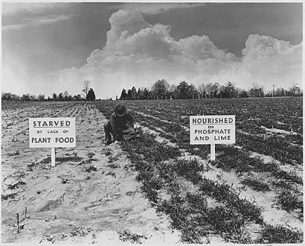

Slide 12
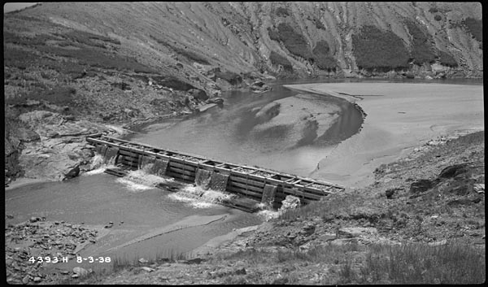

Slide 13
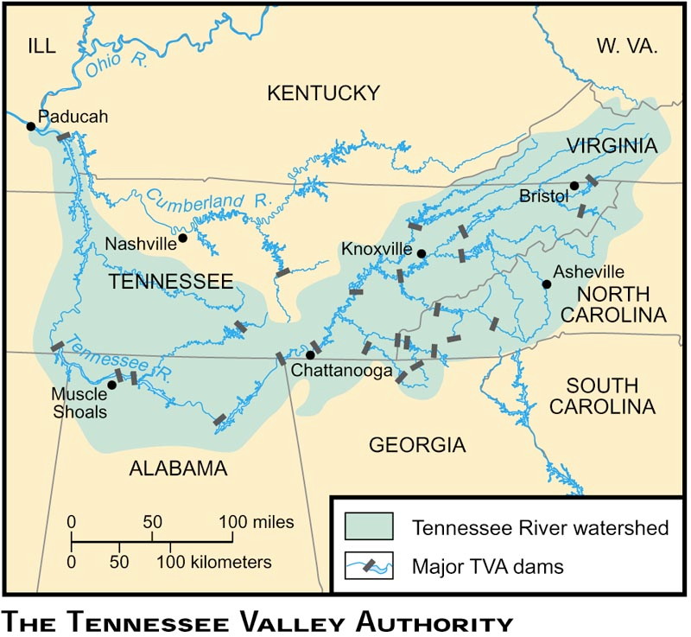

Slide 14
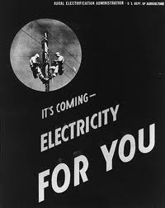
Rural electrification act, 1935
Gave loans to install electric companies in rural areas
REA agents wired houses with lights and outlets
Long-term impact: rural consumers could buy electric appliances

Slide 15
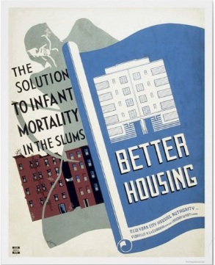
Federal housing administration, 1934
Issued loans to encourage home building and home buying
Long-term impact: Its loan policies tended to increase segregation in cities and made inner city slums worse

