Slide 1
United States History
Hoover and the Depression
[9.03]
Dr. King-Owen

Slide 2
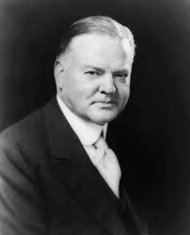
Hoover’s Ideas
The economy will fix itself!
Rugged Individualism:
Solve your own problems!
The government should not help people—it will make them weak
“Mellon pulled the whistle
Hoover rang the bell
Wall Street gave the signal
And the country went to hell.”

Slide 3
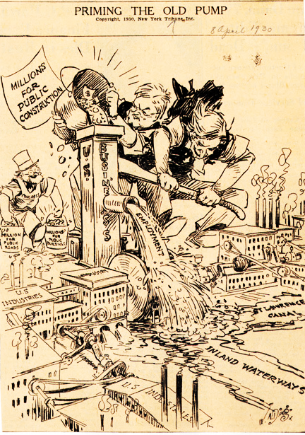
“Priming the Pump”
By spending money on corporations, Hoover thought that the benefits would trickle down to ordinary people in the form of jobs.

Slide 4
Hoover’s Solutions
Reconstruction Finance Corporation, 1932
$2 billion for banks, railroads, large businesses (=BAILOUT)
Hoover thought that $$$ would trickle down to average citizen
RFC loaned $805 in 5 months but businesses continued to fail

Slide 5
Bonus Army
1932 – appx. 20,000 WWI veterans came to Washington D.C.
They wanted a “bonus” for their WWI service ($500)
Built a shanty-town in DC while waiting for Congress to pay them
When Congress did not, 2000 stuck around
Hoover ordered the Army to forcibly remove the men - army gassed 1000 people (killing a baby)
Incident damaged Hoover’s reputation – and he lost the election of 1932

Slide 6
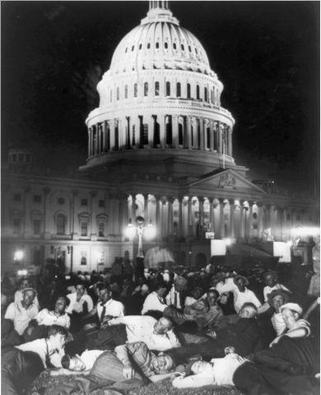
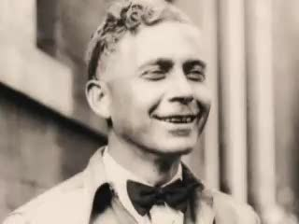

Slide 7
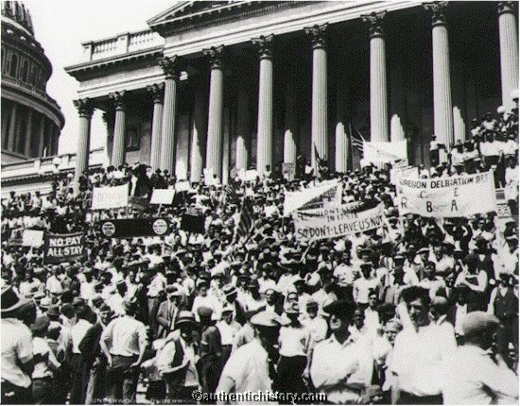

Slide 8
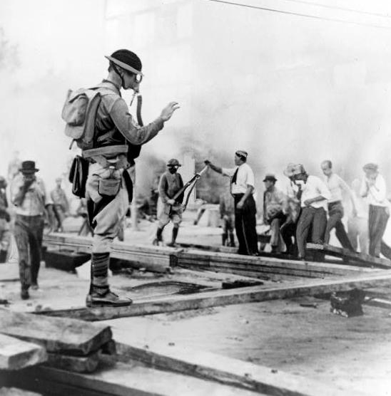

Slide 9
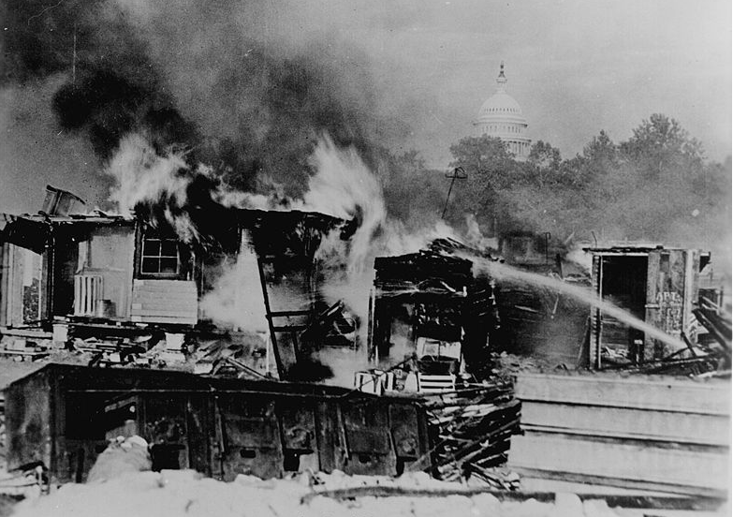

Slide 10
