Slide 1
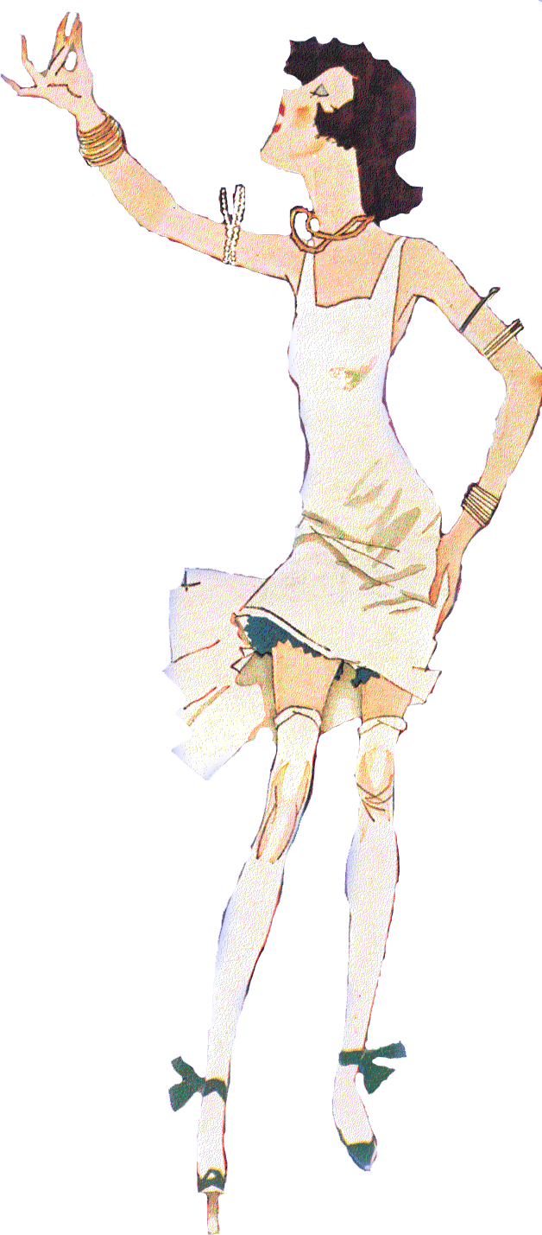
United States History
All That Jazz
Dr. King-Owen

Slide 2
Liberating Women
More Women Working Outside the Home
Declining Birth Rates (down 11%)
Margaret Sanger and Birth Control – fight for reproductive freedom
Equal Rights and Voting
19th Amendment (only 46% of women voted)
Equal Rights Amendment (1923) - failed
Flappers
Sexual liberation
Dancing, drinking, smoking

Slide 3
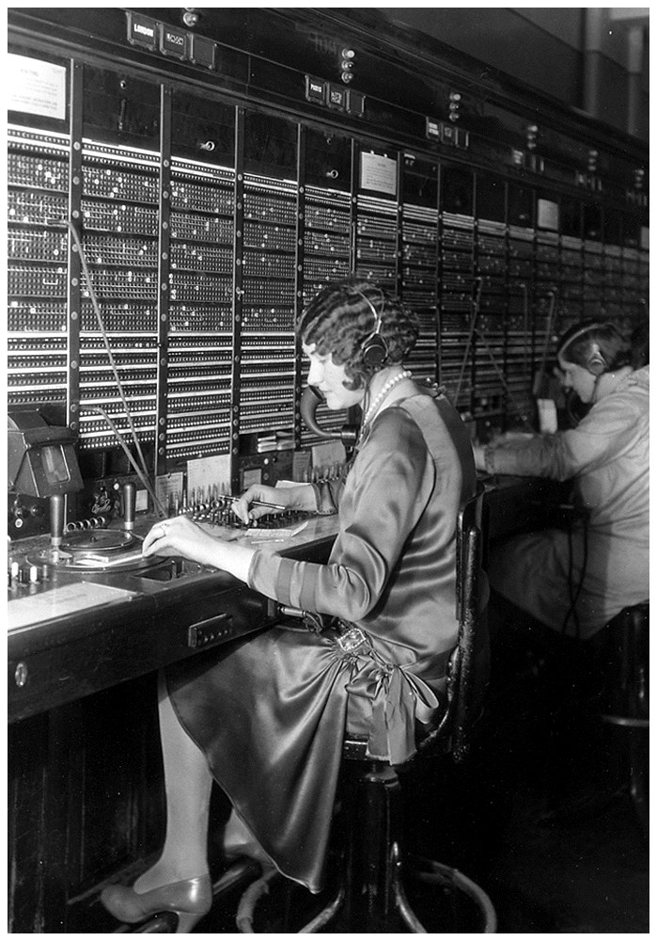
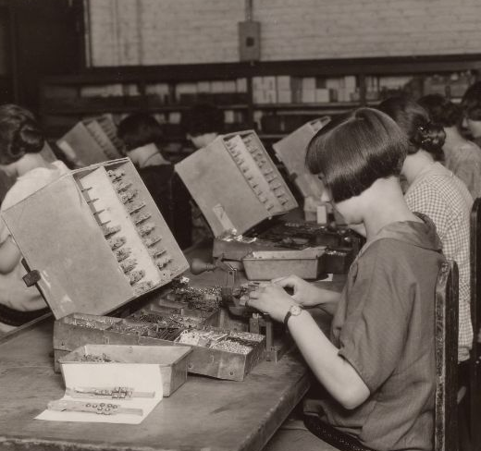
Notes:
Western Electric – women building electrical equipment

Slide 4
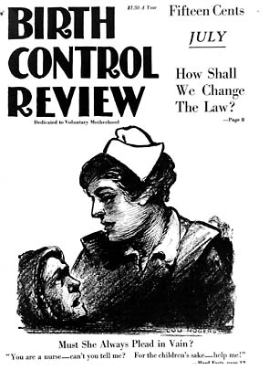
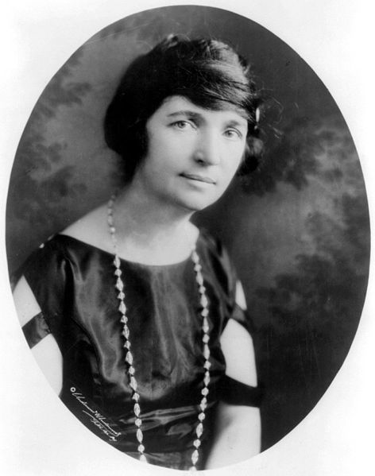

Slide 5
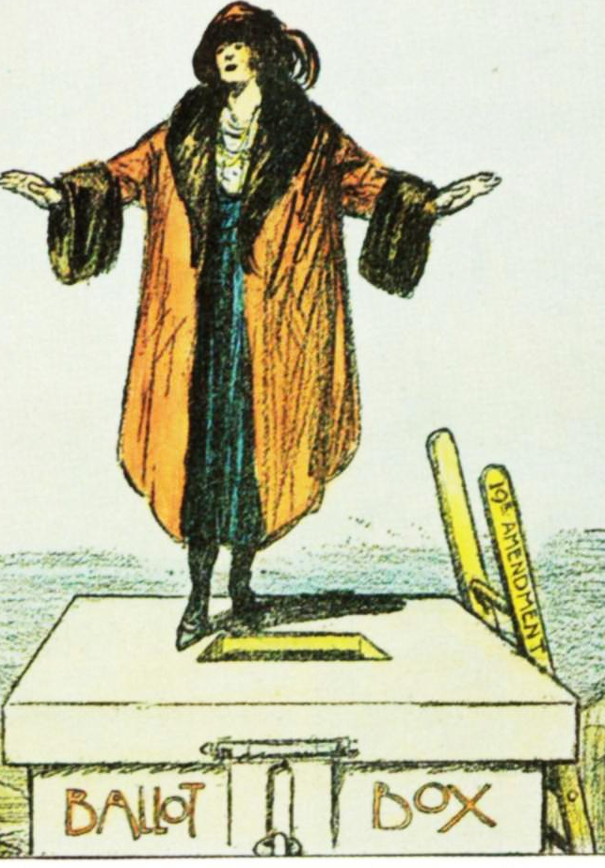
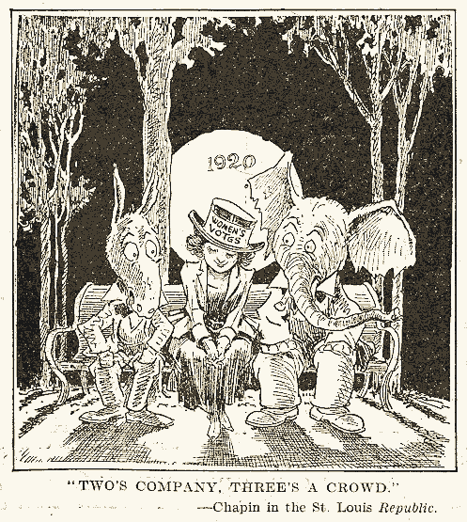

Slide 6
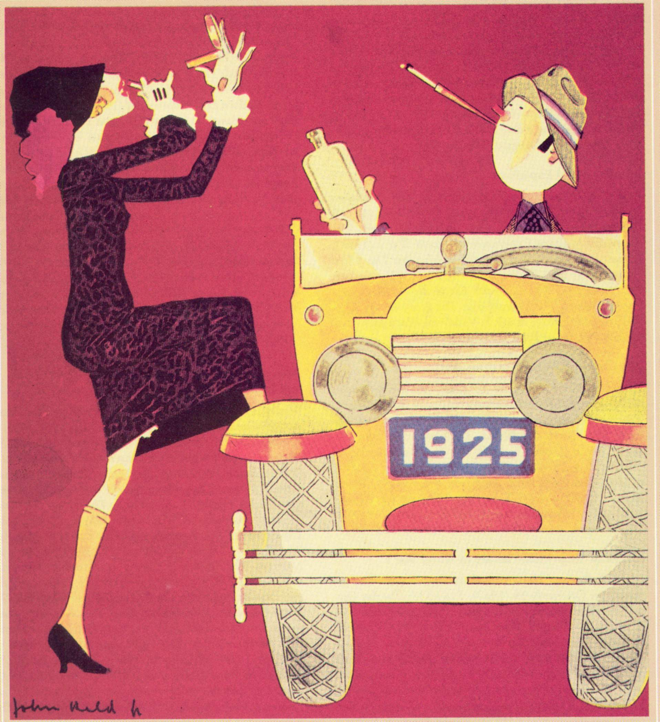

Slide 7
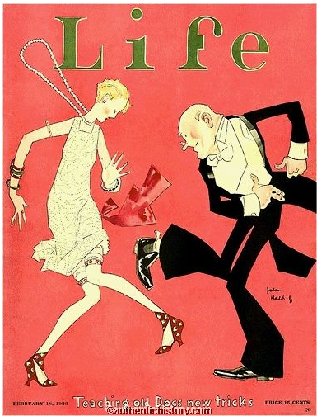
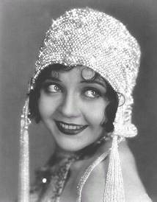

Slide 8
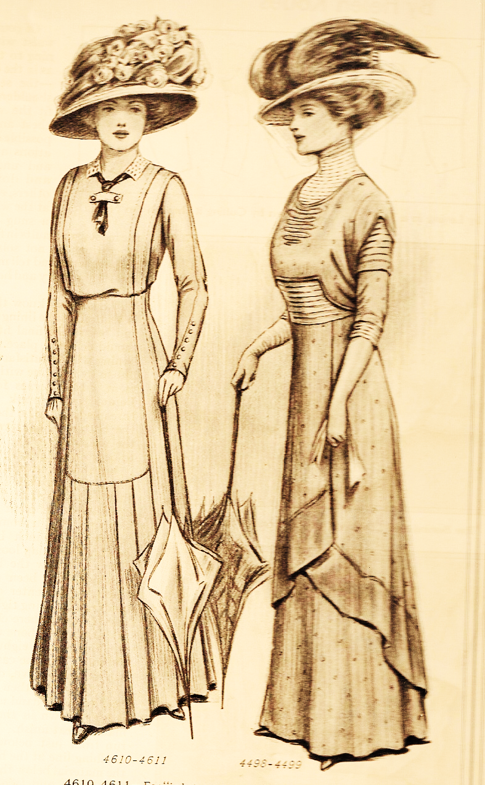
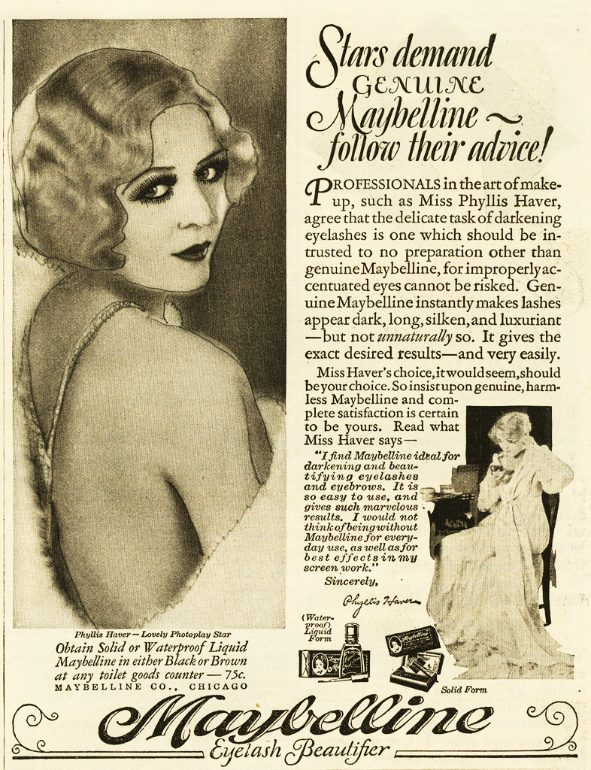

Slide 9
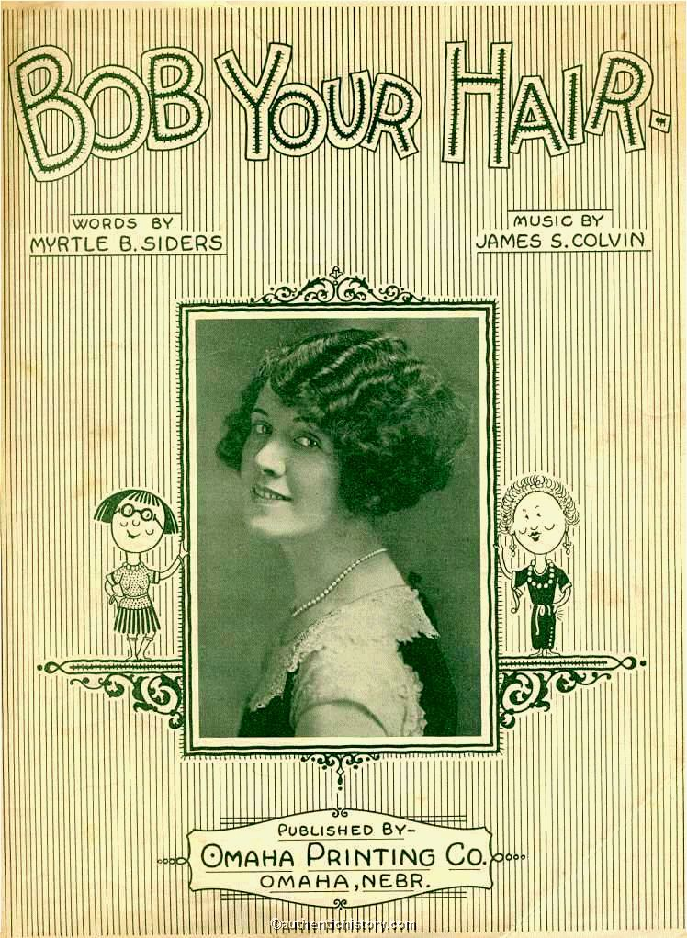
That long hair wins mans devotion Is a Horse and Buggy notion, In these days of locomotion in the air If you would look cute and pretty like the girls do in the city Can the small town stuff by witty Bob your hair.

Slide 10
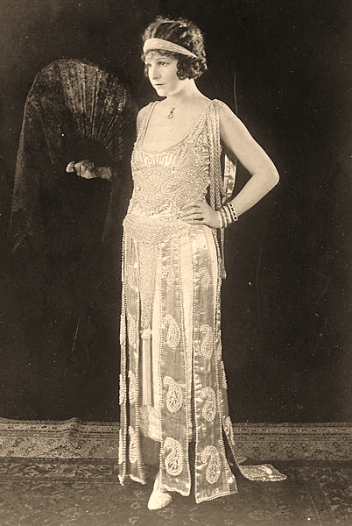
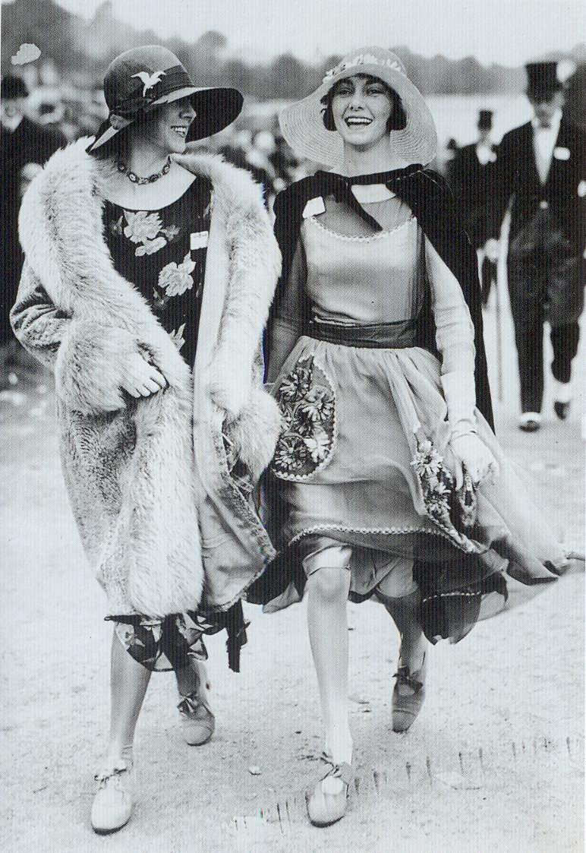

Slide 11
Prohibition
18th Amendment (1920) – sale, transportation, or making alcohol illegal
Supported by rural, Protestants, KKK
Unintended Consequences
Increased crime
Gangsters (Al Capone)
Speakeasies (private drinking clubs)
Bootlegging (making illegal hooch)

Slide 12
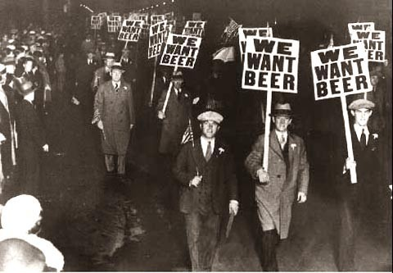

Slide 13
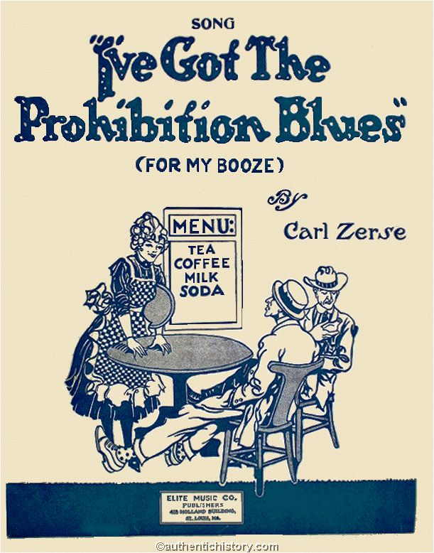
I'm so thirsty that I'm blue, Old friend Booze I long for you, I never knew that I'd miss you, The way I do Boo-hoo, Boo-hoo, Anheuser Busch has ceased to bloom, Now my life is filled with gloom, My tongue's crackin' I'm so dry Since the country's gone Prohi:
I've got the Prohibition Blues I've got the Prohibition Blues Now when I take a drink that sky juice at the sink, Just makes me cry and sigh For dear old Rock and Rye I've got the Prohibition Blues I've got the Prohibition Blues, In memory of beer I'll shed a tear, a bitter tear, All 'round the town I toddle, I'm a molly coddle*, I've got the Prohibition Blues, for my booze, I've got the Blues, for my booze.

Slide 14
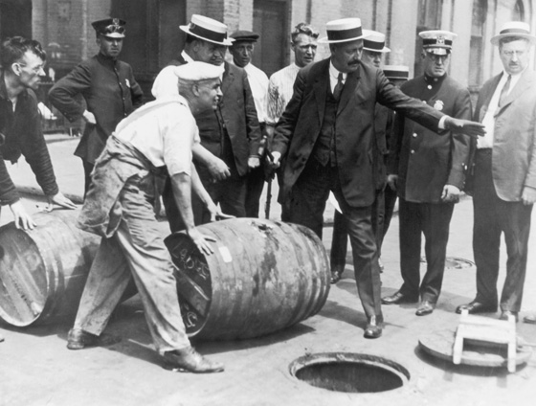

Slide 15
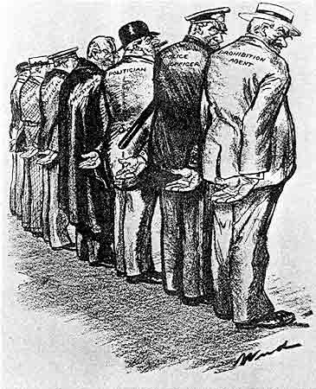
The National Gesture,
1926

Slide 16
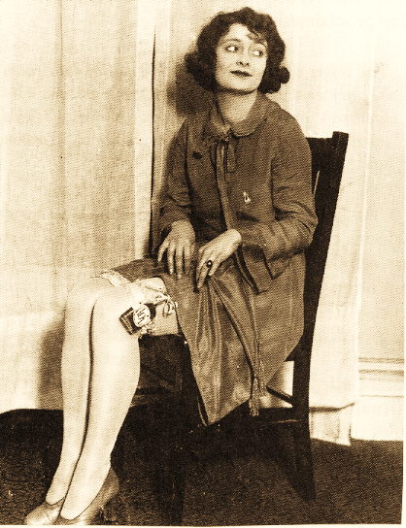
“…right up here is where I store the juice….”
-Chicago

Slide 17
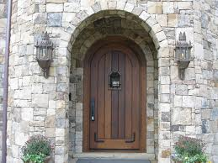

Slide 18
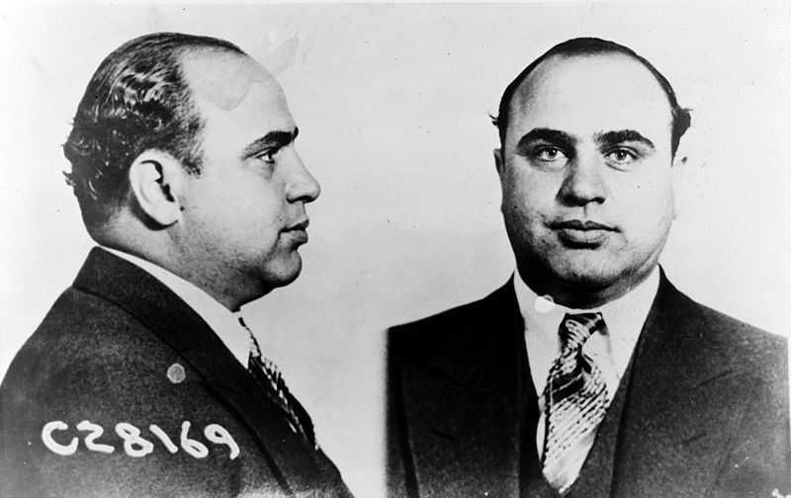

Slide 19
Was Prohibition effective?
Impact of Prohibition in Philadelphia, 1919-1925
Year | Intoxication | Intoxication/Disorderly Conduct | Habitual Drunkards | Total for Year
1919 | 16,819 | 6,794 | 127 | 23,740
1920 | 14,313 | 6,097 | 33 | 20, 443
1921 | 21,850 | 5,232 | 33 | 27,609*
1922 | 36,299 | 7,925 | 50 | 44,746*
1923 | 45,226 | 8,076 | 177 | 54,124*
1924 | 47,805 | 6,404 | 874 | 55,766*
1925 | 51,361 | 5,522 | 814 | 58,517*
*After 1921, includes records of number of intoxicated drivers.

Slide 20
All That Jazz
Jazz originates in West African music
Soundtrack of the 1920s: fast, fun, and forbidden
Jazz goes “White”
George Gershwin’s Rhapsody in Blue – “classical” piano piece but infused with jazz

Slide 21
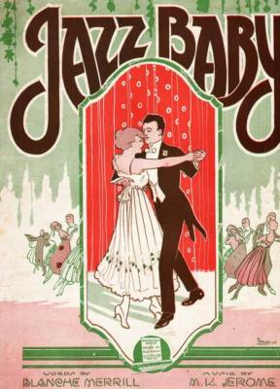
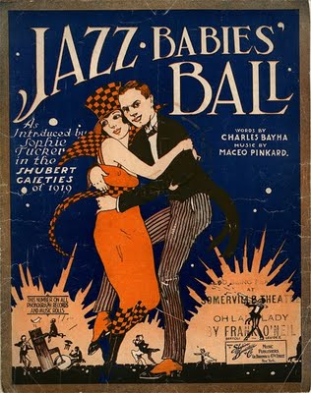

Slide 22
