Slide 1
United States History
The New Deal: RELIEF
Dr. King-Owen

Slide 2
Direct Relief
The New Deal represents the FIRST TIME in American history that the federal government gave direct relief to individuals
Direct relief = welfare
New Deal paid people to work—Americans wanted to earn their $$$

Slide 3
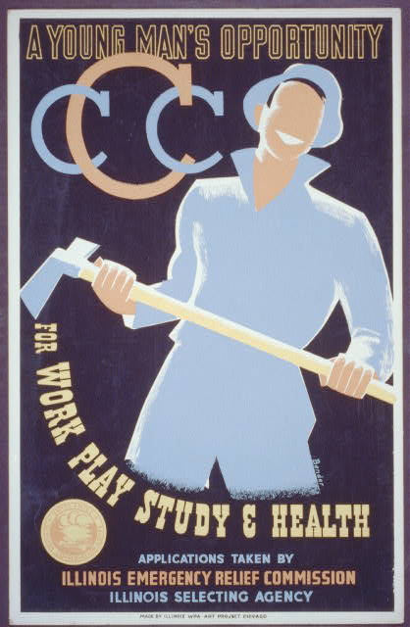
Civilian Conservation Corps, 1933
Helped men, 18-25
$30 a month in pay; $25 was sent back home to family
Men planted trees, built roads, developed state parks
Lasted until 1942
Served 3 million men

Slide 4
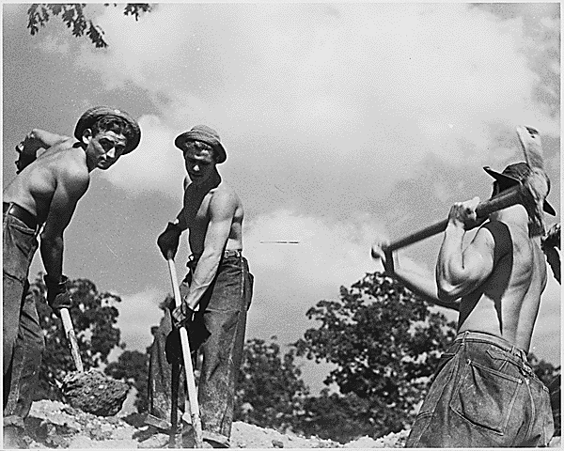

Slide 5
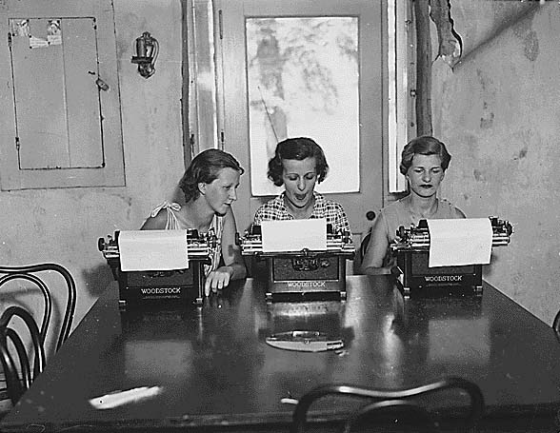
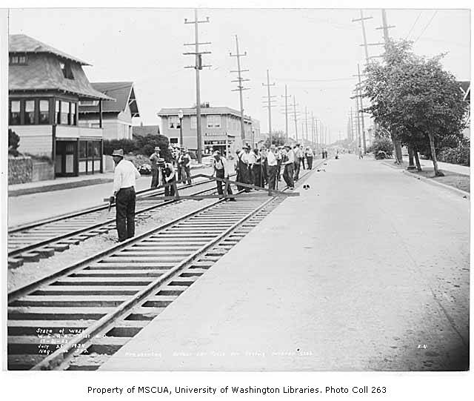
Federal Emergency Relief Administration, 1932
Created under Pres. Hoover
Gave states $3.1 billion to build roads, public buildings
Employed women (parks, museums)
Ended in 1935

Slide 6
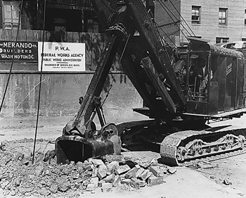
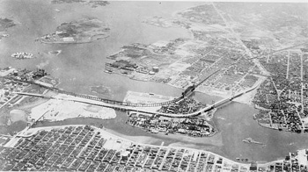
Public Works Administration, 1933
Gave $6 billion to states
Men built schools, bridges, hospitals
Ended in 1943

Slide 7
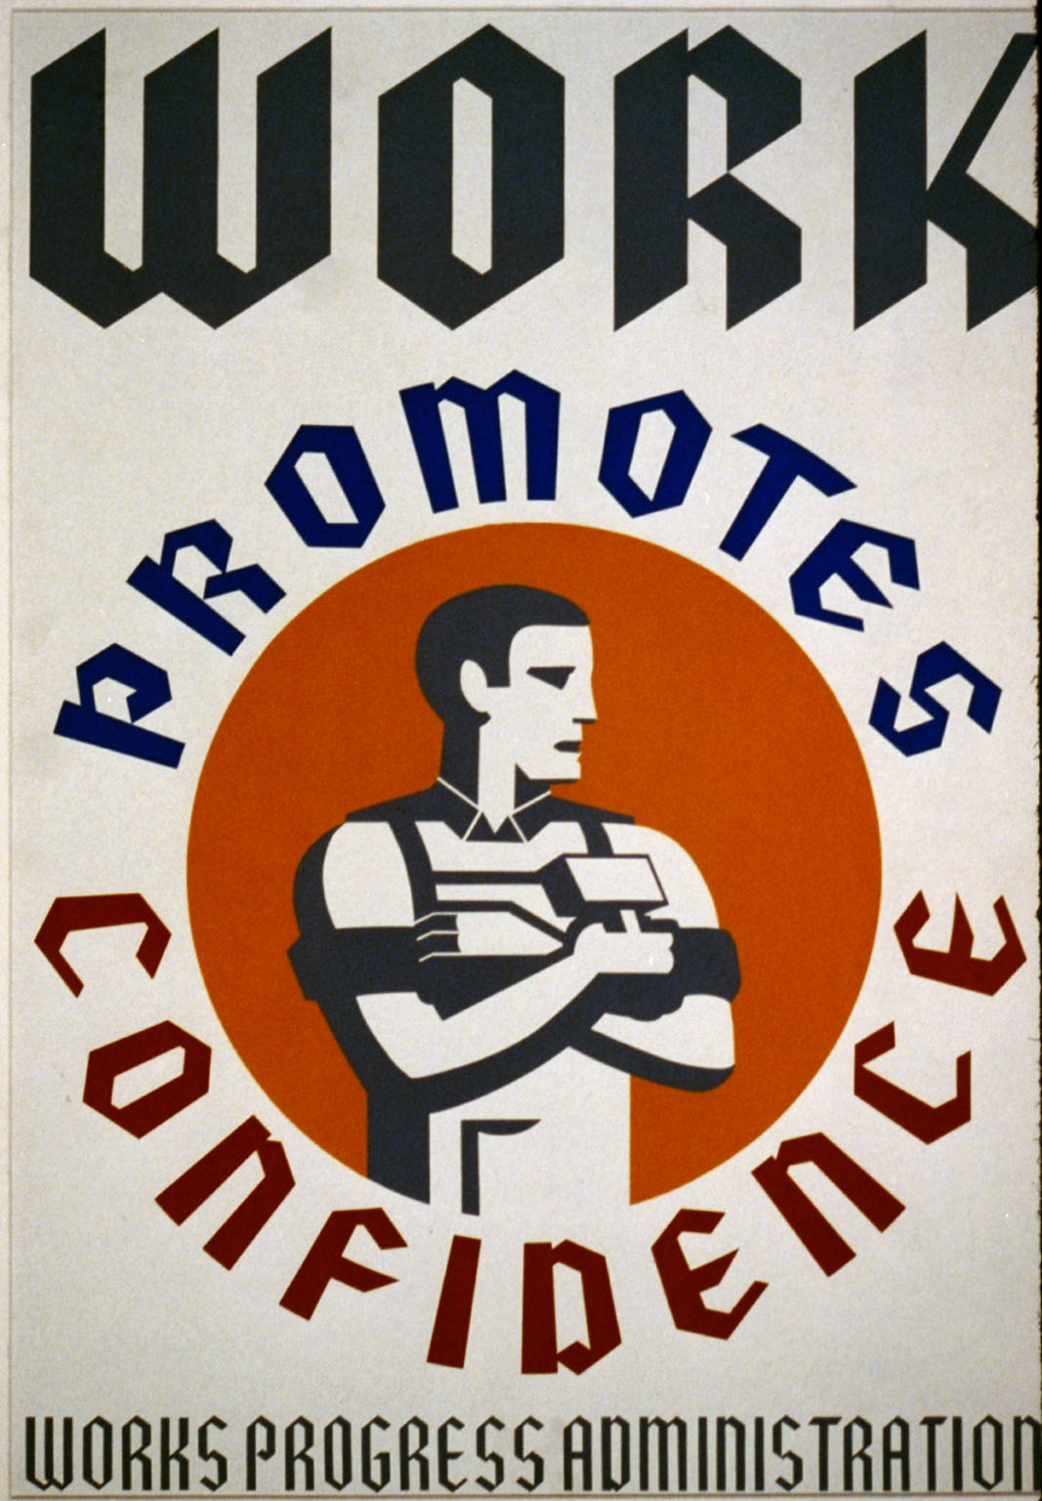
Works Progress Administration, 1935
Largest of the New Deal relief programs
Spent $13.4 billion
Provided jobs in construction, employed artists, historians, writers
Employed women
Ended in 1943

Slide 8
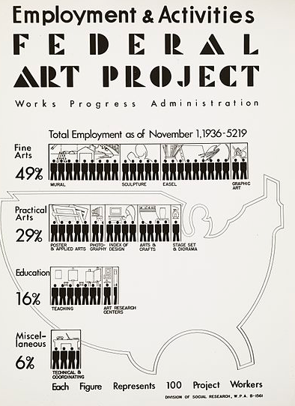
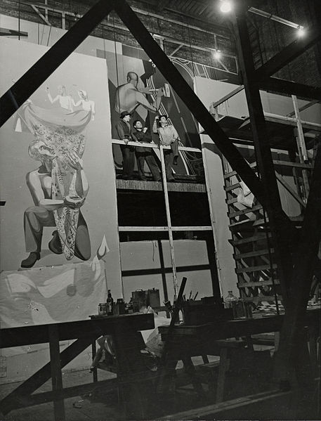

Slide 9
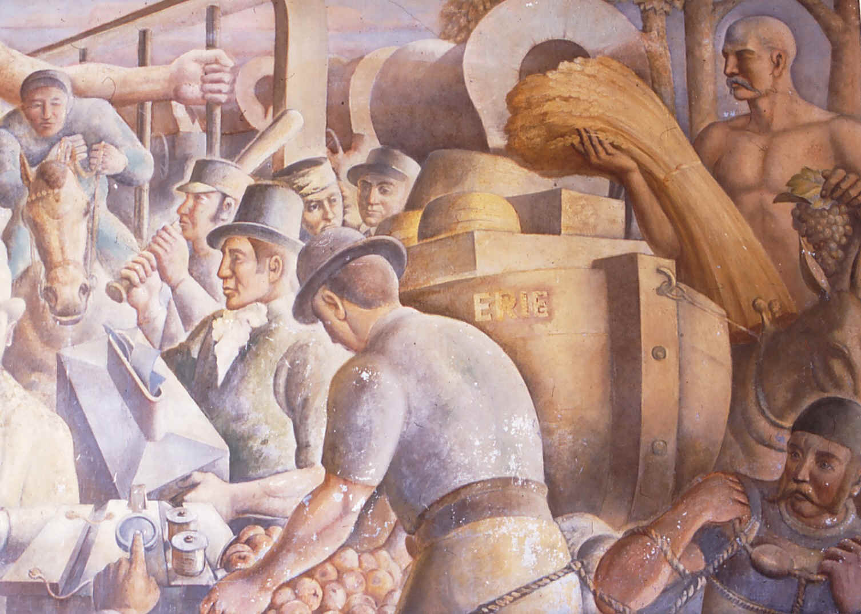

Slide 10
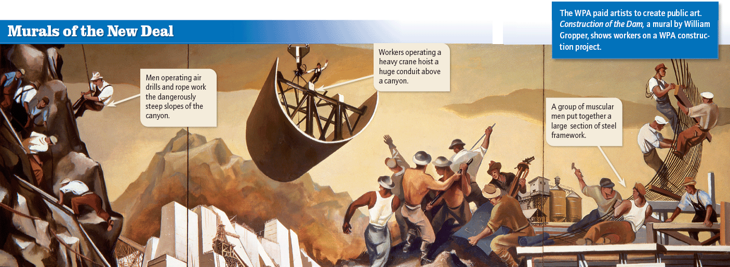

Slide 11
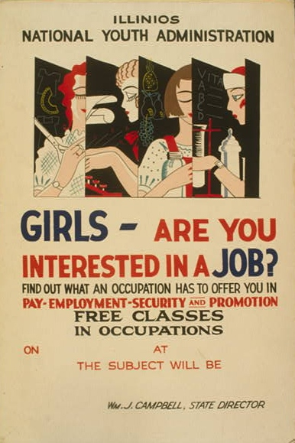
National Youth Administration, 1935
Paid high school and college youth from $6 to $40 for “work study” and job training
Ended in 1943

Slide 12
