Slide 1
Depression Photo Analysis
United States History
Dr. King-Owen

Slide 2
Directions
Scroll through the photographs in this powerpoint until you find one that captures your attention.
Copy the photo to a word document.
Write a one page, DOUBLE-spaced analysis of the photo. (the space the photo takes up does not count in your one page)-appx. 300 words
12 point Times New Roman font MUST be used.
Alternate Choice: Write ½ page on 2 photos.

Slide 3
Questions to Answer
Why did this photograph capture your attention?
What mood do you think the photographer was trying to capture? How do you know?
What story does the photograph tell? How does the placement of people, objects, and the background tell that story?
Would this photograph encourage you to support government programs to help the people in the photo? Why or why not?
Does the photograph appear staged? Are people placed in a certain way to influence your emotions?

Slide 4
Images of the Dust bowl storms

Slide 5
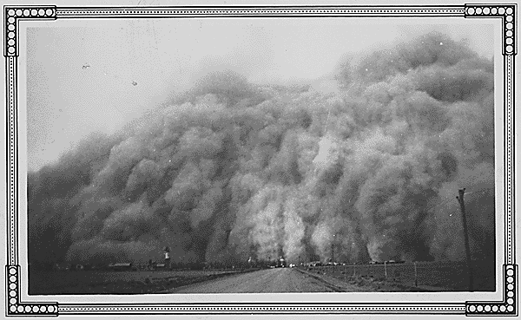
Dust Storms: "Kodak view of a dust storm Baca Co., Colorado, Easter Sunday 1935"; Photo by N.R. Stone (Circa April 1935)

Slide 6
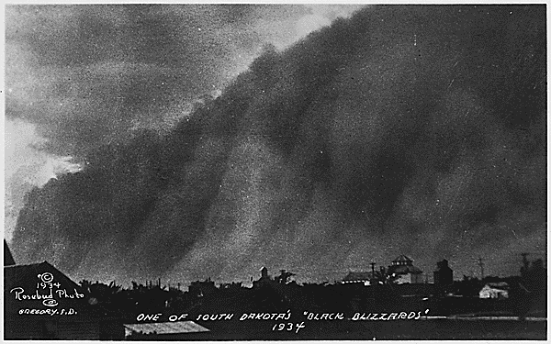
Dust Storms; "One of South Dakota's Black Blizzards, 1934"

Slide 7
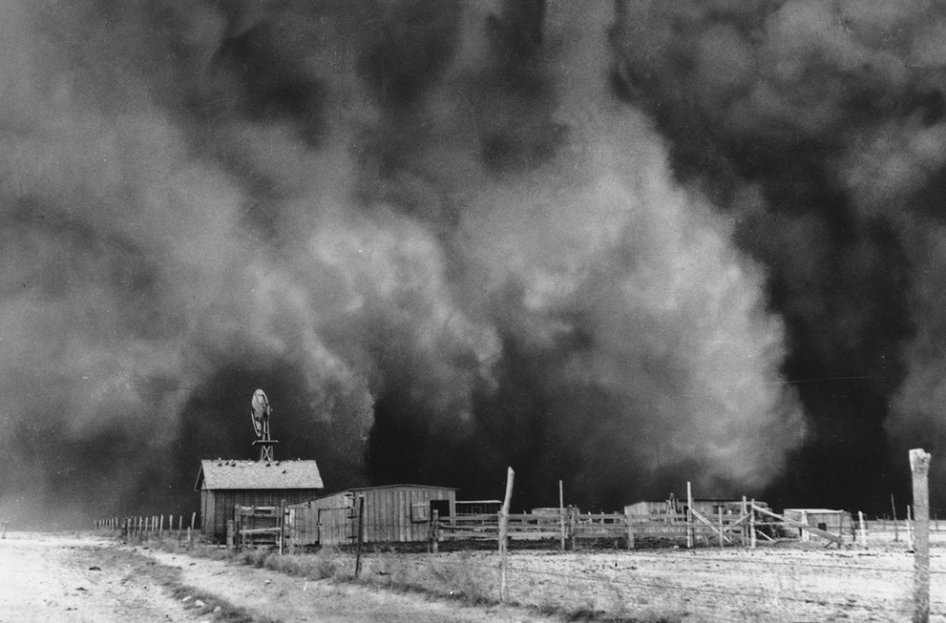
Boise City, Oklahoma. This photo was taken on April 15, 1935.

Slide 8
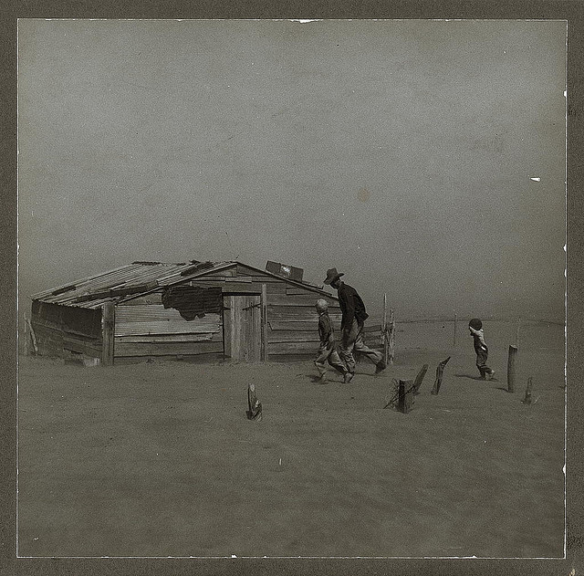
Farmer and sons walking in the face of a dust storm. Cimarron County, Oklahoma (LOC)
Rothstein, Arthur, 1915-1985, photographer.
Farmer and sons walking in the face of a dust storm. Cimarron County, Oklahoma
1936 Apr.

Slide 9
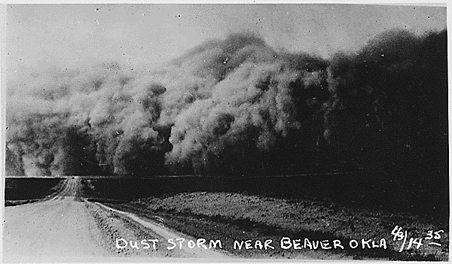
Dust Storms: "Dust Storm Near Beaver, Oklahoma." (July 14, 1935)

Slide 10
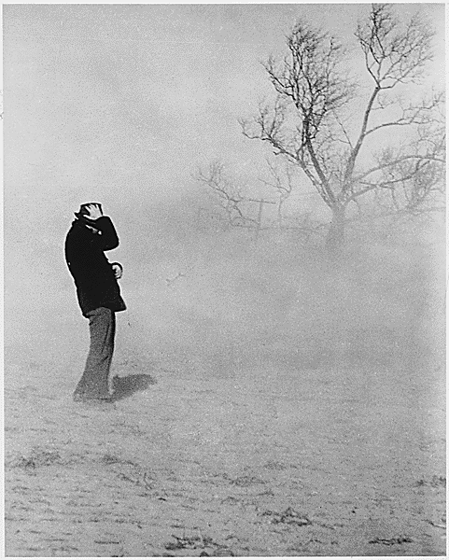
Dust Storms: In 1934 and 1936 drought and dust storms ravaged the great American plains and added to the New Deal's relief burden.

Slide 11
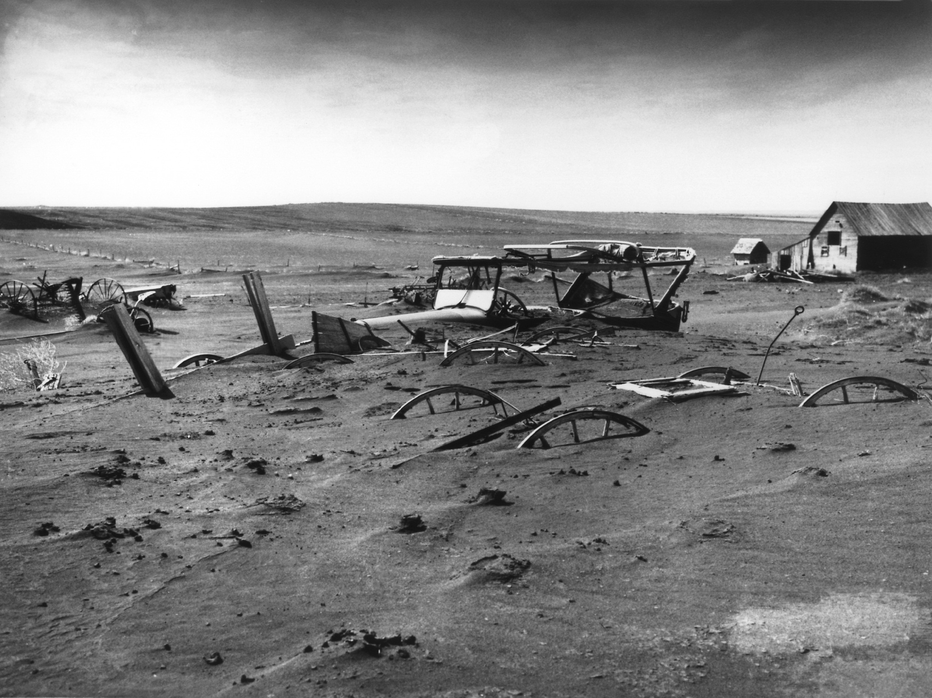
Buried machinery in a barn lot; South Dakota, May 1936.

Slide 12
Farm foreclosures

Slide 13
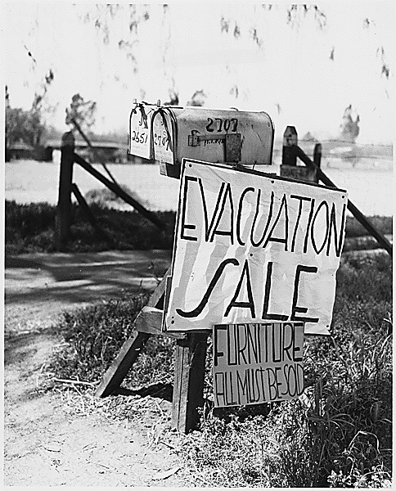
Farm foreclosure sale. (Circa 1933)

Slide 14
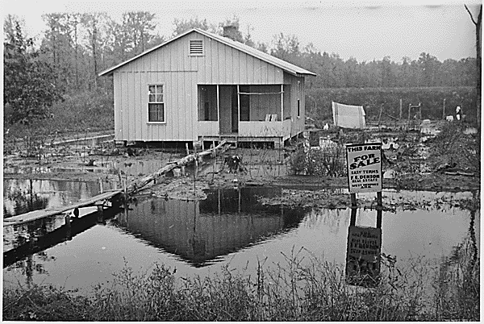
Farm foreclosure sale. (Circa 1933)

Slide 15
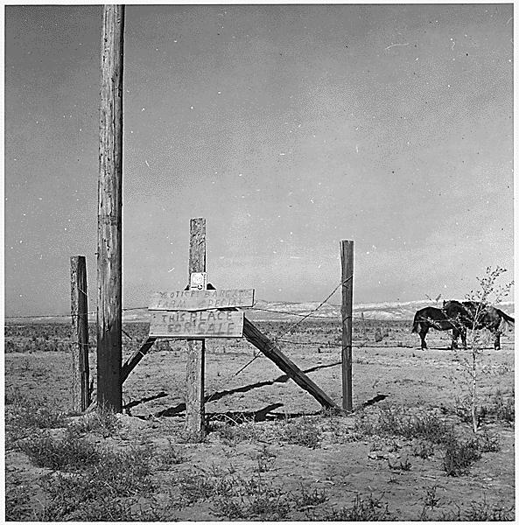
Farm foreclosure sale. (Circa 1933)

Slide 16
The Unemployed and hungry

Slide 17
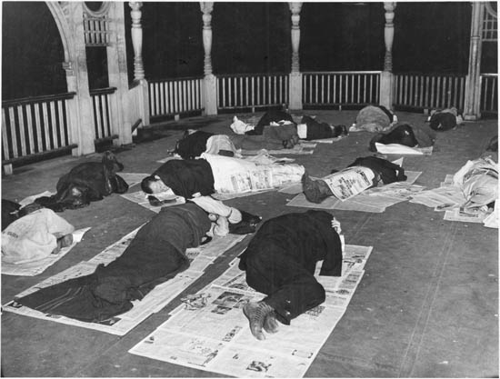
Homeless people sleep outdoors on newspapers, 1930s.

Slide 18
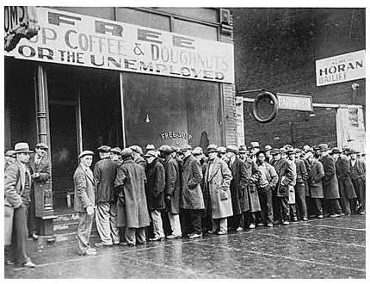
Unemployed men queued outside a depression soup kitchen opened in Chicago by Al Capone, 1931.

Slide 19
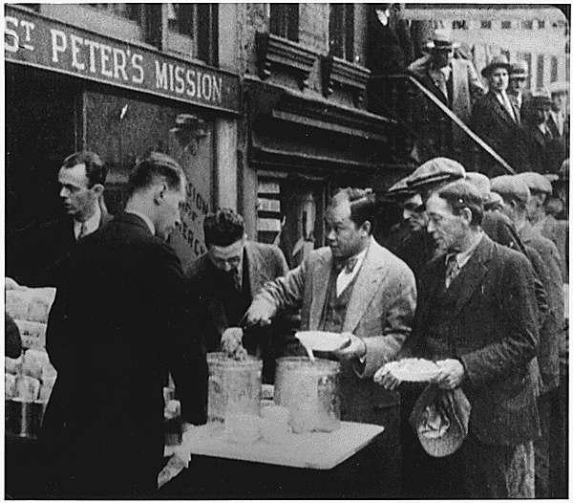
Depression: Breadlines: long line of people waiting to be fed: New York City: in the absence of substantial government relief programs during 1932, free food was distributed with private funds in some urban centers to large numbers of the unemployed.

Slide 20
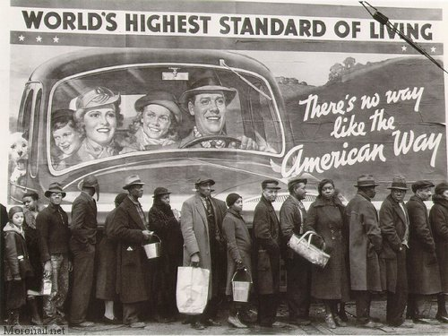
People waiting outside in a bread line (1936).

Slide 21
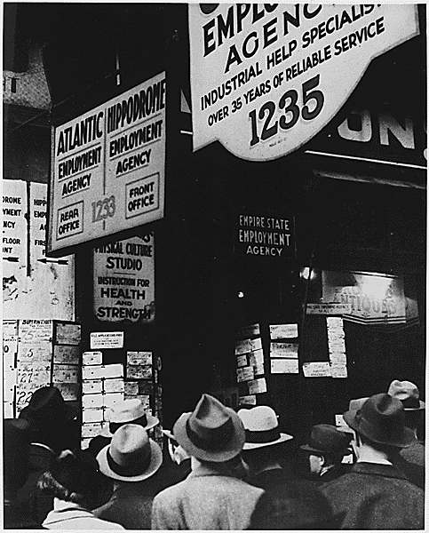
Depression:Unemployed: Typical picture capturing the number of people who were unemployed and looking for a job. (Circa 1935)

Slide 22
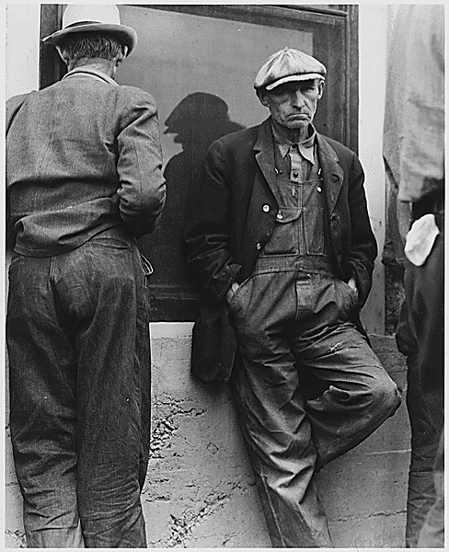
Farm Security Administration: Everywhere the unemployed stood in the streets, unable to find jobs and wondering how they could feed their families. (Circa 1935)

Slide 23
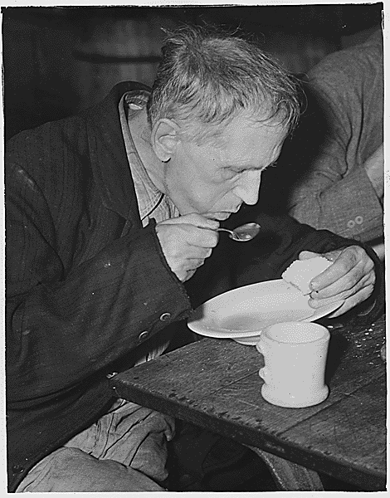
Farm Security Administration - Works Progress Administration: Unemployed men eating in Volunteers of America Soup Kitchen in Washington, D.C. (Circa June 1936)

Slide 24
Children

Slide 25
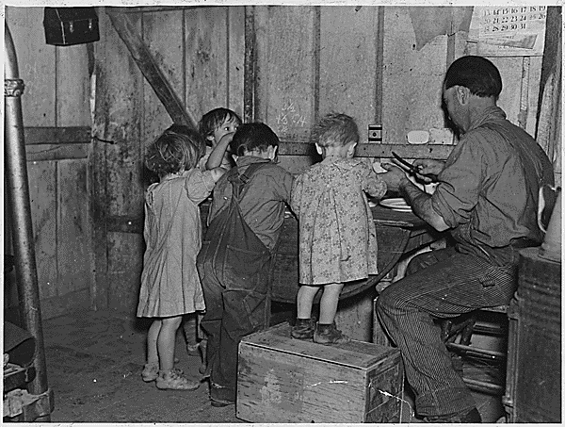
Farm Security Administration: Christmas dinner in the home of Earl Pauley near Smithland, Iowa. (Circa 1935)

Slide 26
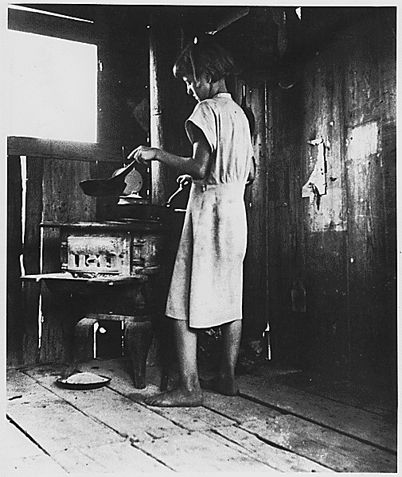
Farm Security Administration: "Suppertime" for the westward migration. (Circa 1936)

Slide 27
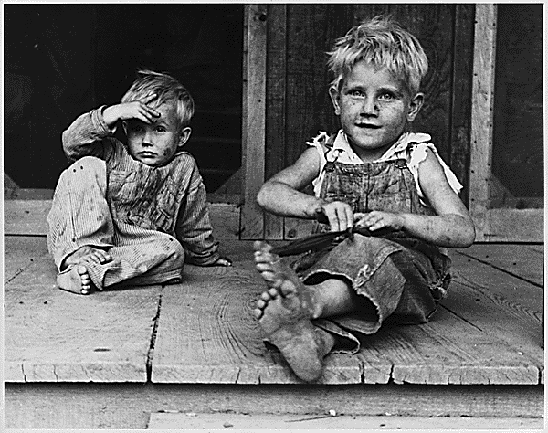
Children of rehabilitation clinic in Arkansas. (Circa 1935)

Slide 28
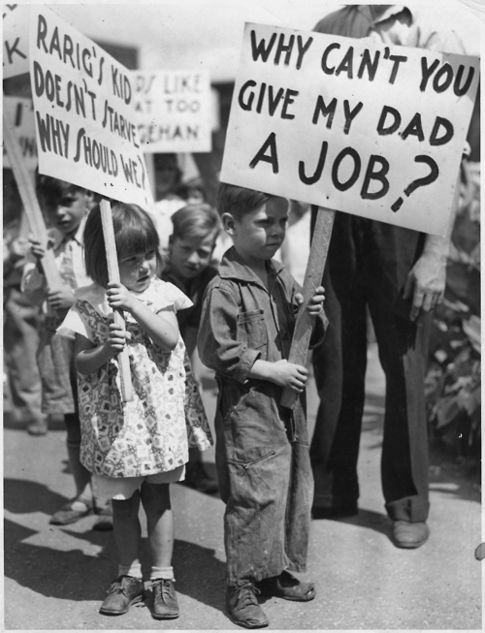
Children picketing in St. Paul, MN (1937)

Slide 29
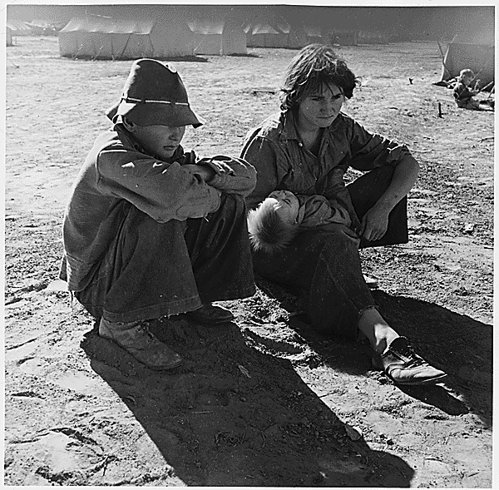
Young Oklahoma mother; age 18, penniless, stranded in Imperial Valley, California. (Circa March 1937)

Slide 30
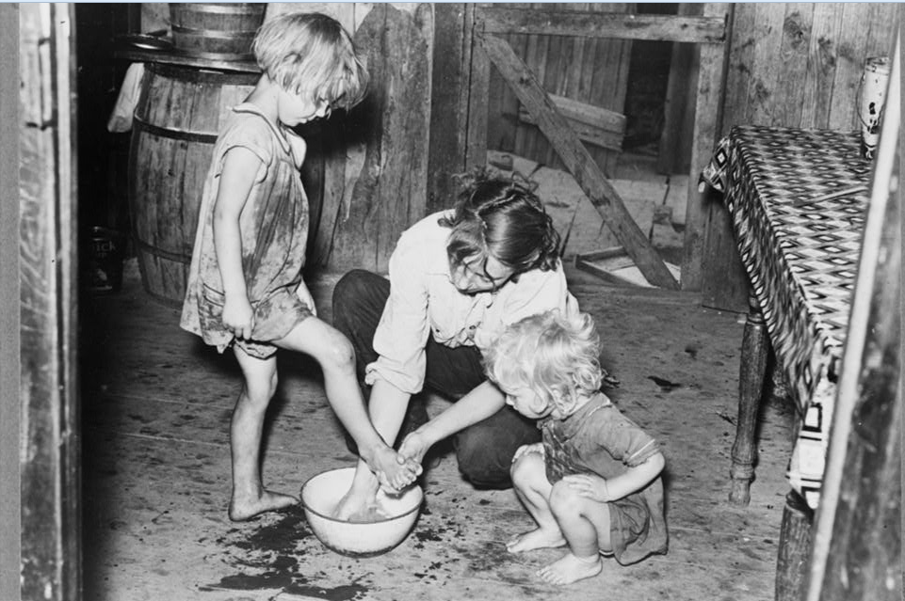
Mother washing children’s feet in a sharecropper’s shack in Missouri (1938)

Slide 31
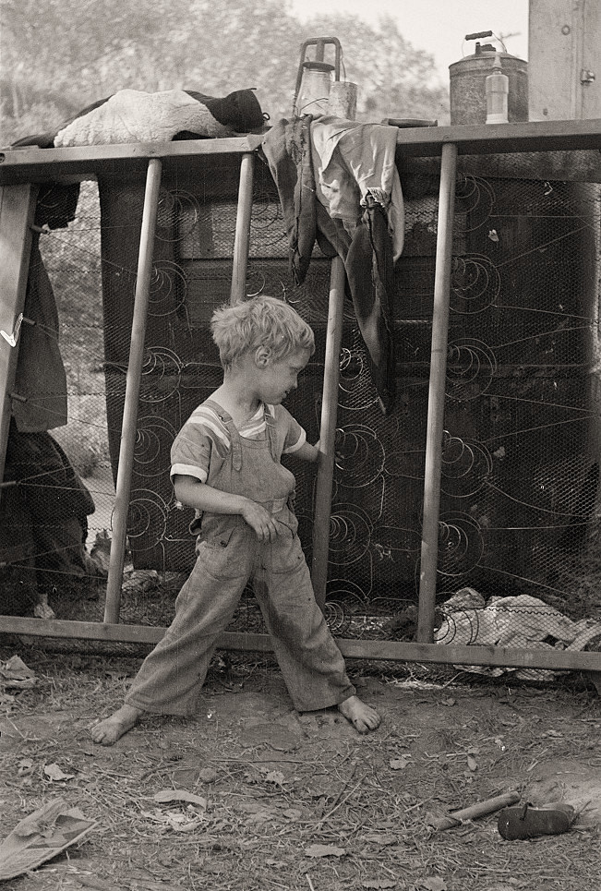
Unhealthy Lifestyle: Son of destitute migrant, American River camp, near Sacramento, California. The boy has dysentery.

Slide 32
Housing

Slide 33
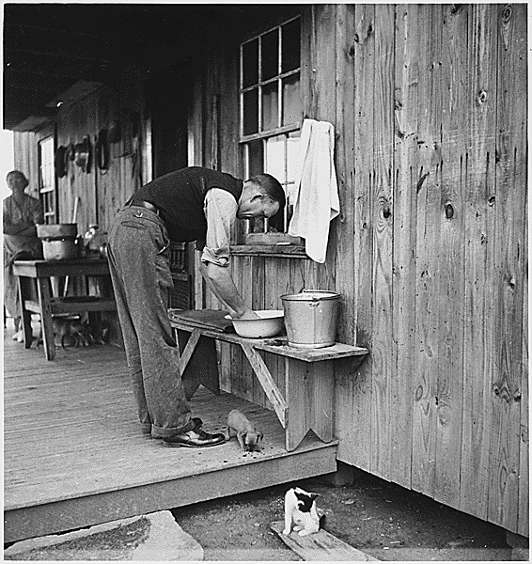
REA; "Man washing hands in bowl, woman in background"

Slide 34
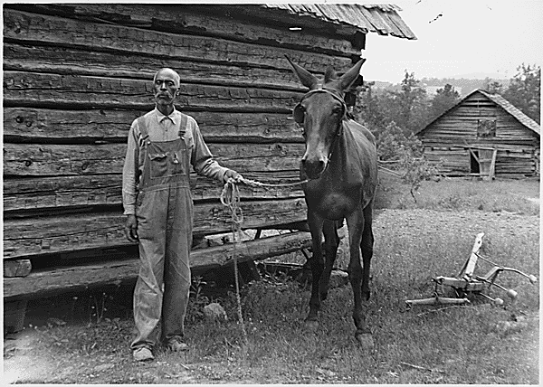
Resettlement Administration; Rural Rehabilitation; "Alvin Sharpe"; Iredell Co., N.C.

Slide 35
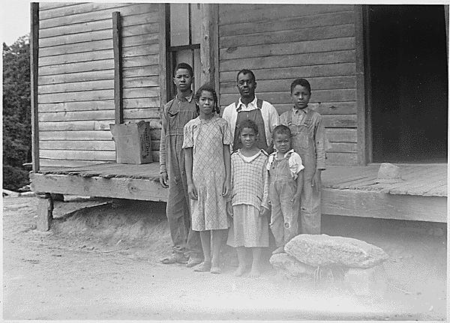
Resettlement Administration; Rural Rehabilitation; "Dave Mayberry"; Iredell Co., N.C. (Circa November 1933)

Slide 36
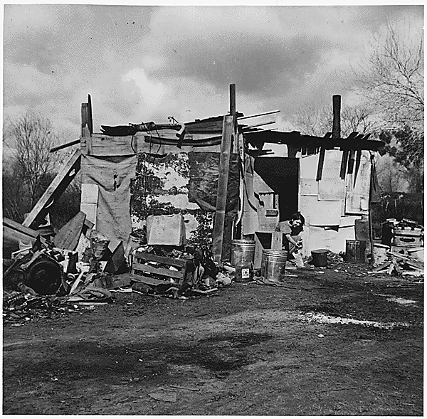
Farm Security Administration: Arkansas squatter for three years in California near Bakersfield, California. Photo by D. Lange. (Circa 1935)

Slide 37
Hitting the road

Slide 38
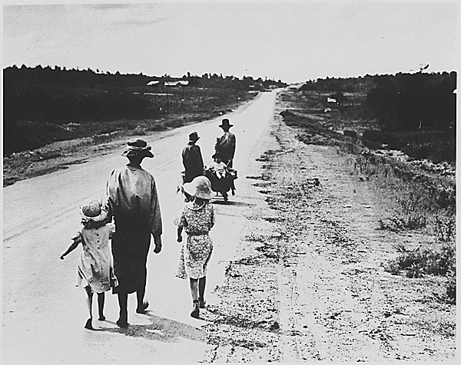
Farm Security Administration: Homeless family, tenant farmers in 1936.

Slide 39
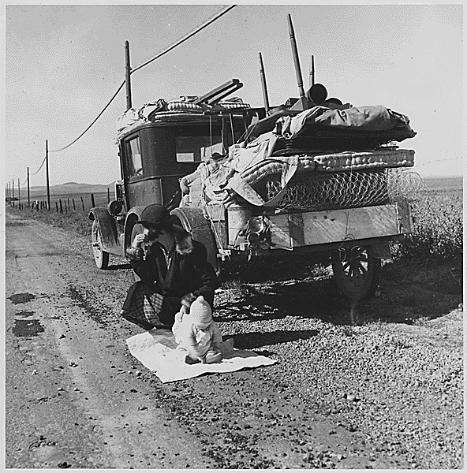
Farm Security Administration: farmers whose topsoil blew away joined the sod caravans of "Okies" on Route 66 to California. (Circa 1935)

Slide 40
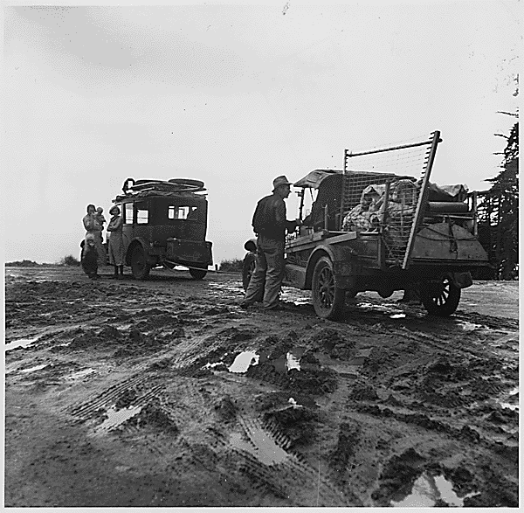
Farm Security Administration: Families on the road with all their possessions packed into their trucks, migrating and looking for work. (Circa 1935)

Slide 41
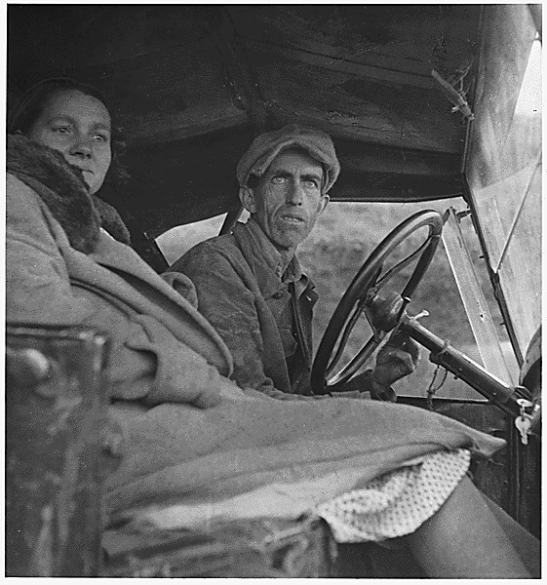
Farm Security Administration: migrants. (Circa 1935)

Slide 42
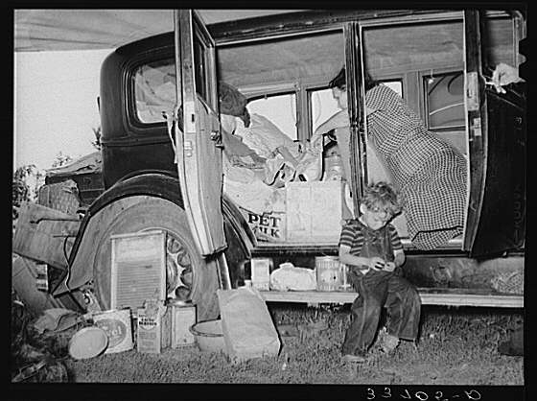
Migrant Family, Muskogee, OK by Dorothea Lange

Slide 43
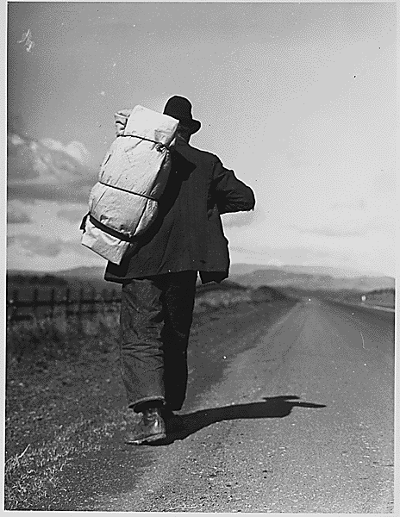
Farm Security Administration: Migrant worker on California highway. (Circa 1935)

Slide 44
Work camps

Slide 45
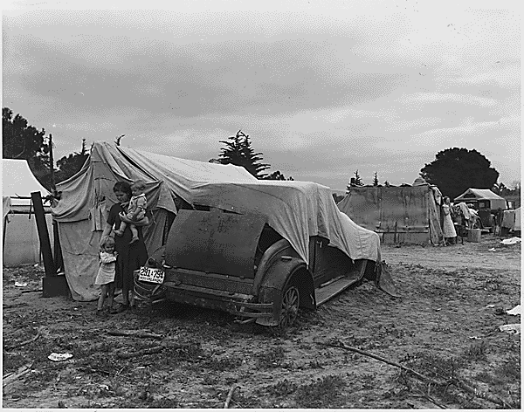
Migrant family looking for work in the pea fields of California. (Circa 1935)

Slide 46
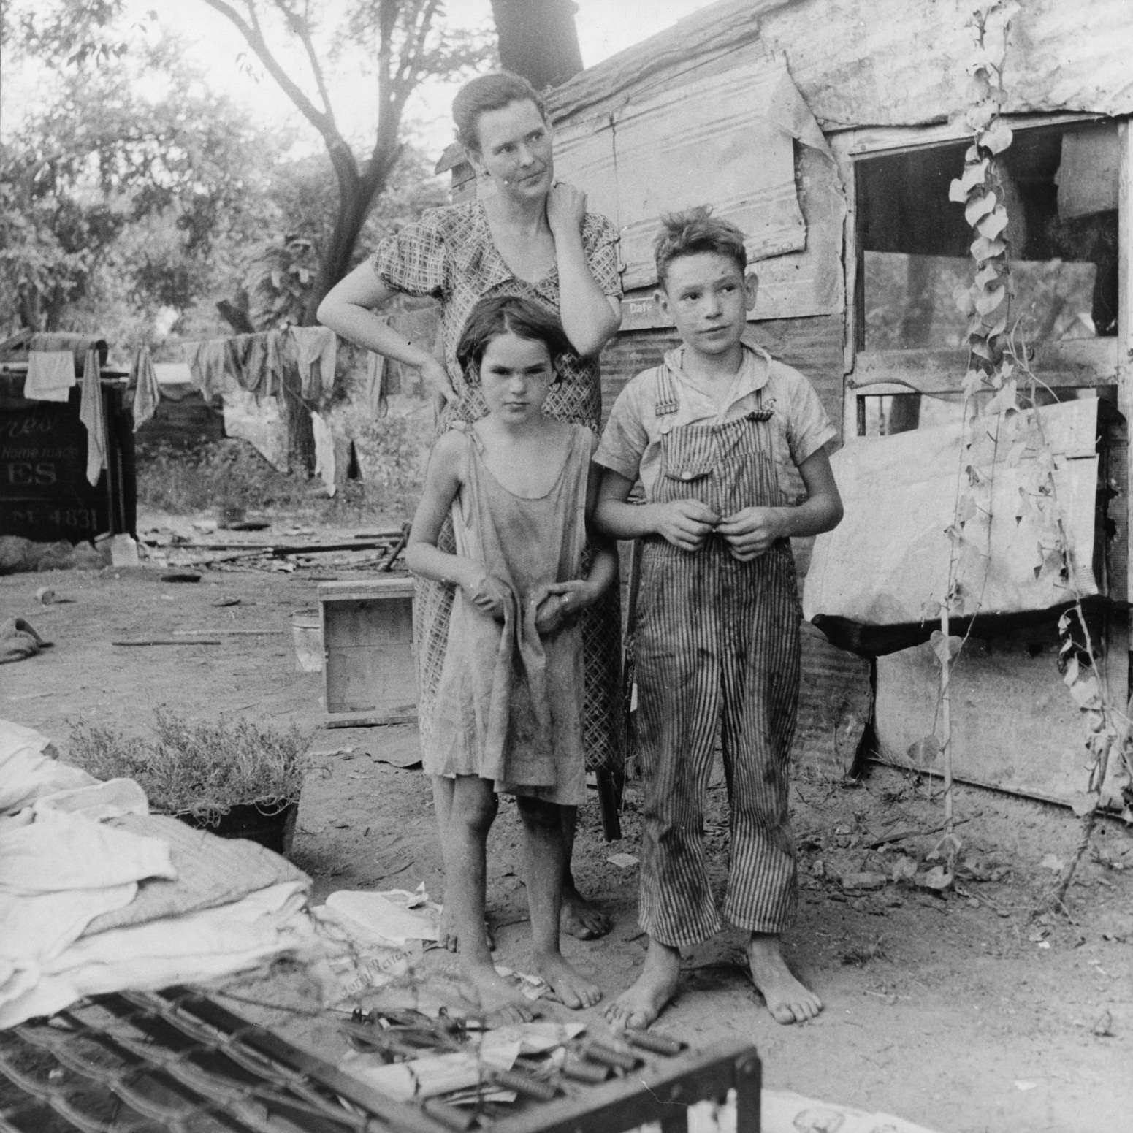
Family during the Great Depression, California, 1936.

Slide 47
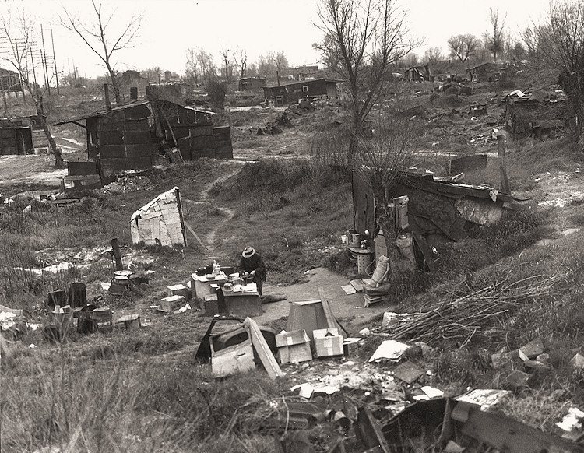
Unhealthy Lifestyle: Migrant workers' camp, outskirts of Marysville, California. The new migratory camps now being built by the Resettlement Administration will remove people from unsatisfactory living conditions such as these and substitute at least the minimum of comfort and sanitation.

Slide 48
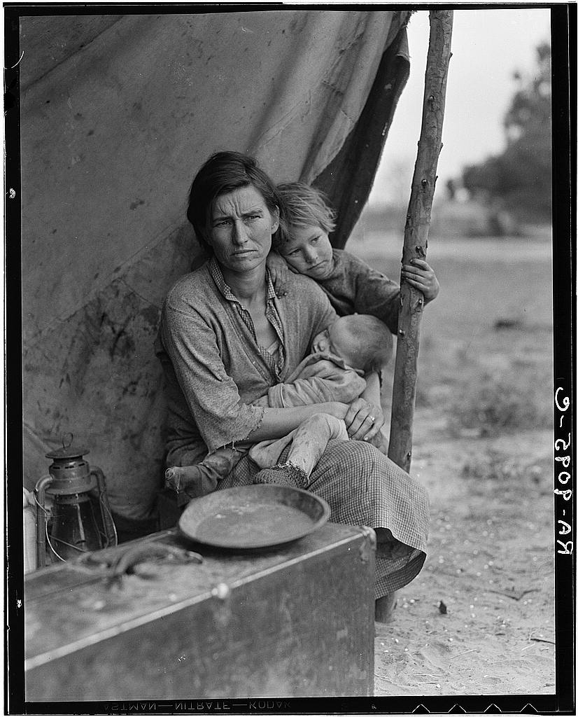
Dorothea Lange, “Migrant Mother,” 1936

Slide 49
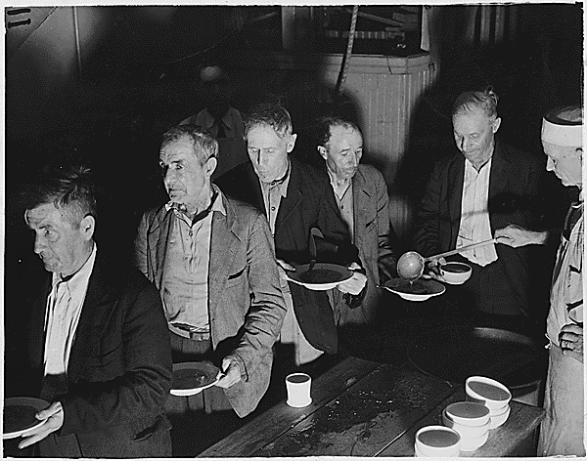
WPA: unemployed shown at Volunteers of America Soup Kitchen: Washington, D.C. (Circa 1936)

Slide 50
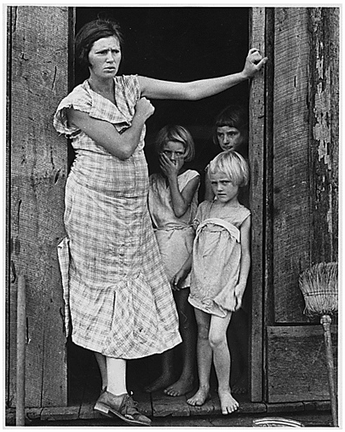
Wife and children of a sharecropper, 1930s.

