Slide 1
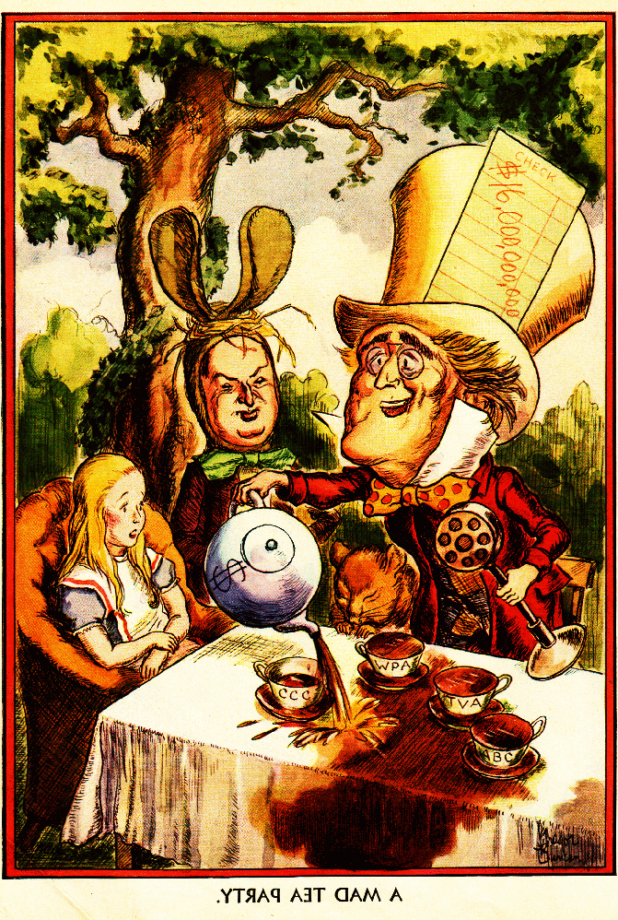
United States History
Critics of the New Deal
Dr. King-Owen

Slide 2
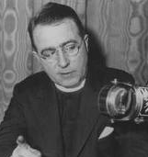
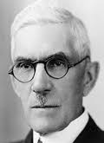
Critics from the Left (Liberals)
The New Deal is NOT doing enough for the poor:
Charles Coughlin
The federal government must take over banks and give everyone a yearly income
Dr. Francis Townsend
There must be more help for the elderly
Huey Long
We must join “Share-Our-Wealth” Clubs to make sure no child is born in poverty

Slide 3
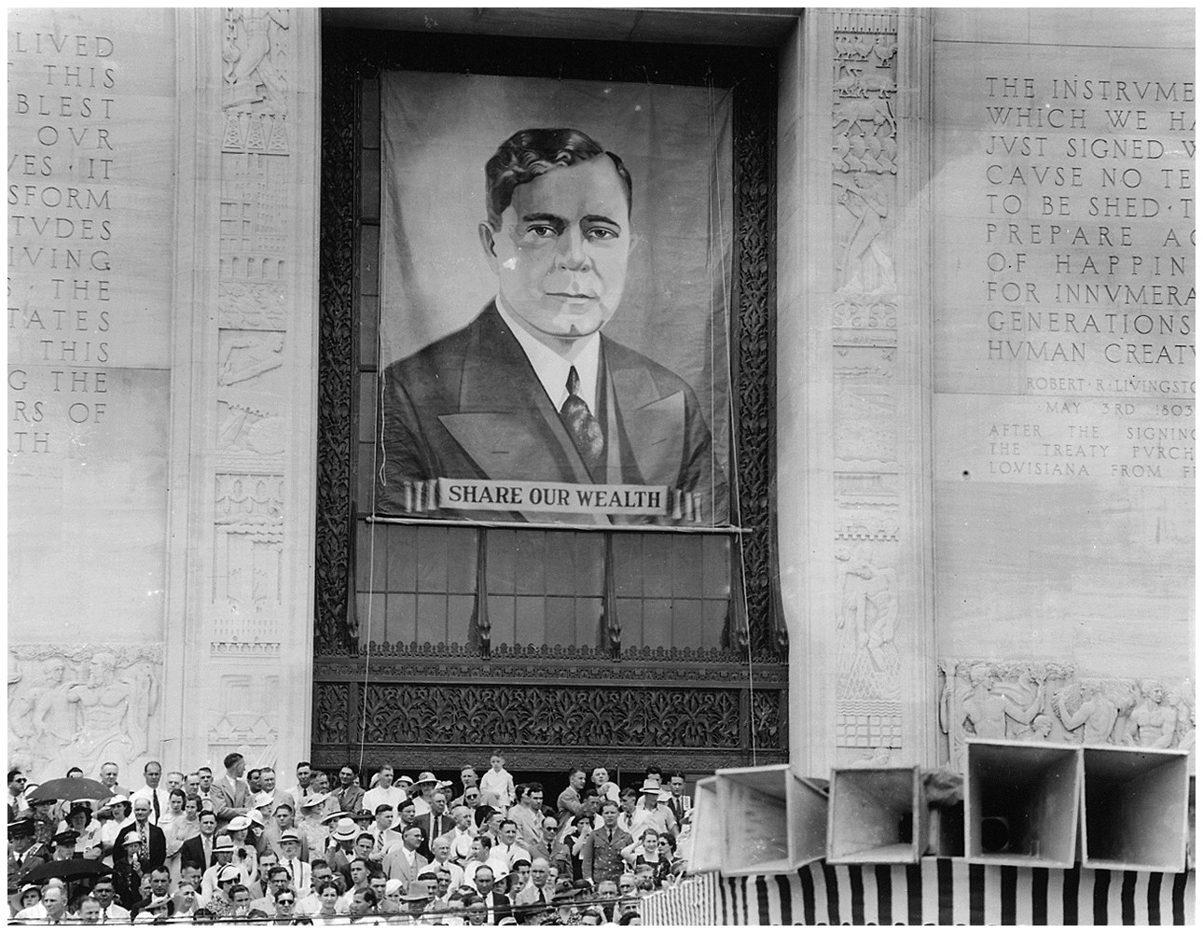

Slide 4
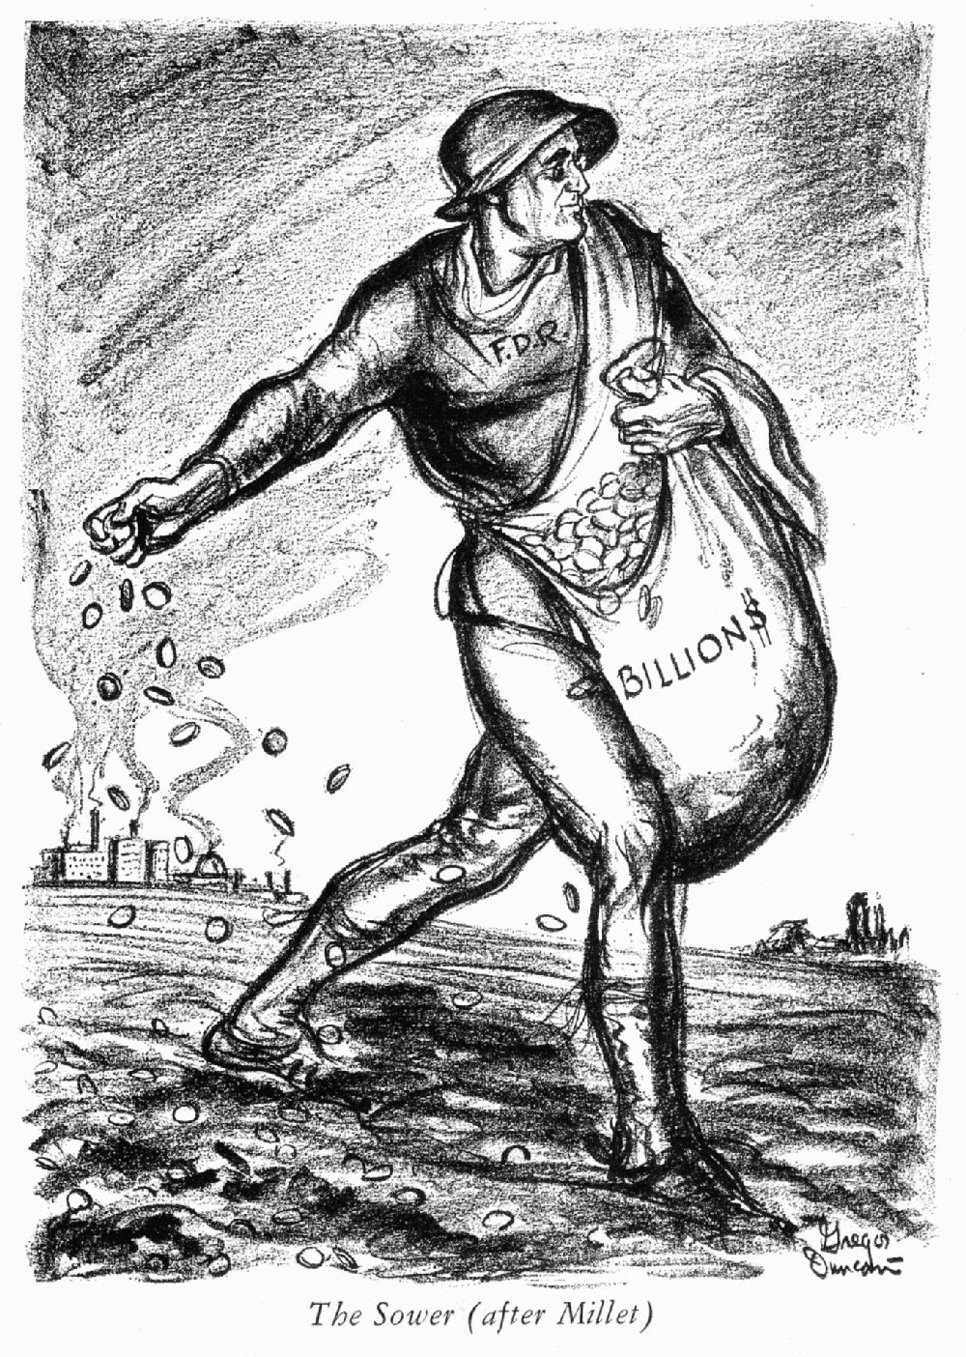
Critics from the Right (Conservatives)
The New Deal:
Took away individual freedom
Would make FDR a tyrant
Violated private property
Encouraged communism/socialism
Encouraged deficit spending – spending more $$$ than the government has (going into debt)

Slide 5
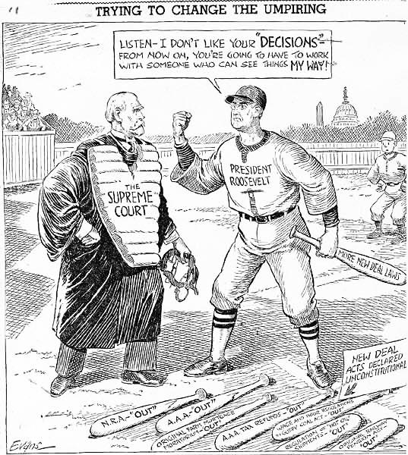
The Court Packing Plan, 1937
The Supreme Court blocked the New Deal in 9 out of 12 cases from 1933 to 1937
FDR blamed the Court for being packed with “old men” who needed to retire
FDR asked Congress to reorganize the Court to allow him to appoint 6 new justices
FDR’s “Court-Packing Bill” was rejected as a violation of separation of powers

Slide 6
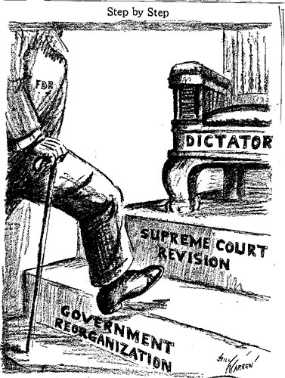
The New Deal’s Long-Term Impact
The President is responsible for fixing the economy
The federal government would become a welfare state
African-Americans join the Democratic Party as Democrats become liberal

