Slide 1
British Acts Timeline
Long-Term Causes
Immediate Causes
Causes that build over a long time.
Stamp Act, 1765
American Revolution, 1776
Causes that are closer in time to the event they cause.
Common Sense, 1776
American Revolution, 1776
11 years

Slide 2
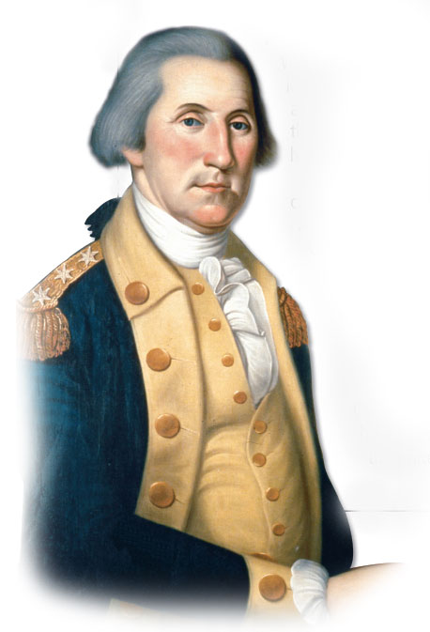
UNITED STATES HISTORY
An (Un)Civil War
Dr. King-Owen

Slide 3
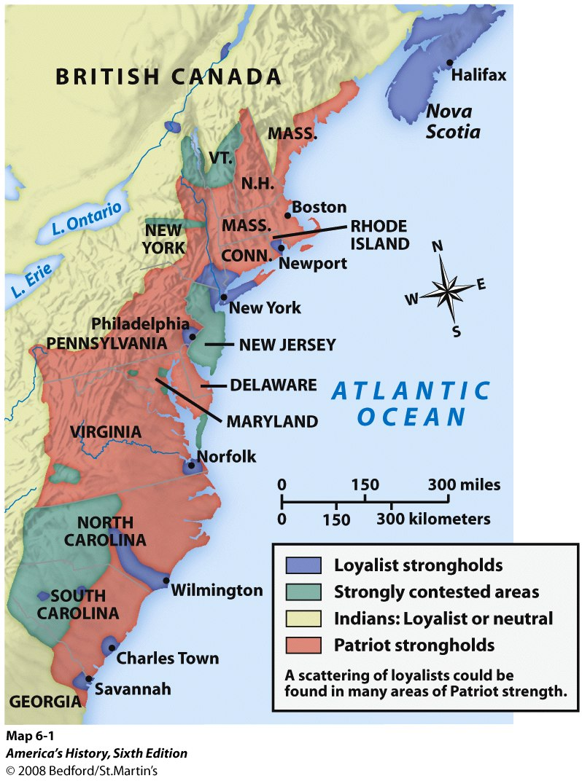
[2.02] Loyalists
American Revolution was a civil war
1/5 of the Americans were loyal to England
Called “Tories” (supporters of the King)
500,000 Loyalists helped the British
They were: Indians, Anglicans, Slaves, Wealthy

Slide 4
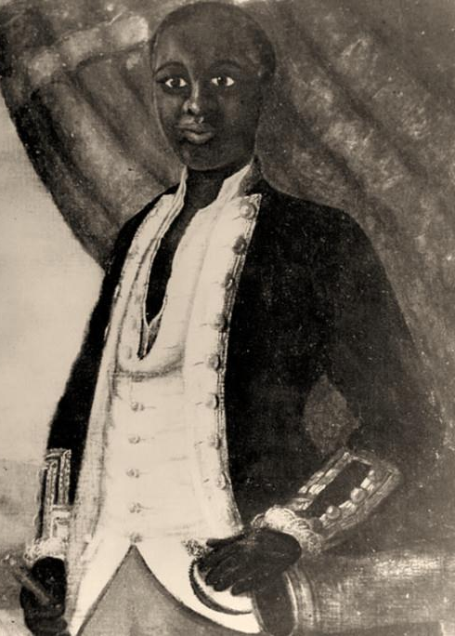
[2.02] Black Soldiers
African-Americans could choose sides
Some fought for the British (about 4000)
5000 fought for America
100,000 slaves just ran away

Slide 5
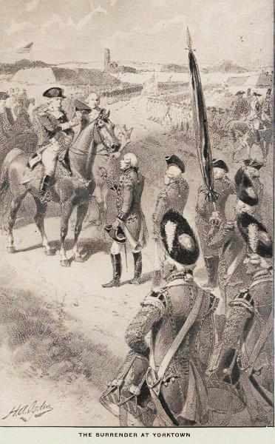
[2.02] Turning Points
Saratoga, 1777
Americans win; French promise to give $$ and troops to help America
Yorktown, 1781
Americans and French trap the British army; British surrender – America wins the war!

Slide 6
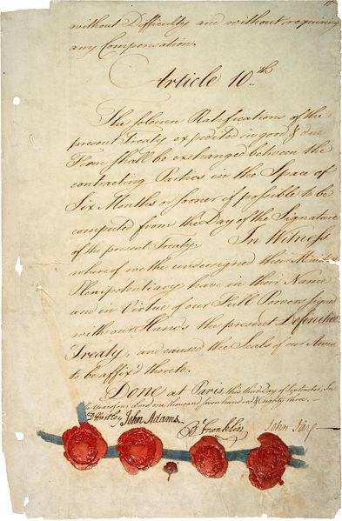
[2.02] Victory
Treaty of Paris, 1783 – America gets all land to the Mississippi River
Cost of the war: $101 million ($2.4 trillion today)
217,000 American deaths

Slide 7
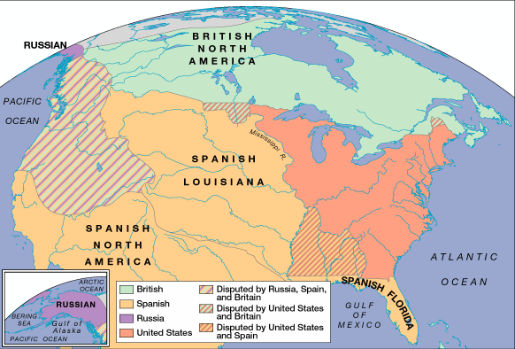
War united them, but, now with freedom, would they stay united?

