Slide 1
Reading, p. 4-5 “Native Americans”
On your post-it note, please write:
1. How hard was the reading? (write one of the following):
Easy
Just right
Difficult
2. ONE fact you learned about Native Americans from your reading.
Put the post-it on the blue paper at the front of the room (next to the smartboard)

Slide 2
United States History
The Invasion of America
[1.01]
Dr. King-Owen

Slide 3
Taking Notes in DKO-Land
How to take notes in this class:
Abbreviate common terms/use symbols
Gov’t = government, → = caused
Summarize what is on the slide – COPYING EXACTLY WHAT IS ON THE SLIDE IS NOT USEFUL
Listen to what I say to ADD to your notes:
First time: I explain the point
Second time: I explain it a different way
Third time: I compare it to something more familiar
Fourth time: I tell why its important, give additional information, or connect it to a big idea

Slide 4
Cornell Notes Format
Key Points
Terms
Questions
Regular class notes go here
Summary of the Whole Page

Slide 5
God, Gold, and Glory
1400s: Europeans begin exploring
Three Motives
God – spread religions (Catholicism especially)
Gold – riches through trade or taking resources
Glory – personal and national pride
1492: Christopher Columbus starts the Columbian Exchange
Movement of plants, animals, people, diseases, metals, and ideas between Old and New Worlds

Slide 6
Cornell Notes Format
[1.01]
Why did Europe explore?
Motives
Col. Exch.
1400s- Europeans start exploring; have 3 desires
God (spread religion)
Gold (get rich)
Glory (pride in self/country)
1492, Columbus starts Col. Exchange
Mov. of plants, animals, gold/silver, diseases, people, ideas- Old← →New World
It had + and - effects
Europeans, seeking God, gold, and glory started exploring in the 1400s and started the Columbian exchange between old and new worlds.

Slide 7
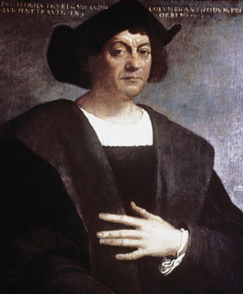
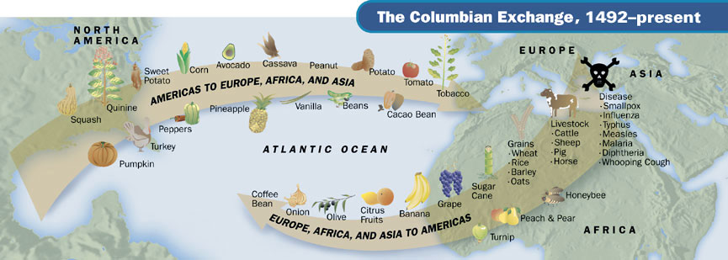

Slide 8
Consequences of Contact
Native Americans (American Indians) and Europe:
Death
80-90% of some Indian peoples were wiped out by European diseases (Indians were not immune)
Dispossession (Dis, “take away,” possession, “ownership”)
Indians lost land – stolen or purchased
Dependence
Indians became dependent on European goods – tools, guns, bullets, alcohol, clothing, paint

Slide 9
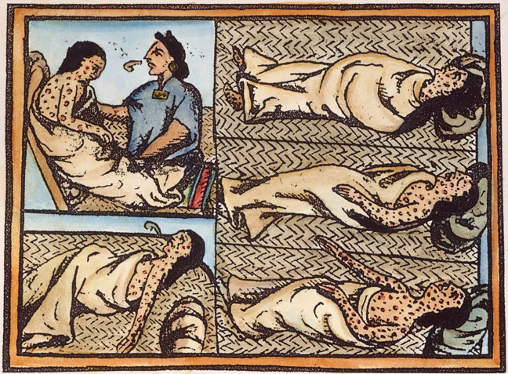

Slide 10
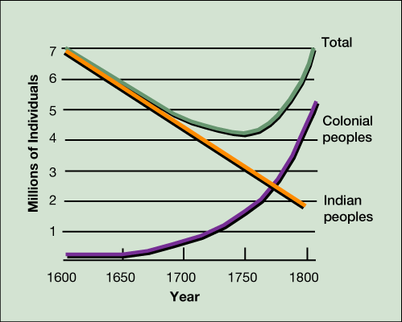

Slide 11
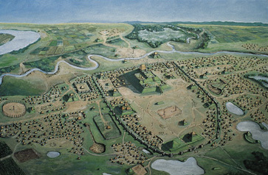

Slide 12
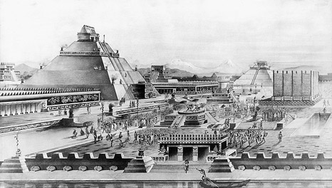

Slide 13
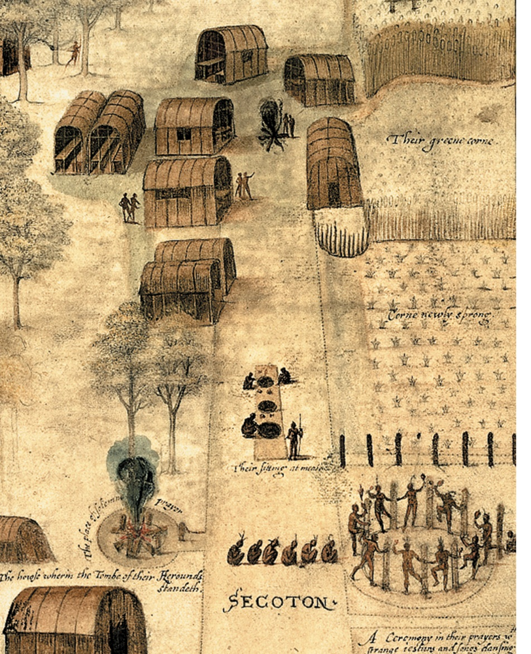
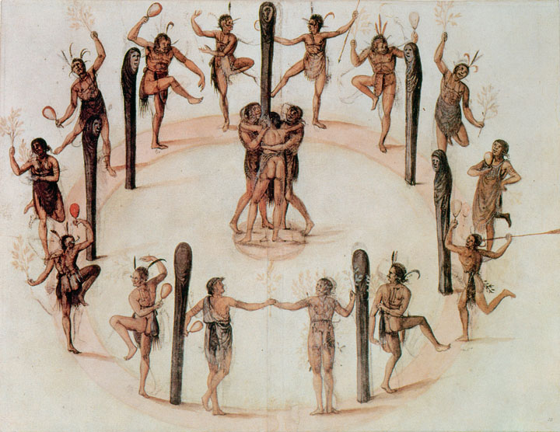

Slide 14
