Slide 1
I see, I think, I wonder
As we look at the next three images, write down one sentence for each.
One sentence must begin with I see (and describe what you see)
One sentence must begin with I think (and then tell us what you think about the image)
One sentence must begin with I wonder (and tell us what you are wondering about).

Slide 2
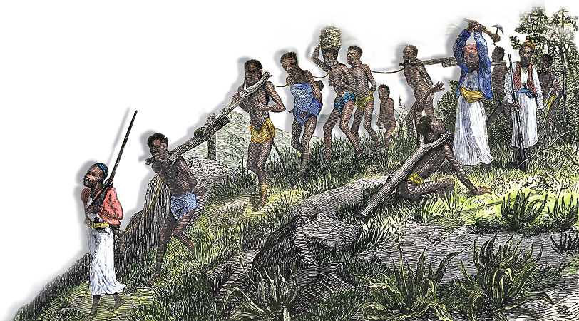

Slide 3
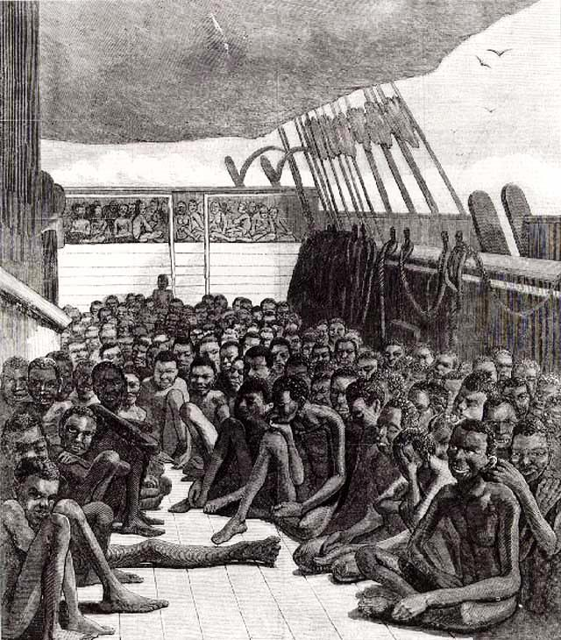

Slide 4
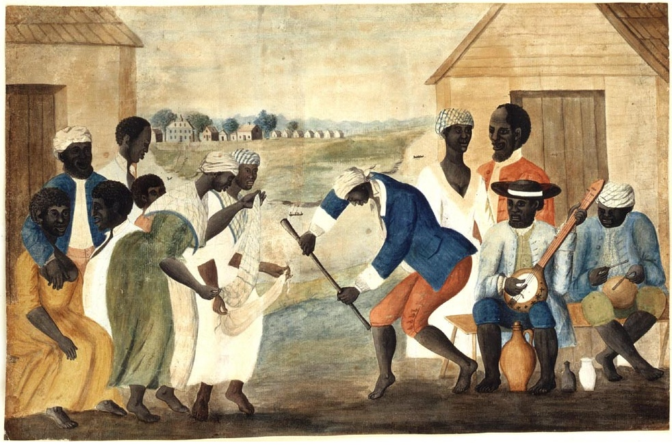

Slide 5
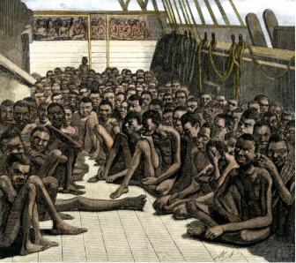
United States History
Social Death
[1.03]
Dr. King-Owen

Slide 6
Unfree Labor
Indentured Servitude
In exchange for a trip to America, young men and women “sold” their labor for 5-7 years
Life for servants was harsh; they were abused and often cheated
After 5-7 years, the master had to give them freedom dues (land, clothes, supplies)

Slide 7
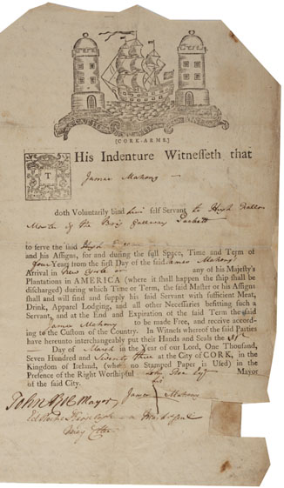
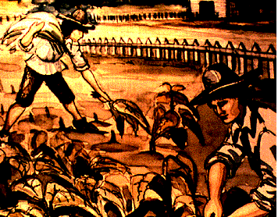

Slide 8
African Slavery
1660s, African slaves became more common
Cheap to purchase (~$150.00)
Lived about 21-22 years
Children of a female slave were automatically slaves
Racial differences could be used to explain “why” African slaves deserved to be enslaved

Slide 9
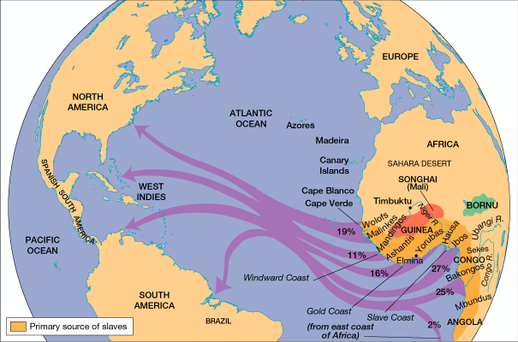

Slide 10
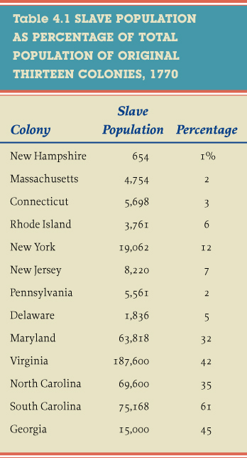
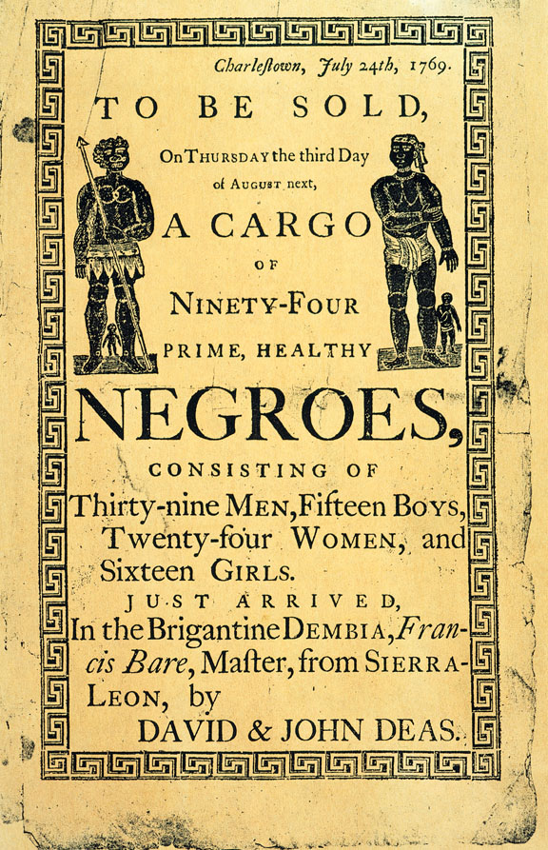

Slide 11
Why Slavery?
Slaves were needed to work plantations in the South
Virginia: Tobacco
South Carolina: Rice
Slaves were part of the Triangular Trade Network
Linked Europe, the Americas, and Africa in exchange of goods

Slide 12
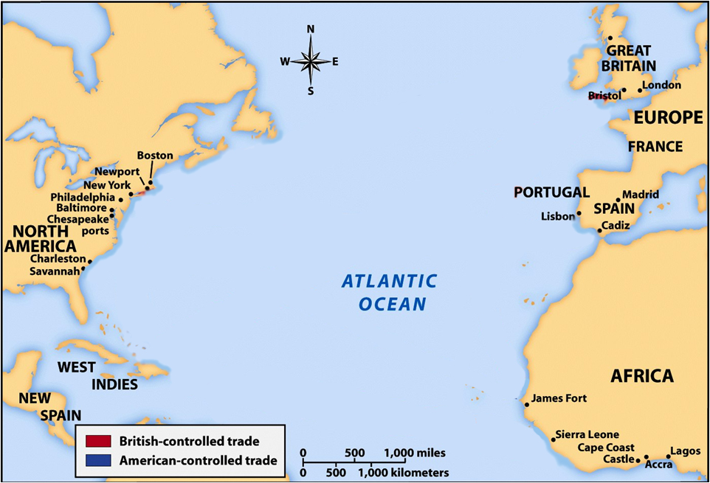
Tobacco, indigo, flour, lumber
Molasses, sugar
Manufactured goods
Salt, wine
fish
Manufactured goods
rice
Rice, fish
slaves
rum
slaves

Slide 13
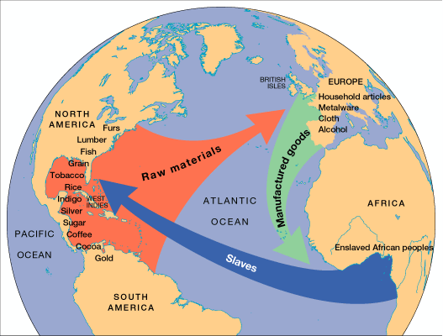

Slide 14
