Slide 1
United States History
Religious Liberty
{1.02}
Dr. King-Owen

Slide 2
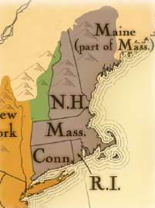
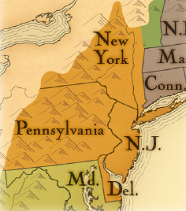
Colonies Established for Religious Freedom
Where are they located?
1620 – Plymouth (MA)
1630 – Massachusetts Bay
1634 – Maryland
1636 – Connecticut
1636 – Rhode Island
1682 - Pennsylvania

Slide 3
Why America?
The official state religion of England was The Church of England (Anglicanism)
Different forms of Christianity were persecuted in England
But, in America, the persecuted became persecutors: Puritans rejected other churches
RI formed by Roger Williams on the idea that church and state should be completely separated
Puritans kicked out Anne Hutchinson in 1638 for teaching that God spoke to her

Slide 4
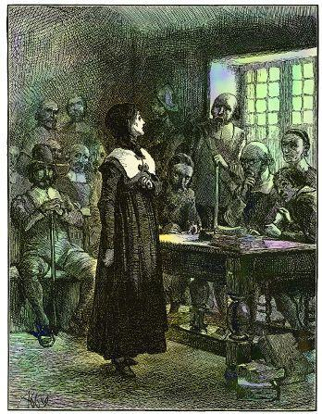
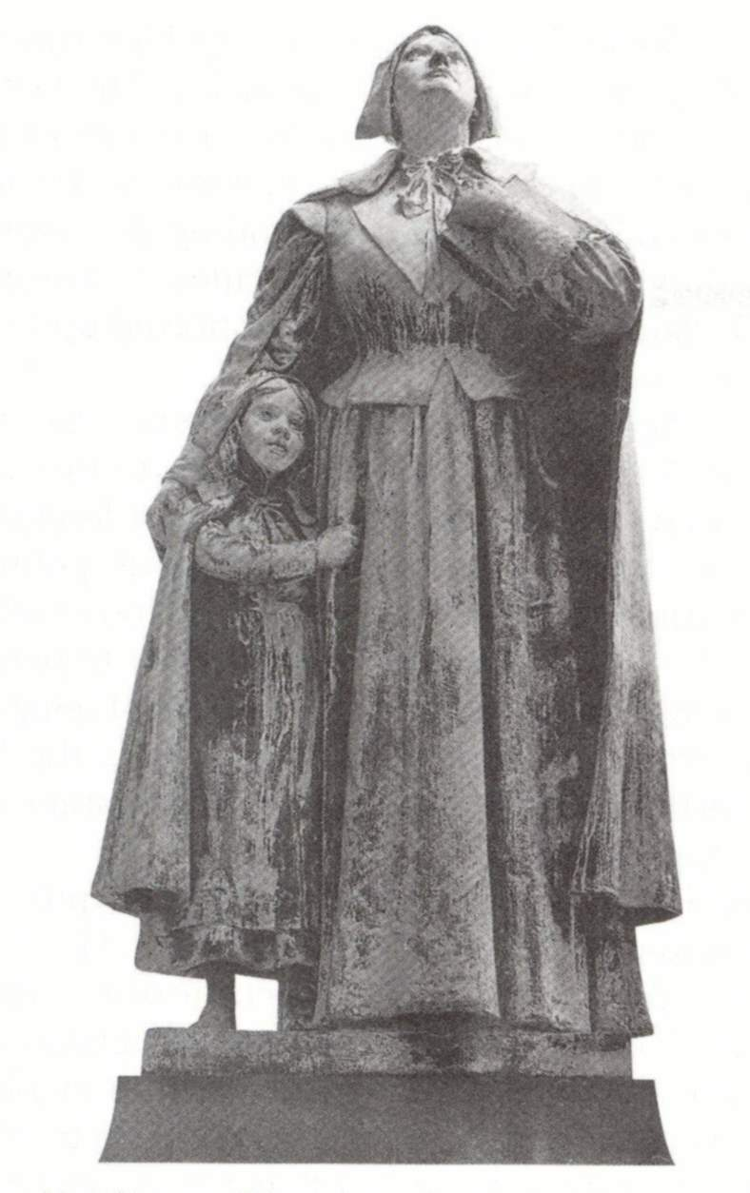

Slide 5
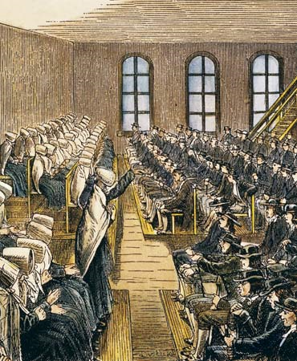
Maryland and Pennsylvania
Maryland, 1634 – A Refuge for Catholics
1649 – Maryland Toleration Act – granted religious freedom to all Christians
Pennsylvania, 1682 – A Quaker Refuge
PA became a home for all different kinds of Christian churches

Slide 6
Origins of Religious Freedom
Reasons for Religious Freedom in Colonial America:
British did not tightly control colonies
Diversity of religion increased so that no one religion could dominate
Idea of separation of church and state defended early on

