Slide 1
UNITED STATES HISTORY
A Disturbance in the Force
Dr. King-Owen

Slide 2
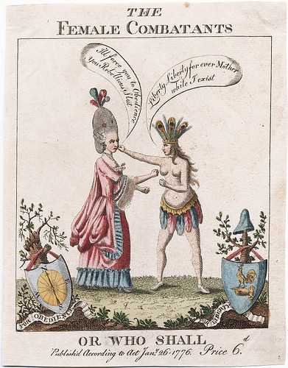
[2.02] America, the Adolescent
1750 – Americans are used to self-governance
They want:
Approval from England
AND freedom to make their own laws
Notes:
By the mid-18th century, Americans still think of themselves as British, with all the rights and privileges of “freeborn Englishmen.” They feel slightly inferior to the English and really work to earn the approval of their social and cultural superiors in England. At the same time, however, they demand that their representatives assemblies have the right to pass their own laws and collect their own taxes. They insist that self-governance was part of their heritage from the beginning of colonization.

Slide 3
[2.02] French and Indian War
1754 – War!
War breaks out between England and France over land in Ohio valley
1754 – Americans discuss a plan to unify all the colonies (Albany Plan of Union) but it fails
1763 – War Ends (Treaty of Paris)
France loses its land in North America
Americans are proud of their contributions to the war
Notes:
The French and Indian War (or Seven Years’ War) begins over competing land claims in the Ohio valley, particularly in the area around modern day Pittsburgh. Indian peoples are determined to keep the region for themselves but the British and the French both claim the area. American colonists in particular have formed several land speculation companies to buy and control the land in the Ohio Valley and want the French kicked out. War broke out when a party of Indians and colonial troops led by a young George Washington attack a French encampment and the Indian allies of Washington kill the French commander (in violation of civility and international law).
Benjamin Franklin suggests to the colonial leaders who met in Albany that they need a plan to unify the colonies against the threat of the French and the Indians on the frontier. The Albany Plan is a spectacular failure because the colonists are not interested in giving up any authority to a central government and because they are more concerned about stealing more land from the Indians.
The war drags on until 1763. The French are spectacularly defeated in a number of locations after a poor start by the English. As a result of the war, the French lose their North American possessions in the Treaty of Paris (1763). Americans, proud of the help they have given to defeating to the French, assume that the British will approve of their hard work and allow them to take the lands occupied by the Indians in the Ohio valley.

Slide 4
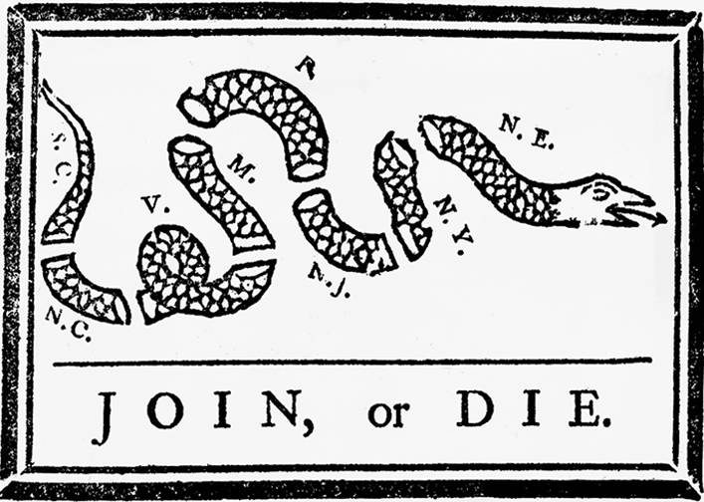
Notes:
This is the cartoon drawn by Franklin for sponsoring the Albany Plan. It has wrongly been interpreted to reference colonial unity in response to the British when, in fact, it refers to the problem of defense on the frontier against the Indians.

Slide 5
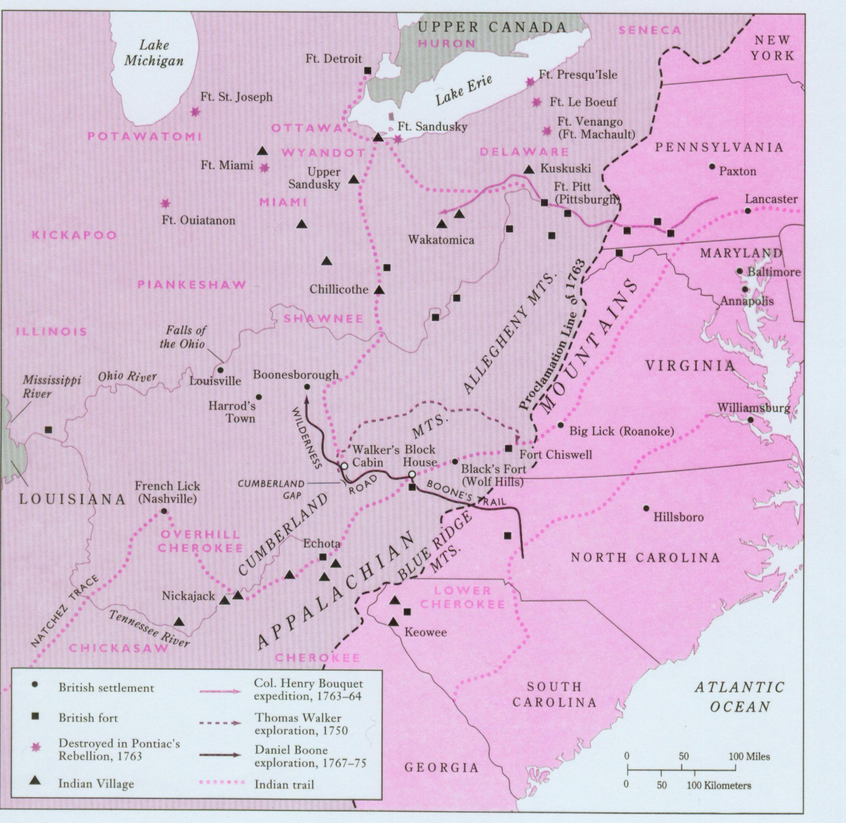
Notes:
This map shows the Indian villages and the line that the British drew to keep colonists out of the backcountry. Notice Chillicothe, Ohio’s first capital and the birthplace of a later important figure, Tecumseh.

Slide 6
[2.02] Legacies of the Seven Years’ War
British Debt
War cost £58 million (=10.2 trillion dollars in today’s money)
British began to tighten control over America with new rules
Americans forbidden to settle in Ohio valley after an Indian war breaks out there
British demand Americans pay new taxes to cover the cost of the war
Notes:
The cost of the Seven Year’s War to the British is immense and the British leaders begin to reform their control over the empire to squeeze more money out of the colonists. The colonists are very lightly taxed in comparison to their relatives in England. They experience a mild depression in 1763 and resent the British attempts to squeeze more funds. They are also angry at the loss of the Ohio backcountry for land speculation.

Slide 7
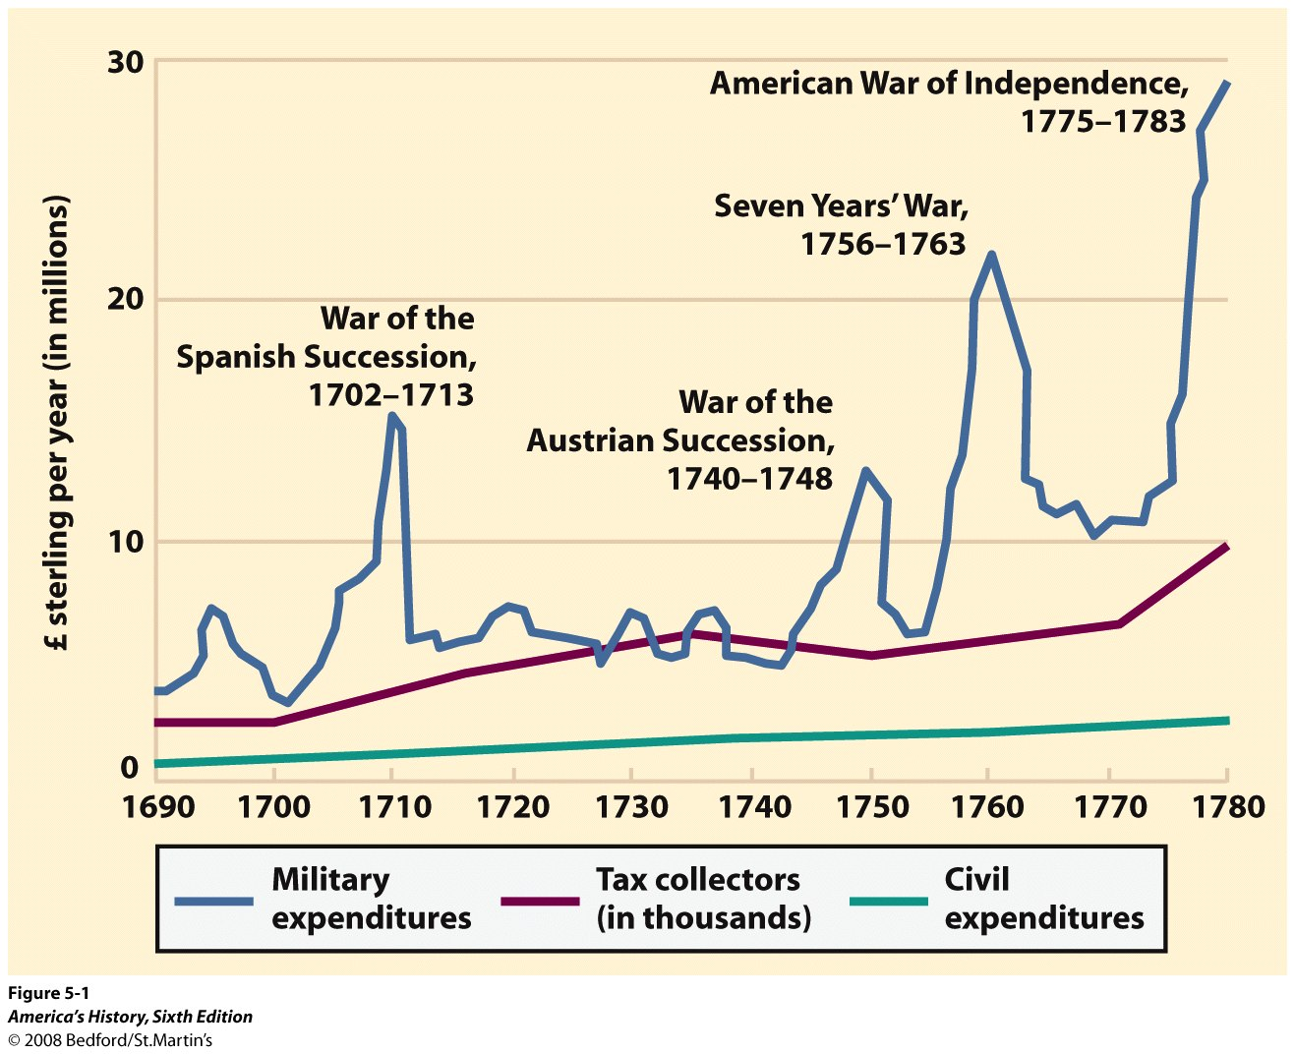

Slide 8
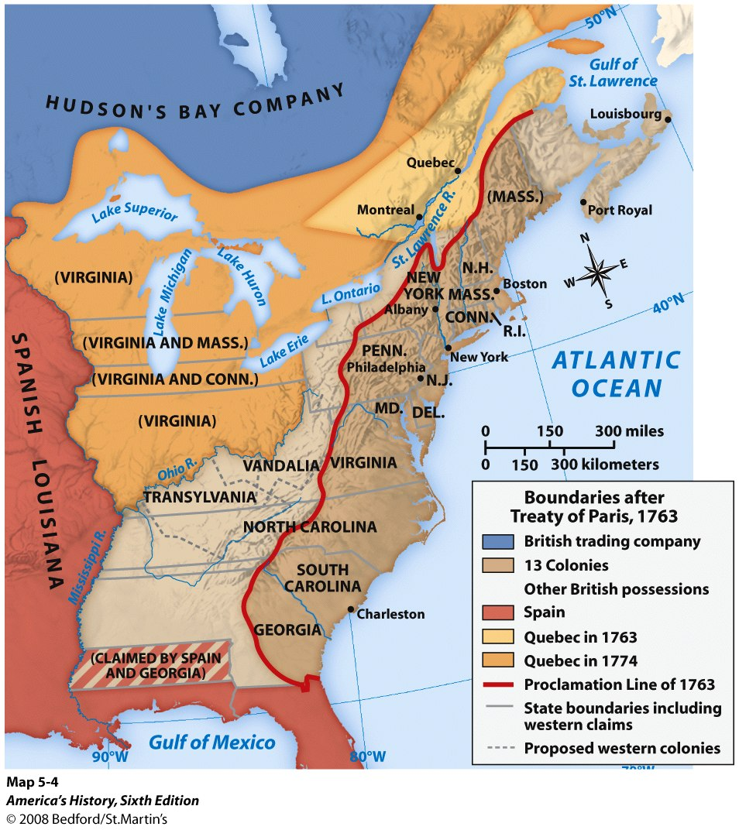

Slide 9
Cause-Effect Charts
CAUSE #1
EFFECT #1
CAUSE #2
EVENT
EFFECT #2
CAUSE #3
EFFECT #2

Slide 10
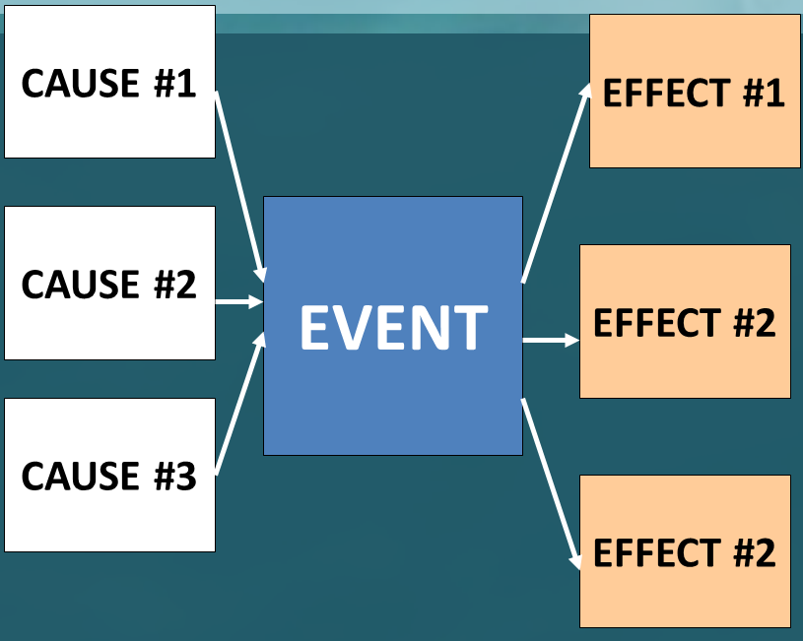
Cause-Effect Charts
Using today’s notes and your textbook (page 12), construct a cause-effect chart for the French and Indian War

Slide 11
French and Indian War
France and England both want land in Ohio
England wins
French kicked out of NA
French and Indian War
England dislikes French Catholicism
England in debt
England and France have been fighting each other in the past
England wants to tax colonies
Colonists not allowed in Ohio

