Slide 1
United States History
[Great]Awakening²
^{Dr.} King-Owen

Slide 2
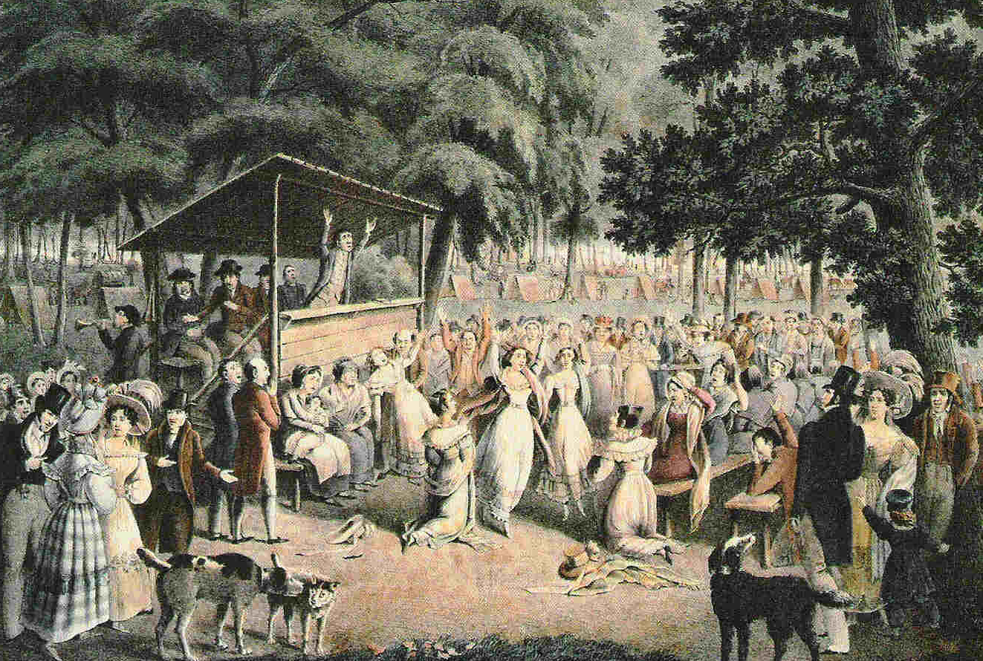
Revival [3.03]
Series of Protestant Christian religious revivals, 1800-1830
Strongest in northern areas where industrialization and urbanization were rapid

Slide 3
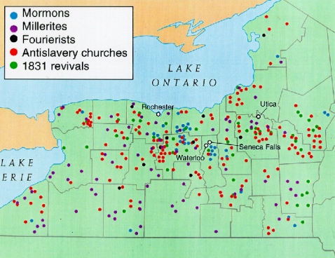
The Burned-Over District: An area of New York where frequent revivals led to reformers and new churches.

Slide 4
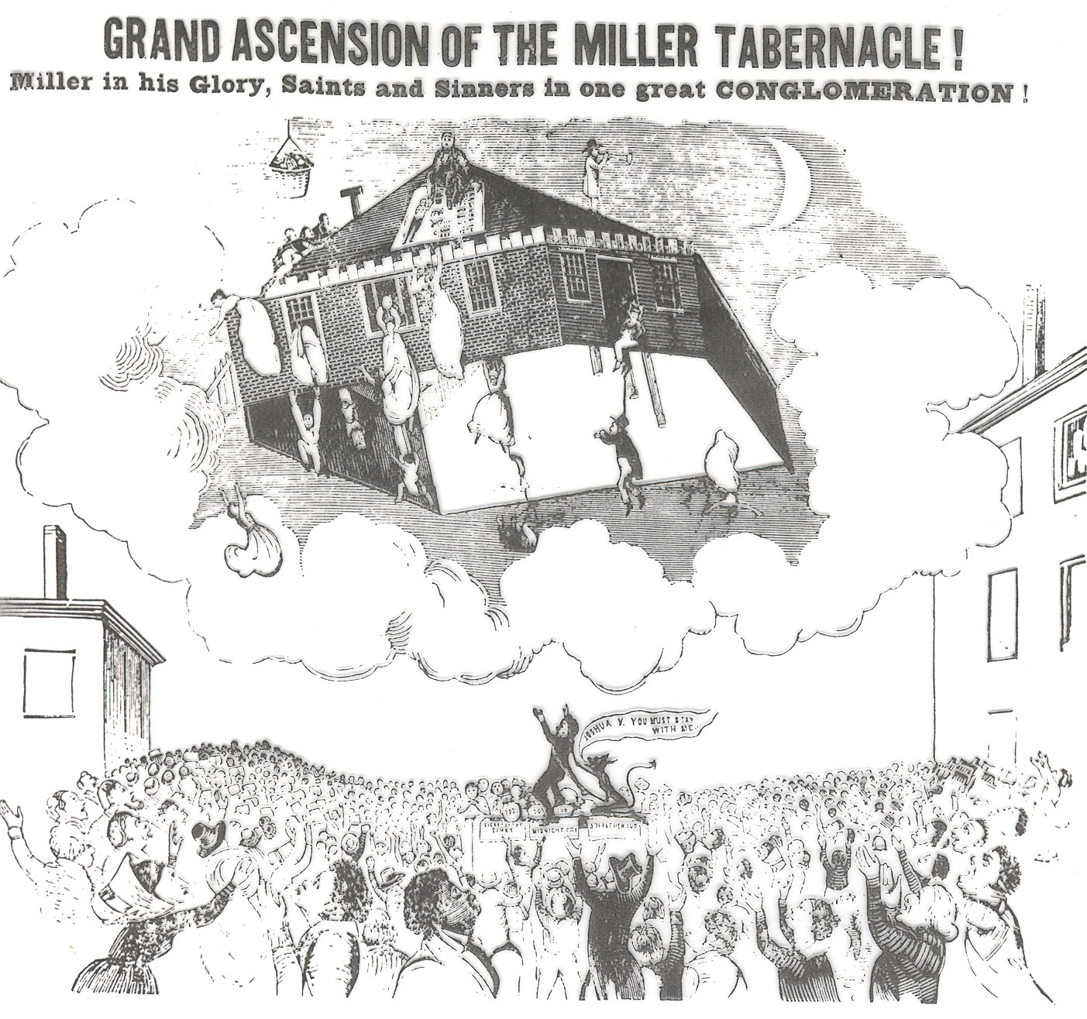
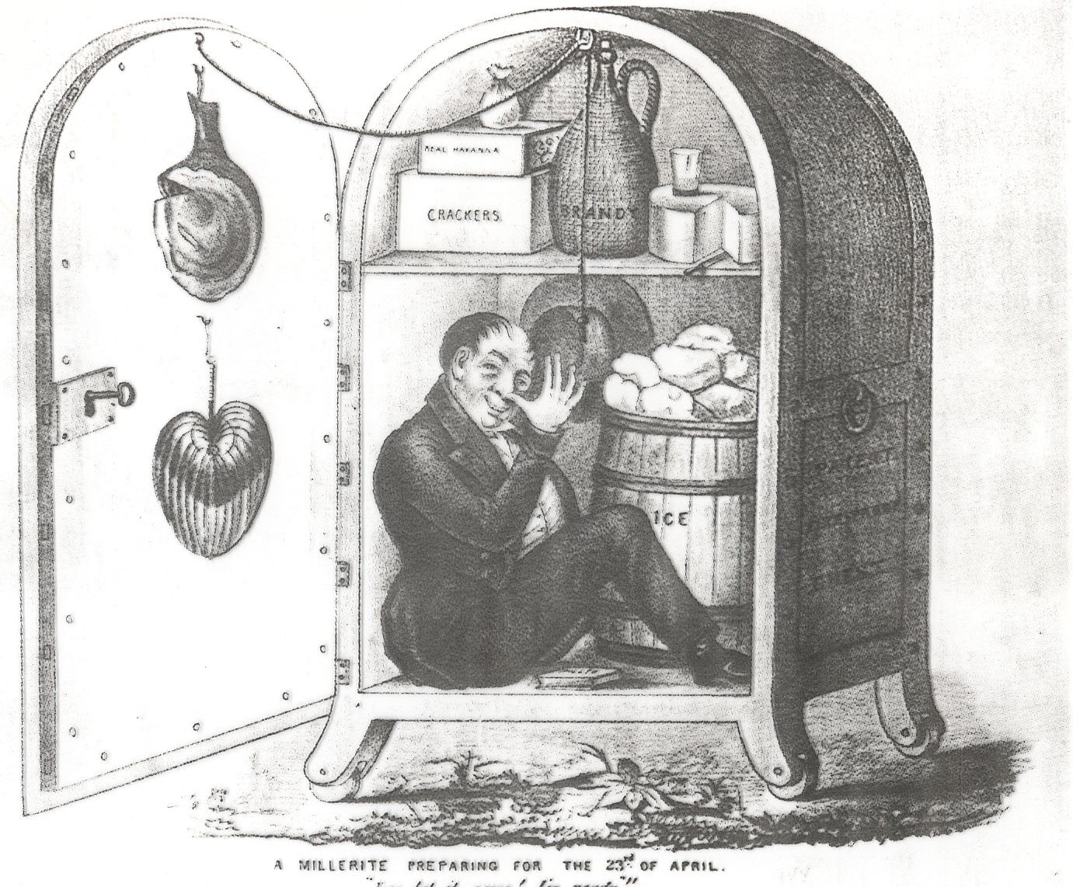
Perfection [3.03]
Shared religious values:
Mankind can reach for God’s grace
Mankind can achieve perfection on earth
Religion is a matter of the heart, not the head
Christians must work together to clean up society before Christ returns

Slide 5
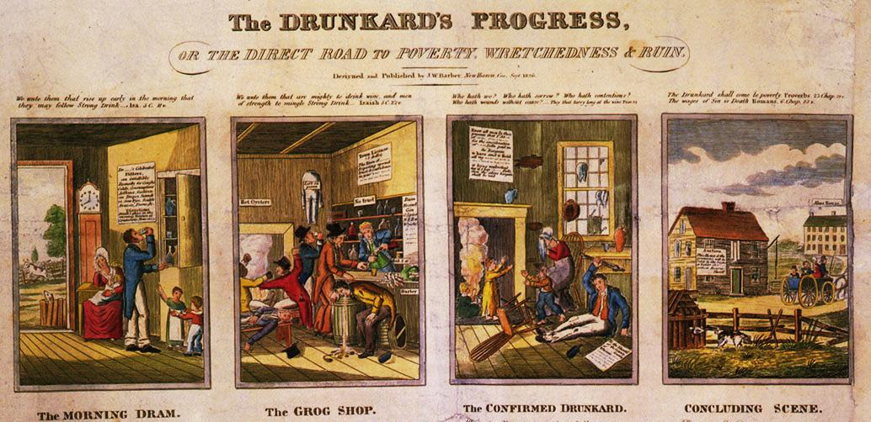
Society [3.03]
Religious Social Reforms
Sunday Schools for youth
Promoting temperance
Missionary work
Charity for the poor

Slide 6
Talk Show
Reforms Talk Show
In your groups, you will read over the handout and become familiar with the reform movement.
Write dialogue that a person would say about your reform movement. You may use the suggested parts to play.
Your dialogue should capture the beliefs and ideas of the reform movement.

