Slide 1
United States History
Constitutional Principles
Dr. King-Owen

Slide 2
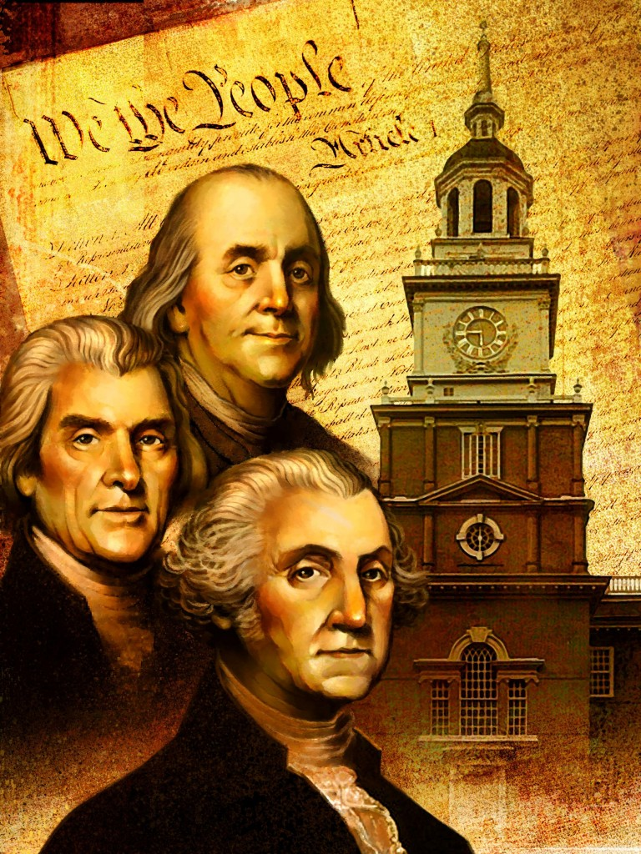
[2.04] Popular Sovereignty
The people are the source of power
Government exists for the people’s needs

Slide 3
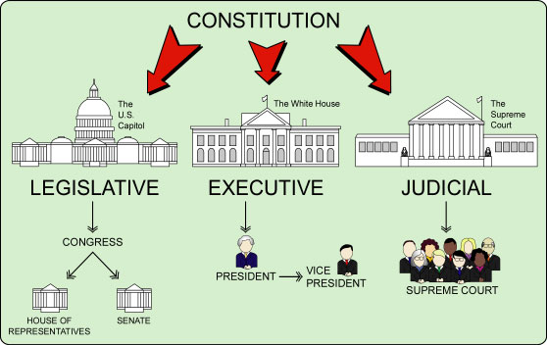
[2.04] Separation of Powers
Legislative, executive, and judicial powers must be split among different branches

Slide 4
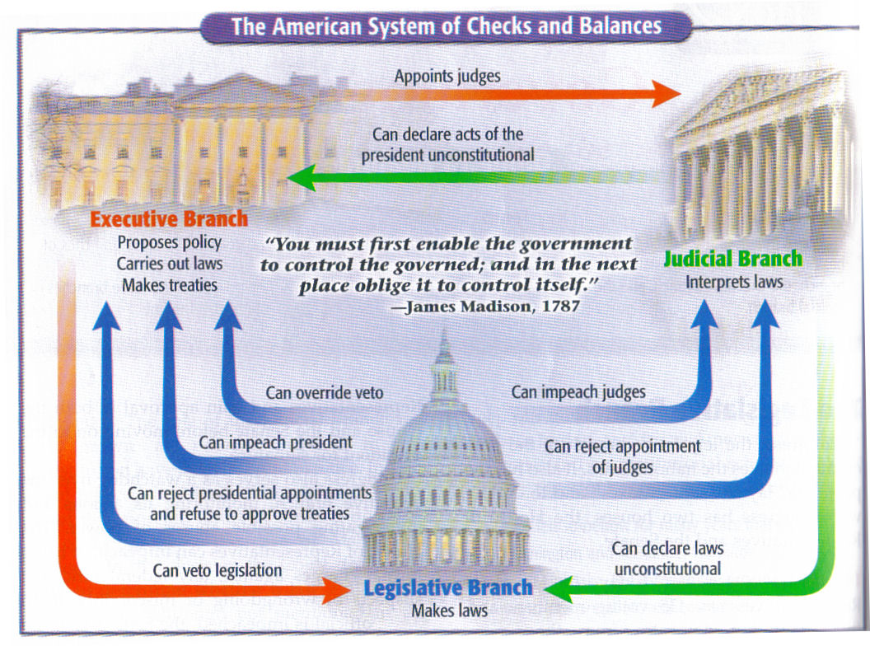
[2.04] Checks and Balances
Government branches can prevent other branches from becoming all-powerful

Slide 5
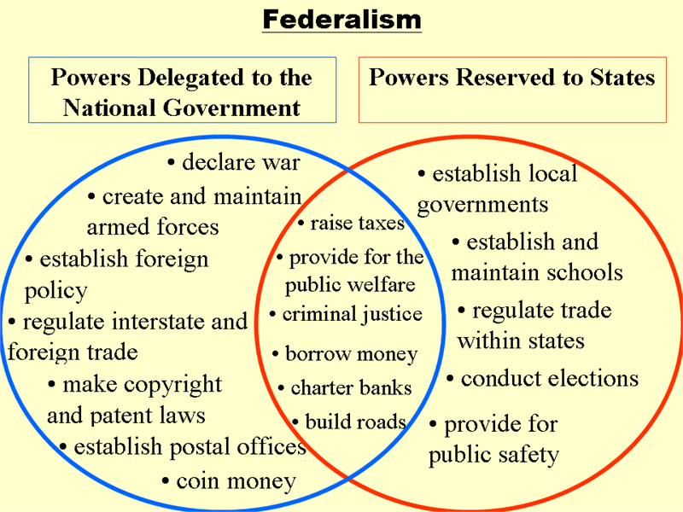
[2.04] Federalism
Sharing power between the federal government and the states

Slide 6
Power: The Big Idea
The Founders were so concerned about power falling into the hands of a person or body that they split it up:
The people have some
The branches of government divide some
The states and federal government divide some

