Slide 1
UNITED STATES HISTORY
RATIFICATION
Dr. King-Owen

Slide 2
[2.03] A War of Words
Federalists
For the Constitution
Antifederalists
Against the Constitution
Wrote The Federalist Papers, 85 essays
Arguments:
America would fall apart without a stronger central power
Federal government had limited powers
Wrote no organized collection of essays
Arguments:
Constitution would destroy the states
Federal government would destroy individual freedoms

Slide 3
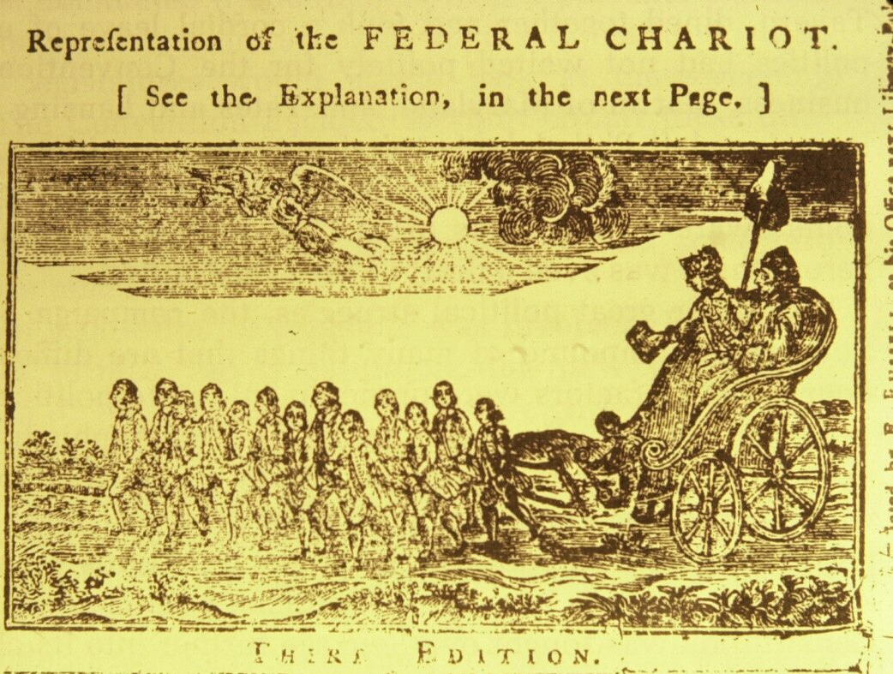
Notes:
Benjamin Franklin and George Washington are in the chariot being pulled by the 13 states.

Slide 4
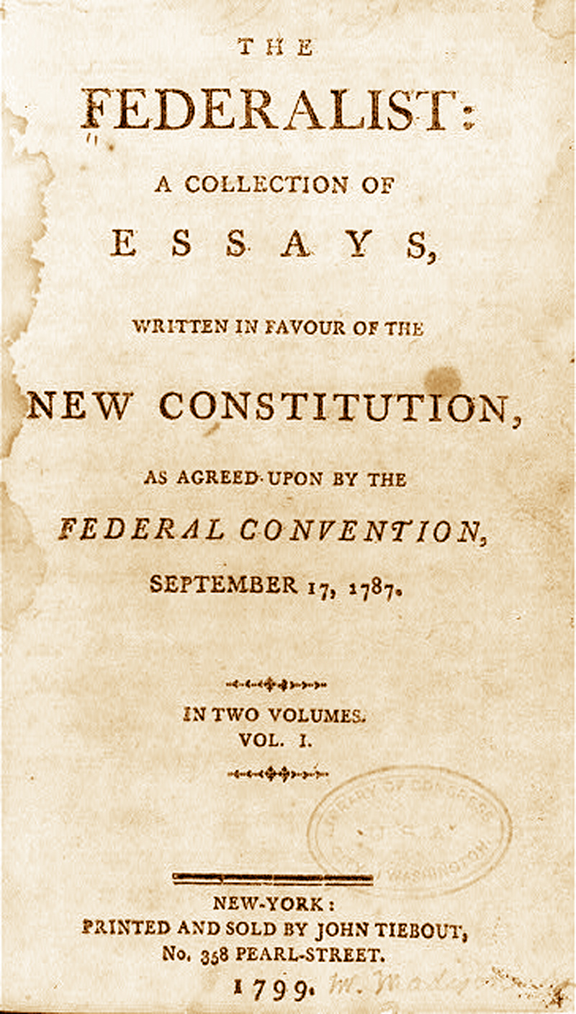
[2.03] A Promise
Federalists promised a Bill of Rights if the people would support the Constitution
The Bill of Rights would protect the people from the power of the federal government

Slide 5
[2.03] Ratification
9/13 states approved the Constitution by 1788
Voters who supported the Constitution: from coastal cities, merchants, wealthy
Voters against the Constitution: owners of small farms, lived in the interior

Slide 6
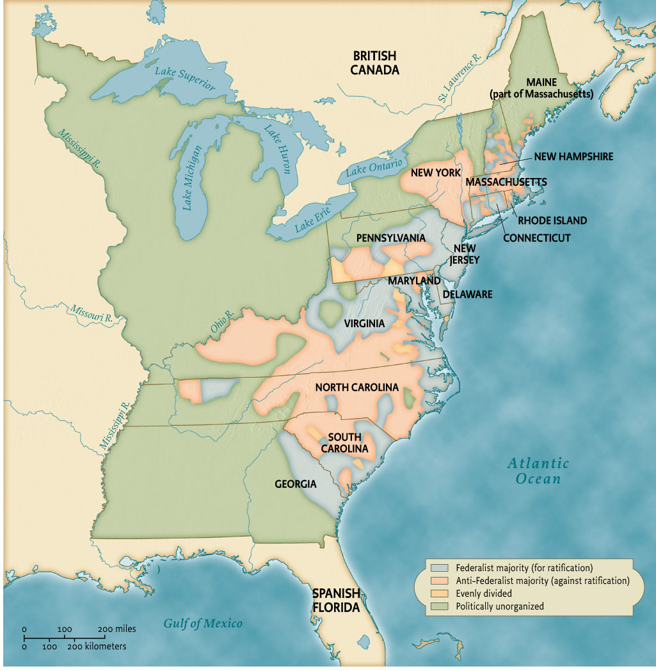

Slide 7
