Slide 1
united states history
the war of 1812
dr. king-owen

Slide 2
[2.07] Really, a War?
1799-1815 – England and France were at war
U.S. wanted free trade with both
Both attacked American ships
British “impressed”¹ American sailors, claiming they were British
British stirred up Indians in the West
1812 – U.S. declared war on Britain
¹kidnapped

Slide 3
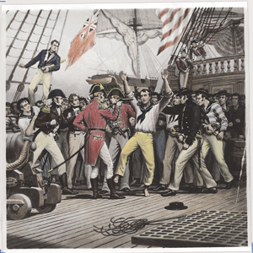
6,000 men were impressed into the British navy between 1803 and 1812

Slide 4
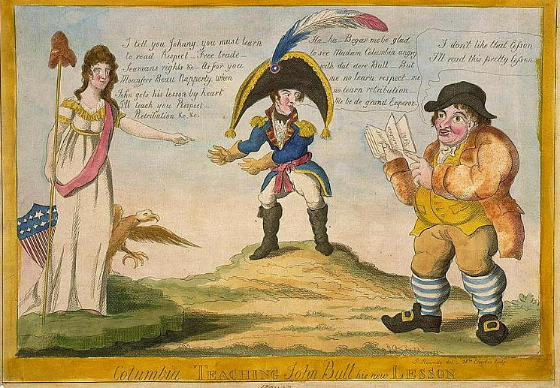

Slide 5
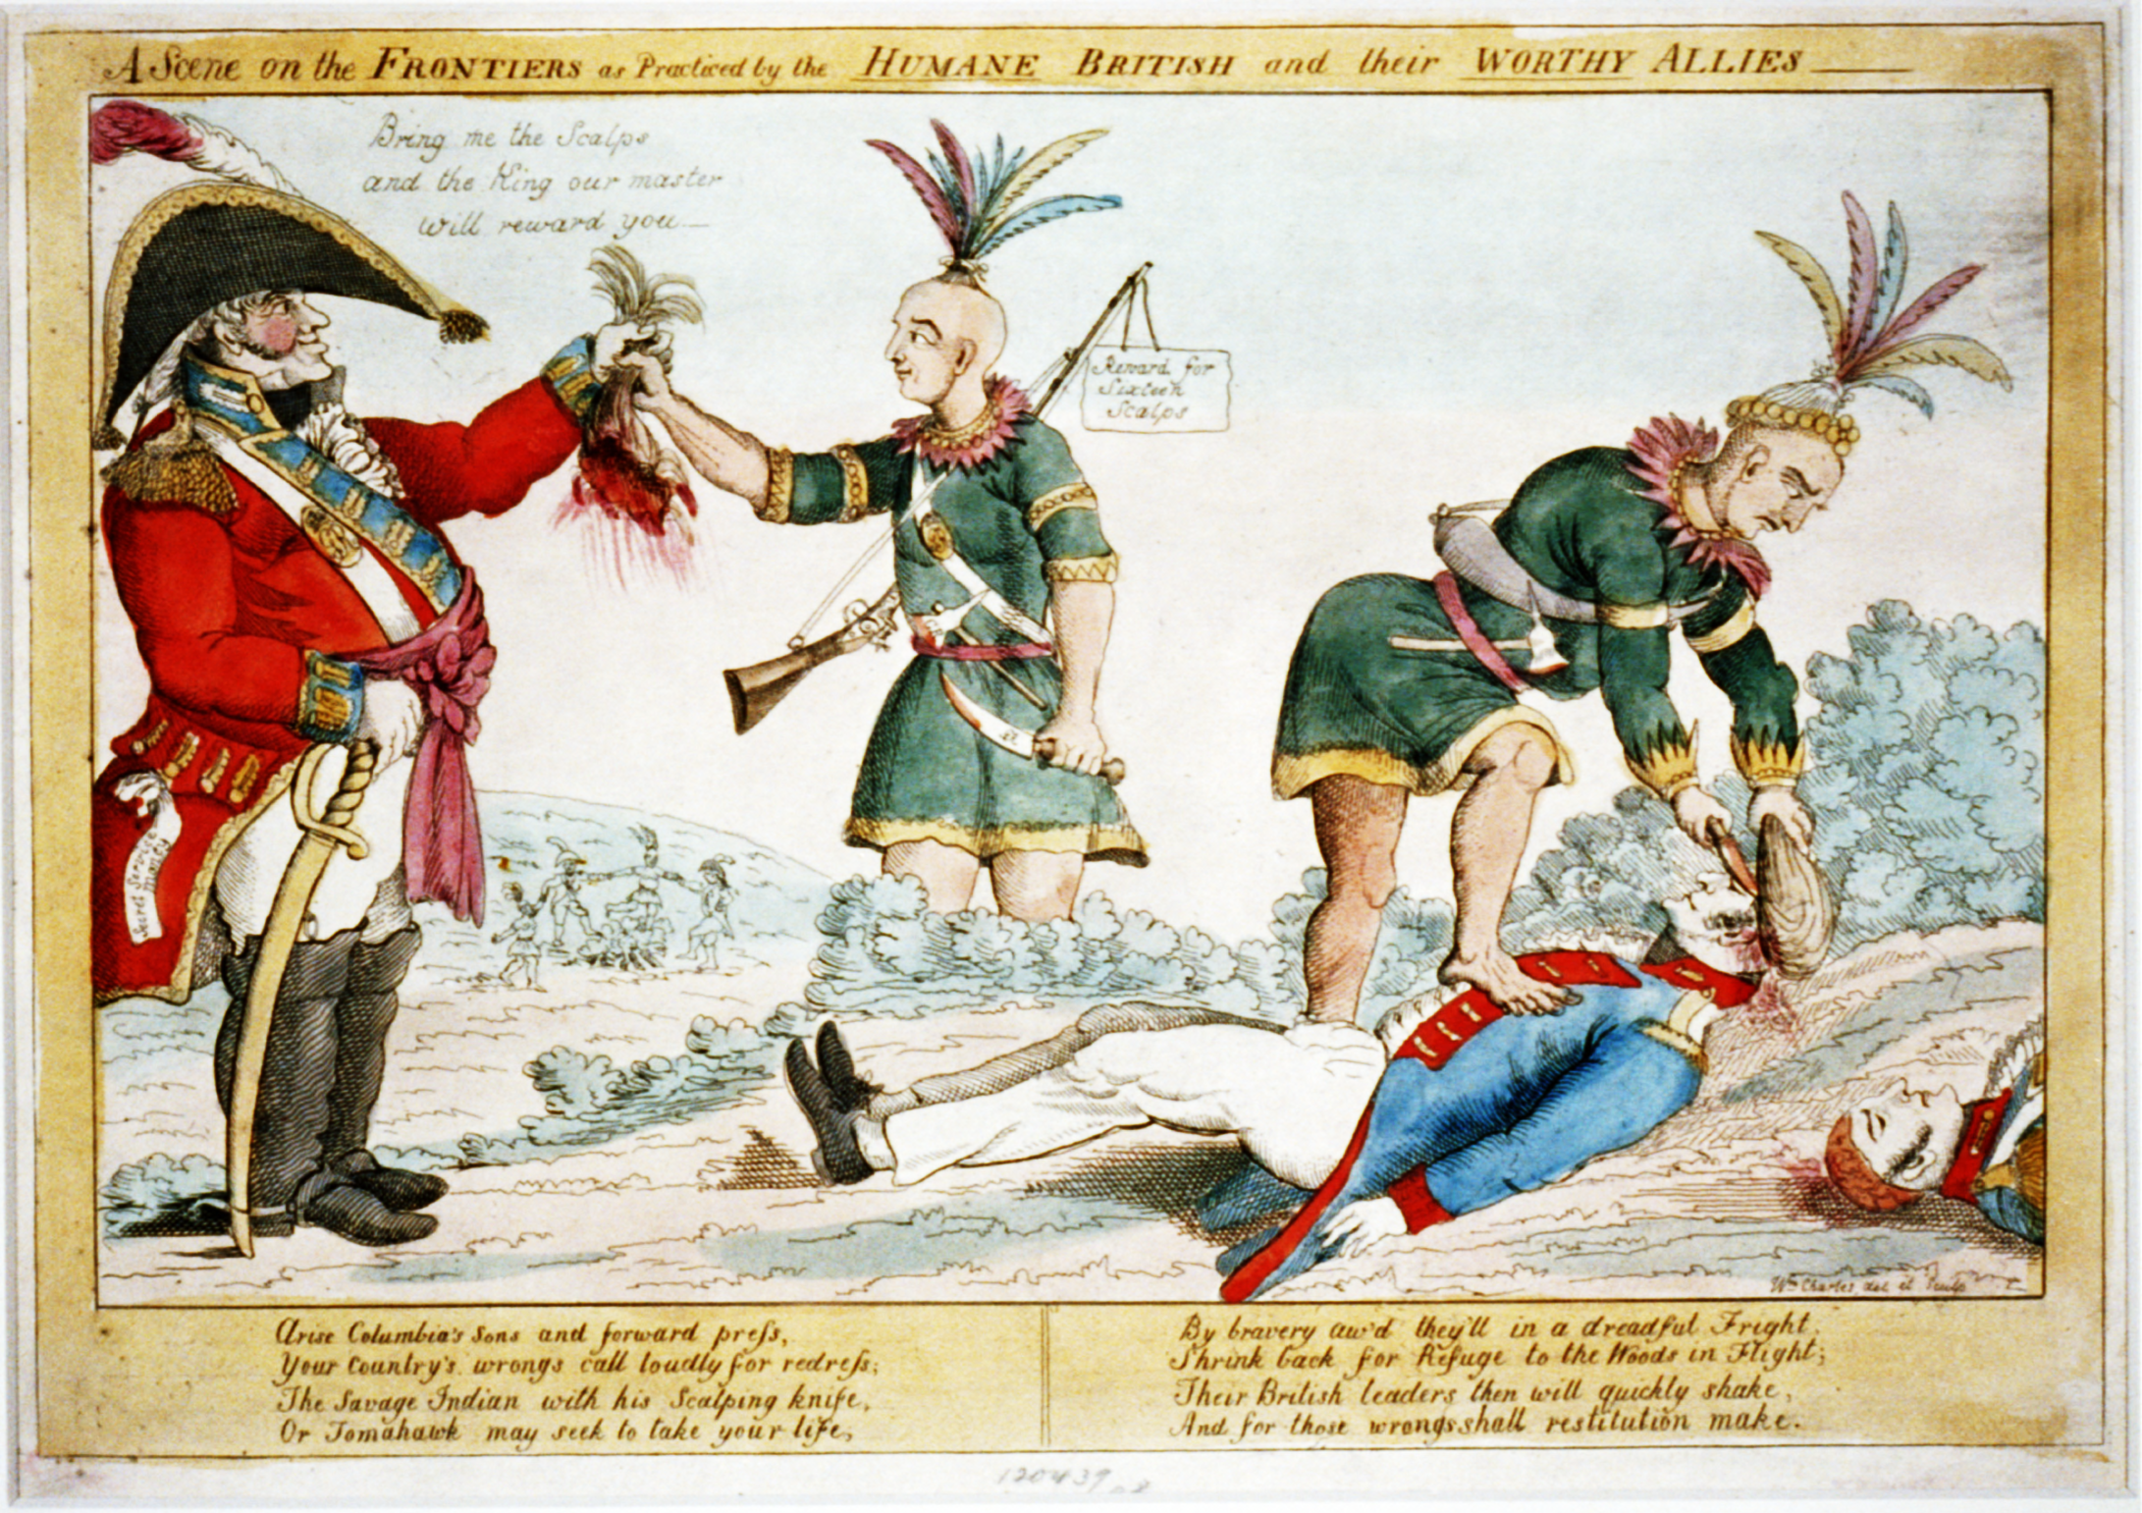

Slide 6
[2.07] Disaster
The war was a disaster
U.S. tried and failed to invade Canada
Washington, D.C. was burned
Economy suffered – in northern states where trade was important
U.S. couldn’t pay for the war

Slide 7
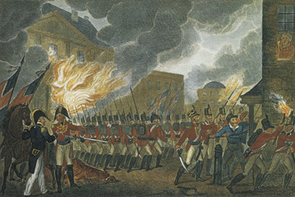

Slide 8
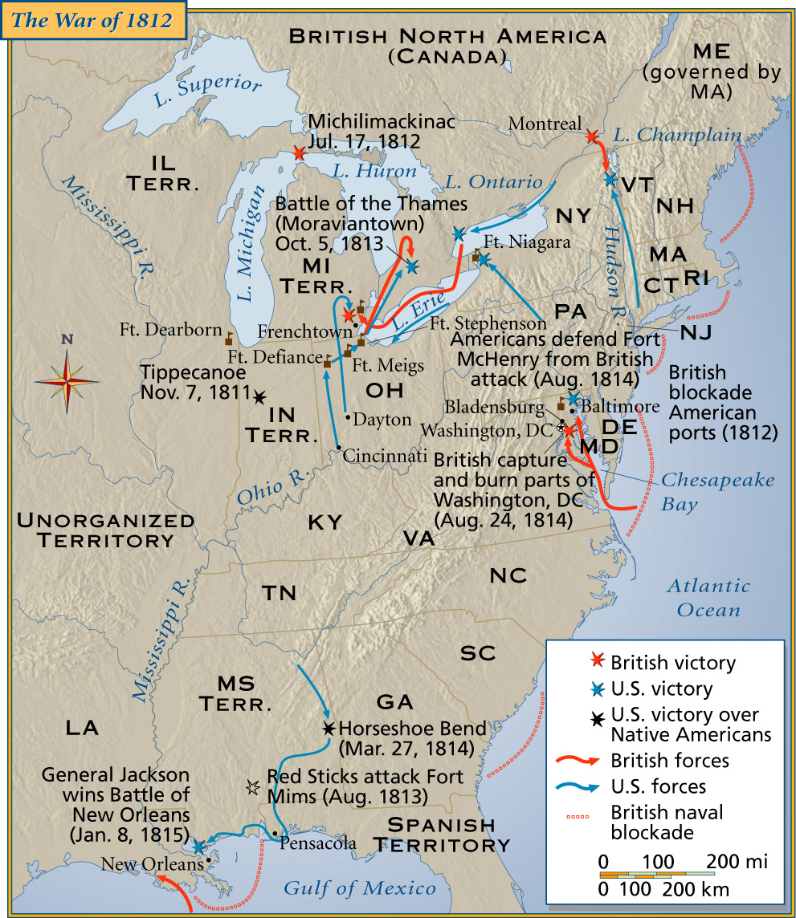

Slide 9
[2.07] Victory: How did that happen?
1814 – Northern states demanded an end to the war at the Hartford Convention
1814 – Treaty of Ghent ends the war: returns everything to pre-1812 status
1815 – Andrew Jackson defeats the British at the Battle of New Orleans

Slide 10
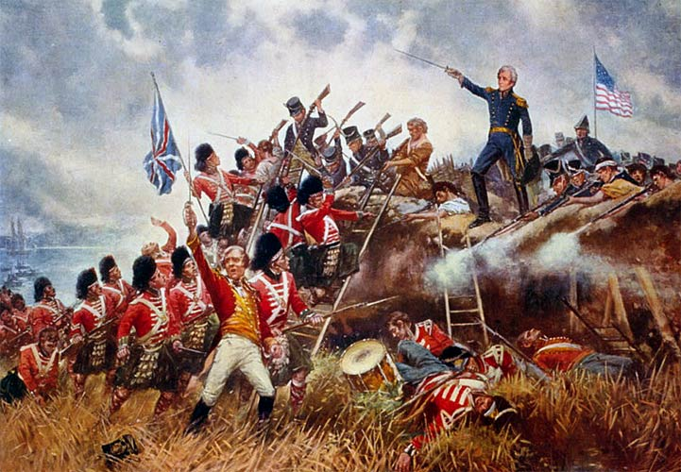

Slide 11
[2.07] Long-Term Impact
1815-1824 – spirit of American nationalism (America! Yeah!)
Death of the Federalist Party
Rise of industrialization in the north

Slide 12
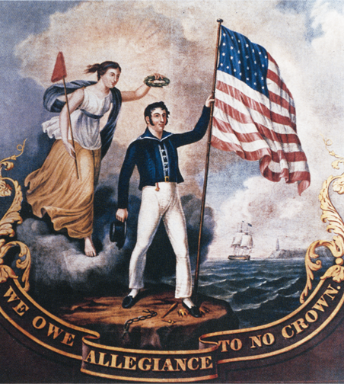

Slide 13
Highlighting
Using the copied text, HIGHLIGHT [stick with ONE COLOR] what you think are the MOST important ideas to understand about the War of 1812.
Put your name on your copy. It will be collected at the end of class.

Slide 14
Review: War of 1812
Which of the following is NOT a cause of the War of 1812?
British and French attacks on American ships
British impressment of American sailors
British taxes to get more money from Americans

Slide 15
Review: War of 1812
Why were New Englanders angry enough to think about leaving the union during the War of 1812?
Most New Englanders were against all forms of war
New England’s economy suffered during the war
New Englanders wanted a second invasion of Canada

Slide 16
Review: War of 1812
Which of the following was a RESULT of the War of 1812?
The British “impressed” American sailors
There was a post-war increase in nationalism
Tecumseh successfully blocked American expansion

