Slide 1
Why Foreign Countries are Dangerous
1798 – U.S. was about to go to war with France
Congress passed an Alien Act to limit citizenship to those who had lived in the U.S. for 14 years
Congress passed a Sedition Act to punish people who criticize the government in wartime.
These were acts of the Federalist Party
Madison and Jefferson see the Sedition Act as a violation of the First Amendment
Write the Virginia and Kentucky Resolutions, which argue that states can “block” federal laws that hurt citizens or violate the Constitution
This was the position of the Democratic-Rep.

Slide 2
United states history
The Monroe Doctrine
Dr. King-Owen

Slide 3
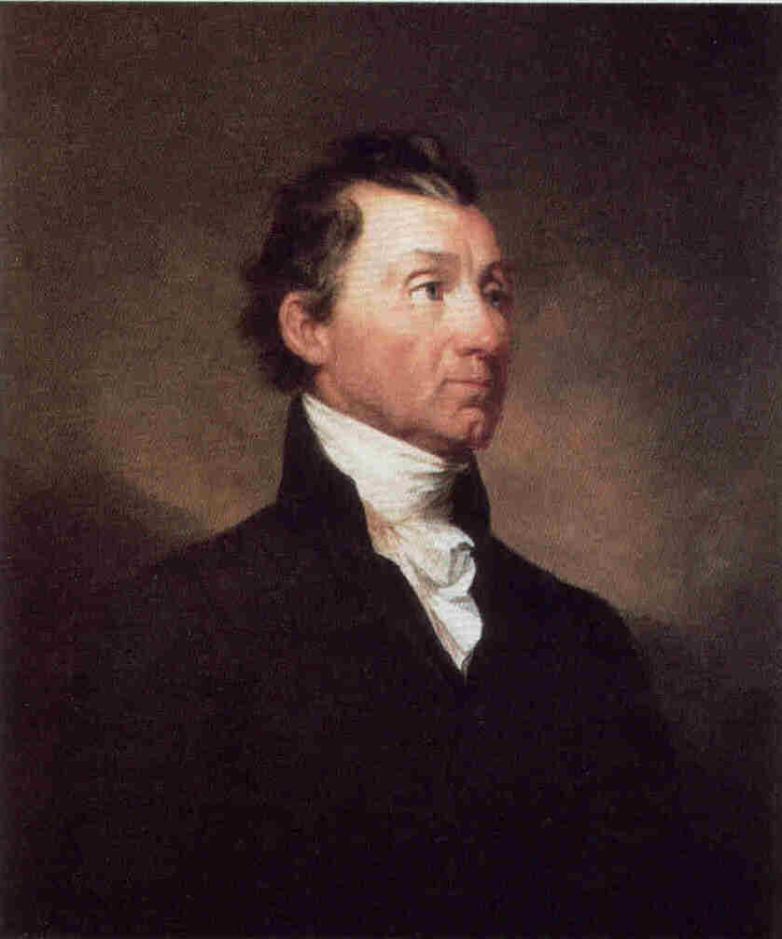
[2.07] Foreign Policy Fears
Fear of Entangling Alliances
Fear of European wars
After Latin and South American countries became independent in the 1820s, there was a fear that Europeans might try to take back their colonies

Slide 4
[2.07] Isolationism…Kinda
1823, Monroe Doctrine was issued by President Monroe
Europe was to stay out of the Americas
The U.S. would stay out of Europe
The Monroe Doctrine has been the center of American foreign policy for 189 years

Slide 5
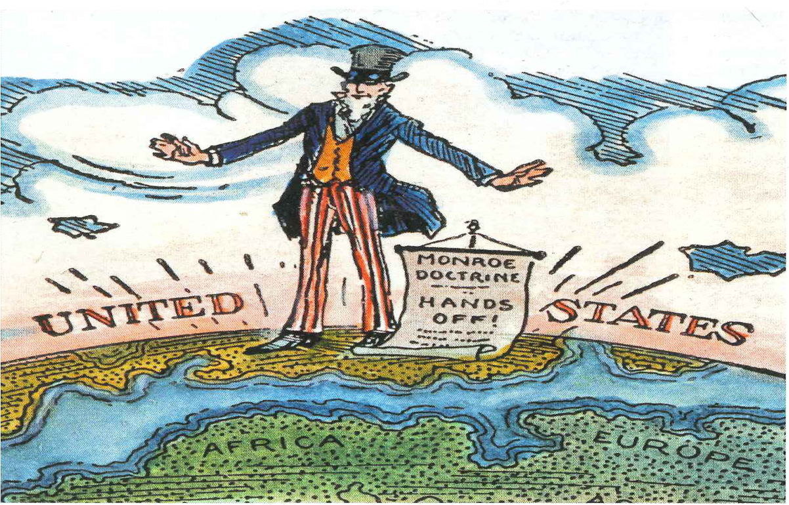

Slide 6
