Slide 1
United States history
Dr. King-Owen
Civil War Origins [5.01]

Slide 2
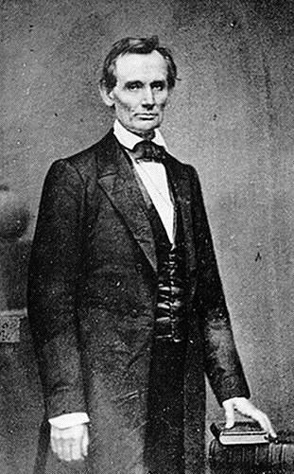
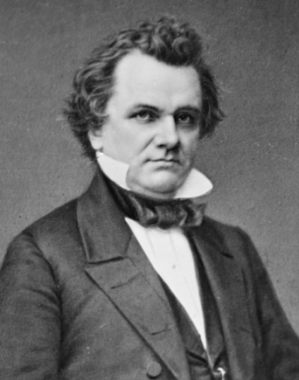
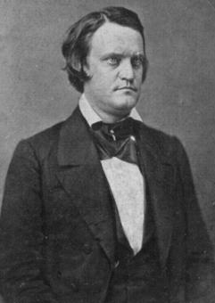
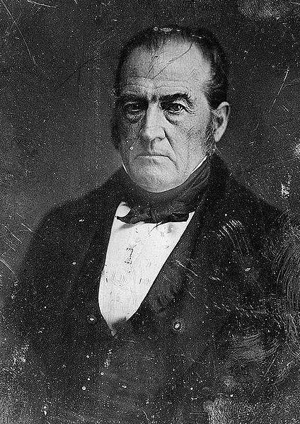
Election of 1860
Republicans
Abraham Lincoln
No slavery in territories
Democrats
Stephen Douglas
Congress would not interfere in slavery in territories
Southern
Democrats
John C. Breckinridge
Federal protection of slavery in territories
Constitutional
Union
John L. Bell
Compromise to save the Union

Slide 3
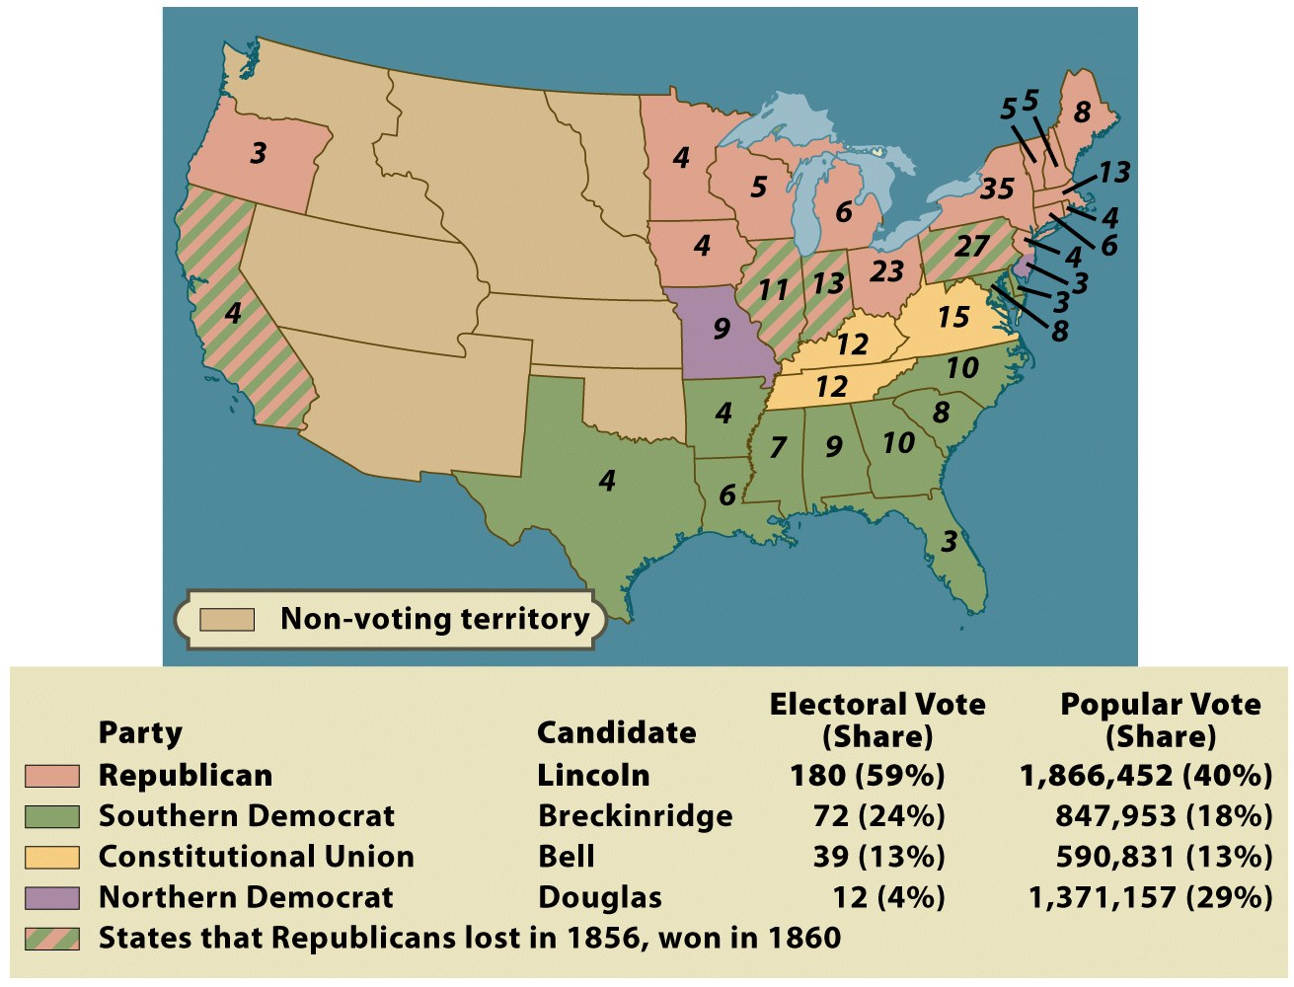

Slide 4
Secession
After Lincoln won, South Carolina left the Union in December 1860
SC argued that Lincoln was a “black Republican” who would try to end slavery
Secession: states had formed the Union and could leave it if they wanted
Lincoln’s Response: the union is permanent and can’t be broken by a single state

Slide 5
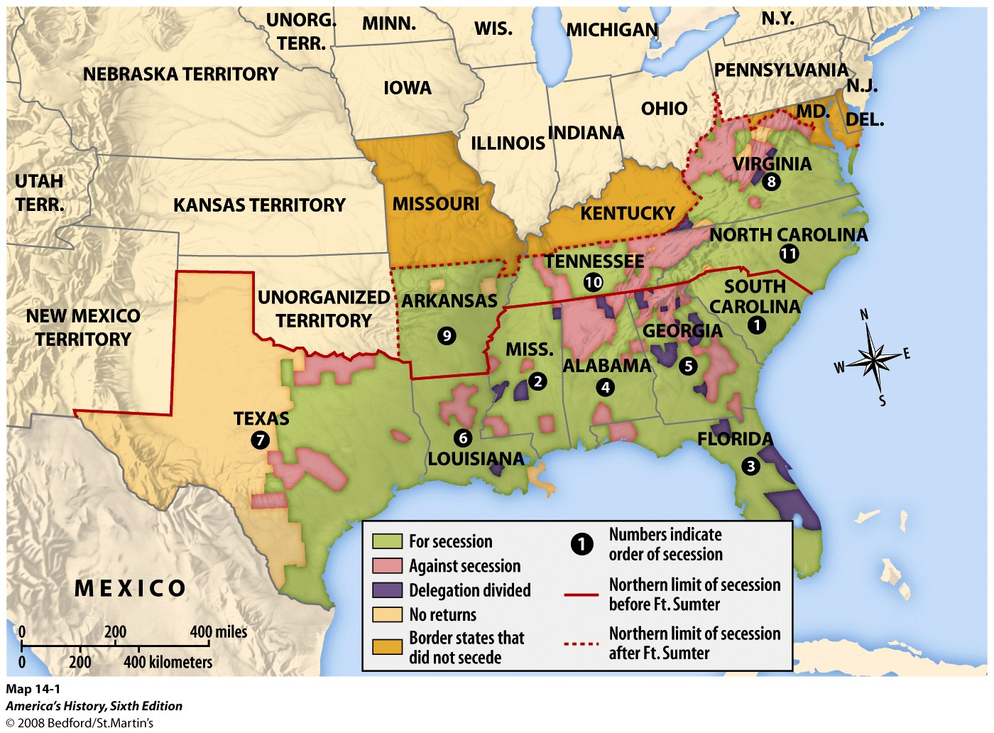

Slide 6
The Confederacy
Fort Sumter, (Charleston, SC) April 12, 1861 – Lincoln wanted to supply the fort but SC refused
Shots were fired – the war begins
Lincoln called for troops from the rest of the South to put down the rebellion
May 1861 – 11 states of the South form the Confederacy under President Jefferson Davis
They write a states’ rights constitution (very much like the AOC)

