Slide 1
United States History
Reconstruction: The Radicals Take Charge
[5.03]
Dr. King-Owen

Slide 2
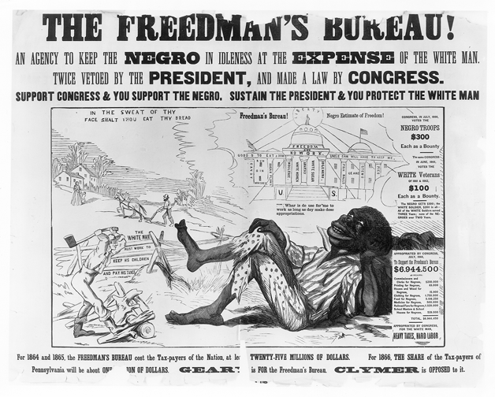

Slide 3
Radicals, 1866
Southerners elected ex-Confederates to Congress and passed Black Codes (restricting the rights of ex-slaves)
Radical Republicans decided to punish the South
Refused to seat ex-Confederates in Congress
Gave more power to Freedman’s Bureau
14th Amendment passed– made blacks citizens and gave them equal protection of laws

Slide 4
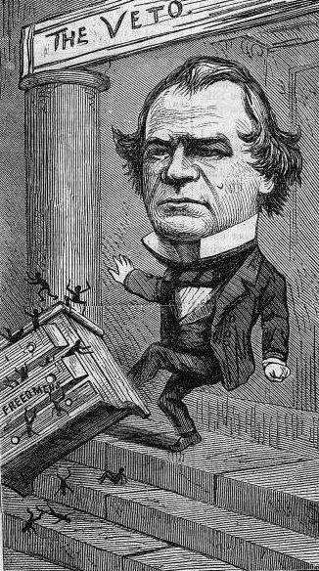
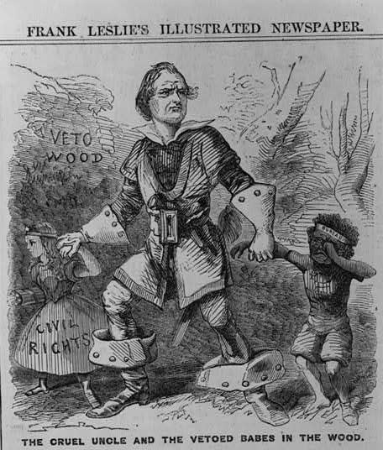

Slide 5
Military Rule, 1867
Reconstruction Act of 1867
South divided into 5 military districts under military governors
States would have to approve new constitutions which enfranchised black males over 21
Ex-Confederates would be disenfranchised
State could reenter the union when it gave political and civil equality to blacks

Slide 6
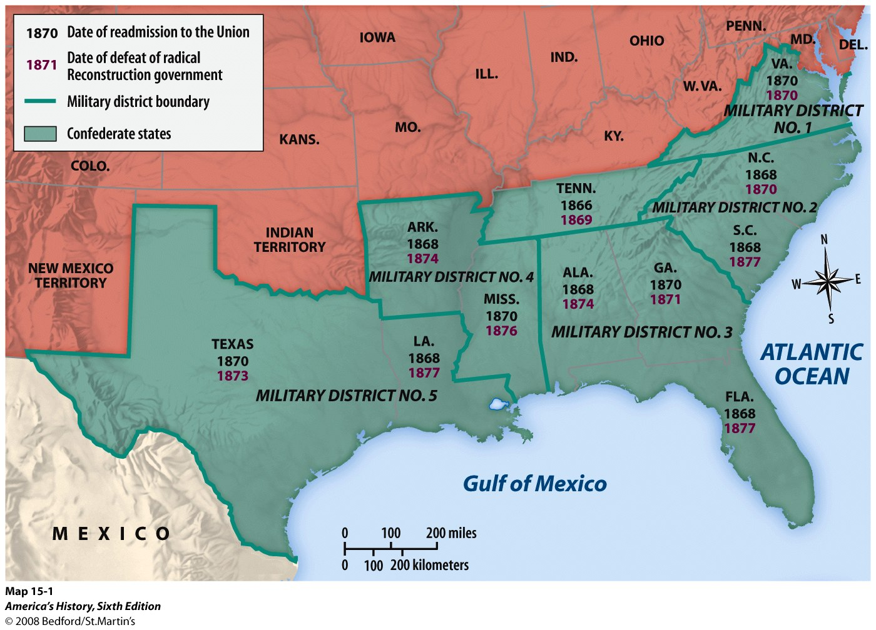

Slide 7
Impeachment
President Johnson tried to block radical Reconstruction
1868 – President fired Secretary of War in violation of Tenure of Office Act
House voted to impeach the President
The trial in the Senate fell short of removal by one vote

Slide 8
