Slide 1
United states history
Dr. King-Owen
Abolition

Slide 2
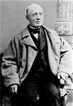
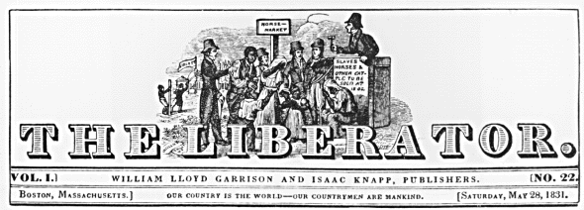
Abolition [3.04]
Called for the immediate abolition of slavery without payment to slave owners
William L. Garrison founded a newspaper, The Liberator, to argue for abolition (1831)

Slide 3
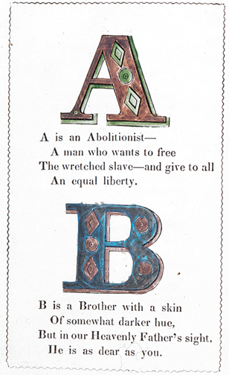
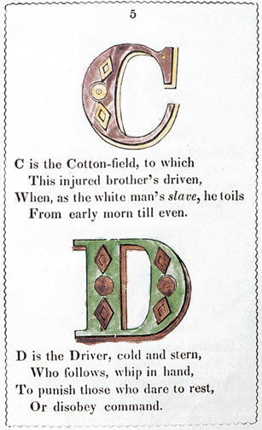

Slide 4
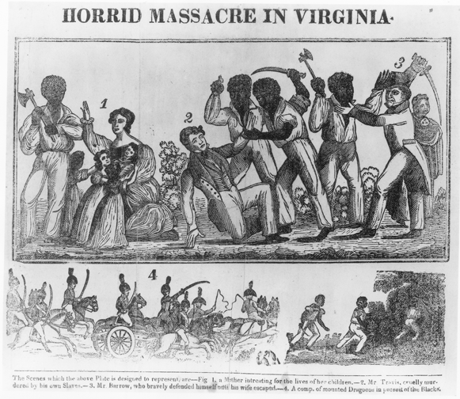
Nat Turner’s Rebellion, 1831 (Virginia) – 55 white people killed by rebel slaves – slaves were challenging slavery already by violence or by running away

Slide 5
Anti – Slavery [3.04]
THE MOST IMPORTANT change in Anti-Slavery was the shift from persuading people to using a political party to end slavery by law OR restrict its extension.
Persuasion
Garrison
Politics
The Liberty Party

Slide 6
Pro-Slavery [3.04]
Southerners responded that slavery was:
Biblical (God-approved!)
Economical (sure made southerners rich!)
Civilizing (rescued those poor Africans!)
Socially Stable (kept poor whites from thinking they had it bad!)

