Slide 1
United states history
Killing the Monster Bank
Dr. King-Owen

Slide 2
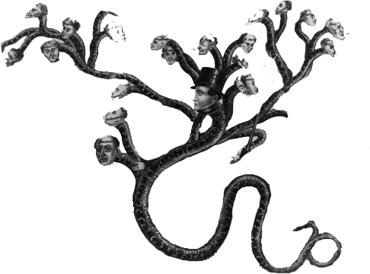
Jackson Hates Banks [3.01]
National Bank controlled the nation’s money supply through its loans to smaller banks
If it called in those loans, it would reduce credit available and hurt those in debt
Jackson feared the “money power”

Slide 3
Veto [3.01]
BUS president Nicholas Biddle asked Congress for a re-charter four years early
Jackson thought Biddle was trying to embarrass him in the Election of 1832
Jackson vetoed the bank re-charter
In 1833, Jackson ordered government deposits in the bank sent to state “pet banks” (run by Jackson’s friends)

Slide 4
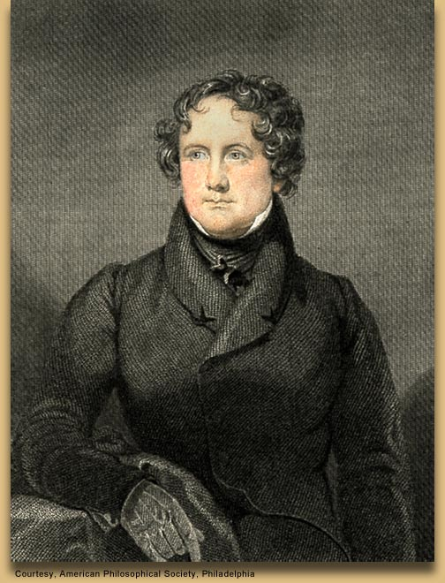
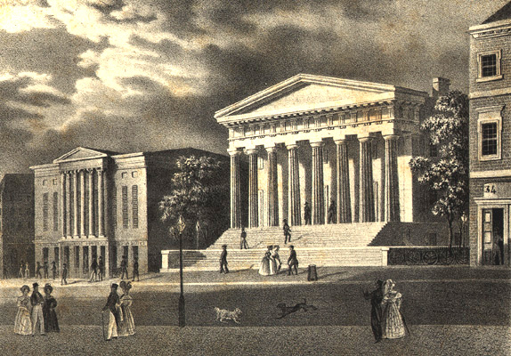
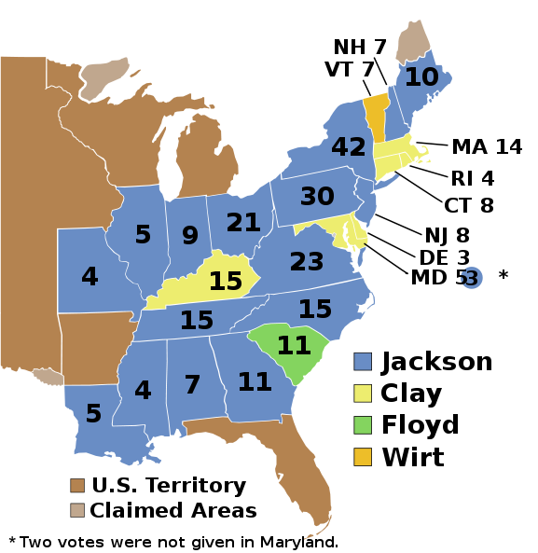

Slide 5
Effects [3.01]
“Bank War” contributed to the formation of the Whig Party (those who hated Jackson)
Saw Jackson as standing in the way of a growing industrial economy
Pet Banks started a “land bubble” of speculation that crashed in the Panic of 1837 (recession lasted 6 years)

Slide 6
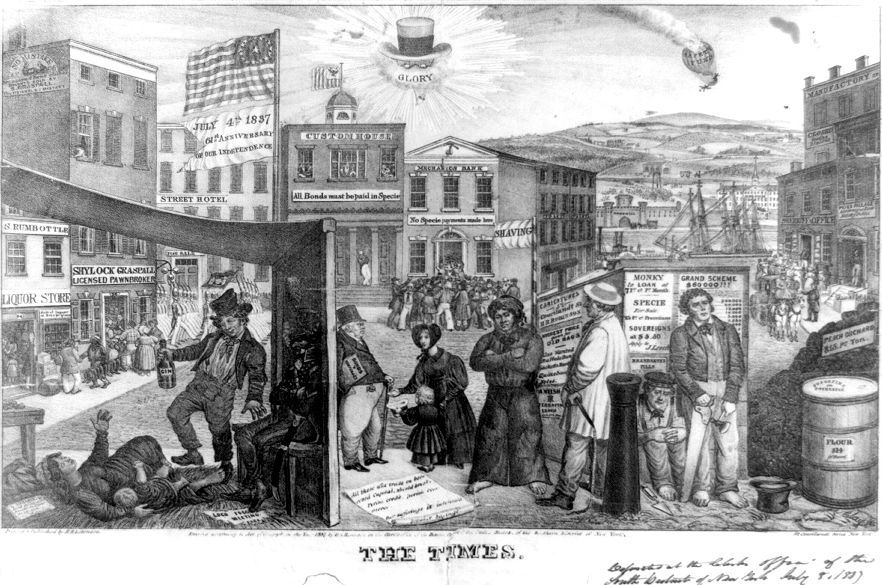

Slide 7
