Slide 1
United States History
Dr. King-Owen
Workers in America
[6.06]

Slide 2
Industry vs. Labor
Ideas of
Industry
Ideas of Labor
It is natural for wealth to be unequal
Property is sacred
Individual rights are important
Inequality is dangerous to democracy
Labor must be valued
Rights are collective

Slide 3
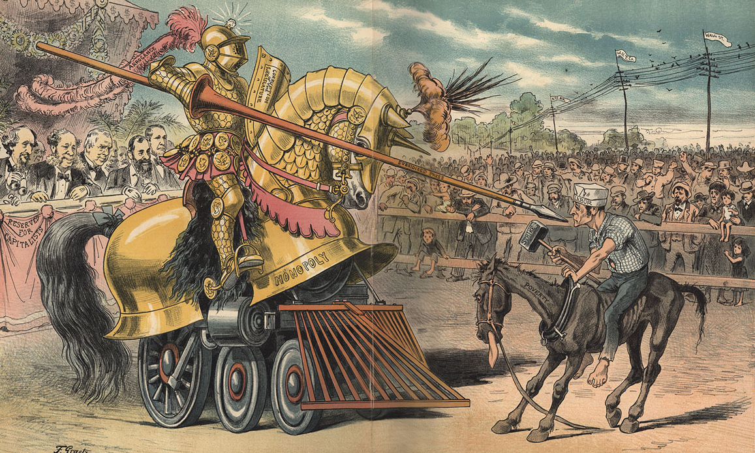
In the contest between industry and labor, industry has the advantage….

Slide 4
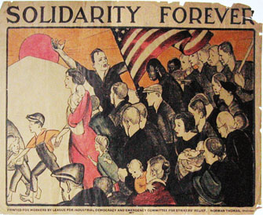
Solidarity forever, Solidarity forever, Solidarity forever, For the union makes us strong.
It is we who plowed the prairies
built the cities where they trade
Dug the mines and built the workshops, endless miles of railroad laid
Now we stand outcast and starving midst the wonders we have made
But the union makes us strong.

Slide 5
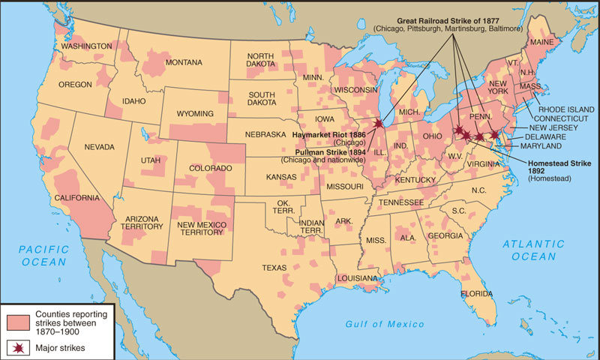
Labor Unrest: 1870-1900

Slide 6
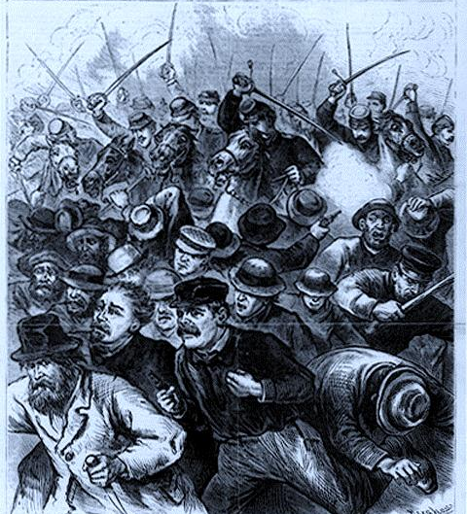
Labor-Industry Conflict
Great Railroad Strike, 1877
First nationwide strike
Strike ended by court order and federal troops
12 days of fighting; 100 dead; $10 million in damage

Slide 7
Labor-Industry Conflict
Haymarket Square Riot, 1886
AFL strike in Chicago
Someone threw a bomb – 7 died, 67 injured
Police caught 8 “anarchist” suspects
Strike led to public blaming unions for violence

Slide 8
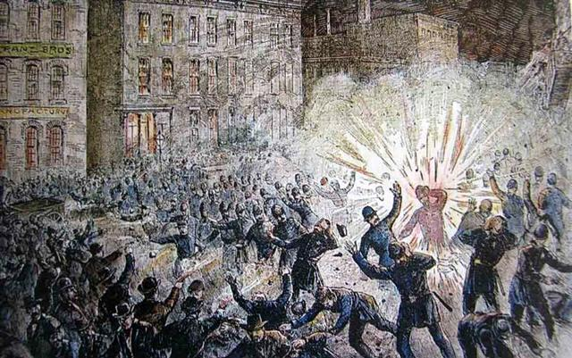

Slide 9
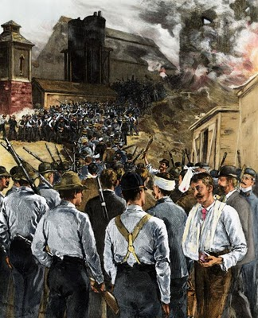
Labor-Industry Conflict
Homestead Strike, 1892
Strike started after wages were cut
Industrialists hired 300 private guards to break the strike
Governor of Pennsylvania sent troops to stop the strike

Slide 10
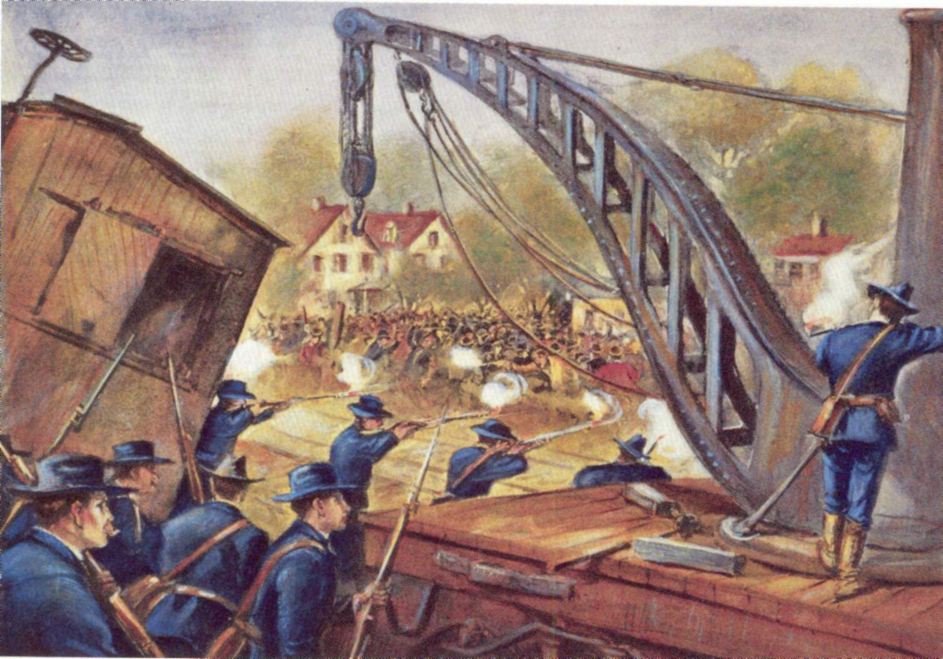
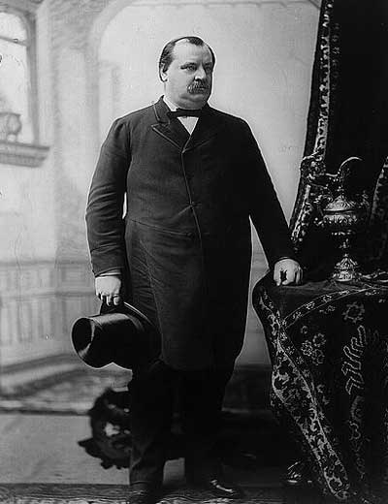
Labor-Industry Conflict
Pullman Strike, 1894
Strike after wages were cut
Industrialists asked President Cleveland to send troops
Strike was ended by a federal court injunction

Slide 11
Key Points
In contests between labor and industry, industry usually won
Large labor supply meant that industries could always find more workers
Government was not “laissez-faire” – they did intervene to help industries
Public usually saw Unions as radicals and dangerous

Slide 12
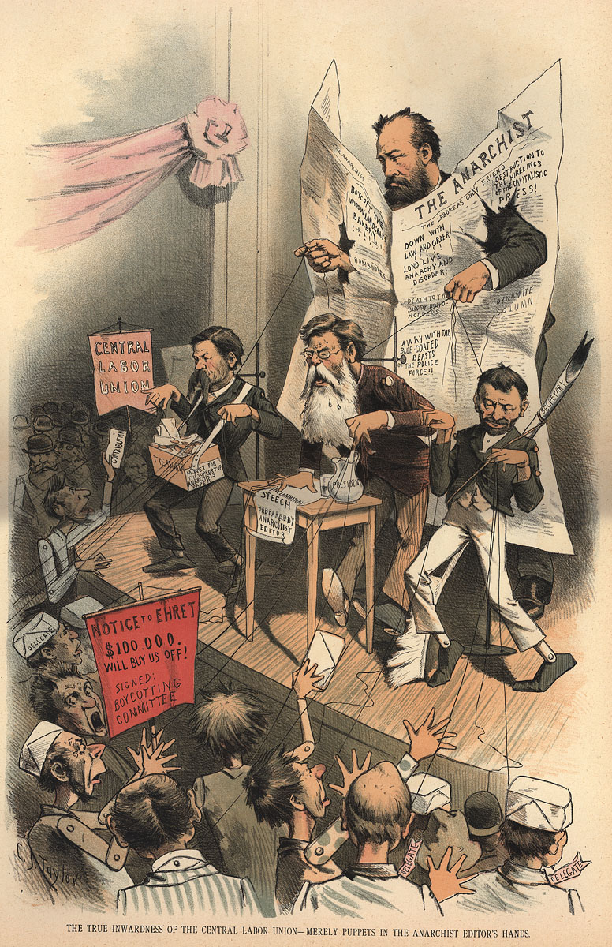
unions +
violence +
strikes = Anarchists

Slide 13
