Slide 1
United States History
Crisis: The 1850s
Dr. King-Owen

Slide 2
Compromise of 1850
Introduced the idea of popular sovereignty – allowing the people of a territory to decide the issue of slavery
Slave trade abolished in Washington, D.C.
Fugitive Slave Act
Angered northerners because they would be made to help catch runaway slaves (and fined if they didn’t)
Slaves would have no right to trial by jury
Northern states passed “personal liberty laws” that nullified the Fugitive Slave Act

Slide 3
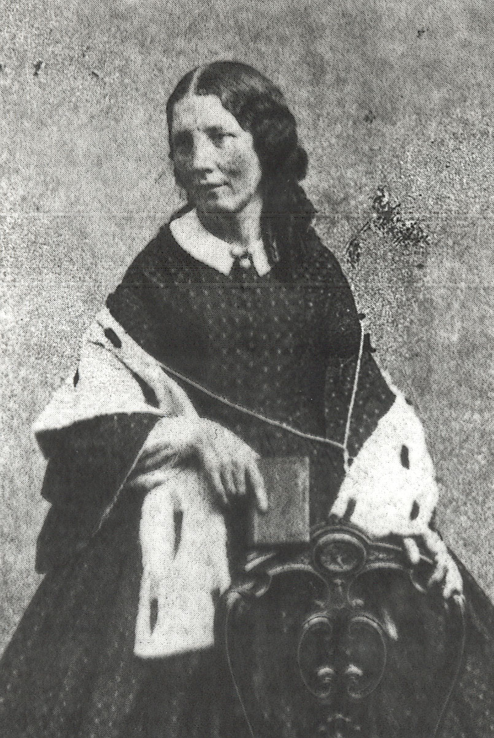
Uncle Tom’s Cabin
Harriet Beecher Stowe
1851: sold 300,000 copies in first year
Illustrations showed horrors facing runaway slaves
Increased northern dislike for slavery

Slide 4
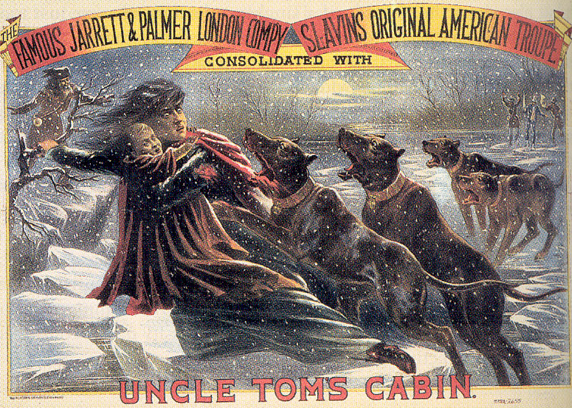

Slide 5
Kansas-Nebraska Act, 1854
Stephen Douglas: wanted popular sovereignty to apply to K-N territory
Act violated the Missouri Compromise of 1820
Slavery would only be allowed south of 36°30’
Led to the creation of the Republican Party
Caused violence in Kansas (“Bleeding Kansas”) – 200 deaths and $2 million in property damage
Caused the Brooks-Sumner Affair (1856)

Slide 6
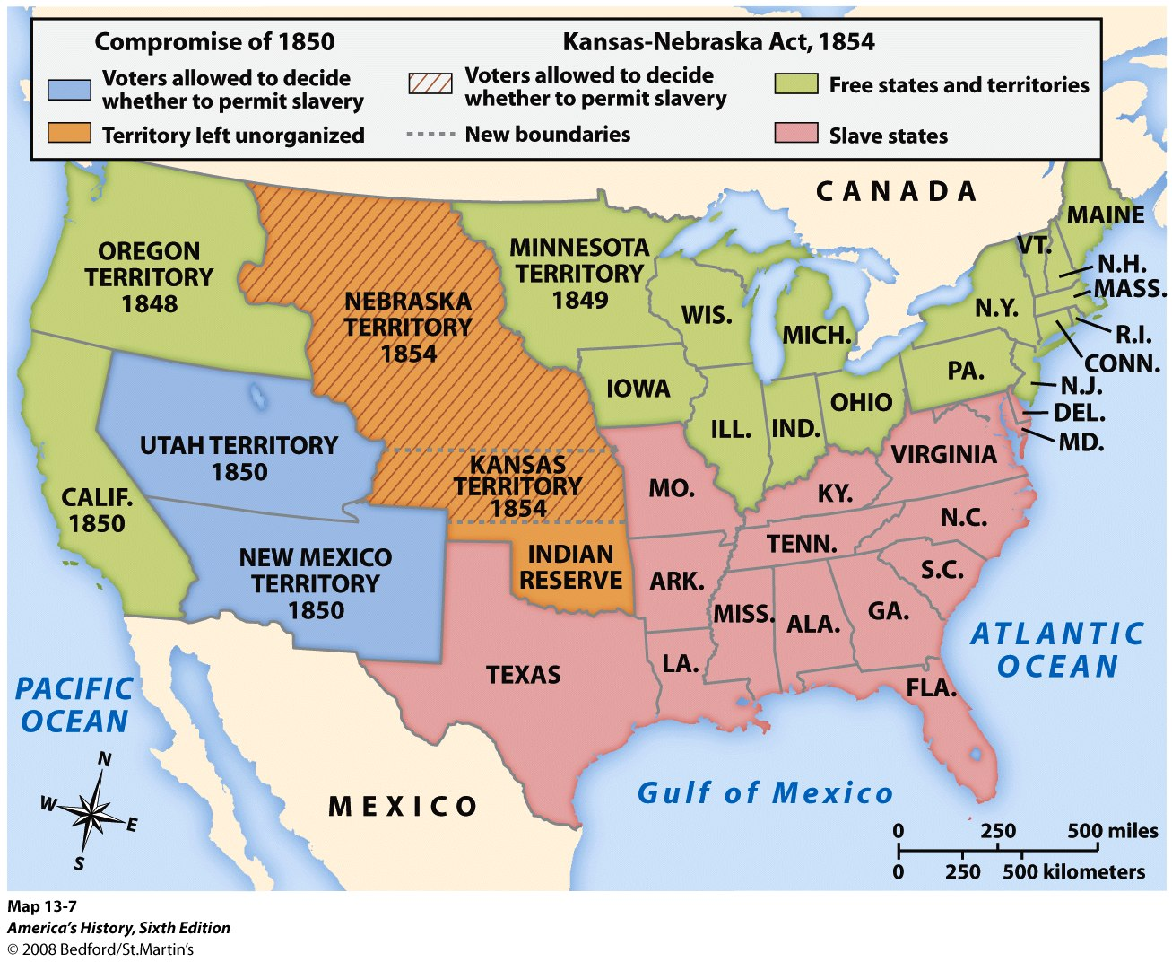

Slide 7
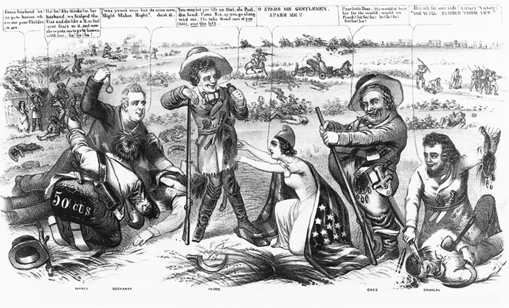

Slide 8
Dred Scott v. Sanford, 1847
Dred Scott – 1852 – Does a slave who lives on free soil become free?
Supreme Court says:
No. Free soil doesn’t make slaves free.
No. Slaves cannot sue because they are not citizens.
No. Congress never had the power to prohibit slavery anywhere (so, Missouri Compromise was unconstitutional).
No. Slaves are property; property is protected everywhere.

Slide 9
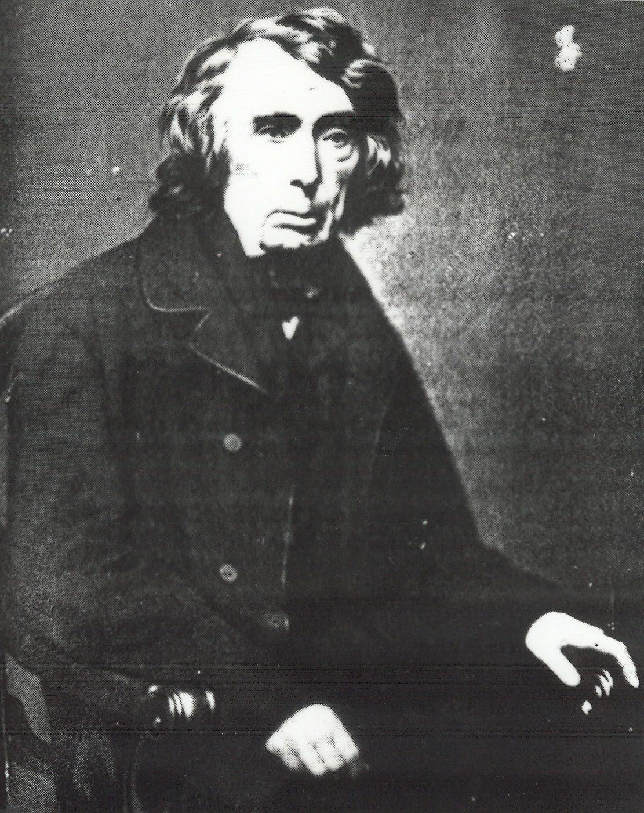
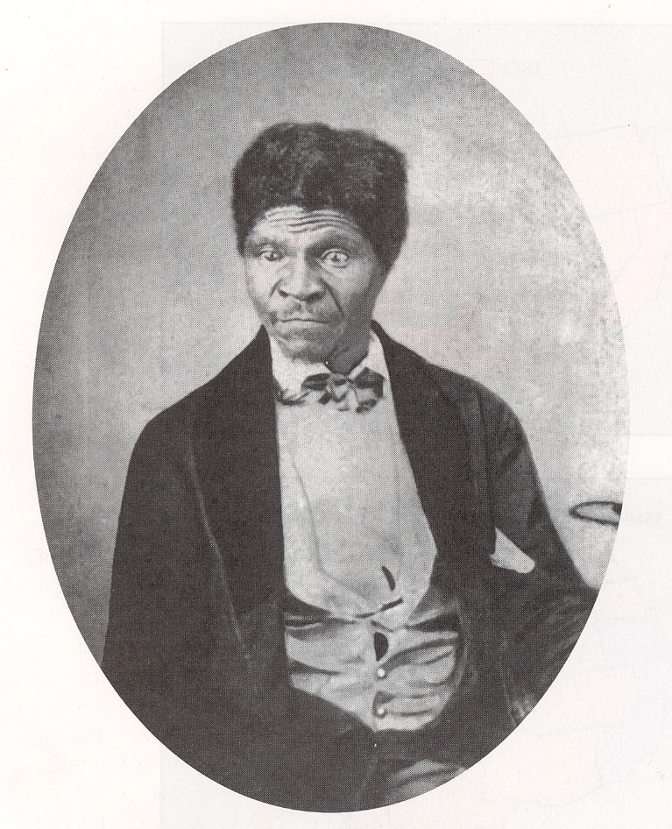

Slide 10
John Brown’s Raid
John Brown = radical, fanatic abolitionist
Funded by a northern group: “Secret Six”
Planned to raid Harper’s Ferry, VA to raise a slave army to free the slaves in the South
Raid failed. Brown was executed. Becomes a hero in North, villain in South.

