Slide 1
United States History
Dr. King-Owen
The Iron Horse [6.01]

Slide 2
Effects of Railroads
Link America—from east to west
Spur industry – steel, lumber
Promote trade – towns grow
Settle the West – transportation
Build the Cattle Frontier – transporting cows

Slide 3
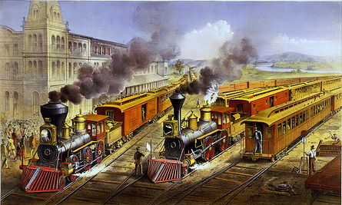

Slide 4
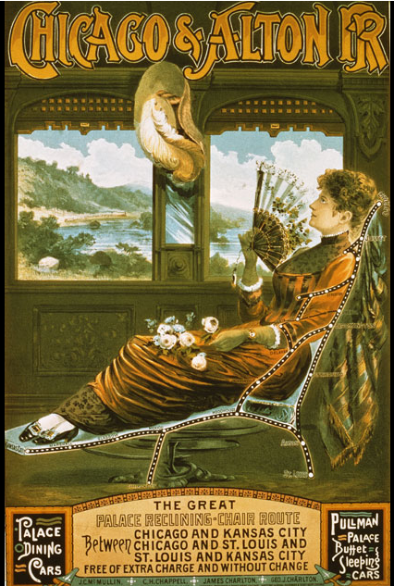

Slide 5
Railroad Power
Railroads own vast tracts of western land –1869 – first Transcontinental Railroad finished
Railroads change Time – 1883 railroads adopt time zones (Congress does in 1918)
Responsible for some economic panics
Panic of 1873 – railroad goes bankrupt

Slide 6
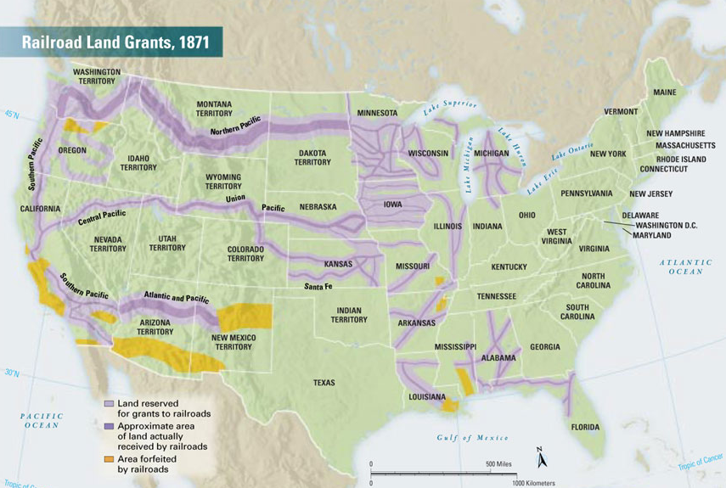

Slide 7
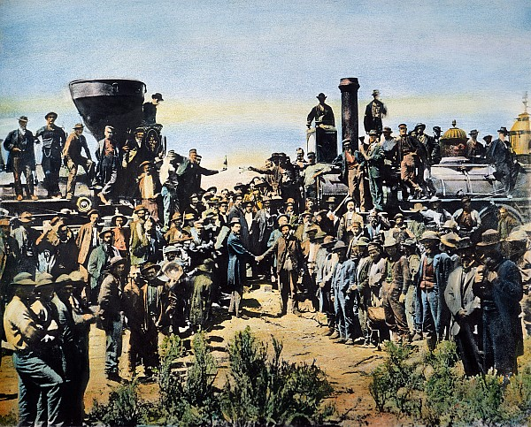

Slide 8
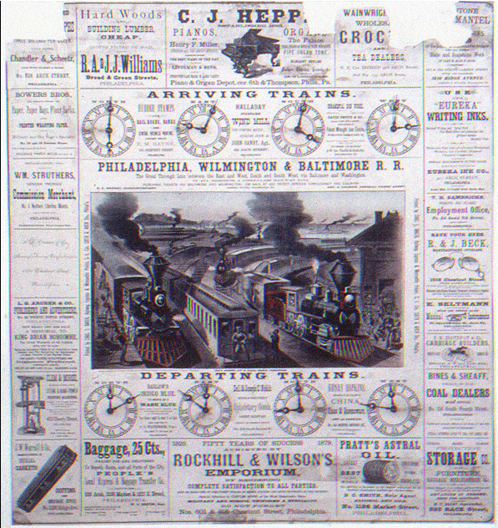

Slide 9
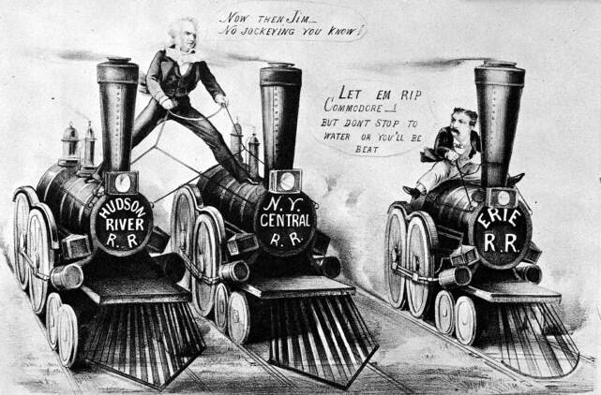
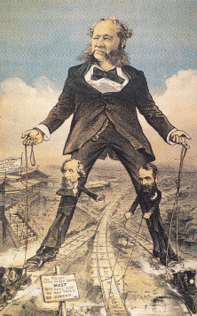

Slide 10
Railroad Corruption
Complaints against railroads
They don’t sell extra western land to settlers
They charge different rates to different customers
They charge excessively high rates
They buy and sell corrupt politicians

Slide 11
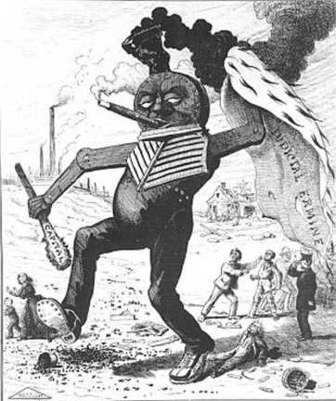

Slide 12
Fixing Railroad Abuses
Granger Laws, 1870s
Reformers in several states pass state laws to limit power of railroads
Munn v. Illinois – Supreme court rules that states can regulate railroads, 1877
Interstate Commerce Act, 1887
Federal government can supervise railroads because they cross state lines
Act is not strongly enforced

