Slide 1
United States History
Dr. King-Owen
Dawn of Mass Culture
[6.04]

Slide 2
Mass Culture
If Americans are buying factory-made products that are available across the United States, then how likely is it that they have the same consumer experiences?
The shared experience of being a consumer of the same products is called mass culture
Mass culture makes people more alike

Slide 3
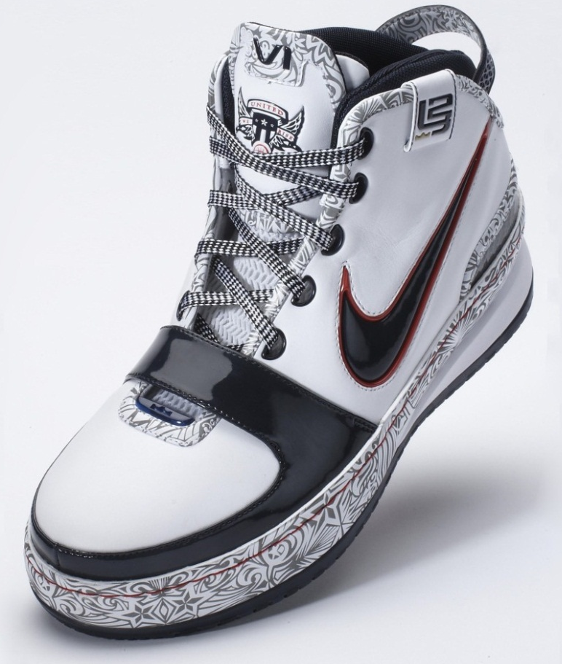

Slide 4
Advertising
Advertising increased from $10 million a year in 1865 to $95 million by 1900
Ads became more visual
Ads began to dominate newspapers
Newspapers expanded – comics, sports, Sunday editions, stories of “sin”
Two major newspaper editors: Joseph Pulitzer and William R. Hearst

Slide 5
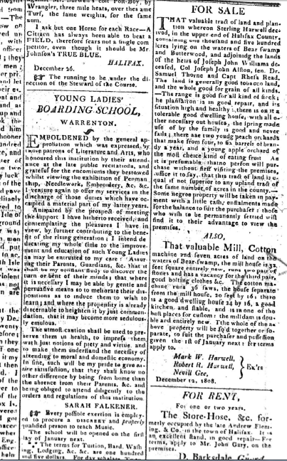
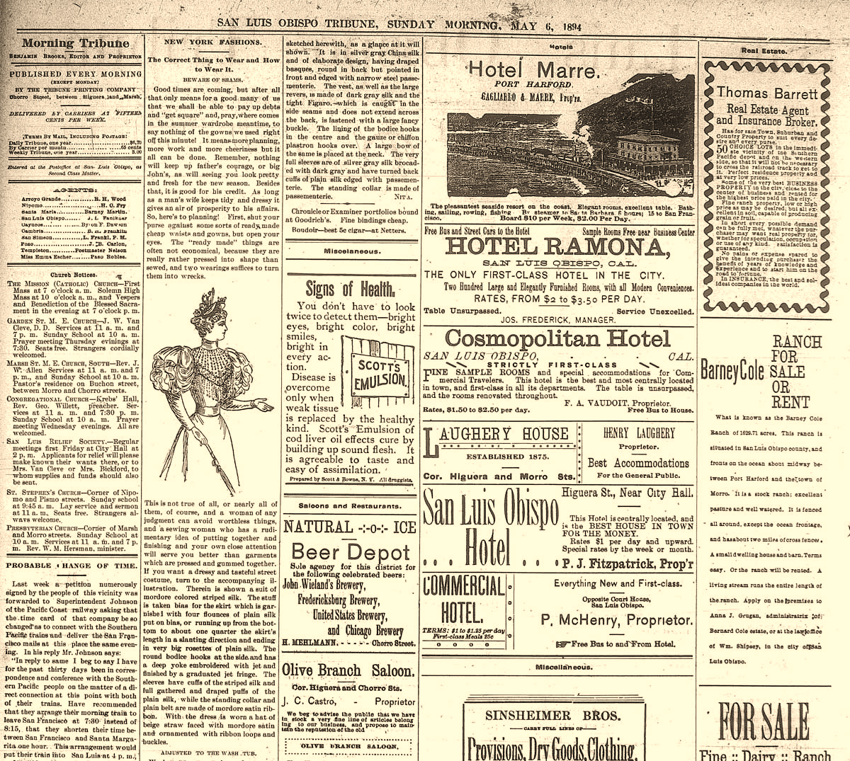

Slide 6
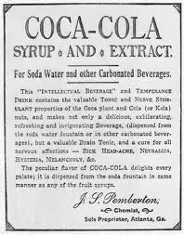
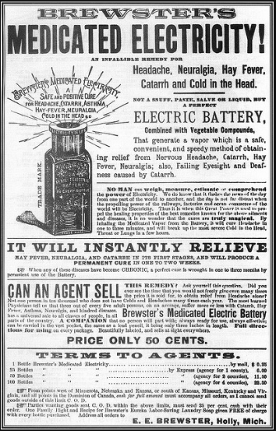
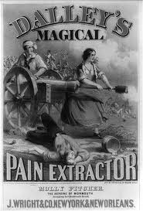
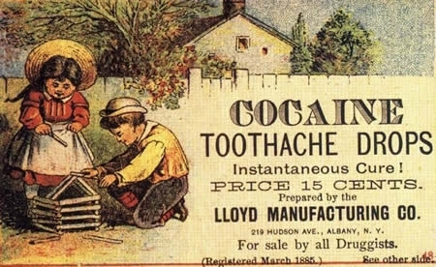
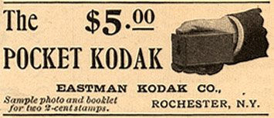

Slide 7
Going Shopping
Americans shopped at department stores and indoor malls
Cleveland – 1890 – first indoor mall
Department stores – 1865 – Marshall Field’s in Chicago
Stores offered pre-priced goods and credit
Rural customers could order from the Sears Catalogue
Rural Free Delivery – 1902 – mail was delivered to your door

Slide 8
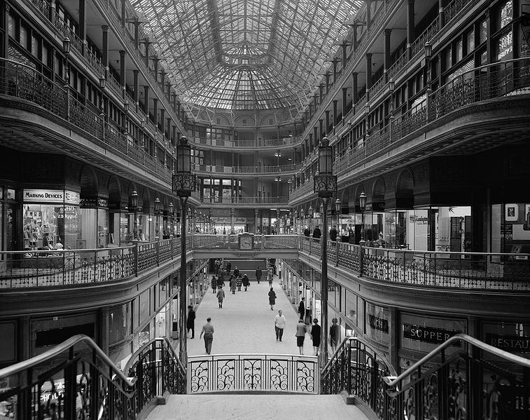
Notes:
Cleveland Arcade (1966); built in 1890; financed by John D. Rockefeller among others.

Slide 9
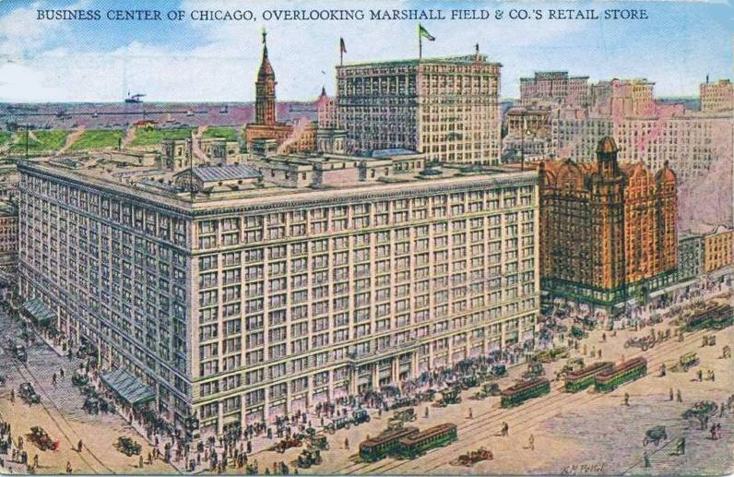
Notes:
Marshall Field’s about 1910

Slide 10
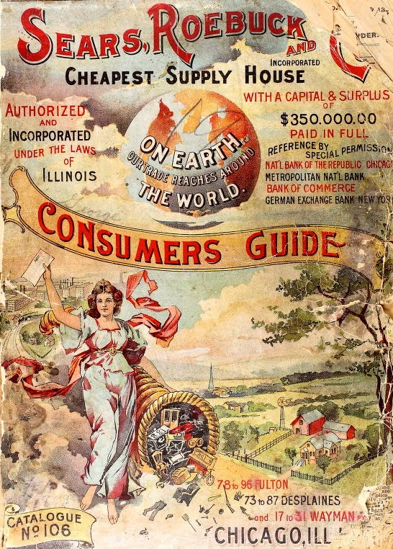
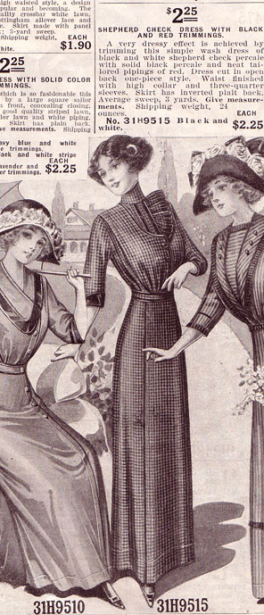

Slide 11
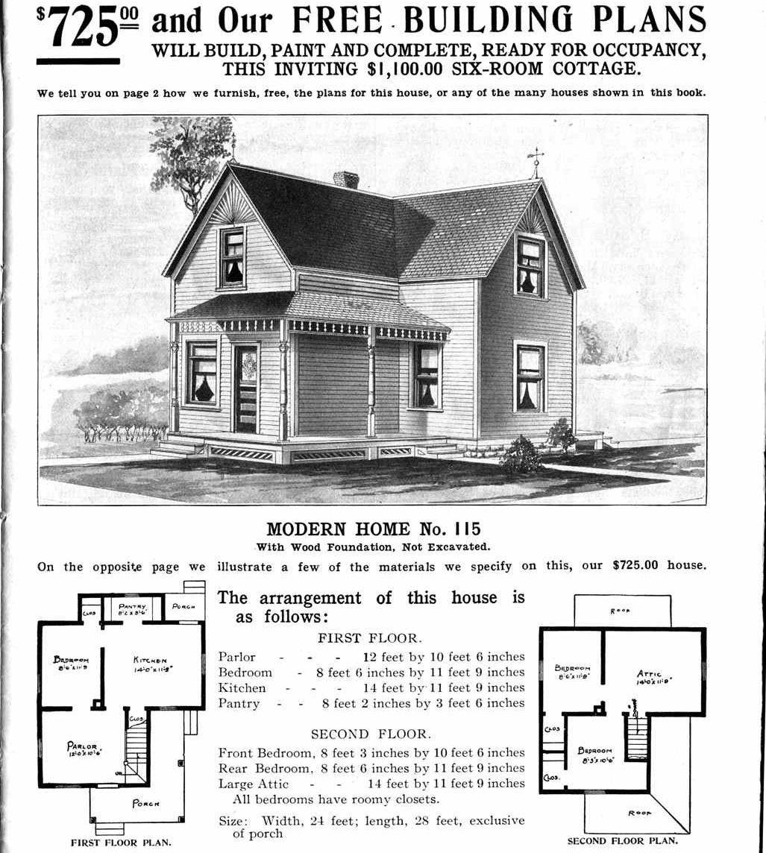
Notes:
Sears sold plans for 447 houses between 1908 and 1940. Individuals could order their own blueprints and Sears would send the precut lumber. Sears used an easy to build floorplan that required only one carpenter, pioneered the use of drywall, and used asphalt shingles. The result was an easy to build, cheap home.

Slide 12
Mass SPORTS Culture
In your groups, read about your sport and answer the accompanying questions.
Choose someone to share your answers with the class.

Slide 13
Comparisons – Way #1
Invented 1891
Game for young
men
College sport
Professional in
1898
segregated
Invented 1840s
Game for
soldiers
Professional
team by 1869
segregated
Origins 1870s
Game for young
men
College sport
Professional in
1880s
Sport for men
Used to advertise
goods
Professional
Rules by 1860s
segregated

Slide 14
Comparisons – Way # 2
Sports for young
Men in college
Men went to games
Some games were
Rough
Bicycling – women
Made men nervous
Rules created
Between 1860 – 1900
Professional leagues
And associations to
Govern sports
Companies formed
To sell sports goods
Sports used to
Advertise
Professional sports
With paid players
Sports segregated
Separate teams
Black sports stars
Made whites
nervous

