Slide 1
United States History
Dr. King-Owen
Life in the Tenements
[6.04]

Slide 2
The Tenement
A tenement – apartment building for many families
Created densely crowded conditions
Part of ethnic neighborhoods – families lived, worked, played, and worshipped together
Tenement houses were:
Dirty
Dangerous
Dark

Slide 3
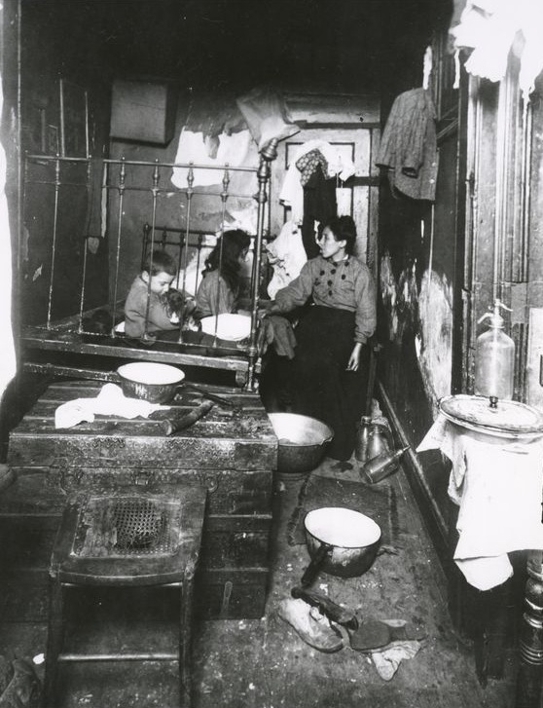
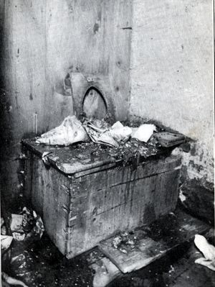

Slide 4
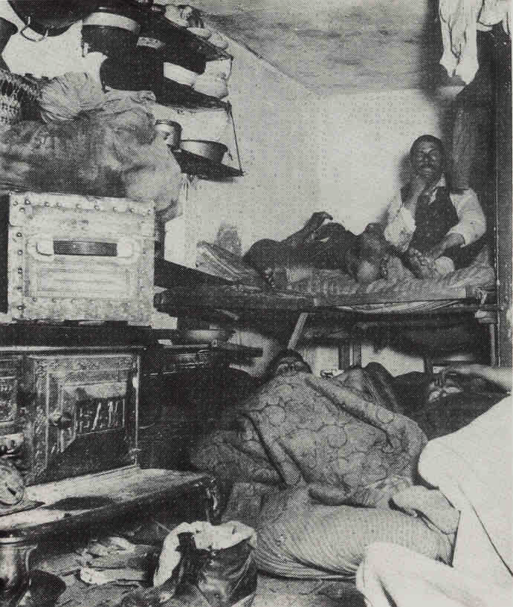

Slide 5
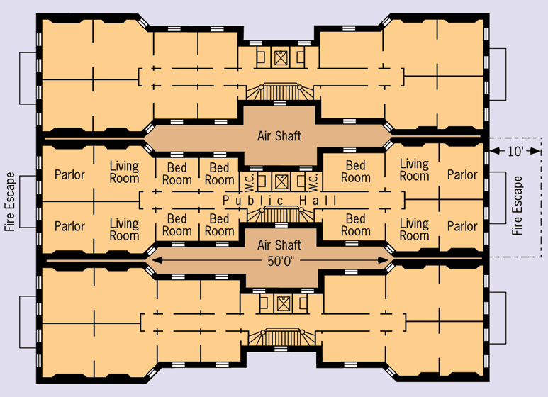
The “Dumbbell” Tenement

Slide 6
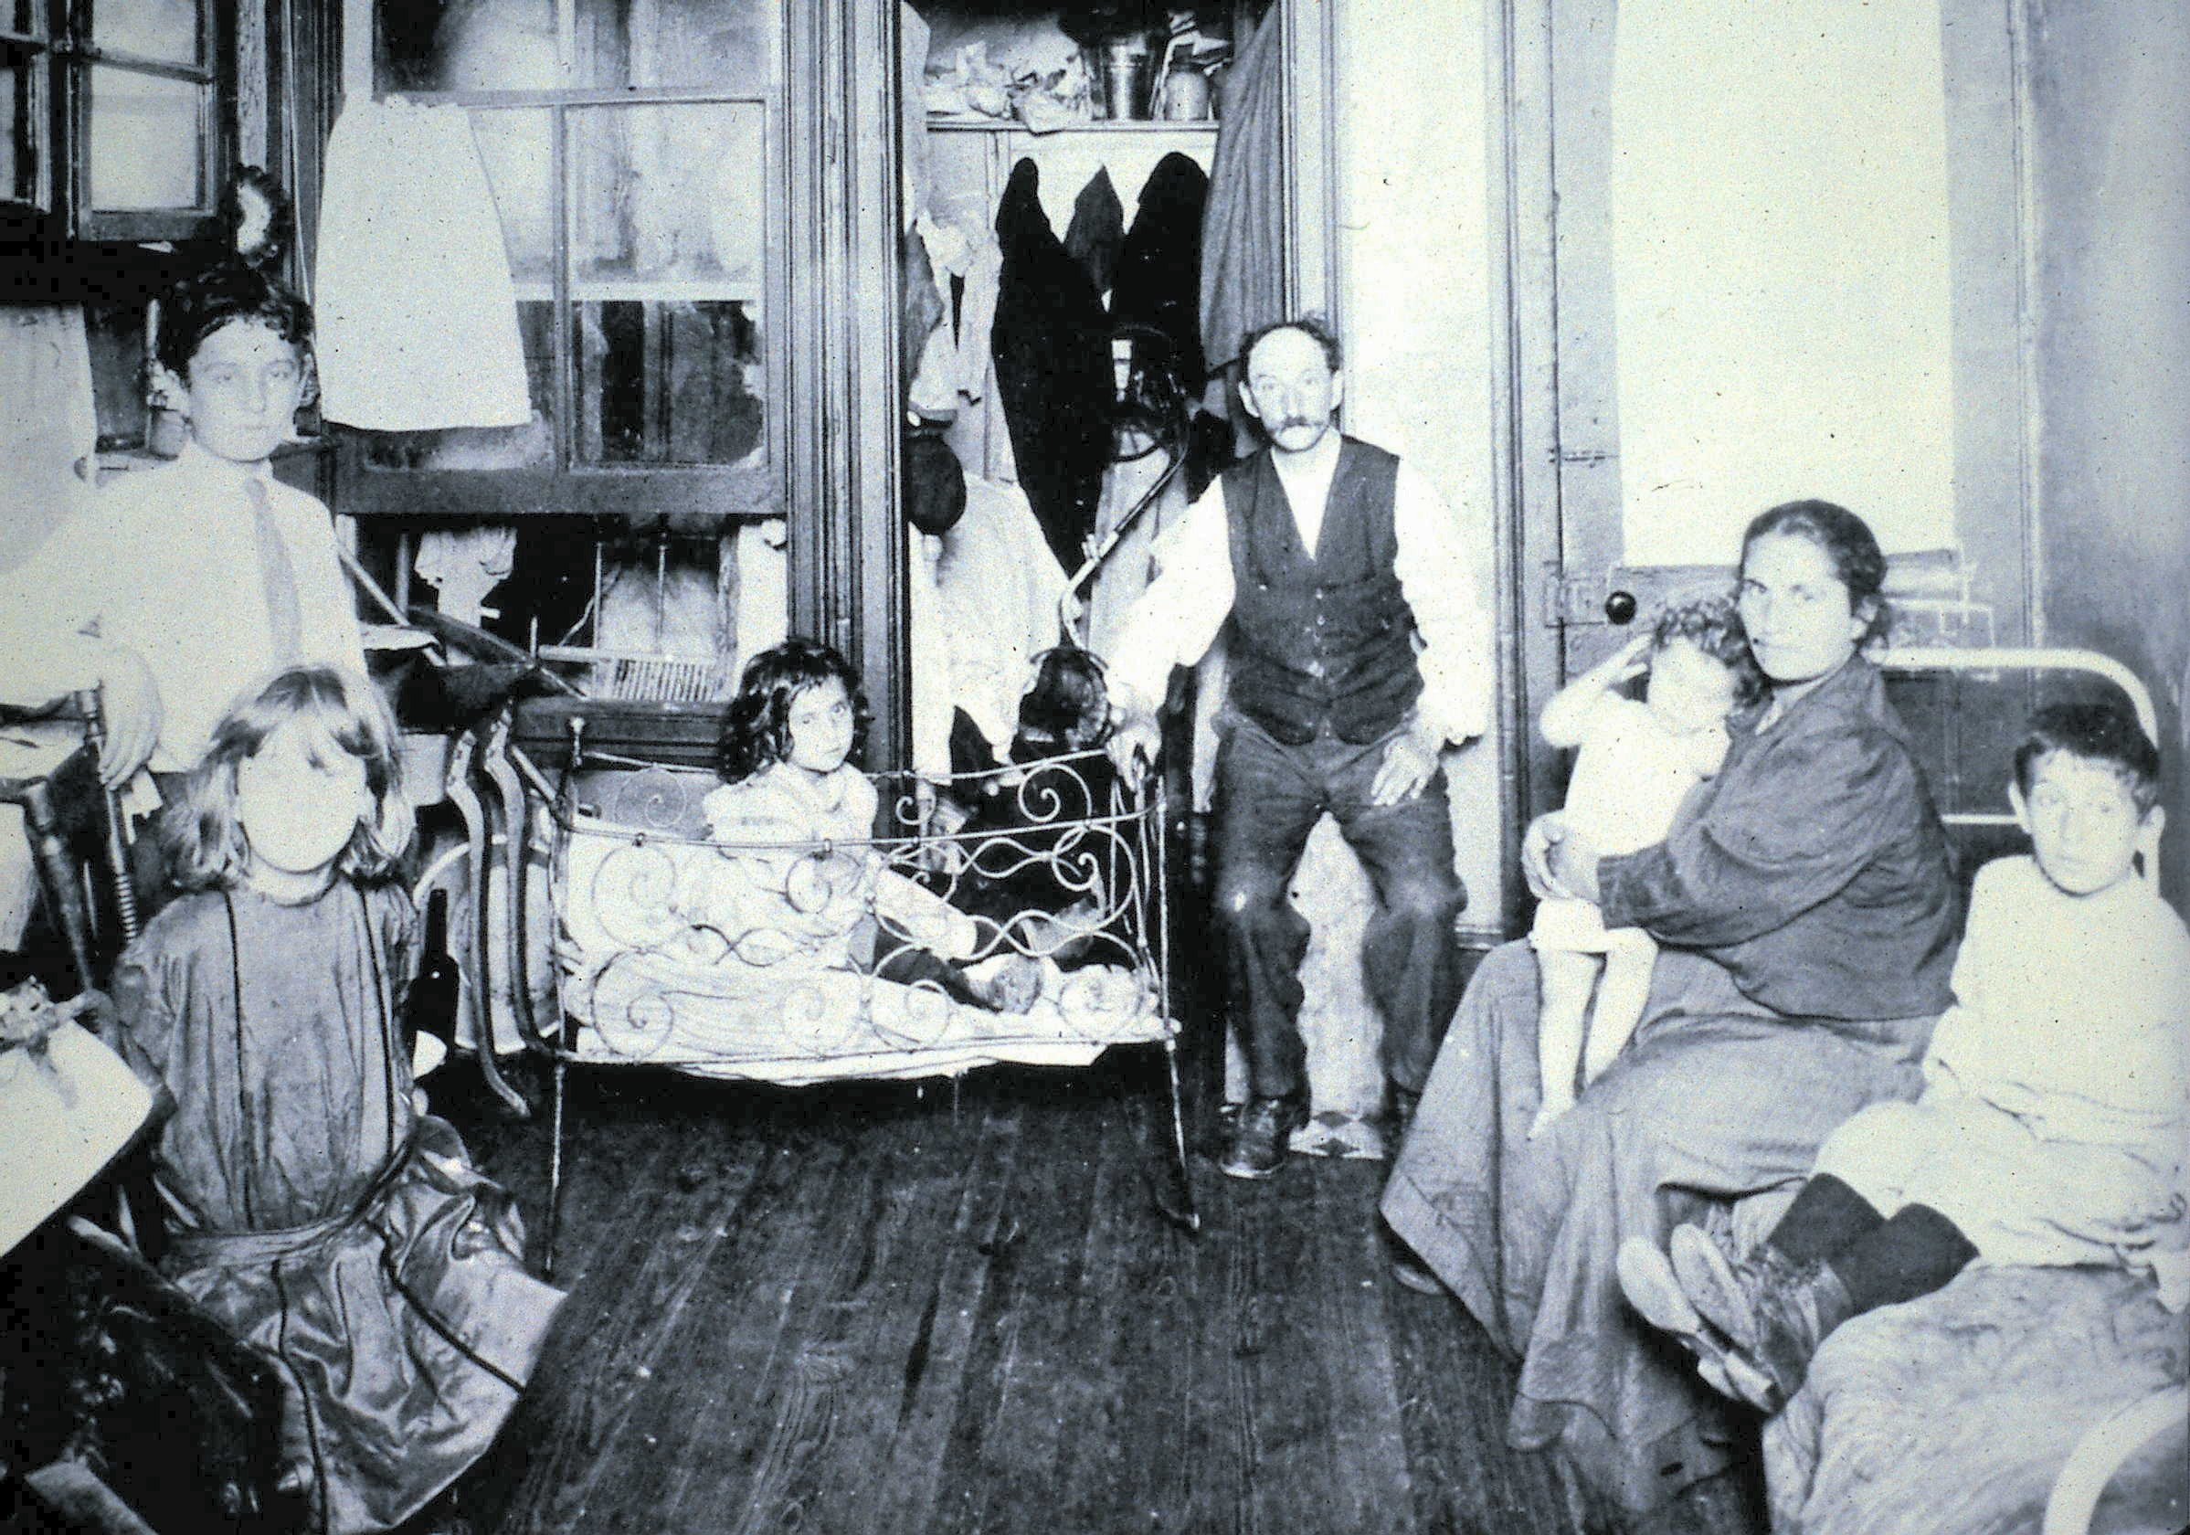

Slide 7
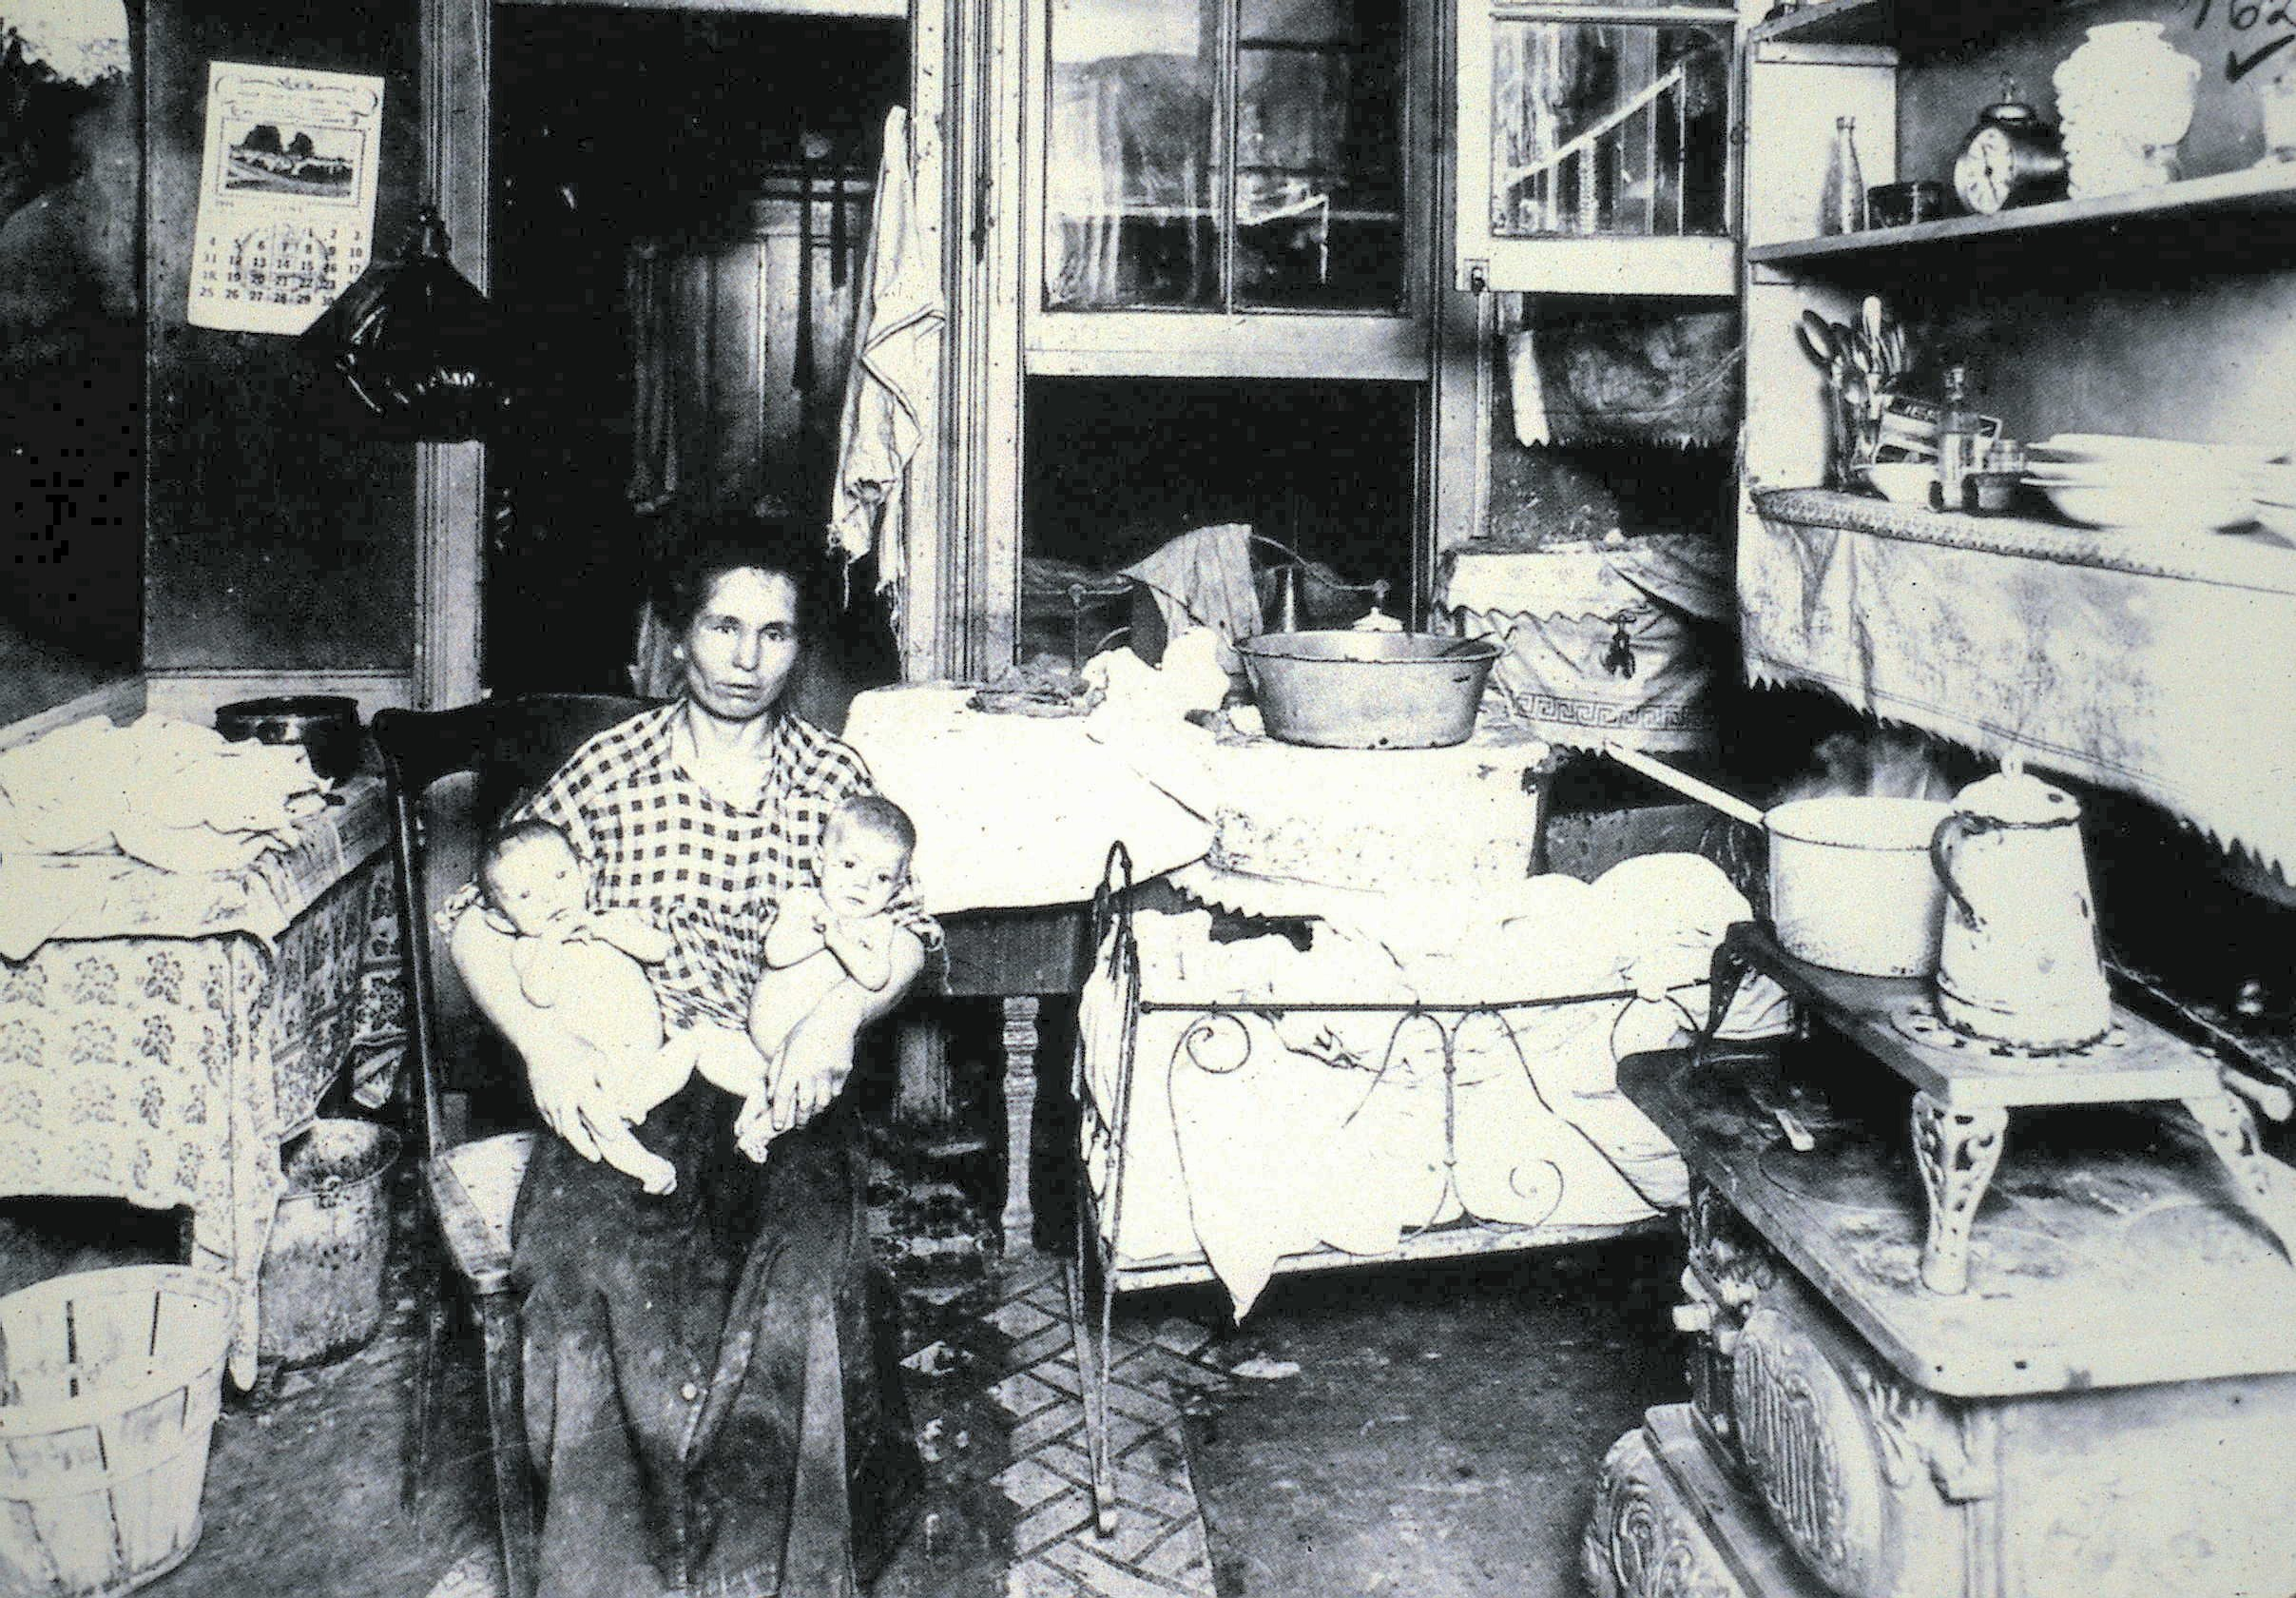

Slide 8
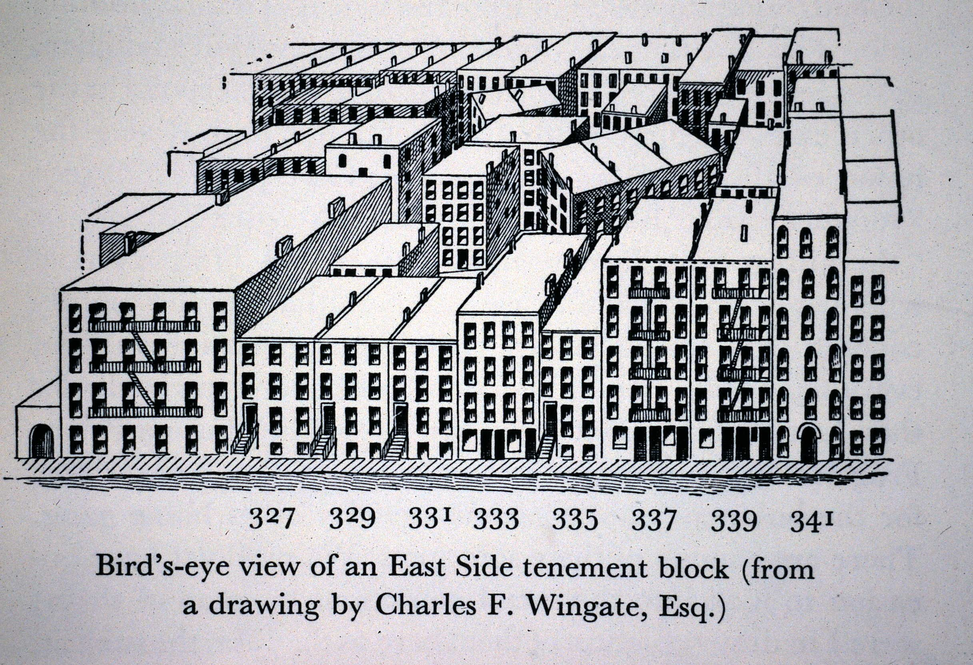

Slide 9
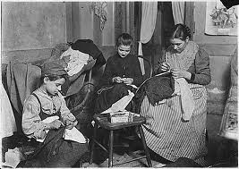
Labor in the Tenements
Many immigrants worked at home
They sewed garments (clothes) together
The entire family often worked

Slide 10
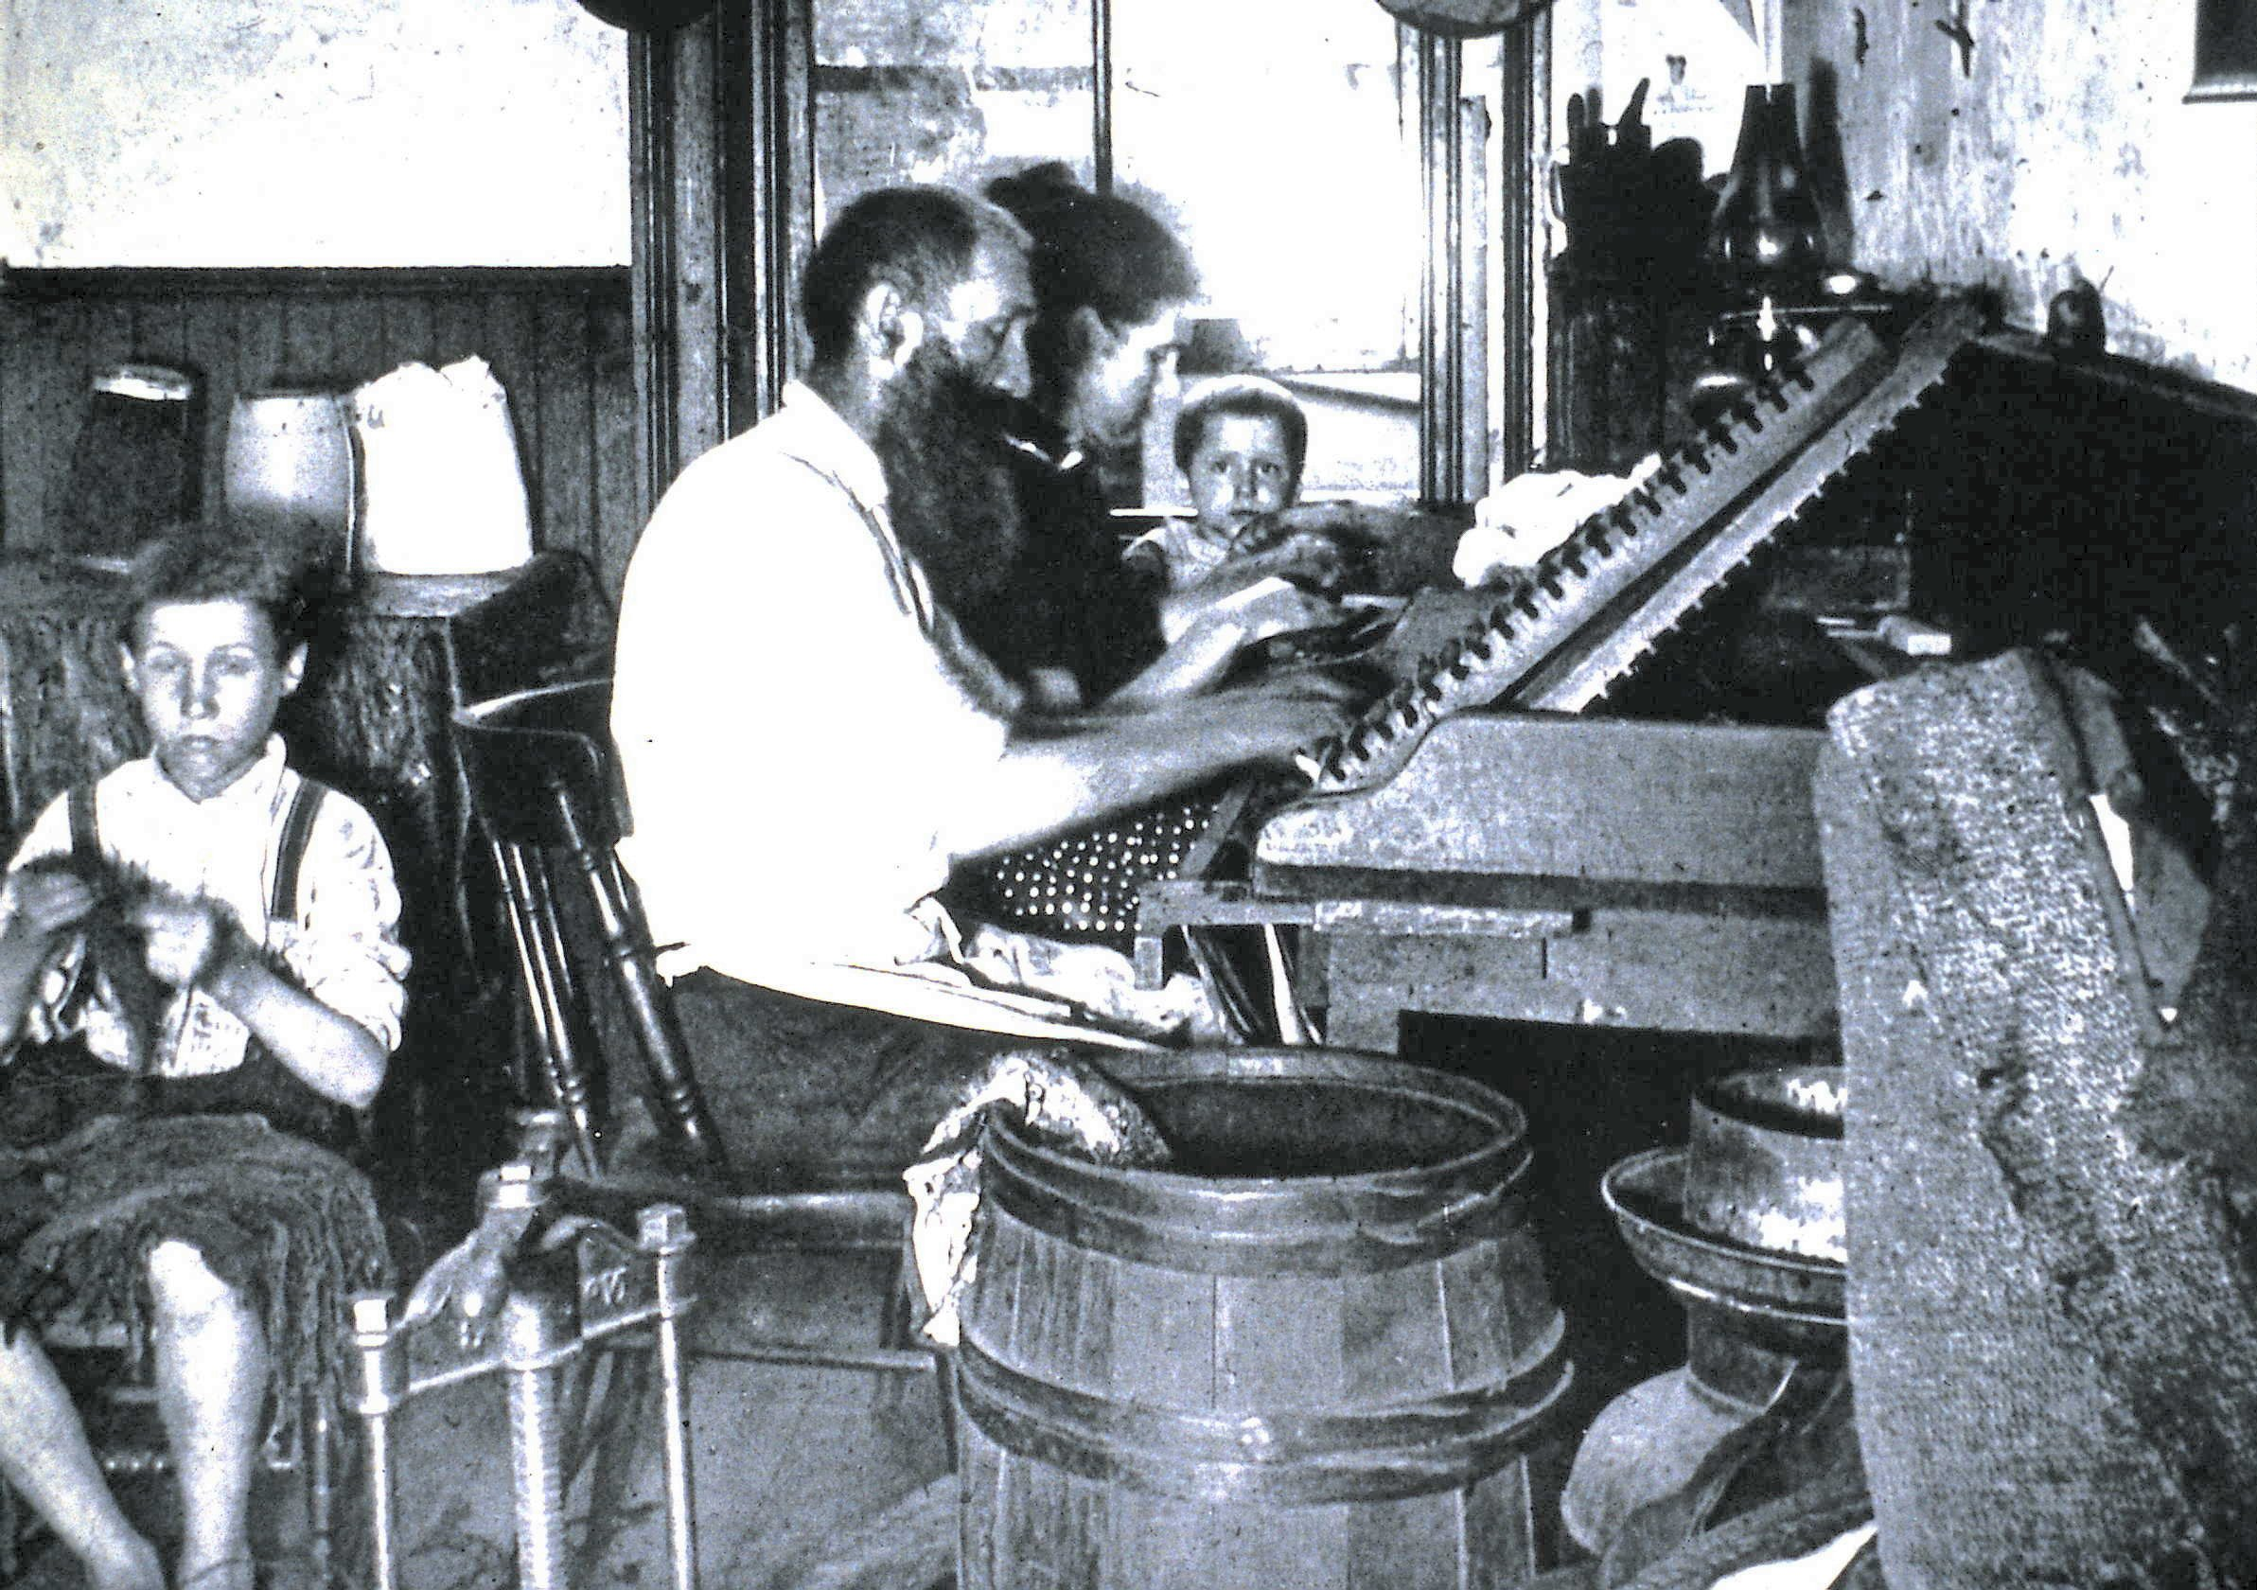

Slide 11
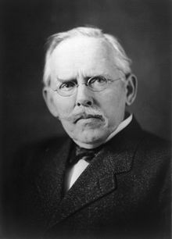
Life in the Tenements
Jacob Riis, a reformer, used photography to document tenement life in an 1890 book, How the Other Half Lives
“The slum is the measure of civilization.”

Slide 12
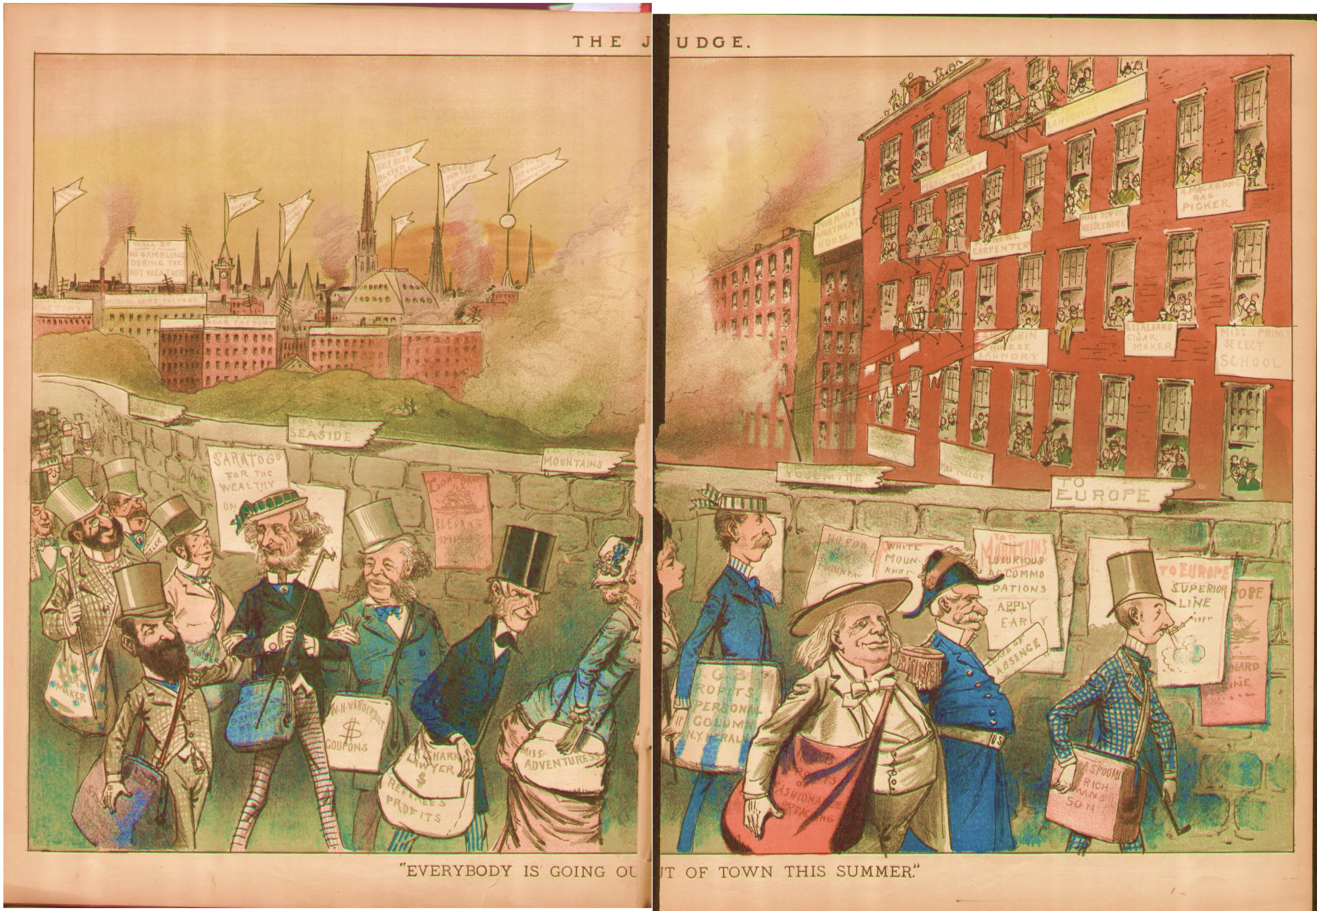

Slide 13
Social Gospel
Reformers in the 1890s began to offer welfare to the poor
Feeding, clothing, and helping the poor must come before trying to talk about religion
Settlement Houses
Homes set up by reformers to provide welfare to immigrants
They taught English, health care, hygiene, job skills
Most famous was Hull House in Chicago – ran by Jane Addams

