Slide 2
UNITED STATES HISTORY
Dr. King-Owen
The Indians’ West
[6.02]

Slide 3
United States Indian Policy
REJECTING INDIANS
CIVILIZING INDIANS
Taking land away
Attacking Indians
“Indians will always be Indian”
Teaching Indians white ways (farming, writing)
Putting Indians on reservations
“Indians can be civilized”

Slide 4
What do Indians Want?
Some want assimilation
They become like white Americans
Others want accommodation
Outwardly, they act like white Americans
Inwardly, they still act like Indians

Slide 5
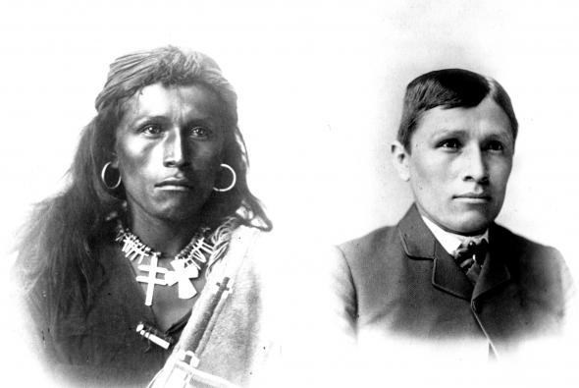

Slide 6
Indian Religion
Faced with the loss of land and murder by the U.S. Army, Indians turned to religion….
Ghost Dance Movement, 1890s
If Indian people returned to their traditional faith, they could escape the white man’s control

Slide 7
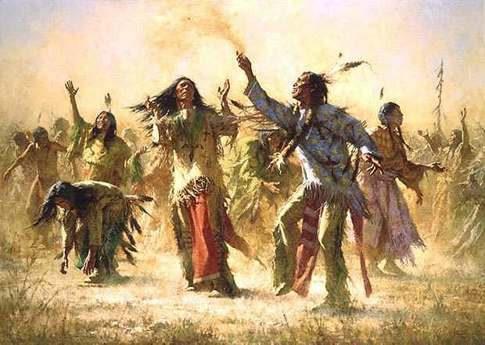

Slide 8
Indian Boarding Schools
In the 1870s and 1880, the federal government set up Boarding Schools to train Indian children how to be white
By 1902 there were 6,000 children enrolled
Some children were forced to attend
Children had to attend Christian churches and could not speak Indian languages

Slide 10
Video
Chief Joseph and the Nez Perce

Slide 11
Chief Joseph of the Nez Perce
I am tired of fighting. Our chiefs are killed. Looking Glass is dead. Toohulhulsote is dead. The old men are all dead. It is the young men who say yes or no. He who led the young men is dead.
It is cold and we have no blankets. The little children are freezing to death. My people, some of them, have run away to the hills and have no blankets, no food. No one knows where they are--perhaps freezing to death. I want to have time to look for my children and see how many I can find. Maybe I shall find them among the dead.
Hear me, my chiefs. I am tired. My heart is sick and sad. From where the sun now stands, I will fight no more forever.

