Slide 1
Unit 7 Overview
Unit 7 has three big storylines:
How American farmers forged a political party to challenge railroads and industrialists
How African Americans responded to increasing segregation and discrimination
How America acquired territory overseas through wars

Slide 2
The Farming Game Target 7.01
Instructions

Slide 3
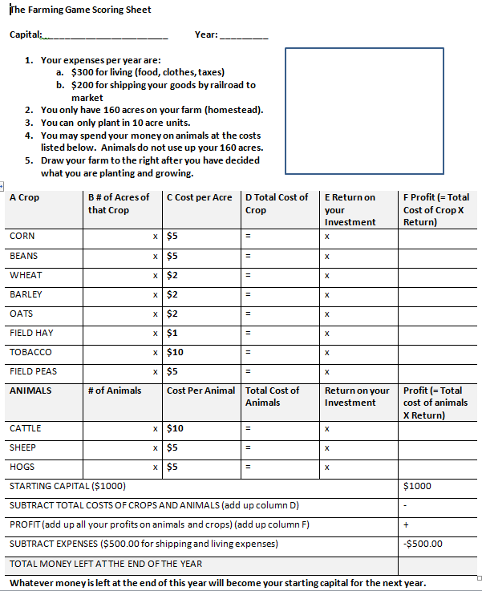
Farming Game Instructions
$1000
1885
Results for 1885:
A serious lack of early spring rains destroyed the wheat, barley, and oat crop. The prices paid for corn, beans, field peas, and tobacco are up because of drought east of the Mississippi River. Cattle prices are depressed because of large herds of range stock being sold. The price for sheep is up and the price of hogs is at an all-time high.
50
$250
x 2
= $500
x 3
50
$100
x 1
= $100
x 1
50
$100
x 1
= $100
10
$10
x 2
= $20
x 2
x 2
10
$100
x 1
$100
x 2
50
$250
x 3
$750
$810
$1570
= $1260

Slide 4
A Crop | B # of Acres of that Crop | C Cost per Acre | D Total Cost of Crop | E Return on Investment | F Profit (= Total Cost of Crop X Return)
CORN | x | $5 | = | 2
BEANS | x | $5 | = | 1
WHEAT | x | $2 | = | 2
BARLEY | x | $2 | = | 2
OATS | x | $2 | = | 2
FIELD HAY | x | $1 | = | 1
TOBACCO | x | $10 | = | 2
FIELD PEAS | x | $5 | = | 2
ANIMALS | # of Animals | Cost Per Animal | Total Cost of Animals | Return on your Investment | Profit (= Total cost of animals X Return)
CATTLE | x | $10 | = | 0
SHEEP | x | $5 | = | 3
HOGS | x | $5 | = | 0
STARTING CAPITAL (from previous year) |  |  |  |  | $
SUBTRACT TOTAL COSTS OF CROPS AND ANIMALS (add up column D) |  |  |  |  | -
PROFIT (add up all your profits on animals and crops) (add up column F) |  |  |  |  | +
SUBTRACT EXPENSES ($500.00 for shipping and living expenses) |  |  |  |  | -$500.00
TOTAL MONEY LEFT AT THE END OF THE YEAR: 1886
Remember to carry over your profit from the previous year. Are you going to gamble it all or save $500 for expenses?
Results for 1886
The coldest winter in history with temperatures 60 below zero destroyed most of the cattle and hogs. Sheep prices are high. Abundant spring and summer rains has produced excellent crops. The price of corn, wheat, barely, and oats is good. The bean crop has a small yield because of a late frost. Limited demand for hay accounts for current hay prices.

Slide 5
A Crop | B # of Acres of that Crop | C Cost per Acre | D Total Cost of Crop | E Return on Investment | F Profit (= Total Cost of Crop X Return)
CORN | x | $5 | = | 1
BEANS | x | $5 | = | 1
WHEAT | x | $2 | = | 2
BARLEY | x | $2 | = | 2
OATS | x | $2 | = | 1
FIELD HAY | x | $1 | = | 2
TOBACCO | x | $10 | = | 1
FIELD PEAS | x | $5 | = | 1
ANIMALS | # of Animals | Cost Per Animal | Total Cost of Animals | Return on your Investment | Profit (= Total cost of animals X Return)
CATTLE | x | $10 | = | 3
SHEEP | x | $5 | = | 1
HOGS | x | $5 | = | 2
STARTING CAPITAL (from previous year) |  |  |  |  | $
SUBTRACT TOTAL COSTS OF CROPS AND ANIMALS (add up column D) |  |  |  |  | -
PROFIT (add up all your profits on animals and crops) (add up column F) |  |  |  |  | +
SUBTRACT EXPENSES ($500.00 for shipping and living expenses) |  |  |  |  | -$500.00
TOTAL MONEY LEFT AT THE END OF THE YEAR: 1887
Remember to carry over your profit from the previous year. Are you going to gamble it all or save $500 for expenses?
Results for 1887
Nature deals a crushing blow to farmers. After a hot, dry spring with little rain, a plague of grasshoppers attacks. Most crops are badly damaged. Cattle prices are very good. Sheep prices are depressed but hog prices are good.
Oh No! The railroad raises its rates $100. Now deduct $600 from your profit

Slide 6
A Crop | B # of Acres of that Crop | C Cost per Acre | D Total Cost of Crop | E Return on Investment | F Profit (= Total Cost of Crop X Return)
CORN | x | $5 | = | 3
BEANS | x | $5 | = | 3
WHEAT | x | $2 | = | 0
BARLEY | x | $2 | = | 0
OATS | x | $2 | = | 0
FIELD HAY | x | $1 | = | 2
TOBACCO | x | $10 | = | 1
FIELD PEAS | x | $5 | = | 3
ANIMALS | # of Animals | Cost Per Animal | Total Cost of Animals | Return on your Investment | Profit (= Total cost of animals X Return)
CATTLE | x | $10 | = | 2
SHEEP | x | $5 | = | 1
HOGS | x | $5 | = | 0
STARTING CAPITAL (from previous year) |  |  |  |  | $
SUBTRACT TOTAL COSTS OF CROPS AND ANIMALS (add up column D) |  |  |  |  | -
PROFIT (add up all your profits on animals and crops) (add up column F) |  |  |  |  | +
SUBTRACT EXPENSES ($500.00 for shipping and living expenses) |  |  |  |  | -$600.00
TOTAL MONEY LEFT AT THE END OF THE YEAR: 1888
Remember to carry over your profit from the previous year. Are you going to gamble it all or save $600 for expenses?
Results for 1888
A serious drought destroyed the wheat, barley, oats, and tobacco crops. Corn, beans, and field peas are in good condition thanks to irrigation systems in the west. Sheep prices are low. Hogs are infested with tapeworms.
Oh No! You were late on your mortgage payment. The bank charges you an extra $100 dollars.

Slide 7
A Crop | B # of Acres of that Crop | C Cost per Acre | D Total Cost of Crop | E Return on Investment | F Profit (= Total Cost of Crop X Return)
CORN | x | $5 | = | 2
BEANS | x | $5 | = | 1
WHEAT | x | $2 | = | 2
BARLEY | x | $2 | = | 2
OATS | x | $2 | = | 2
FIELD HAY | x | $1 | = | 1
TOBACCO | x | $10 | = | 2
FIELD PEAS | x | $5 | = | 2
ANIMALS | # of Animals | Cost Per Animal | Total Cost of Animals | Return on your Investment | Profit (= Total cost of animals X Return)
CATTLE | x | $10 | = | 0
SHEEP | x | $5 | = | 3
HOGS | x | $5 | = | 0
STARTING CAPITAL (from previous year) |  |  |  |  | $
SUBTRACT TOTAL COSTS OF CROPS AND ANIMALS (add up column D) |  |  |  |  | -
PROFIT (add up all your profits on animals and crops) (add up column F) |  |  |  |  | +
SUBTRACT EXPENSES ($600.00 for shipping and living expenses) |  |  |  |  | -$600.00
TOTAL MONEY LEFT AT THE END OF THE YEAR: 1889
Remember to carry over your profit from the previous year. Are you going to gamble it all or save $600 for expenses?
Results for 1889
A good spring season of rain brought about abundant crops this year of wheat, barley, oats, and tobacco. Corn and beans were plentiful while field hay and field peas suffered from overproduction. Cattle and hogs suffered from disease but sheep are at an all-time high.

Slide 8
Debriefing: The Farming Game
What was the most difficult part of the farming experience?
Would you have wanted to be a farmer during the 1880s? Why or why not?
Why is so hard to get ahead if you make the wrong choice early in the game?

Slide 9
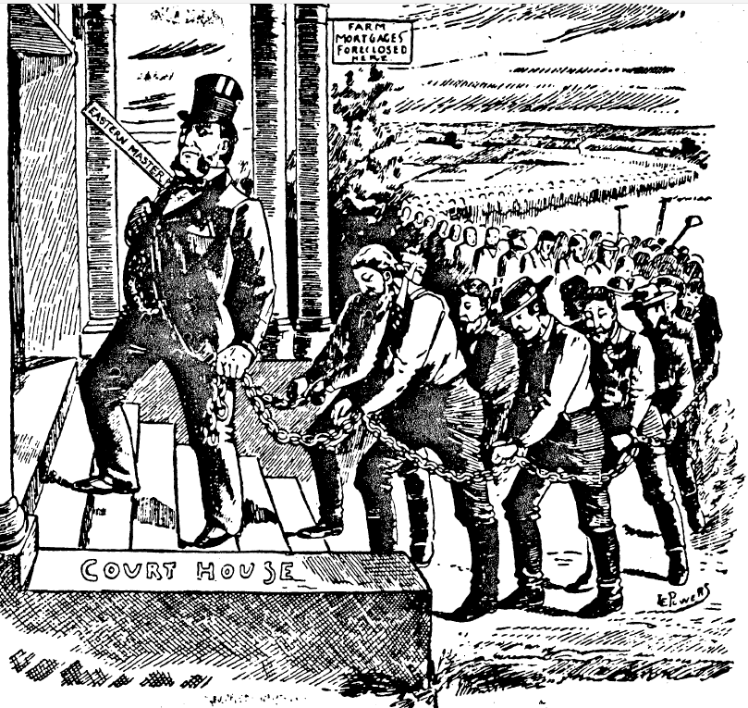

Slide 10
