Slide 1
America: World Power Dr. King-owen [7.03]
United States History

Slide 2
Reasons for Imperialism
Everyone’s Doing It
Race for empire around the globe
Military Muscle
Building an American navy
American Imperialism
Thirst for Markets
Selling American goods
Superiority
American civilization is the best

Slide 3
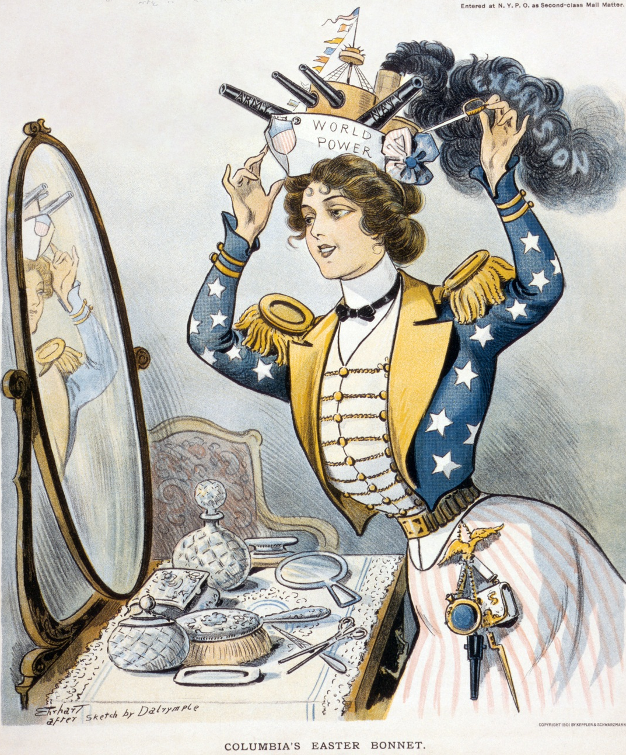
Military Muscle
America builds a navy to compete with other nations
To sail around the world, the navy needs bases in the Pacific (food and fuel)

Slide 4
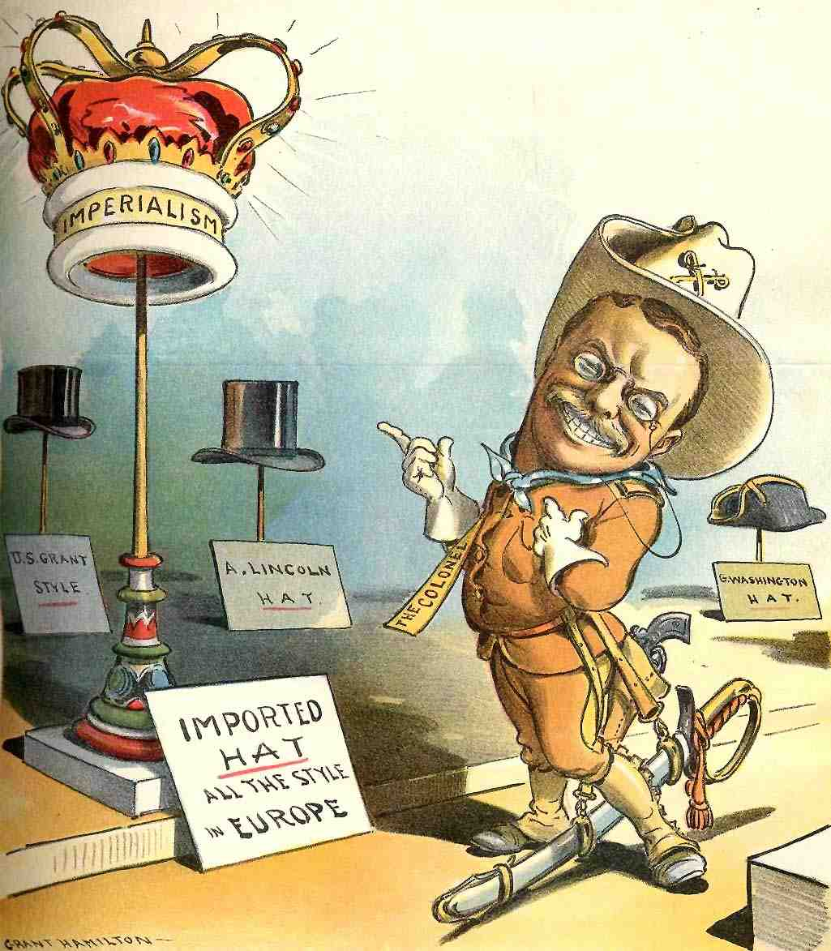
Everyone’s Doing It
Europe is colonizing other lands in the late 19th century (known as Imperialism)
America has a history of Manifest Destiny
America’s frontier – limit of American settlement—closes in 1893

Slide 5
Thirst for Markets
Robber Barons need new markets to sell goods and new sources of raw materials

Slide 6
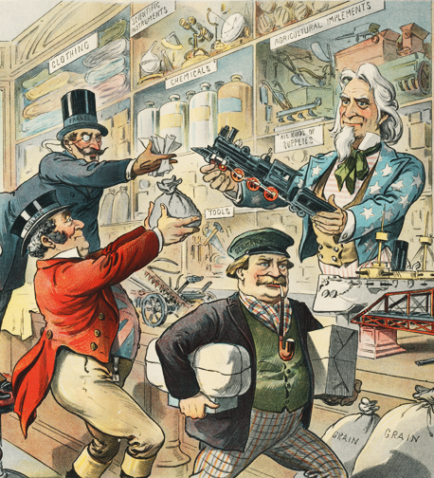
1899, “The Greatest Department Store on Earth”
Uncle Sam sells what the rest of the world wants.

Slide 7
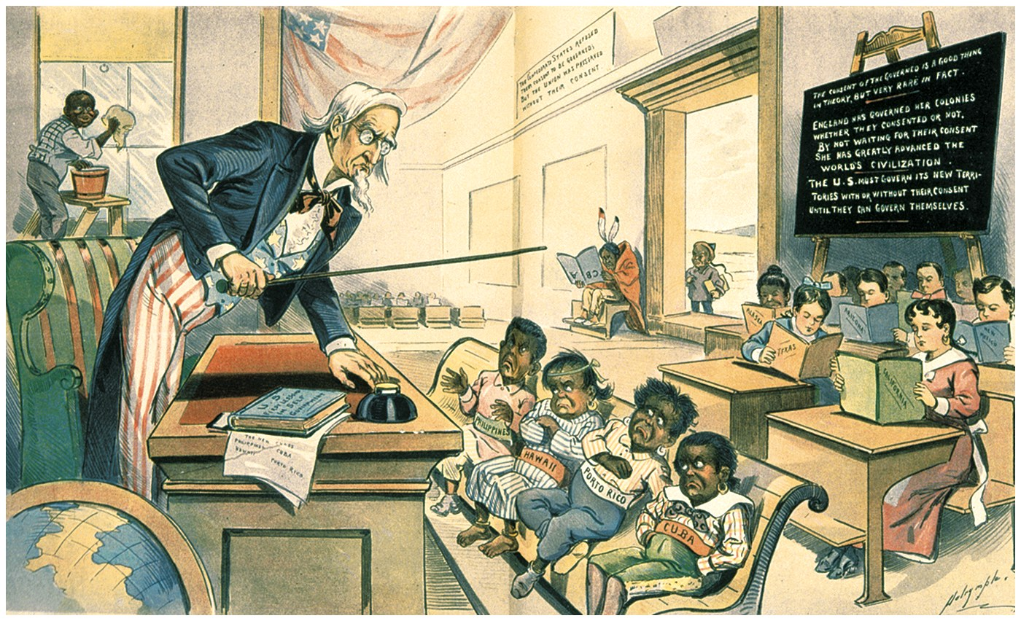
Superiority
Americans believe that, as Anglo-Saxons, they are
Religiously, politically, and culturally superior to other people

Slide 8
Adding New Territory
Territory | Date Added | How Acquired
Alaska | 1867 | Purchase from Russia for $7.2 million
Hawaii | 1898 | Americans overthrew the Queen and took control
Puerto Rico | 1899 | Americans defeated Spain in a war
Philippines | 1899 | Americans defeated Spain; U.S. paid $20 million
How did the U.S. acquire most of its territory from 1867 to 1899?

Slide 9
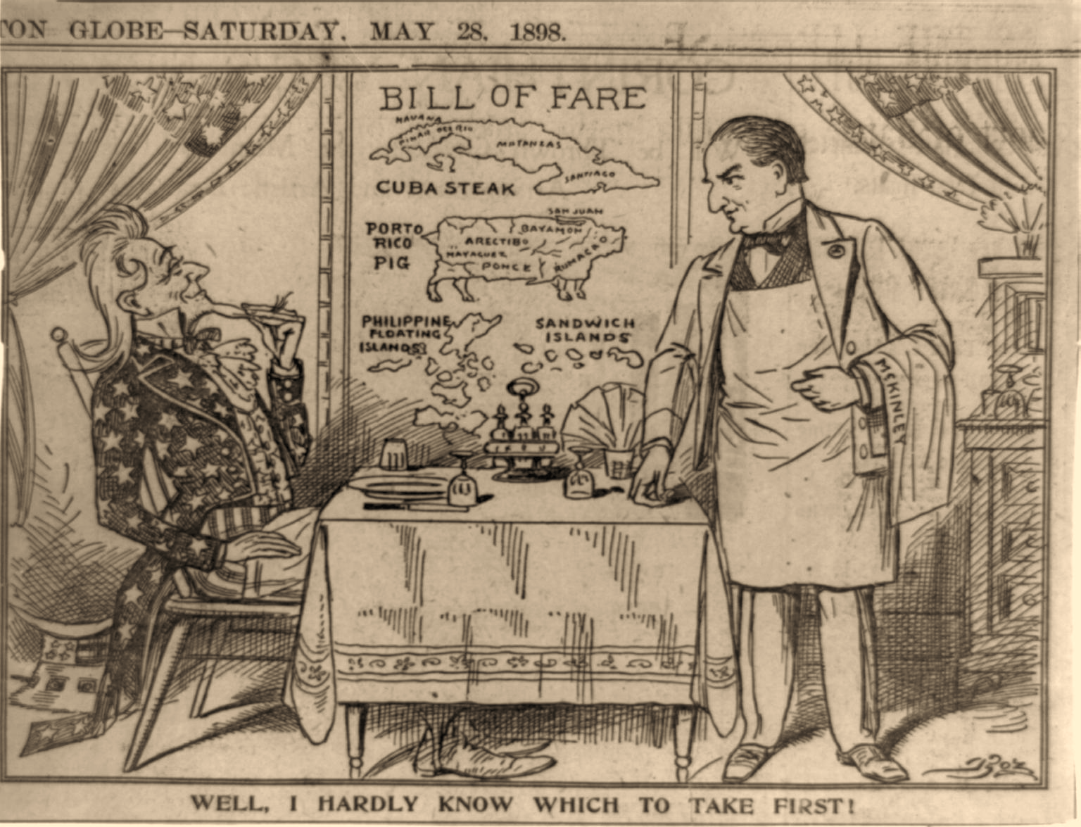
Uncle Sam
President McKinley

Slide 10
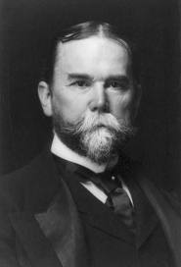
The Open Door
The United States did not always conquer new lands but did insist on the right to trade
1899 – John Hay (Secretary of State) wrote a series of “Open Door” notes concerning China
Hay insisted that no European country have a right to monopolize China’s trade
America did send troops to China in 1900 after a rebellion broke out – to protect American trading rights, the U.S. would use force

Slide 11
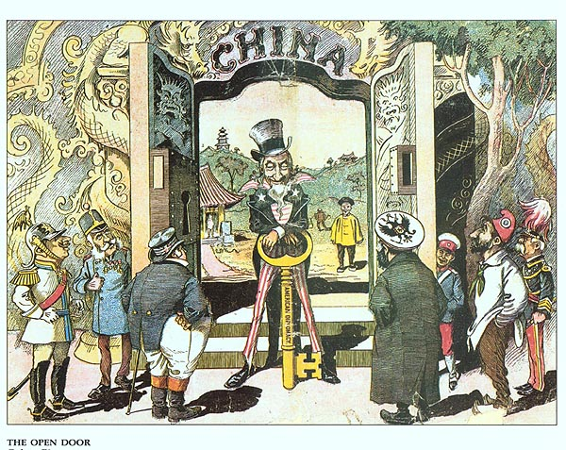

Slide 12
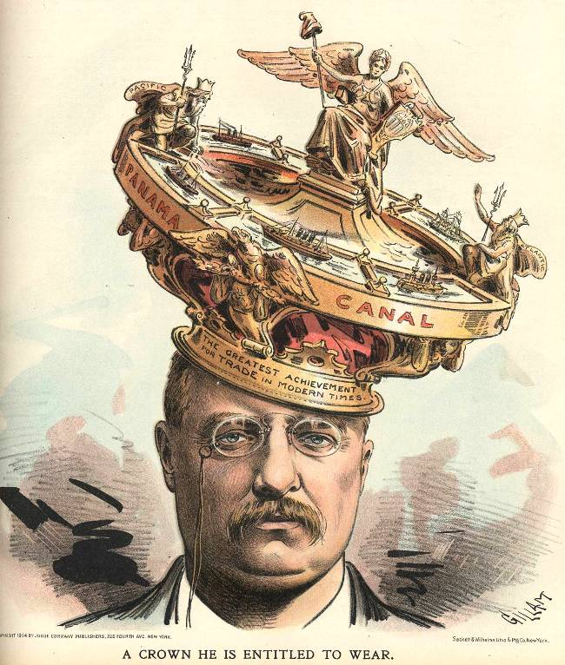
Panama Canal
1903 – United States navy helped a rebellion start in Panama so that the U.S. could build canal that would link the Atlantic and Pacific Oceans
U.S. involvement in the rebellion caused resentment in Latin America
In 1914, at a cost of $380 million and 5600 deaths, the Panama Canal opened

Slide 13
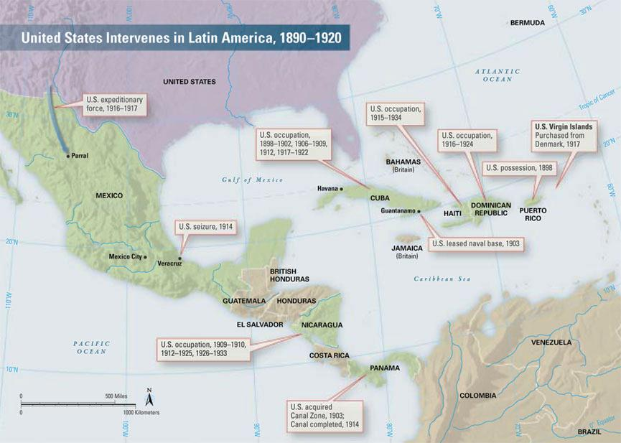

Slide 14
President Teddy Roosevelt is shown here using America’s “big stick” to get what he wants in Panama.

Slide 15
America: World Policeman
Principles guiding American involvement in the world:
The U.S. would force any country in Latin America to maintain order or pay its debts (Roosevelt Corollary)
The U.S. would use force to protect the investments of businessmen (Dollar Diplomacy)
The U.S. would force weaker countries to change their governments to suit U.S. interests (Platt Amendment)

Slide 18
Teddy Roosevelt: “Walk softly, and carry a big stick….”

