Slide 1
United States History
Dr. King-Owen
The Money Problem, 1870-1895
[7.01]

Slide 2
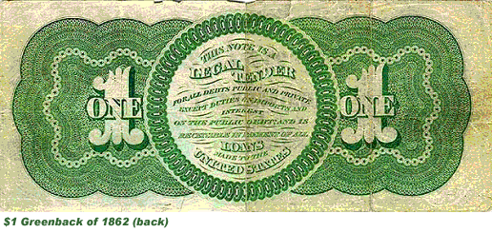
Greenbacks
During the Civil War, the North printed paper money called greenbacks to increase the supply of money
  The value of greenbacks was not tied to the value of gold, so its value was not stable
  The money was popular with farmers, workers, and debtors

Slide 3
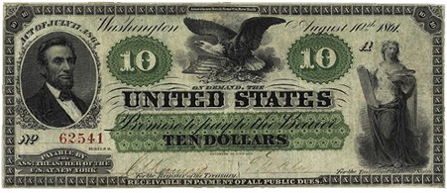
How Paper Money Works I
When paper money is not backed by gold, its value changes with the public’s faith in its ability to be used to buy goods
At the end of the Civil War, a $1.00 greenback was worth only 46 cents
Imagine you go into debt when the value of the greenback is 46 cents.
If the value of the greenback goes up to 67 cents, your debt increases.

Slide 4

How Paper Money Works II
In gold-based currency systems, governments print as much paper money as they have gold to buy it back
I have $300 in gold
I can print $300 in paper bills

Slide 5
The Issue of Silver
You can also increase the money supply by using silver to back paper money
Gold
Silver
MO’ MONEY!

Slide 6
The Silver Debate
Debtors, farmers, and workers wanted more silver to be used to back paper money (to increase the supply)
  Crime of ‘73 (1873) – US stopped using silver, angering western silver miners and debtors
  Bland-Allison Act (1878) – US resumed using silver to increase the money supply
  Sherman Silver Purchase Act (1890) – increased US purchases of silver for increasing the money supply

Slide 7
Gold Versus Silver
Those who support gold only
Those who support gold + silver
Gold is rare, so money supply is smaller
Prices stay stable
Rich benefit
Silver is more abundant than gold, so money supply is larger
Prices change more often
Debtors, poor, farmers benefit

Slide 8
Money in Circulation, 1865-1895

Slide 9
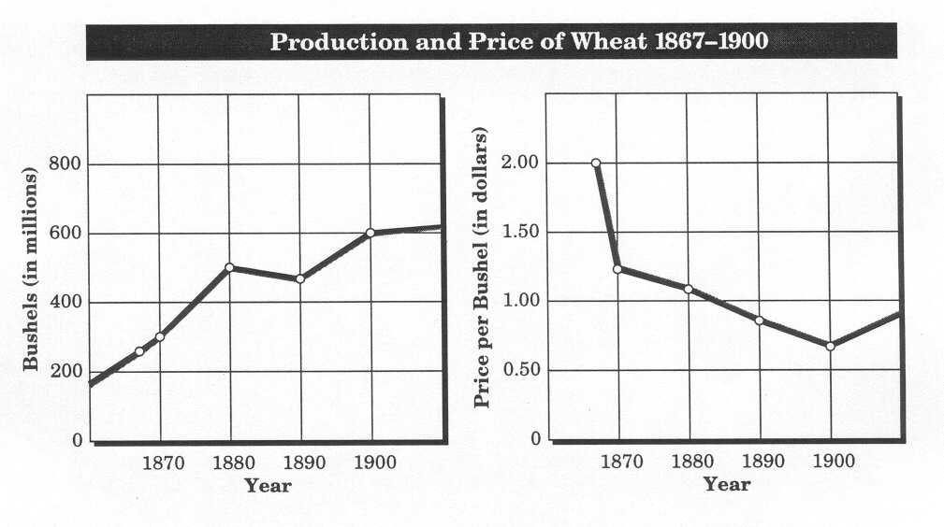
Problems Farmers Faced
Farmers faced many problems from 1870 to 1900:
  Banks were foreclosing on farm mortgages
  Railroads charged high fees to ship goods
  The price of crops was falling because farmers were producing more and more (= oversupply)

Slide 10
Modernization
Farmers complained about modernization –the way technology was changing American life
  Improved farm machinery meant that one farmer could produce more by himself
  Machines decreased the need for farm labor

Slide 11
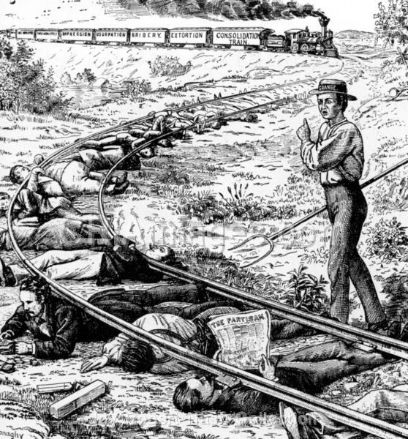
Farmers complained often that railroads took advantage of them.

Slide 12
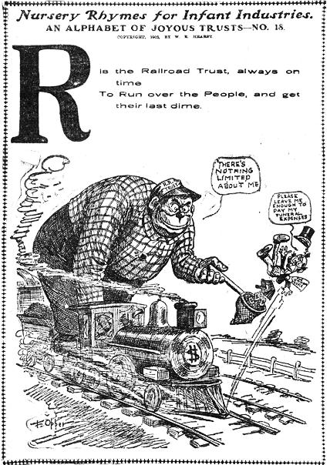
“the railroads have never been so prosperous, and yet, agriculture languishes….”

