Slide 1
UNITED STATES HISTORY
The Spanish-American War
Dr. King-Owen [7.04]

Slide 2
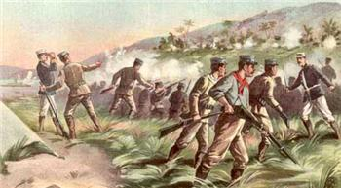
Cuba Libre!
Cuba, controlled by Spain, lies only 90 miles south of Florida – Americans built plantations there
In 1895, the Cubans revolted against the Spanish
Many Americans wanted to help Cubans get their freedom

Slide 4
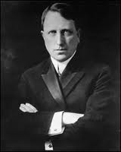
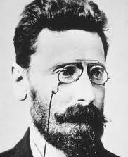
Yellow Journalism
Joseph Pulitzer and William R. Hearst – NY newspaper editors – exaggerated the terrible conditions in Cuba
“yellow journalism”: news stories that sensationalize and stretch the truth
Pulitzer and Hearst increased war fever in America

Slide 5
Hearst to illustrator: “You furnish the pictures and I’ll furnish the war.”

Slide 6
Remember the Maine!
February 1898 – Spanish leader Enrique de Lome wrote a private letter calling President McKinley weak
February 1898 – American ship, the Maine, exploded in the Havana harbor in Cuba, killing 260 men
Public opinion called for war even though there was no evidence the Spanish were responsible
Teddy Roosevelt on President McKinley: “He has no more backbone than a chocolate éclair.”

Slide 7
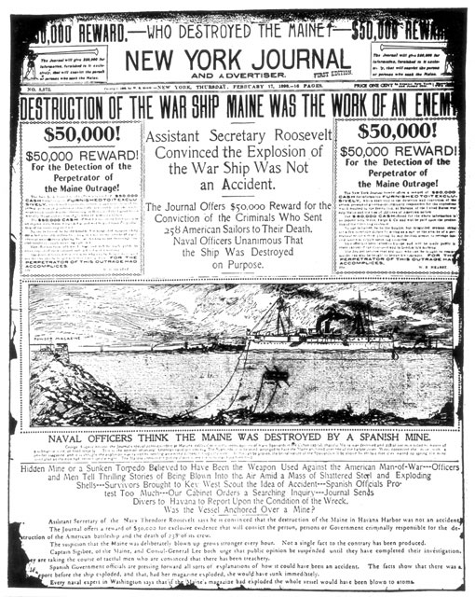

Slide 11
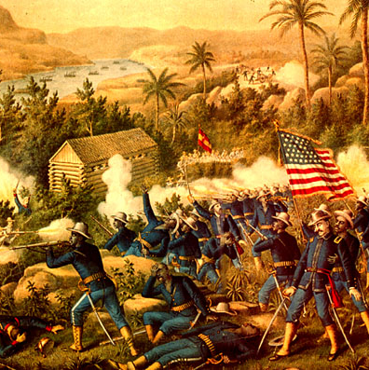
Conquest
The Spanish-American war lasted four months – a “splendid little war”
Treaty of Paris, 1898
U.S. gets Puerto Rico and Guam
U.S. gets Philippines
Cuba becomes independent

Slide 13
¿Cuba Libre?
1900 – Cuba wrote its constitution
1901 – U.S. told Cubans to include the Platt Amendment to their constitution
Cuba could not make treaties that would allow other countries to control it
U.S. could intervene in Cuba anytime
Cuba was not to go into debt
U.S. could buy or lease naval stations in Cuba
Cuba became a protectorate – a free country, but under the influence of the U.S.

Slide 15
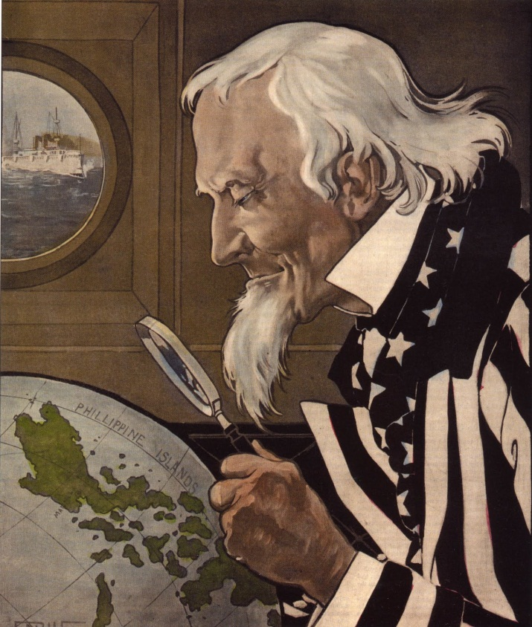
Philippine War
1899 – the Filipinos revolted against U.S. control
Americans wanted control of the Philippines for two reasons:
As a base for reaching China
They believed Filipinos were not civilized enough to govern themselves
After 3 years, the U.S. defeated the rebels

Slide 16
American economic imperialism – China as a market for American goods.

Slide 17
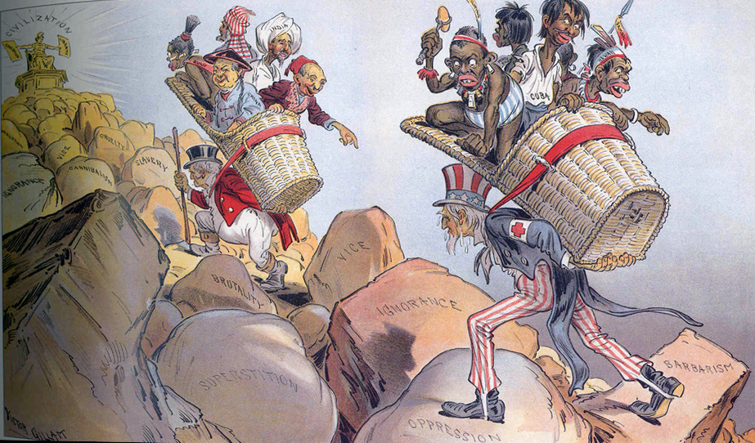
America: The White Man’s Burden

