Slide 1
United States History
The Politics of the Harlem Renaissance
Dr. King-Owen

Slide 2
Langston Hughes, “A Dream Deferred”
What happens to a dream deferred?
Does it dry up like a raisin in the sun? Or fester like a sore-- And then run? Does it stink like rotten meat? Or crust and sugar over-- like a syrupy sweet?
Maybe it just sags like a heavy load.
Or does it explode?

Slide 3
Claude McKay, “If We Must Die” 1919
If we must die, let it not be like hogs Hunted and penned in an inglorious spot, While round us bark the mad and hungry dogs, Making their mock at our accursed lot. If we must die, O let us nobly die, So that our precious blood may not be shed In vain; then even the monsters we defy Shall be constrained to honor us though dead! O kinsmen we must meet the common foe! Though far outnumbered let us show us brave, And for their thousand blows deal one deathblow! What though before us lies the open grave? Like men we'll face the murderous, cowardly pack, Pressed to the wall, dying, but fighting back!

Slide 4
Countee Cullen “Christ Recrucified” 1922
The South is crucifying Christ again
Christ's awful wrong is that he's dark of hue
The sin for which no blamelessness atones;
But lest the sameness of the cross should tire,
They kill him now with famished tongues of fire,
And while he burns, good men, and women, too,
Shout, battling for his black and brittle bones.

Slide 5
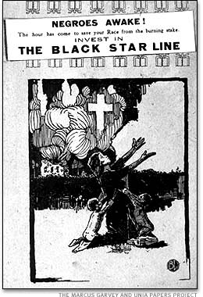
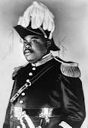
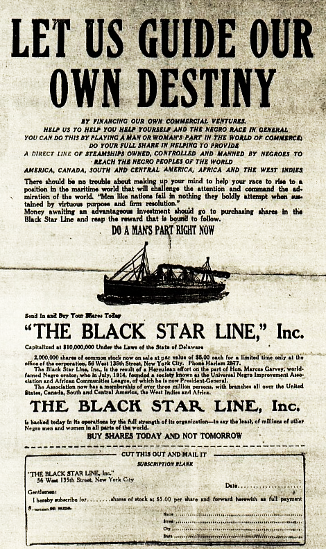

Slide 6
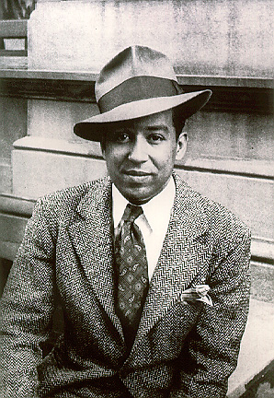
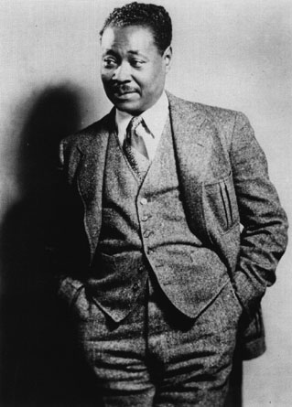
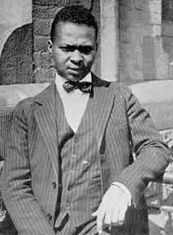
Langston Hughes
Claude McKay
Countee Cullen

Slide 7
Marcus Garvey
Founder of the Universal Negro Improvement Association (1917)
Promoted black nationalism
Pan-Africanism
Rejected integration
Black Star Line – 1919 – to take blacks back to Africa
Convicted of mail fraud in 1923 (5 year jail time); deported to Jamaica in 1927
Notes:
UNIA was founded in Jamaica first—1914. Garvey came to the U.S. as a followed of Booker T. Washington

Slide 8
W.E.B. DuBois, NAACP
Continuing legal fight (using the courts) against injustice, discrimination, Jim Crow, and lynching
Recognized that African-Americans wanted to share in American liberties
Opposed to the separatism of Garvey’s movement→ goal was integration

Slide 9
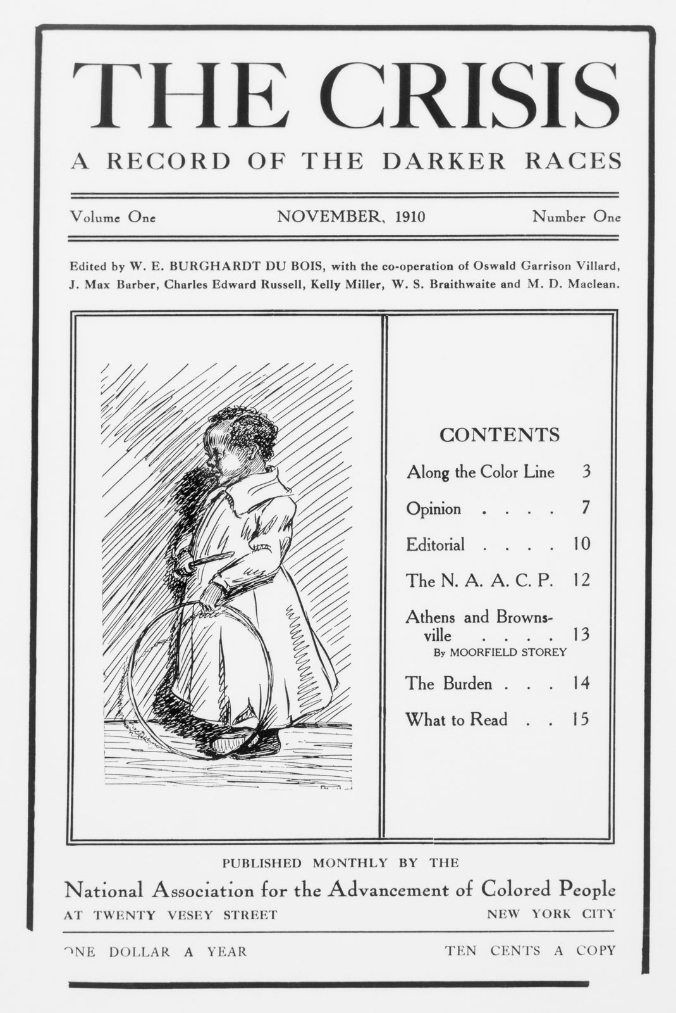
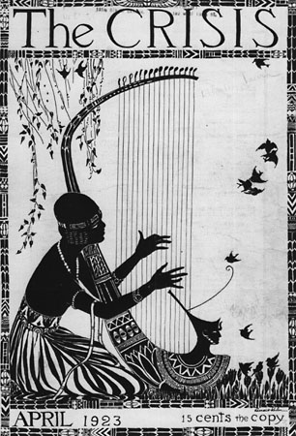

Slide 10
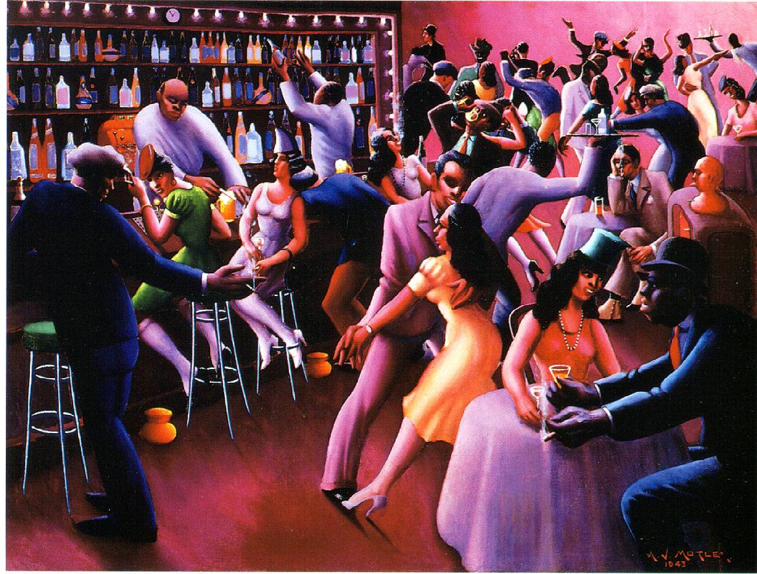

Slide 11
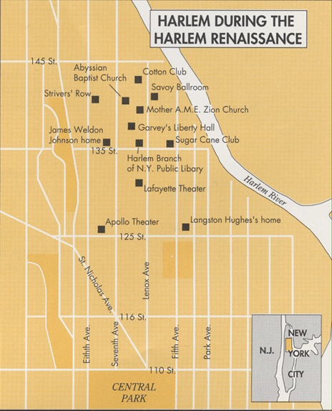

Slide 12
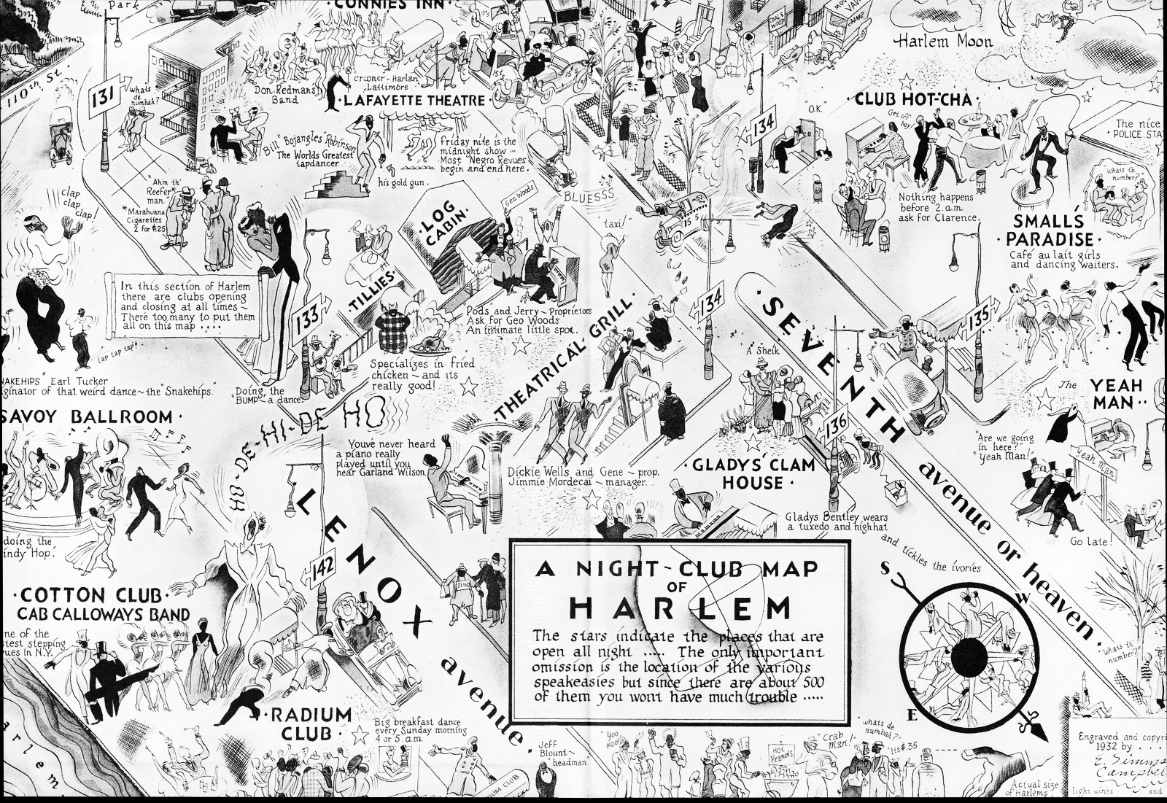

Slide 13
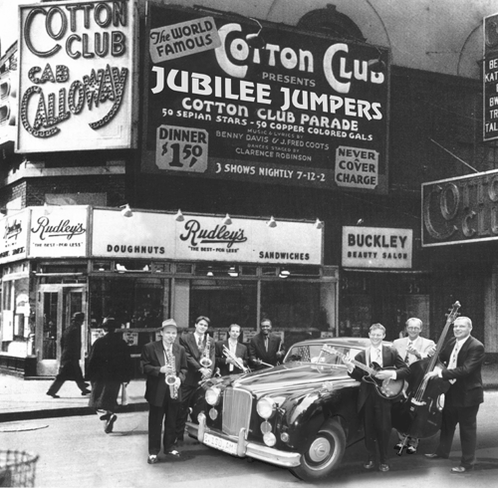

Slide 14
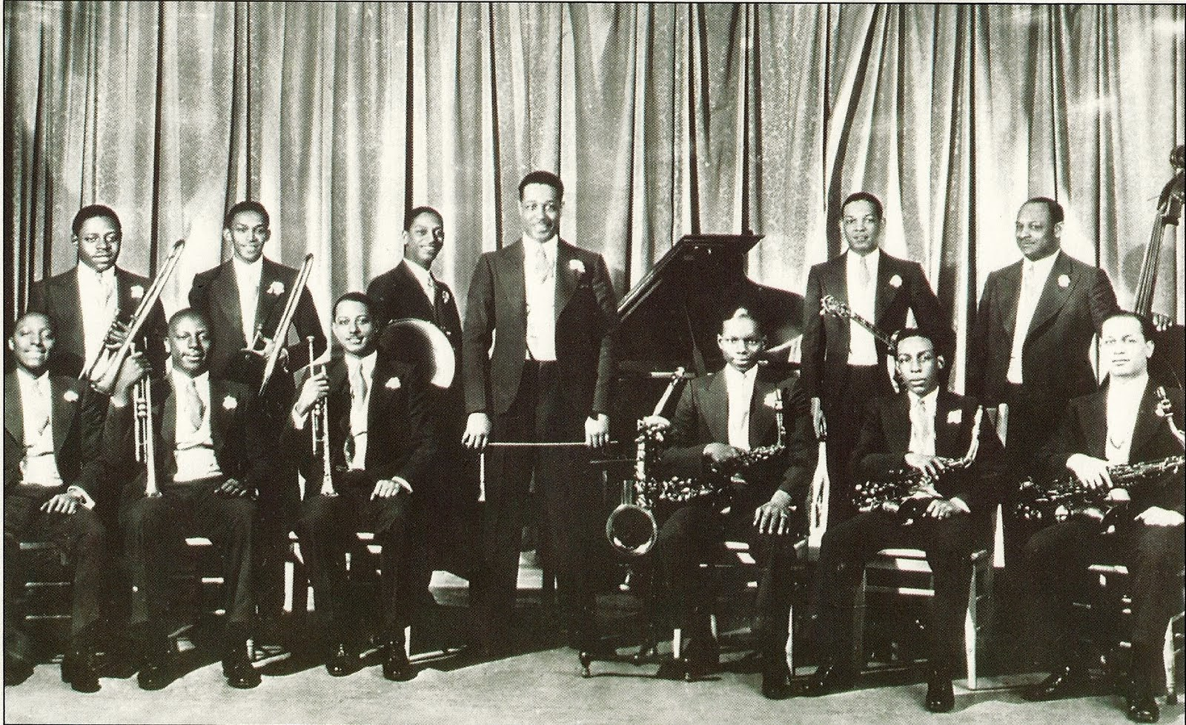

Slide 15
Artistic Harlem
Pride in Black Culture
Literature and music became a source of black pride
Literature tended to focus on developing a black identity to protest injustice
Creation of Black Arts
Cotton Club and Jazz – space for blacks to celebrate
Possibility of Integration? – many whites attracted to black music; came to clubs

