Slide 1
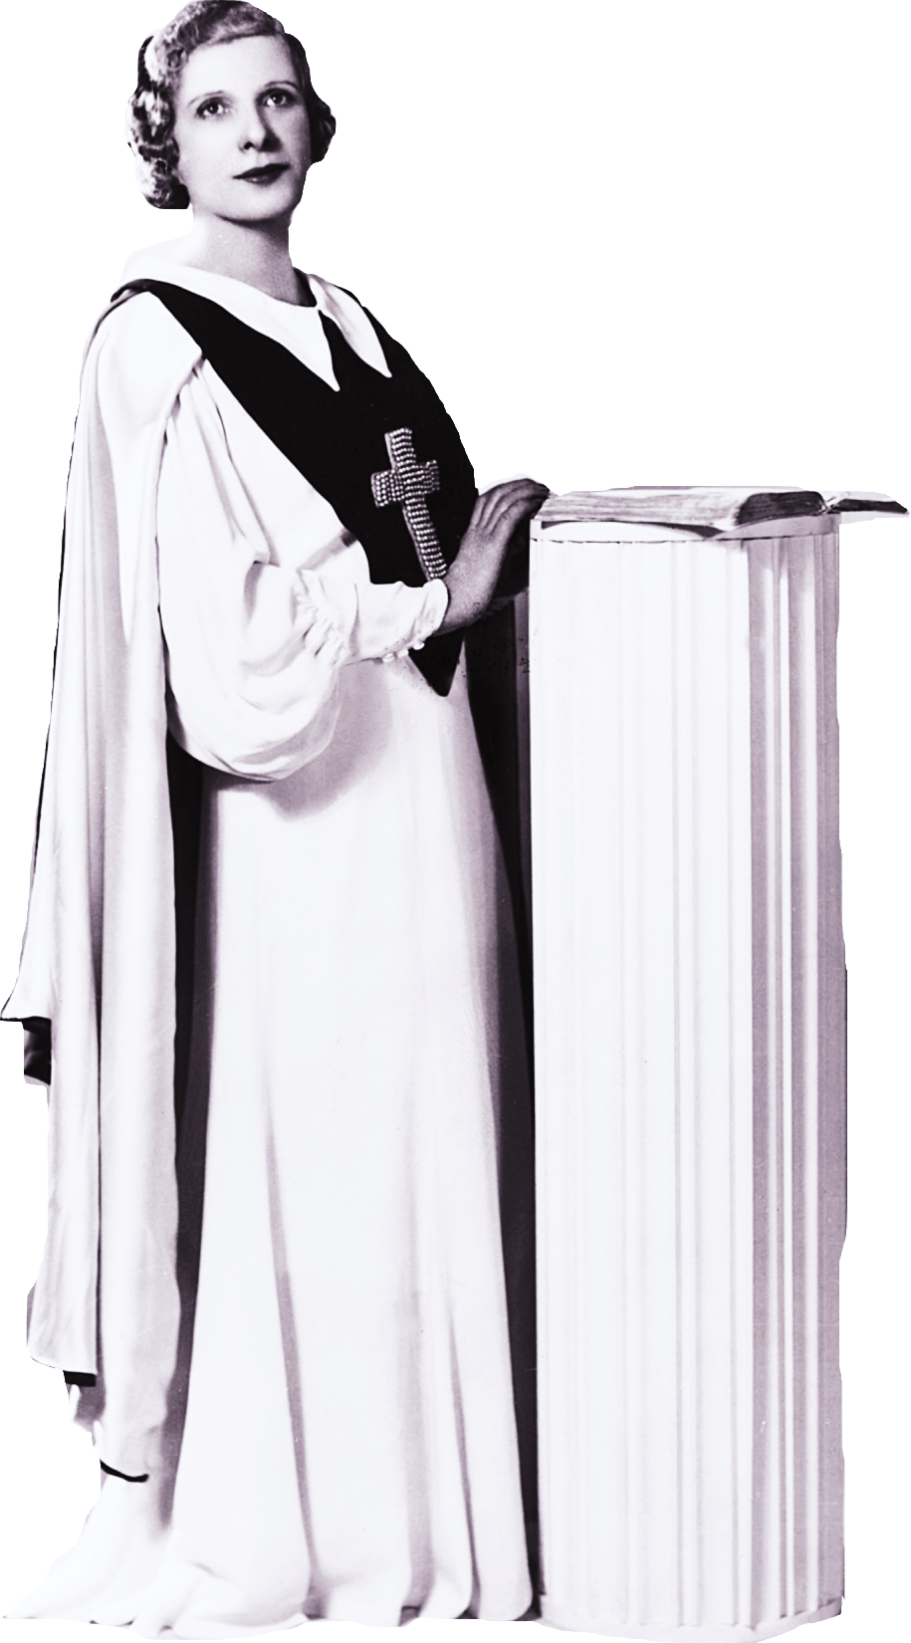
United states history
Rural America Strikes Back
Dr. King-Owen

Slide 2
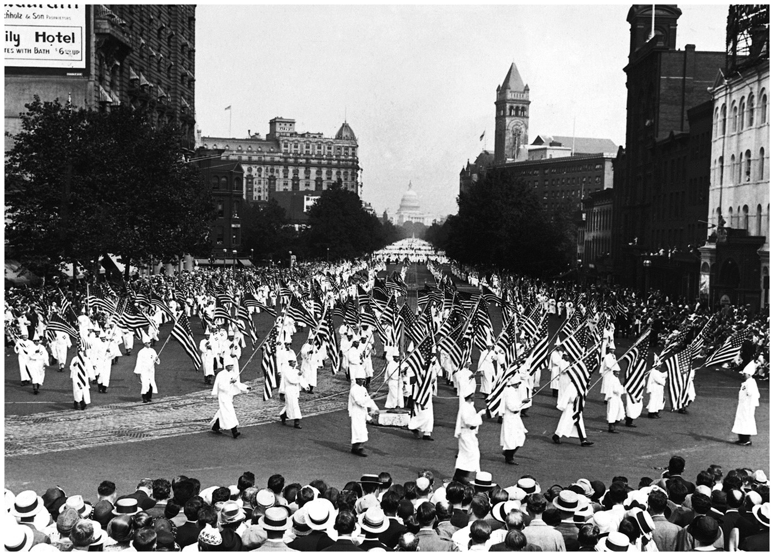

Slide 3
KKK
KKK (1915-1924)
Preached rural, all-American values
Love of country
Protestant Christianity
Family
Honor
Anti-immigrant
Anti-alcohol

Slide 4
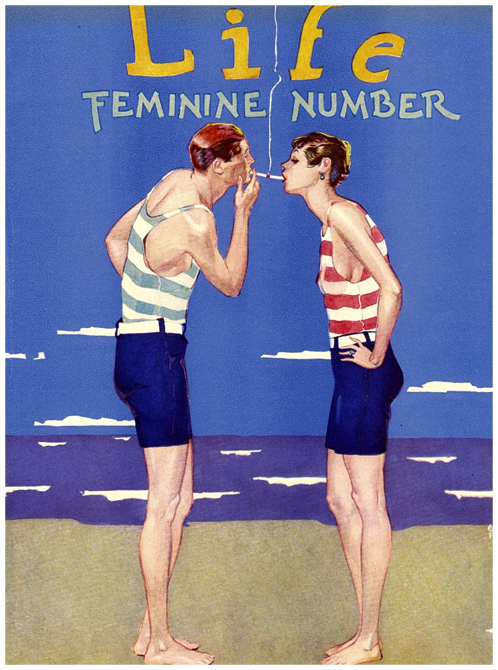
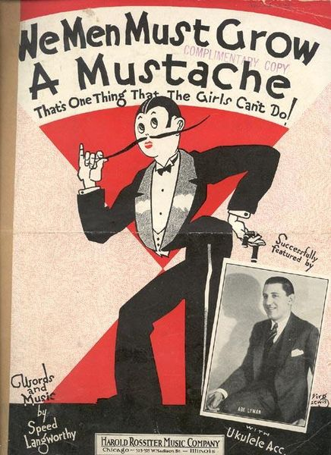
Notes:
Masculine women, Feminine men
Which is the rooster, which is the hen?
It's hard to tell 'em apart today! And, say!
Sister is busy learning to shave,
Brother just loves his permanent wave,
It's hard to tell 'em apart today! Hey, hey!
Girls were girls and boys were boys when I was a tot,
Now we don't know who is who, or even what's what!
Knickers and trousers, baggy and wide,
Nobody knows who's walking inside,
Those masculine women and feminine men!

Slide 5
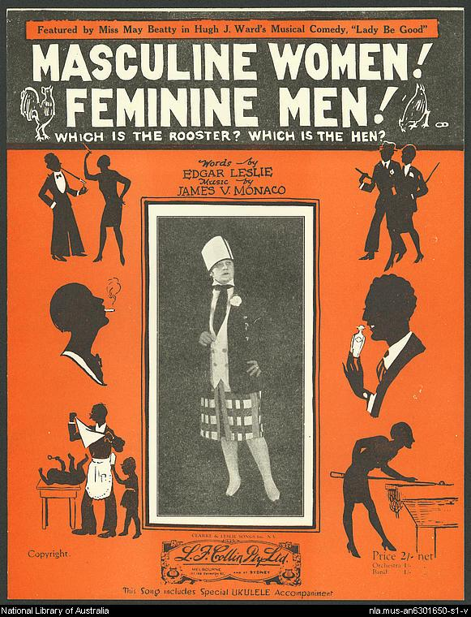
Masculine women, Feminine men
Which is the rooster, which is the hen?
It's hard to tell 'em apart today! And, say!
Sister is busy learning to shave,
Brother just loves his permanent wave,
It's hard to tell 'em apart today! Hey, hey!
Girls were girls and boys were boys when I was a tot,
Now we don't know who is who, or even what's what!
Knickers and trousers, baggy and wide,
Nobody knows who's walking inside,
Those masculine women and feminine men!

Slide 6
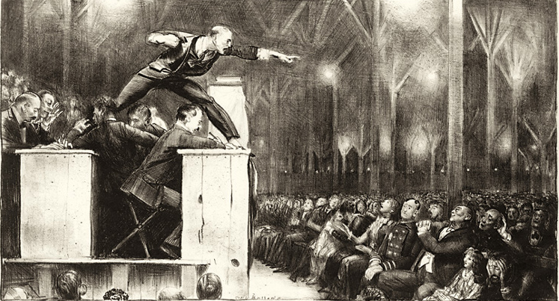

Slide 8
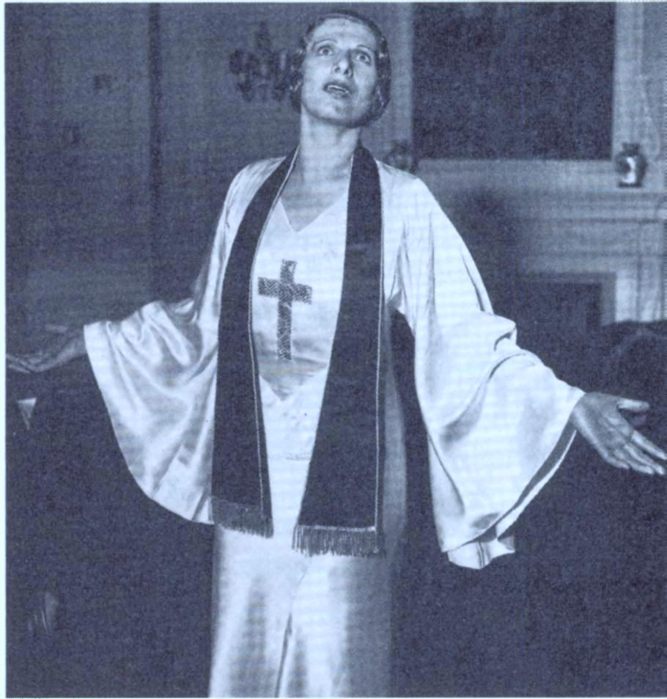

Slide 9
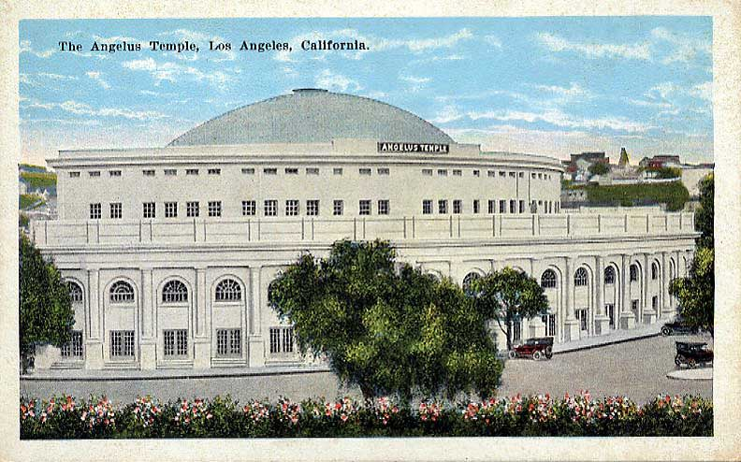
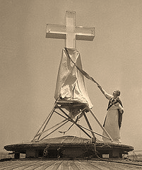

Slide 10
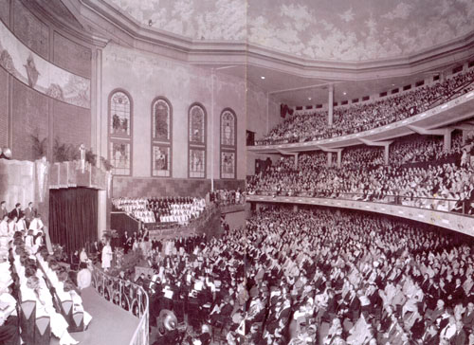

Slide 11
Fundamentalism
Reading the Bible
Bible is to be read literally….if God said, it happened!
Attack on Modernism
Christians rejected modern values: skepticism towards religion, love of money, self-indulgence, consumerism
Famous Evangelists
Reflected the 1920s love of celebrities yet also called for moral reform
Billy Sunday (former baseball player)
Aimee Semple McPherson (acted like a movie star)

Slide 12
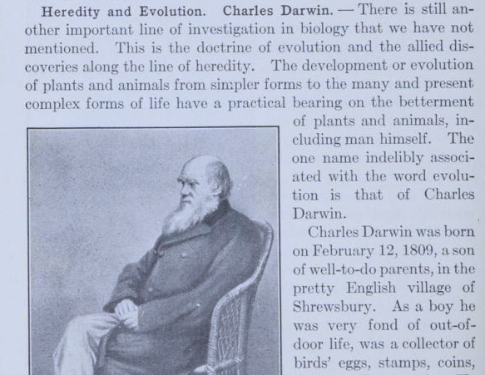
Notes:
Page from Hunter’s Civic Biology—the text that Scopes used when he was filling in for the regular biology teacher.

Slide 13
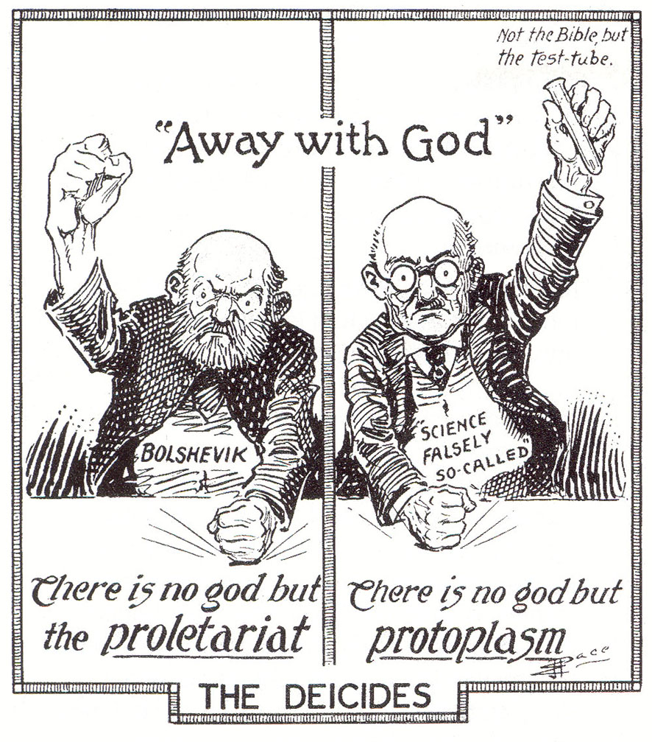

Slide 14
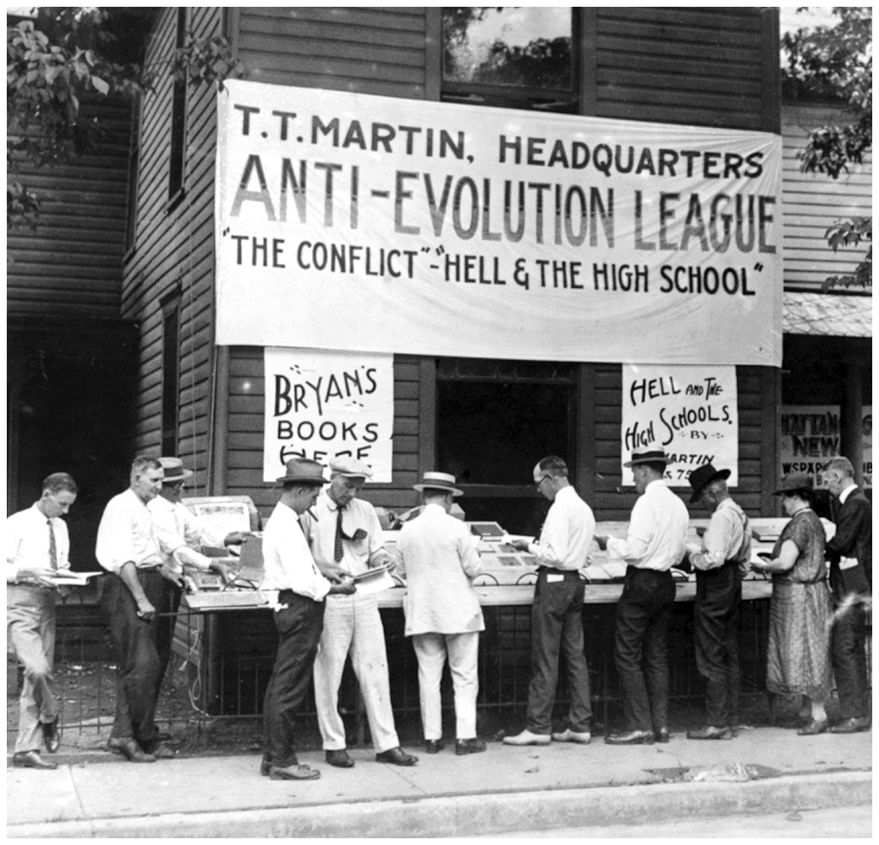

Slide 15
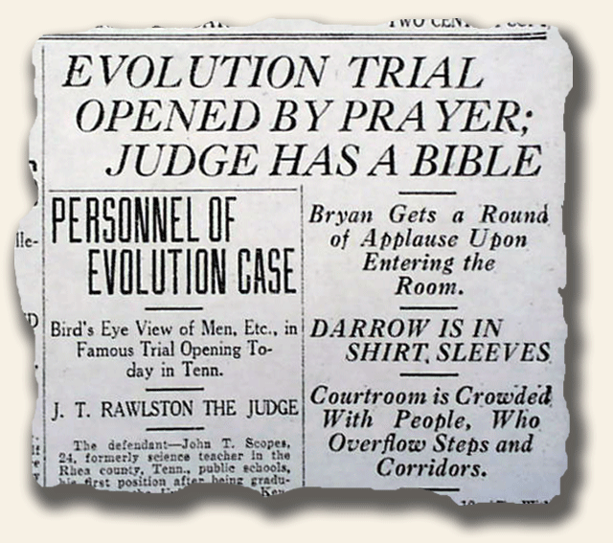

Slide 16
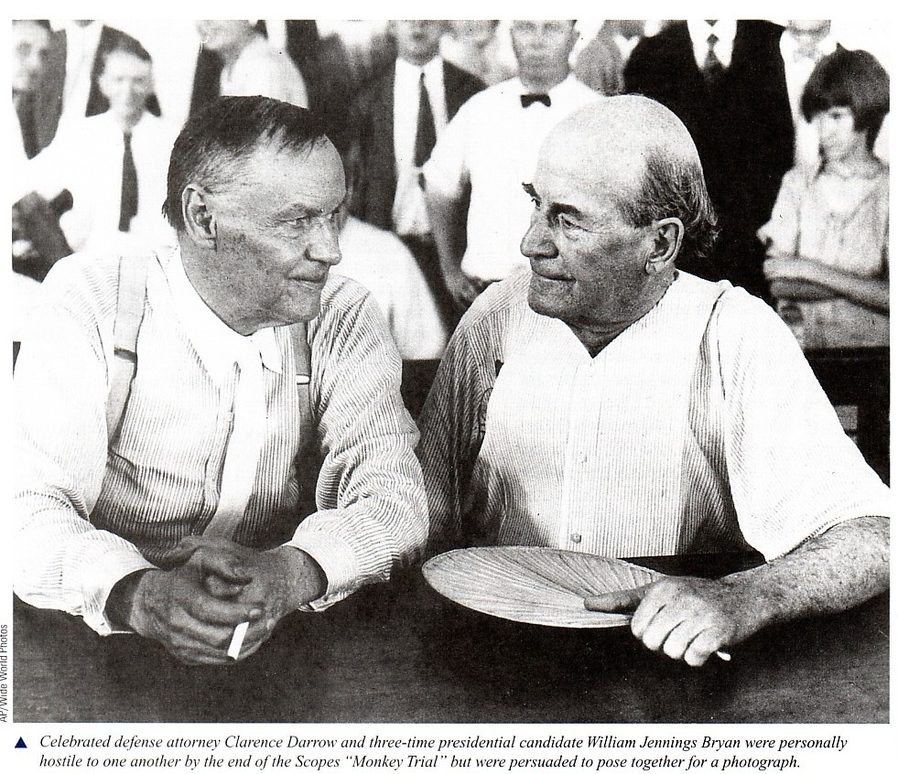

Slide 17
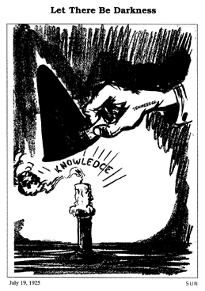
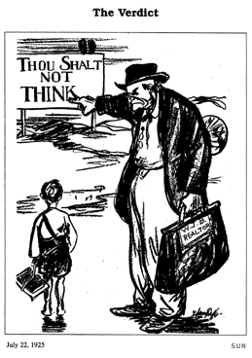

Slide 18
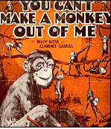
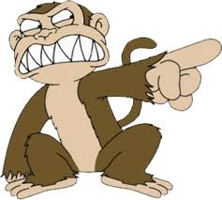
You Can’t Make a Monkey of Me
We're in a revolution just over evolution. The battle of ages is on. Some scientists have claimed We're human just by name, That monkeys and men are the same. But Darwin's theory doesn't sound good to me. I might have monkey manners But with him I can't agree.
CHORUS
You can't make a monkey of me. You can't make a monkey of me. There's not a monkey in my family tree. I've searched on each branch from Adam to me. I am inclined to believe The story of Adam and Eve. There's no chimpanzee In my pedigree. And you can't make a monkey of me.
Can science ever prove it? Will monkey trials remove it? We don't have ideas of our own. In some would monkeys be. Let them stay in their tree. But don't talk their chatter to me. That long missing link Puts history on the blink. I'll give you my opinion The whole chain was lost I think.

Slide 19
Scopes Monkey Trial (1925)
Biology teacher John T. Scopes taught evolution, violating Tennessee’s Butler Act
Scopes was tried, found guilty, and fined $100
Clarence Darrow of the American Civil Liberties Union defended Scopes
William J. Bryan prosecuted the case
Trial made fun of rural, Bible-carrying Christians as ignorant

