Slide 1
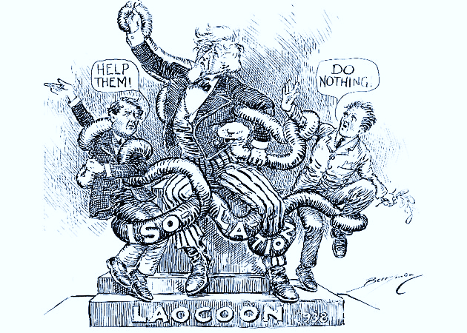
United States History
American Diplomacy in the 1930s [10.01]
Dr. King-Owen

Slide 2
Isolationism
U.S. foreign policy:
Not joining League of Nations (1919)
Kellogg-Briand Pact (1928) – war is outlawed (but no way to enforce it!)
RULE: U.S. will trade with almost anyone but not get politically involved

Slide 3
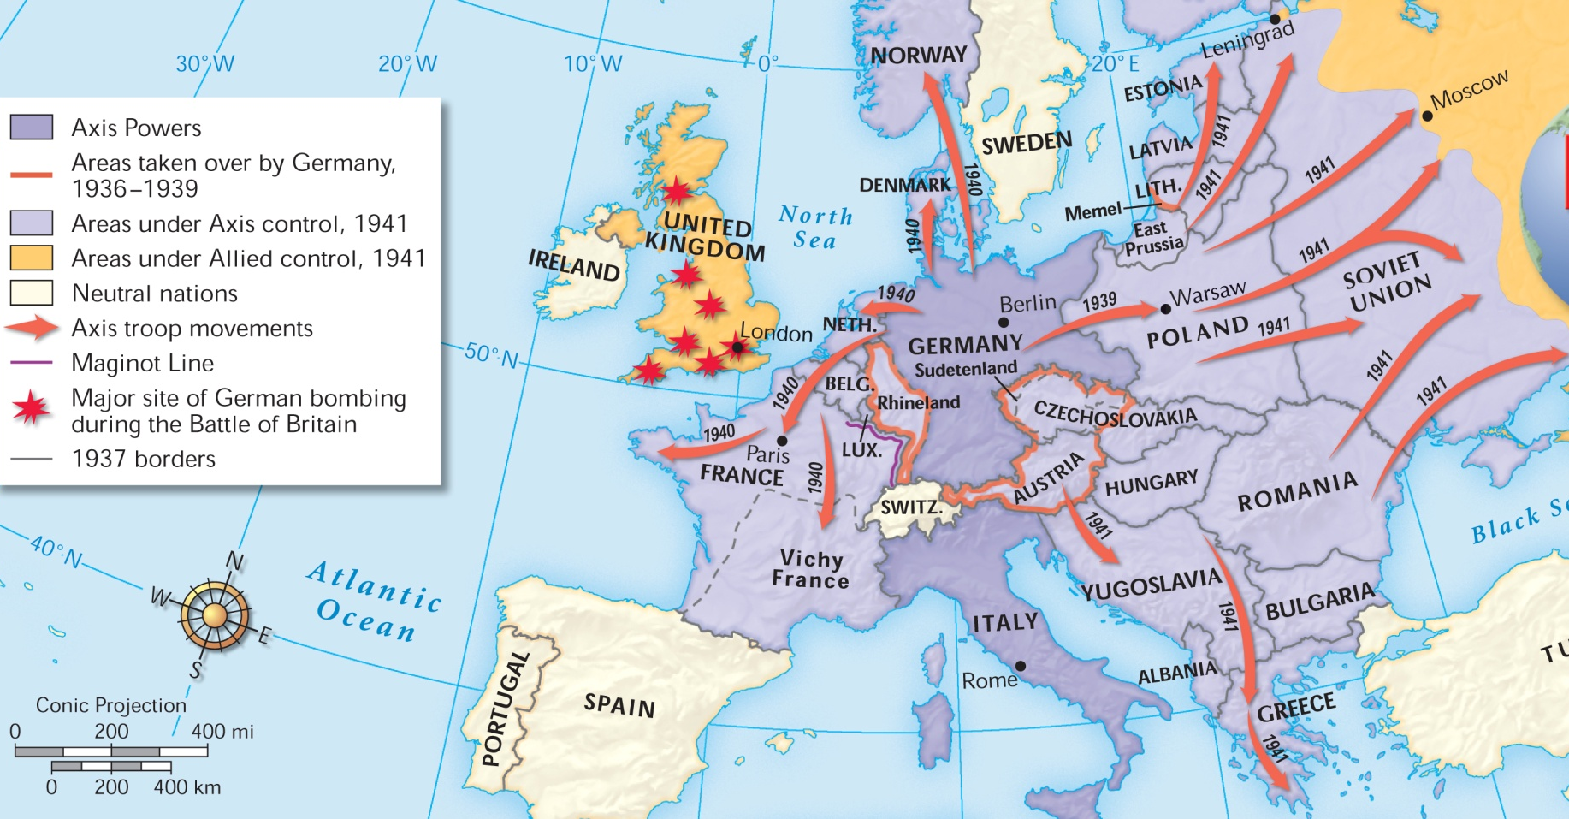
Hitler wanted lebensraum (“living space”) for Germany – took the Rhineland in 1936
1938 – Anschluss (re-union) with Austria, violating the Treaty of Versailles

Slide 4
Even the United States practiced appeasement:
When the Japanese invaded Manchuria in 1931, the U.S. sent a note to the Japanese saying that they would not recognize any Japanese conquests in the area. This was the Hoover-Stimson Doctrine. The U.S., however, did nothing to stop Japanese aggression.

Slide 5
Instability
Treaty of Versailles
Both Germany and Italy resented the treaty – reparations, loss of land
Depression
People would listen to any leader who promised reform and hope
Appeasement
World leaders wanted to avoid another major world war – so they gave in to dictators’ demands

Slide 6
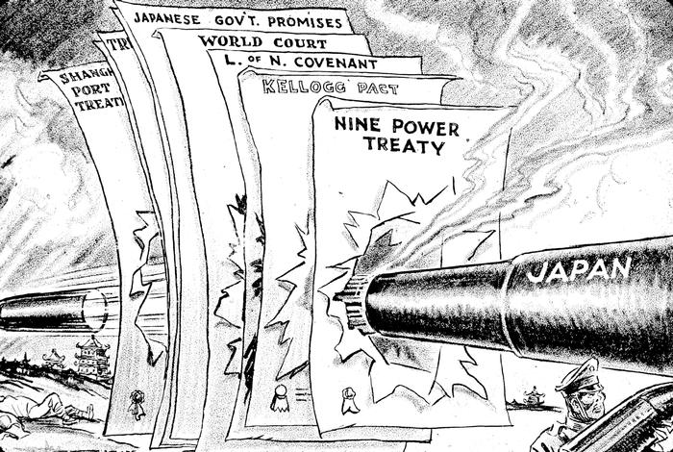

Slide 7
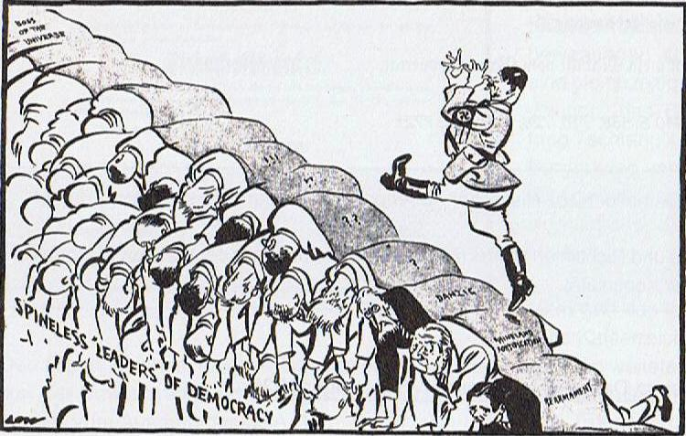

Slide 8
1930s Isolation
Memories of WWI and the Depression made Americans isolationist in the 1930s
1935 – Neutrality Act – no weapons sales to countries at war
1937 – “Cash and Carry” – weapons sales IF the buyer paid cash and carried them
America First Committee – 1940 – wanted to keep the U.S. out of war

Slide 9
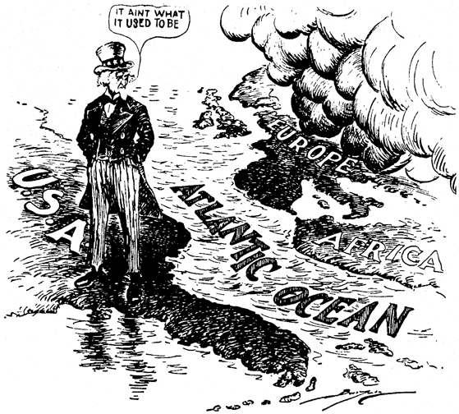

Slide 10
